Slide 1
NLP
The definition is very simple if you understand the 3 words, i.e. Natural Language Processing. NLP involves machines or robots to understand human language, the way we humans talk so that they can effectively communicate with us.

Slide 2
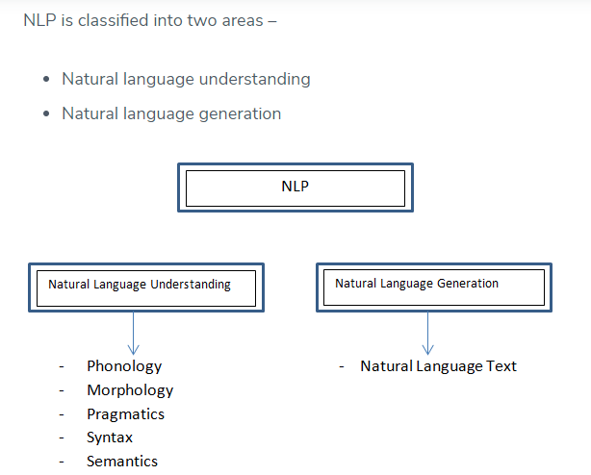
Phonology refers to the science of understanding sound, Morphology refers to word formation, and syntax refers to the structure, whereas Pragmatics refers to understanding.

Slide 3
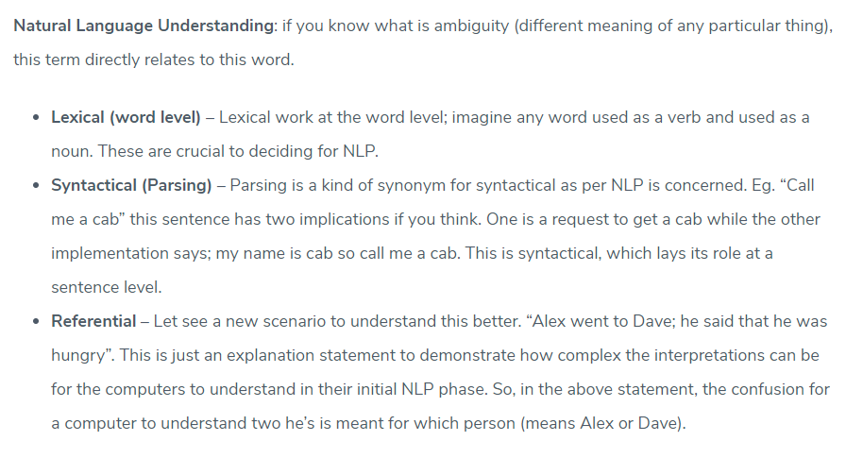

Slide 4
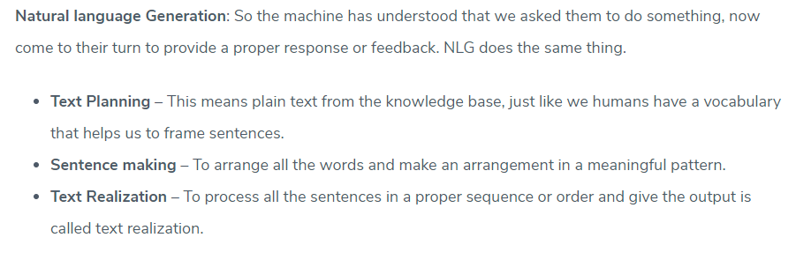

Slide 5
Application of NLP
NLP has a wide spectrum of applicability.
Machine Translation,
Email spam detection,
Information Extraction,
Summarization
Machine Translation is very crucial as the entire world is present online and the task of data accessible to each individual is a huge challenge. Language barrier contributes most to the challenge, with every language associated is a multitude of structure and grammar.
Spam filtering works using text categorization, and in recent times, various machine learning techniques have been applied to text categorization or anti-spam filtering, just like Rule learning, Naïve Bayes models.
Information extraction concern with identifying more relevant and correct textual data. Many applications for whom extracting entities such as names, places, dates, and time are a powerful way of summarizing the relevant information as per the user’s need is concerned.
Summarization, As we are currently surrounded by data, which means our ability to understand it. Since data is on an ever-increasing trend and the ability to summarize it with exact meaning is high in demand. This gives us a better chance to manipulate data and also to take necessary decisions (which is what NLP is trying to do).

Slide 6
1. Social Media Sentiment Analysis
NLP for social media listening is unique because it understands internet short forms (BRB), slangs, code-switching, emoticons and hashtags. No matter what your customers choose to speak, NLP allows you to extract information from it, and prepare it for an ML model to ingest
2. Patient Voice & Healthcare
Hospitals and healthcare providers are using NLP technology more frequently now than before, to capture and manage patient notes, and electronic health records (EHRs). Patient feedback, their waiting room experience, post-surgery care, opinions and feelings, are all analyzed through AI/ML models using textual data from in-clinic questionnaires, post-appointment surveys, and feedback web forms

Slide 7
3. Language Translation
In NLP, there is a task called Sentence Boundary Detection (SBD) that understands the boundaries of a set of words. It is one of its most fundamental tasks in translation. That’s why you can translate entire texts in different languages, and they match sentence by sentence. Google Translation alone is used by 500 million people to translate documents or text in 100 different languages. There are numerous other translation apps and websites.
4. Text Analytics
Companies use text analytics to gain insights from any and every source of information that is related to them. This flood of data can be from news, social media reviews, tweets, online surveys, voice-to-text notes, or any other source. NLP converts this raw data into meaningful documentation that can be analyzed by a machine learning algorithm. Semantic Search further helps in understanding the meaning and intent behind words and phrases.

Slide 8
5. Optical Character Recognition
Raw data that is collected for text analytics can be from emails, invoices, service agreements, research papers, human resource documents, purchase orders, and other textual formats. But it can also be sourced from video formats on various platforms like YouTube, Igtv, Facebook, TikTok or in images (think Instagram or Pinterest). Natural Language Processing algorithms use Optical Character Recognition (OCR) technology for images, as well as for Video Content Analysis, to understand this image-based data. The technology converts the scanned file into a text searchable file, and in this way helps the machine model read the data to derive insights.

Slide 9
HOW TO USE NLP
Tokenization
Part of Speech Tagging
Stemming & lemmatization
Stop Word Removal

Slide 10
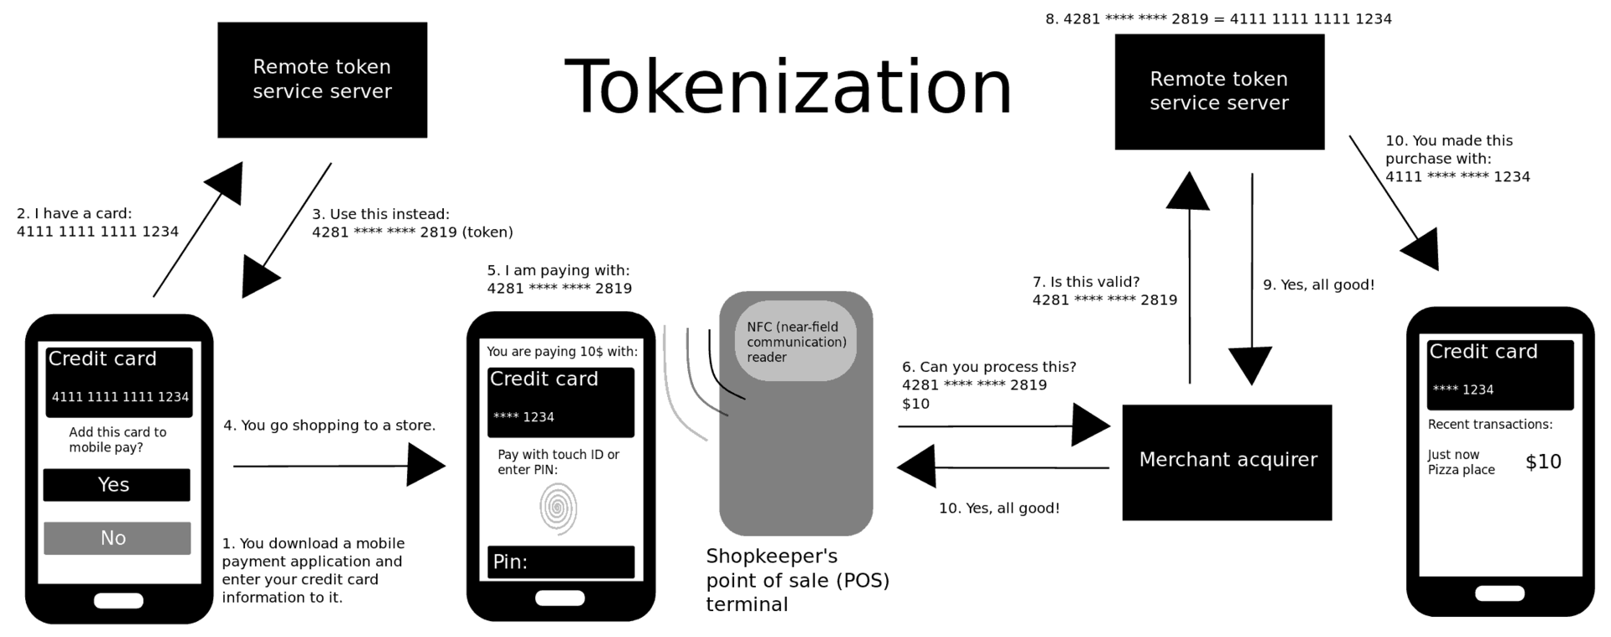
Tokenization is the process of replacing sensitive data with unique identification symbols that retain all the essential information about the data without compromising its security.

Slide 11
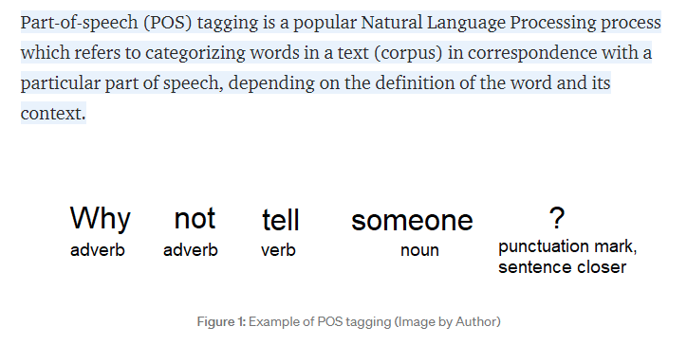
POS

Slide 12
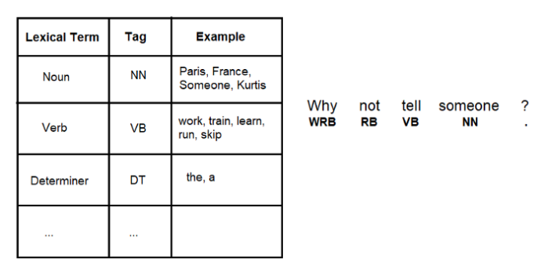
A POS tag (or part-of-speech tag) is a special label assigned to each token (word) in a text corpus to indicate the part of speech and often also other grammatical categories such as tense, number (plural/singular), case etc. POS tags are used in corpus searches and in text analysis tools and algorithms

Slide 13
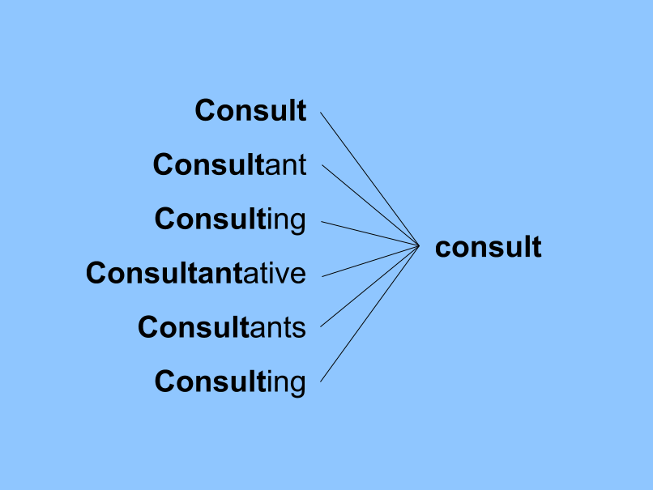
Stemming : stemming reduces its word to root.

Slide 14
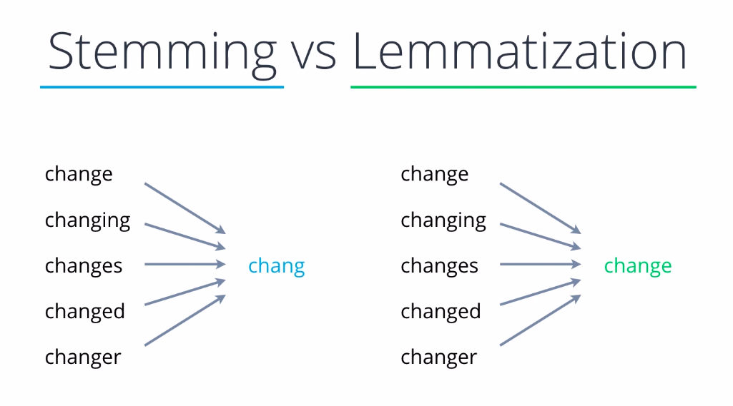

Slide 15
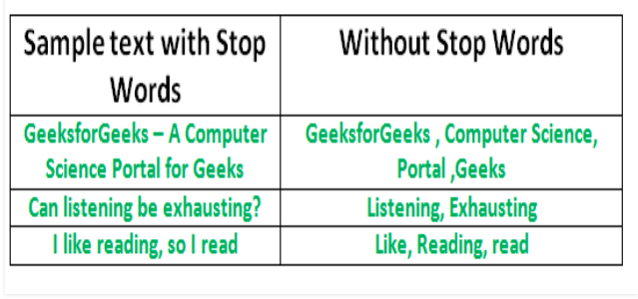
Stop Words: A stop word is a commonly used word (such as “the”, “a”, “an”, “in”) that a search engine has been programmed to ignore, both when indexing entries for searching and when retrieving them as the result of a search query.

