Slide 1
Chat bots
K Kishore Kumar
Dept. of CSE

Slide 2
What are chatbots?
A chatbot is a conversational agent that interacts with users using natural language.
Started as an attempt to fool humans.
Numerous applications of chatbots such as Customer Service, call centers etc

Slide 3
Need for chatbots?
Widespread use of personal machines
Better Human Computer Interaction
“To express their interest, wishes, or queries directly and naturally, by speaking, typing, and pointing”.

Slide 4
Need for chatbots?
You: Hello
Op: Hi. This is Railway Enquiry
You: What is the status of train 2803?
Op: It’s right on time. The train will leave CST at 5:45 pm. Is there anything else I could assist you with?
You : No, thank you
Op: You are welcome. Indian railways wishes a nice and happy journey.

Slide 5
The Rise of Chatbots
Natural language processing in the cloud :
The availability of natural language processing capabilities in the cloud has been the most potent force behind the rise of chatbots. NLP, specifically text classifiers and entity extractors, powers a few of the core functionalities inside a chatbot

Slide 6
Human in the loop:
Embedding a human into your chatbot has two significant benefits. First, humans are an excellent way to bootstrap your chatbot before it gathers enough data to operate autonomously. If the chatbot is not confident about its response, it can ask the human for approvals or edits before sending it to the end user. Another setup is to have the chatbot provide multiple responses, and have the human choose the most appropriate one.

Slide 7
The second benefit is that humans are the best way to prevent your chatbot from utterly failing your users. There are a few ways to detect if the conversation needs to be routed to a human:
• The chatbot doesn’t understand the user’s input—this usually means the user input doesn’t match any of your established intents.
• The conversation is taking too long, or a circular pattern is detected.
• Negative sentiment is caught in the user’s input.
• The user directly asks to talk to a real person

Slide 8
Proliferation of Messaging Platforms
Messaging apps have come to dominate our mobile app usage. Recent data shows that these messaging apps have surpassed social networks in monthly active users.
Companies are now looking to help users by embedding chatbots inside these message channels to answer questions or assist with various tasks

Slide 9
Natural Language Interface
In most human–machine interactions, users translate their intentions into a series of keystrokes and button clicks. The machine then responds via pixels on a screen.
Ex:
Askjeeves ( webpage allows to communicate with natural language)
Amazon Echo ( Voice Communication System)

Slide 10
How to Build a Chatbot
A chatbot has a frontend and a backend. The frontend is the messaging channel where the chatbot interacts with the user. The backend is the application logic, the persistence stores, and the supporting services
Messaging Channel:
Slack (messaging app)
Build own messenger

Slide 11
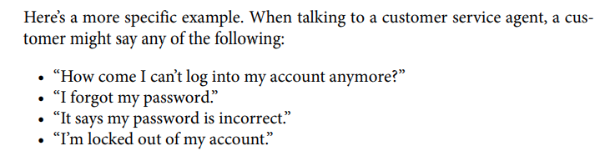
Backend
Text Classifier

Slide 12
Using Existing FW or Build your own
It’s straightforward to build a chatbot within it, but impossible to customize or inte‐ grate the chatbot in a way that’s outside the design of the framework
There are many chatbot frameworks available, including
API.ai, Wit.ai, Microsoft Bot Framework, and IBM Watson Conversation

Slide 13
Anatomy of a chatbot backend
you do decide to choose a framework, the backend of your chatbot will most likely consist of three main parts:
intents, entities, and dialog
Intent :
To train your chatbot to recognize an intent, first determine the action you’d like to map to this intent—for example, provide information on business hours.
‘what time the shop open?’ ‘Is weekend shops open?’

Slide 14
The most common intent for a chatbot is to greet the user.When a user first comes in contact with your chatbot, it needs to introduce itself.
some common greetings that a developer might deploy using Watson Conversation’s Intents tab.

Slide 15
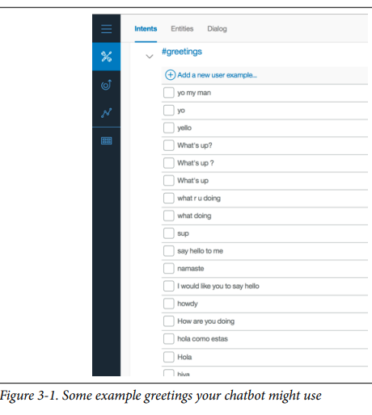

Slide 16
Entity:
If intents are the verbs for a chatbot to act on, then entities are the nouns.
For example, if a user wants to find the business hours of a bank’s branch, the location of the bank would be one of the entities. Specifically, if a user asks, “What are the hours for the Austin branch?” provide business hours would be the intent and Austin would be the entity

Slide 17
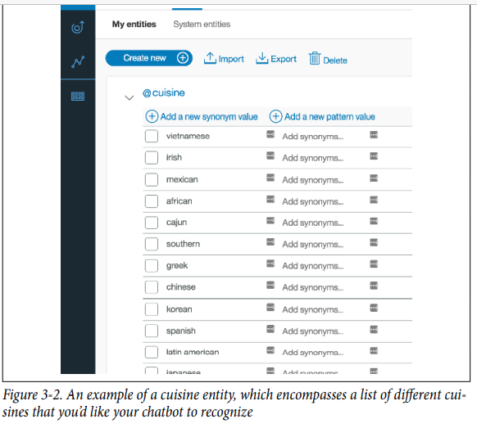

Slide 18
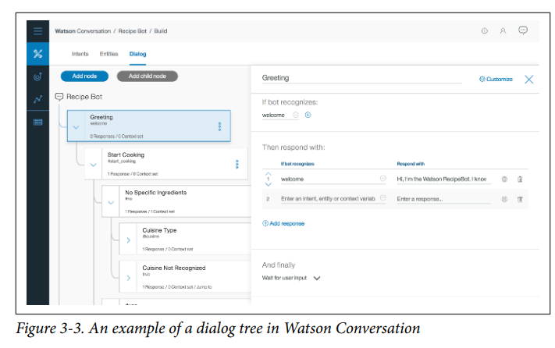
Dialog:
Dialog is the conversation flow. It’s usually represented as a directed graph where each node represents one exchange in the conversation. Together, it is the combined structure of all your possible conversations. Since this can become quite complex, most chatbot platforms provide a UI to help you visualize the process

Slide 19
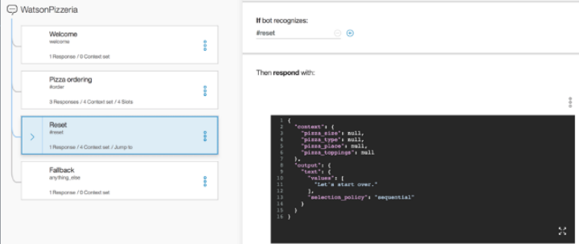
Context variable. A context variable contains the information shared between the framework and your application. It’s the way to exchange information between your business logic and the framework.
the context object stores all the variables related to the user’s pizza order. The variables are updated as the user progresses through the ordering process

Slide 20
Analytics and metrics:
One of the best ways to improve chatbot performance is to monitor user interactions through chat logs. This is especially important as you scale up your operation to simultaneously serve multiple customers. The more users you have, the larger the chat logs. Being able to examine the logs effectively will help you monitor your chatbot performance, and deliver a better user experience

Slide 21
Challenges of Building a Successful Chatbot:
This is not an easy problem.
For example, one travel agency tried to deploy a vacation planning chatbot. A critical component was a vocabulary base large enough to recognize all the destinations, along with its colloquial variations. It turns out there were over 10 ways people could refer to the Cayman Islands, even assuming all spellings were correct.

Slide 22
Best Practices:
Tip #1: Introduce Your Chatbot to First-Time Users
One way to create a better user experience is to immediately introduce the user to the chatbot’s capabilities and explain how to converse with it. A welcome message (something short, simple, and motivating) is usually best followed by a helpful paragraph describing the chatbot.
Tip #2: Add Variations to Your Responses
Adding variations to your responses makes your chatbot seem more human, and thus more engaging. One simple trick is to rotate through a set of different replies to the same question. This gives your chatbot an additional sense of randomness. After all, as humans, we rarely give the same response to a question twice in a row.

Slide 23
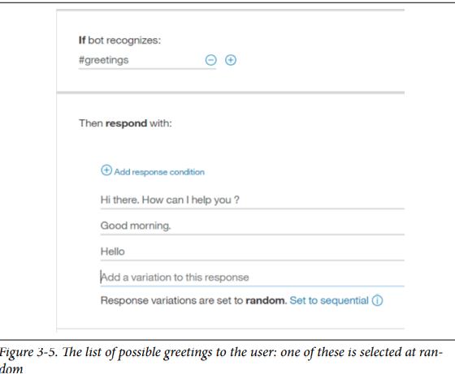

Slide 24
Tip #3: Make a Main Menu That’s Accessible Anywhere
A better approach would be to make the main menu always accessible via some intuitive phrases:
“Where do I go from here?”
“I need the menu.”
“Where is the main menu?”
When the chatbot recog‐ nizes these phrases, it can remind the user of the available options.
Tip #4: Have Context Awareness
One example of having context awareness is storing information that has already been discussed. As we mentioned earlier, Watson Conversation provides a con‐ text object that stores context variables as key/value pairs

Slide 25
Tip #5: Be Able to Fix Incorrect Inputs
Users will inevitably enter incorrect information in the middle of a conversation. When that happens, starting over should be the last resort. Instead, the user should be able to enter the correct response immediately after. One way to imple‐ ment this is with an idea similar to the slots feature in Watson Conversation
Slots are a way to collapse dialog nodes. In some instances, you need to gather multiple pieces of information in a single node
If the user accidentally entered “small” for the size of the pizza, she can simply say, “actually I meant large” to fix the mistake. This is because when we’re at this node, Watson Conversation automatically checks all user inputs for the defined entities such as size (small, medium, large) or toppings (pepperoni, mushroom, cheese). And in this case when Watson Conversation sees the entity value “large” in the phrase “actually I meant large,” it updates the slot with that value

Slide 26
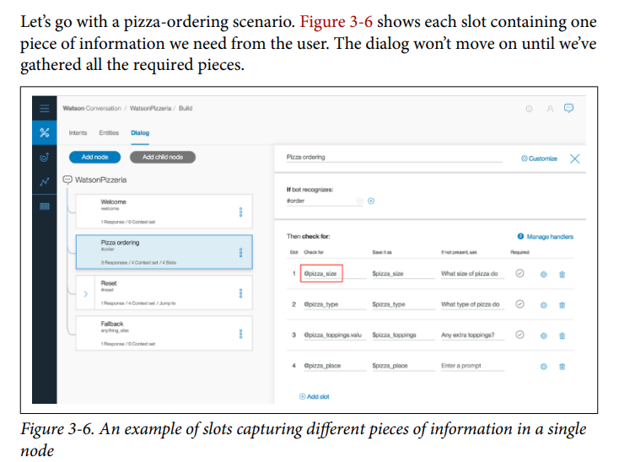

Slide 27
Tip #6: Handle the “I Do Not Understand” Case
As users interact with your chatbot, you’ll encounter messages that you’ve never seen before. That’s OK. When it happens, the most important thing is to acknowledge the situation rather than having no response. This is why it’s essen‐ tial to have a catch-all node in your dialog
You can even thank the user for the new message and say that an answer will be available on her next visit.
Tip #7: Be Careful About Creating a Personality
Creating a personality for your chatbot is tempting. After all, it can be a crucial differentiator
Poncho(weather forecasting chatbot) will even behave differently based on your politeness. If you’re rude to him, he’ll ask you to apologize. If you continue to be aggressive, he won’t respond for 24 hours.

Slide 28
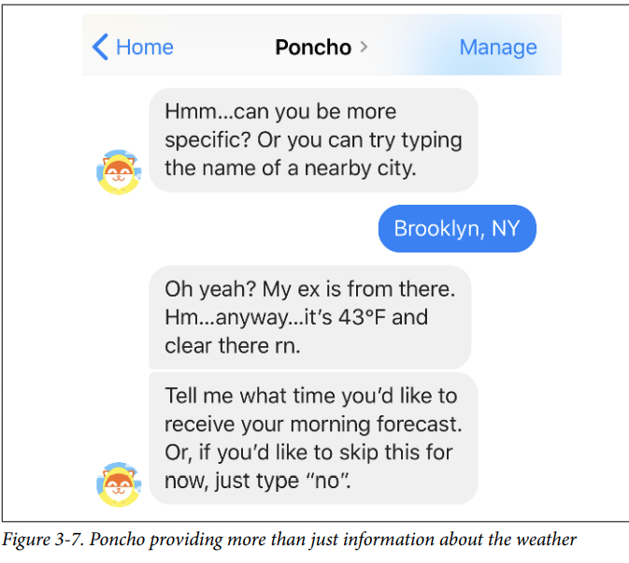

Slide 29
Industry Case Studies
Autodesk: Customer Support
Autodesk is known for its 3D design and engineering software. As the company switched from a desktop licensing model to a SaaS model.
Autodesk’s staff of about 350 customer support agents handles roughly one million customer and partner contacts per year. About half of these are simple activation code requests, changes of address, contract problems, and technical issues
Autodesk built a virtual agent called Autodesk Virtual Agent (AVA), designed to answer common customer queries quickly. It was first trained from chat logs, use cases, and forum posts. It analyzed more than 14 million sentences for keywords, entities, phrases, clusters, and other speech and language patterns.

Slide 30
AVA has had 146,652 conversations, a 35% increase quarter over quarter (QoQ).
AVA has helped 45,514 customers total, a 54% increase QoQ.
Resolution takes an average of 5.6 minutes, compared to the original 38 hours with human support agents.
Autodesk estimates a support agent headcount savings of 12–15.

Slide 31
Staples: Conversational Commerce
Staples built an intelligent Easy Button such that when a customer speaks to it, the Watson Conversation service extracts the customer’s intent and entities.
The system currently understands five intents:
product ordering, product reordering, shipment tracking, checking on reward summaries, and processing back-toschool lists from scanned images provided by customers.
After Watson Conversation recognizes the intent and entity of a request such as “I want to reorder black pens,” it calls the Staples personalization engine. This engine combs through the customer’s purchasing history to identify the pen (an excellent use of contextual information)

