Slide 1
IoT-Based Automated Tropical Terrarium Using ESP32
Course Code: | EEE 4103 | Course Name: | Microprocessor and Embedded Systems
Course Teacher: DEBRAJ DAS
Lecturer
Department of Electrical and Electronic Engineering
SL # | Students ID | Students Name | Program | Section | Signature
1 | 23-54520-3 | Kishor Tarafder | BSc in CSE
2 | 23-55027-3 | Tahomina Era | BSc in CSE
3 | 23-54483-3 | MD. Shakhawat Hossen | BSc in CSE
4 | 23-54508-3 | Avishek Saha | BSc in CSE
5

Slide 2

Attributes of Complex Engineering Activities
BAETE Specified Complex Engineering Activity Profile (EA): It involves around communication (PO10). Not activity but communication is required to solve a problem; e.g., to find the project’s impact on society, to mitigate the problem, engineers need to communicate with people living in the society.
EA1 Range of Resources: involves the use of diverse resources(and for this purpose, resources include people, money, equipment, materials, information, and technologies)
EA2 Level of Interactions: requires resolution of significant problems arising from interactions between wide-ranging or conflicting technical, engineering, or other issues
EA3 Innovation: involves the creative use of engineering principles and research-based knowledge in novel ways
EA4 Consequences to Society and the Environment: Have significant consequences in a range of contexts, characterized by difficulty of prediction and litigation.
EA5 Familiarity: Can extend beyond previous experiences by applying principles-based approaches.
Differentiating Characteristic | Description | Taxonomy Domain
PO10: Communication | Communicate effectively on complex engineering activities with the engineering community and with society at large, such as being able to comprehend and write effective reports and design documentation, make effective presentations, and give and receive clear instructions | Affective

Slide 3
Five Levels of the Affective Domain of Bloom’s Taxonomy
Affective Domain: The affective domain of Bloom’s Taxonomy, developed by David Krathwohl and Benjamin Bloom, focuses on emotional learning, including attitudes, values, appreciation, and motivations. It comprises five hierarchical levels—receiving, responding, valuing, organizing, and characterizing—ranging from basic awareness to internalizing values that guide behavior.
A1 Receive (Aware): The lowest level, representing a willingness to listen or pay attention. (e.g., listen to others with respect, attend a session).
A2 Respond (Participate Actively): Active participation and reaction to a phenomenon. (e.g., participating in class discussions, complying with safety rules).
A3 Value (Attach Worth): Attach worth or value to a specific object, phenomenon, or behavior. (e.g., appreciate the role of, demonstrate belief in, or show commitment to an idea).
A4 Organize (Conceptualize): Organize values into priorities and resolve conflicts between them to create a consistent value system. (e.g., prioritize time to meet goals, create a life balance).
A5 Characterize (Internalize): The highest level of the Affective Domain, where values are deeply internalized or naturalize and guide actions consistently. (e.g., act in accordance with personal values, behave ethically).
Action Verbs: Ask, choose, follow, comply, discuss, help, perform, express, arrange, prioritize, act.

Slide 4
Presentation: Course Outcomes and Rubrics
CO | Assessment Materials (Course Outcome Statement) | EA | Assessed POI | Marks
CO3 | Course Project Presentation (Explain the complex engineering activities of a course project solving a complex engineering problem of the electrical and electronic engineering discipline through an effective presentation.). | A1, A2 | P.j.3.A4 | 15
CO-POI | Excellent to proficient [12 to 15] | Good [8 to 11] | Acceptable [4 to 7] | Unacceptable [1 to 3] | No Response [0] | Secured Marks
CO4 P.j.3.A4 | The presentation explains the complex engineering activities of a course project solving a complex engineering problem of the electrical and electronic engineering discipline incorporating all points. | The presentation somewhat explains the complex engineering activities of a course project solving a complex engineering problem of the electrical and electronic engineering discipline but not incorporating all points. | The presentation does explain the complex engineering activities of a course project but fails to solve a complex engineering problem of the electrical and electronic engineering discipline but missing some important points. | The presentation does not explain the complex engineering activities of a course project and fails to solve a complex engineering problem of the electrical and electronic engineering discipline but missing most of the points. | No Response
Comments: |  |  |  |  | Total Marks (15)

Slide 5
Outline of the Presentation
1. Aims and Objectives
2. Introduction
3. Literature Review
4. Working Method
5. Description / Methodology of the Work
6. Equations / Mathematical Model
7. Survey Report
8. Gantt Chart
9. Outcomes / Results and Discussions
10. Conclusions
11. Future Scopes

Slide 6
Aims and Objectives of the Work
1. To design a fully enclosed, sensor-driven micro-climate control system for a tropical terrarium.
2. To develop ESP32 firmware with a closed-loop rules engine (AUTO / MANUAL) for misting, airflow and lighting.
3. To implement five sensing channels: temperature / humidity / pressure, light, dual soil moisture, leak and water level.
4. To incorporate safety interlocks: reservoir float cut-off, leak alarm, daily watering cap and buzzer alerts.
5. To design dual-mode control: a phone dashboard over Wi-Fi / hotspot and a Windows console app over USB.
6. To calibrate the soil sensors and analyze system performance against measured data.

Slide 7
Introduction …
Tropical plants (ferns, mosses, orchids) need 70-90% relative humidity, 22-28 °C and evenly moist soil. These conditions collapse quickly in air-conditioned rooms and in the dry season.
Manual care fails silently: one missed misting crashes humidity within hours, while over-watering rots roots.
Commercial plant controllers are either simple timers that act blindly (open loop), or cloud-locked products that stop working without internet.
Motivation: a self-contained controller that senses, decides and acts locally, with no internet required, tunable by anyone.

Slide 8
Introduction
The developed system reads seven signals continuously: temperature, humidity, pressure, light level, two soil-moisture probes, tray leak and reservoir level.
It drives ultrasonic mist makers, an exhaust fan and a grow light through a 4-channel opto-isolated MOSFET stage.
Closed-loop rules with hysteresis hold humidity and soil moisture inside target bands; interlocks block unsafe actions.
Control from any phone (over Wi-Fi or the board's own hotspot) or from a one-click Windows console app over USB.
All 14 thresholds and timings are editable live from the UI and persist in flash, so nothing needs re-flashing to re-tune.

Slide 9
Literature Review
Commercial misting systems (e.g., MistKing Starter) run on fixed timers: open loop, so they keep misting even when humidity is already high.
Humidistat controllers (e.g., Inkbird IHC-200) close the loop on humidity only, with no awareness of soil, light, water level or leaks.
Published Arduino / DHT11 greenhouse projects push readings to cloud dashboards (Blynk, ThingSpeak) but are monitoring-oriented, internet-dependent and use low-accuracy sensors (±5% RH).
Gap addressed by this work: multi-variable closed-loop control, local-first operation with zero internet, hardware safety interlocks, and runtime configurability on low-cost hardware.
[2-3 course-approved journal references to be added here]

Slide 10
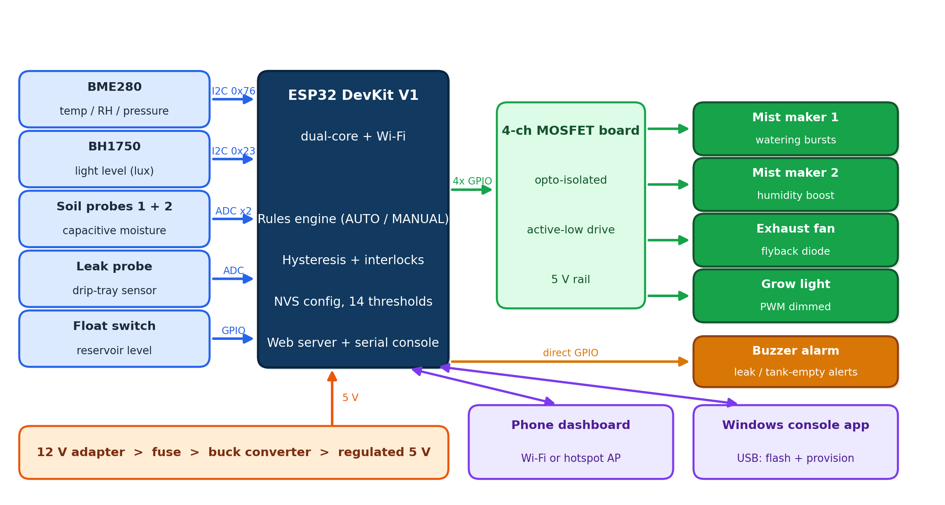
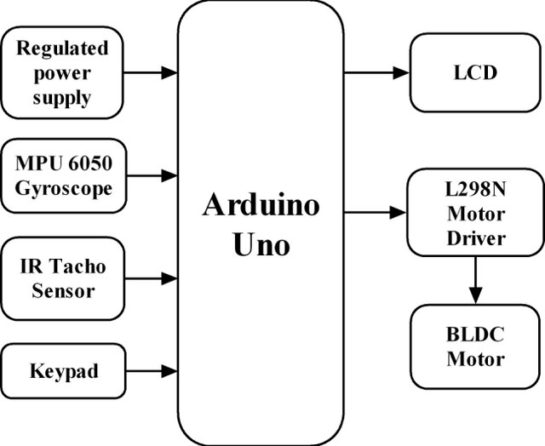
Research/Working Method
Sense > decide > act loop runs every 2 seconds on the ESP32.
AUTO mode: rules engine with hysteresis bands. MANUAL mode: direct per-channel control from the UI.
All actuators are isolated from the logic side through opto-coupled MOSFET drivers (active-low).
Fig. 1: Block diagram of the automated terrarium system

Slide 11
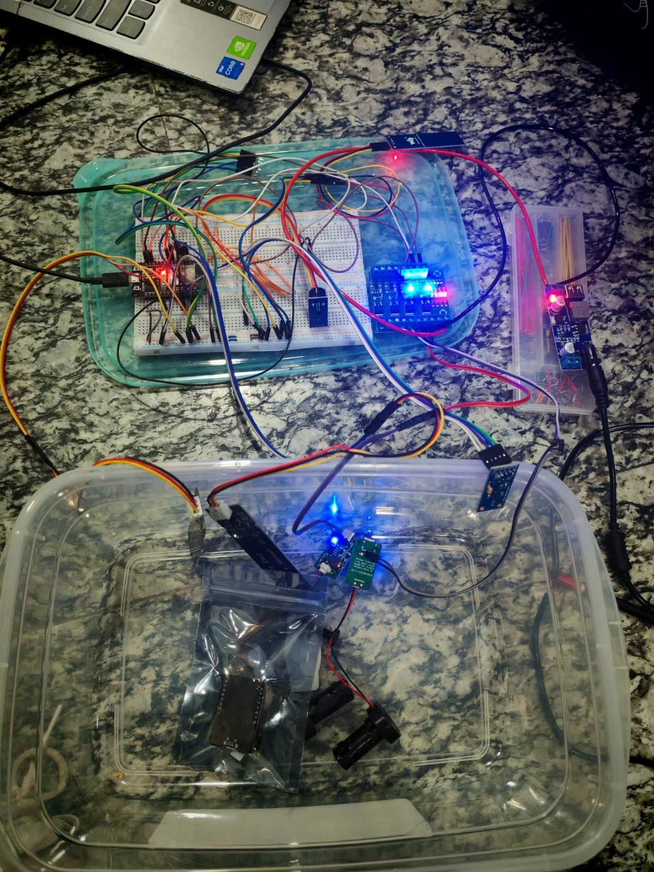
Description/Methodology of the Work …
ESP32 DevKit V1 (dual-core, Wi-Fi) is the controller; its CP2102 USB port doubles as the console link.
BME280 (temp / RH / pressure) and BH1750 (lux) share the I2C bus; capacitive soil probes and the leak sensor use 12-bit ADC pins.
A 4-channel opto-isolated MOSFET board switches the 5 V mist drivers; flyback diodes clamp fan back-EMF.
Power: 12 V adapter feeds a fused buck converter, giving a regulated 5 V rail for logic and mist; sensors run from 3.3 V only.
The complete system was assembled and verified on the bench before enclosure integration.
Fig. 2: Bench prototype under test (all channels live)

Slide 12
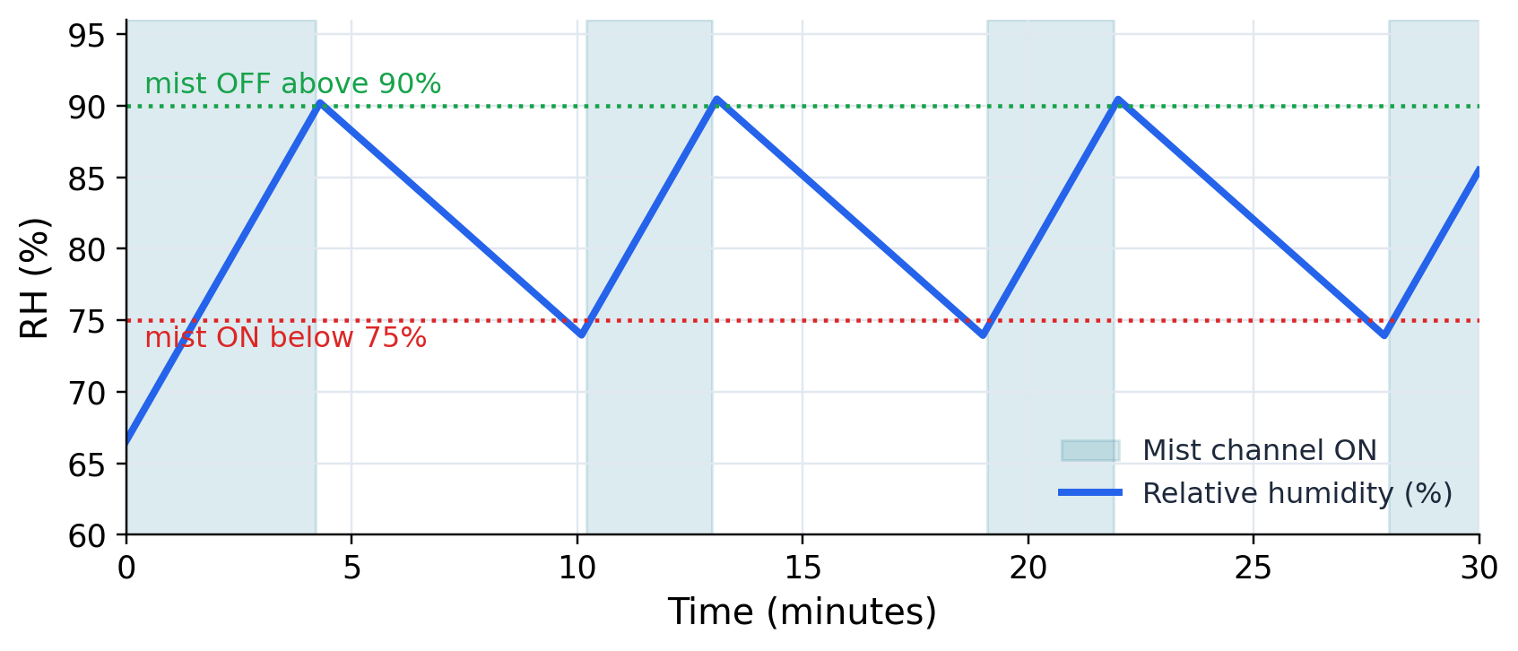
Description/Methodology of the Work …
Humidity: mist turns ON below the low threshold and OFF above the high one; the hysteresis band prevents rapid on/off chatter.
Soil watering: short mist burst, then a soak wait, repeated until the target moisture, with a hard daily cap for safety.
Interlocks: the reservoir float stops all watering when empty; the leak probe raises the buzzer alarm.
Grow light follows a lux threshold and an on/off schedule; the exhaust fan dumps excess heat and humidity.
Fig. 3: Humidity hysteresis control principle (simulated behaviour)

Slide 13
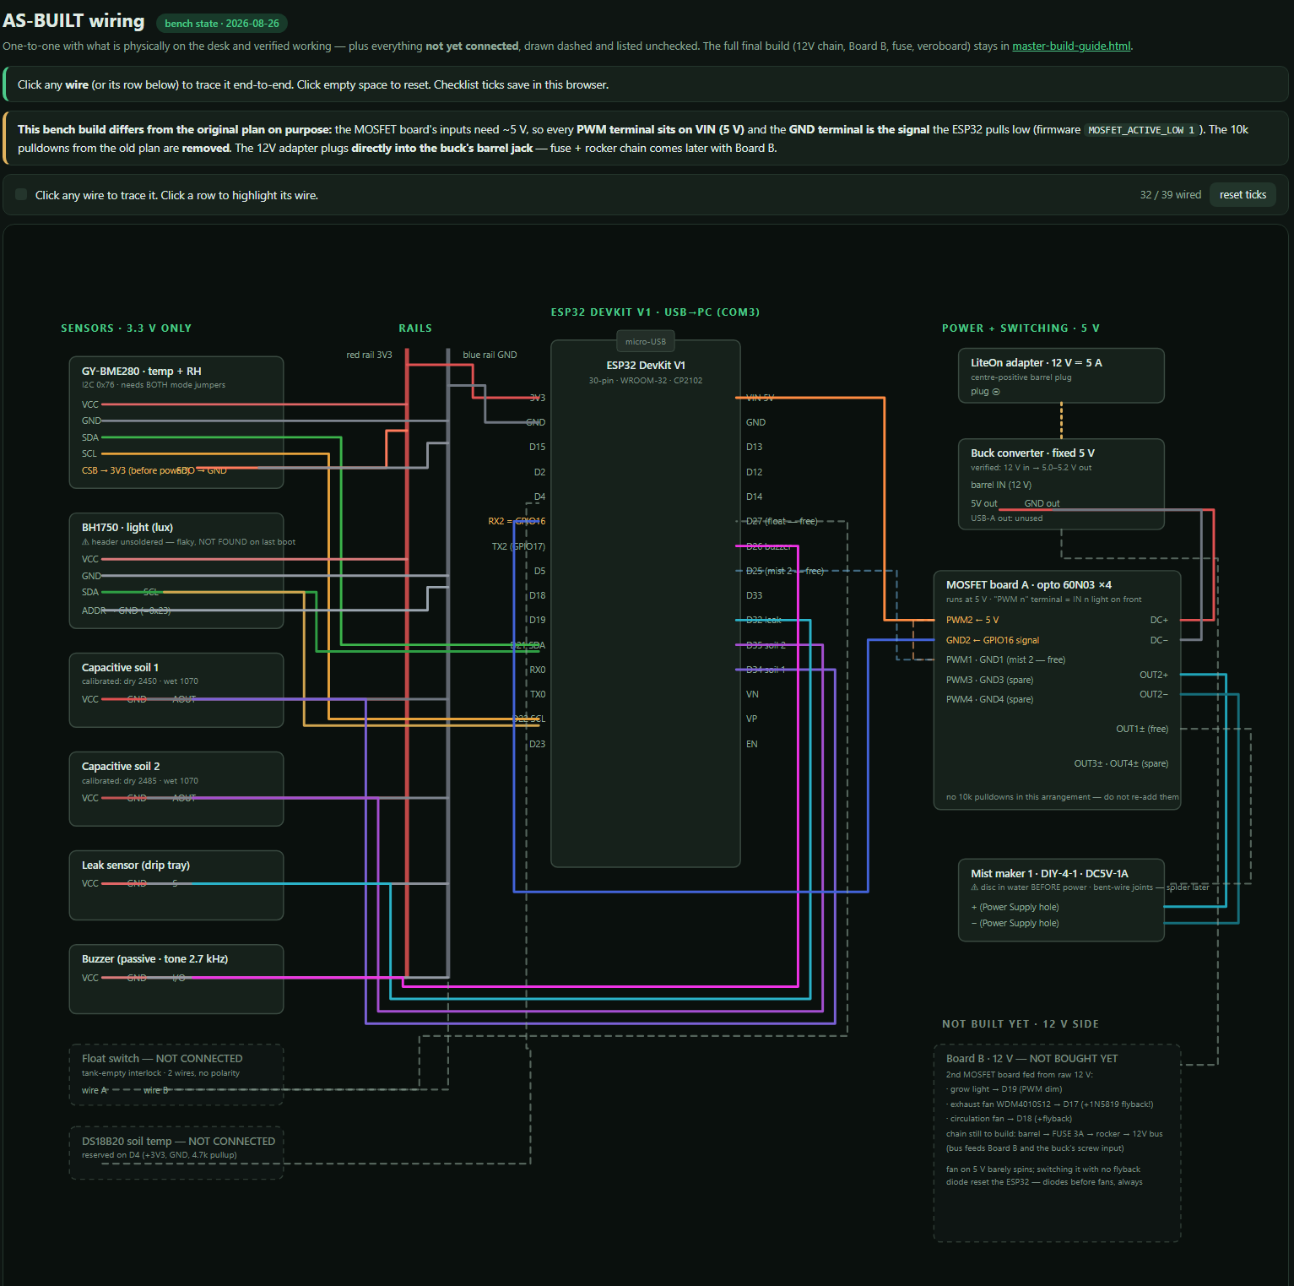
Description/Methodology of the Work
As-built wiring is documented one-to-one in a self-developed interactive diagram; 32 of 39 planned connections are live on the bench build.
Firmware: Arduino C++ on the ESP32, with a web server, a serial command console and settings persisted in flash (NVS).
Windows console app (single .exe): auto-detects the board, installs the driver and toolchain, flashes firmware and provisions Wi-Fi over USB.
Fig. 4: Interactive as-built wiring diagram (self-developed tool)

Slide 14
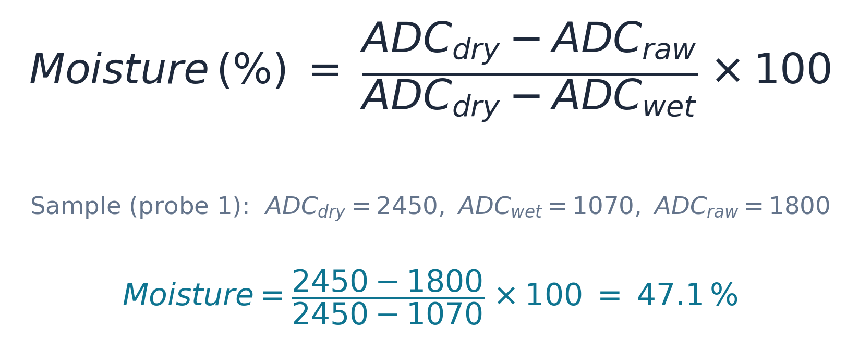

Equations/Mathematical Model
Two-point calibration mapping used in the firmware, worked with measured probe-1 values.

Slide 15
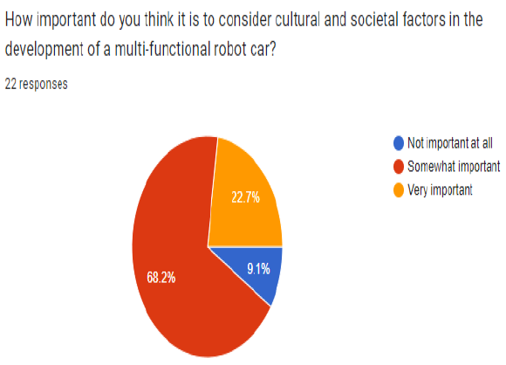
Survey Report
Survey plan (Google Forms, target N ≥ 30 respondents):
1. Do you keep indoor plants at home?
2. Have you lost a plant to missed watering or humidity swings?
3. Would you trust an automated system to water your plants?
4. Which feature matters most: auto misting, grow light, alerts, or remote monitoring?
5. How much would you pay for a local, internet-free plant-automation kit?
6. Is operation without internet / cloud important to you?
[ Response pie / bar charts inserted here once collection closes ]
Fig. 5: Survey response summary (to be inserted)

Slide 16
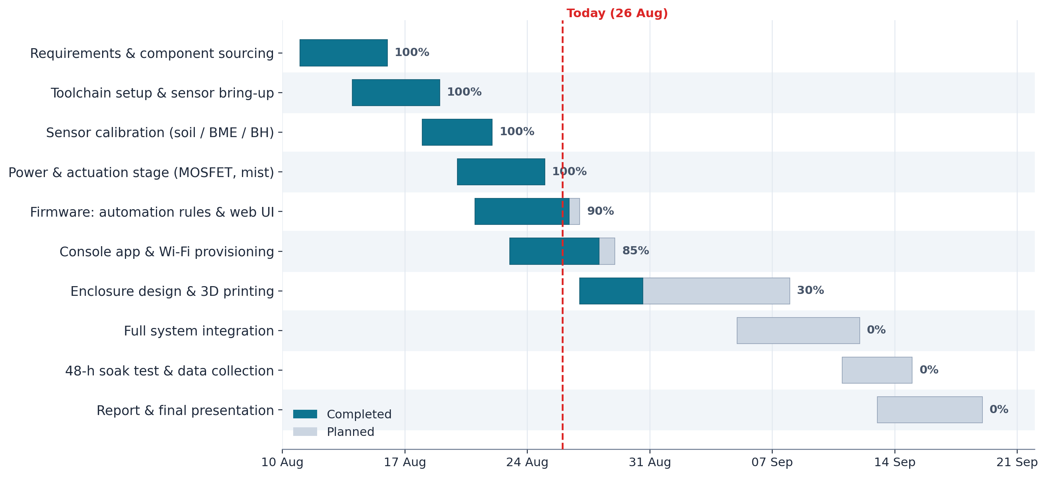
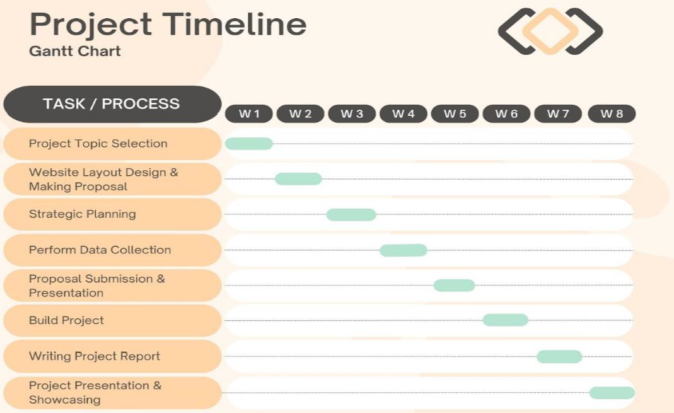
Gantt Chart
Work started 11 Aug 2026. The bench system was completed in the first three weeks; enclosure, integration and the 48-hour soak test are scheduled before the final defence.
Fig. 6: Project Gantt chart

Slide 17
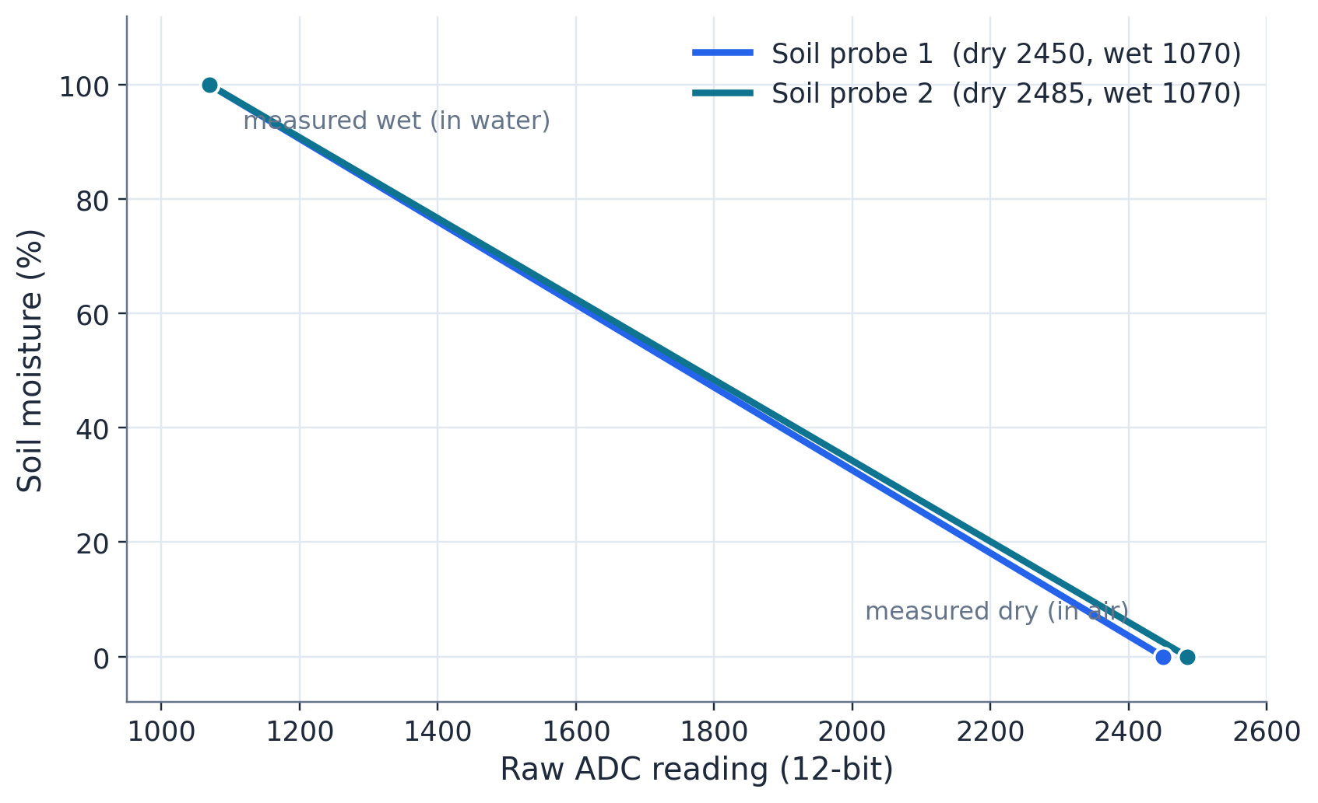
Outcomes/Results and Discussions …
Both capacitive soil probes were calibrated by two-point measurement: dry in air, then submerged in water.
The wide usable span (about 1,380 ADC counts) gives roughly 0.07% moisture resolution per count; probes track wetting within seconds.
BME280 humidity was verified against breath / mist response; BH1750 tracks room-light changes for the lux threshold.
Table 1: Measured soil-sensor calibration
Probe | ADC dry (air) | ADC wet (water) | Usable span
Soil 1 | 2450 | 1070 | 1380
Soil 2 | 2485 | 1070 | 1415
Fig. 7: Soil-moisture calibration transfer curves (measured)

Slide 18
Outcomes/Results and Discussions
Mist channels switch reliably through the opto-isolated driver after converting to active-low 5 V drive.
The watering burst / soak cycle and the daily cap were verified live from the dashboard; buzzer and leak alarm respond in the UI in real time.
Wi-Fi provisioning over USB verified end-to-end: credentials sent from the console, the board joined the target network (RSSI −53 dBm) and the dashboard was reachable immediately.
Hotspot fallback lets a phone connect with no router present; all settings survive power cycles (NVS flash).
48-hour soak-test data and the reference-hygrometer comparison will be appended before the final defence.

Slide 19
Conclusions
A complete closed-loop terrarium controller was developed and verified end-to-end on the bench.
Five sensing channels were calibrated; mist, fan, light and alarm actuation proven through isolated drivers.
The system runs internet-free, with dual control paths (Wi-Fi dashboard + USB console) and live-tunable thresholds.
The platform is low-cost, reproducible and adaptable to other plant species and enclosure sizes.

Slide 20
Future Scopes
Integrate the 3D-printed PETG enclosure and the 12 V lighting / airflow stage.
Long-term data logging with charts, trends and mobile push alerts.
Camera-based plant-health monitoring (leaf-colour analysis).
Battery / UPS backup and multi-terrarium networking from one console.

Slide 21
Thanks for Listening our Presentation….
?

