Slide 1
Kishorkumar S
Final Project
3/21/2024 Annual Review

Slide 2
PROJECT TITLE
Detecting Age and Gender from Images
3/21/2024 Annual Review

Slide 3


AGENDA
Introduction
Problem Statement
Project Overview
End Users
Solution Highlights
Modeling Approach
Results
Conclusion
3/21/2024 Annual Review

Slide 4

PROBLEM STATEMENT
Recognizing age and gender from images has numerous applications ranging from targeted advertising to security systems.
However, accurate and efficient detection of age and gender in real-time from images remains a challenge.
3/21/2024 Annual Review

Slide 5

PROJECT OVERVIEW
Objective: To develop a system capable of accurately detecting age and gender from images or video streams in real-time.
Tools Used:
OpenCV: For image processing and computer vision tasks.
Deep Learning Models: Utilizing pre-trained models for face detection, age estimation, and gender classification.
Python: Programming language for implementation.
3/21/2024 Annual Review

Slide 6

WHO ARE THE END USERS?
Marketing Agencies: Targeted advertising based on demographic information.
Security Systems: Age and gender-based analysis for surveillance and access control.
Entertainment Industry: Audience analysis for content personalization.
Healthcare: Patient monitoring and demographic analysis.
3/21/2024 Annual Review

Slide 7

YOUR SOLUTION AND ITS VALUE PROPOSITION
Solution: Our solution involves utilizing deep learning models for accurate face detection, age estimation, and gender classification.
Value Proposition:
Accuracy: Leveraging state-of-the-art deep learning models ensures accurate age and gender detection.
Real-Time: Capable of processing images or video streams in real-time, enabling instant analysis.
Versatility: Applicable across various domains, providing valuable insights for different industries.
Efficiency: Optimized implementation ensures efficient resource utilization.
Scalability: Can be integrated into existing systems or deployed as standalone applications.
Customization: Flexibility to fine-tune parameters or integrate with other modules for specific use cases.
3/21/2024 Annual Review

Slide 8

THE WOW IN YOUR SOLUTION
High Precision: Achieving precise age and gender detection even in challenging conditions.
User-Friendly Interface: Intuitive interface for easy deployment and usage.
Adaptability: Capable of adapting to diverse environments and scenarios.
Ethical Considerations: Ensuring privacy and ethical usage of demographic information.
3/21/2024 Annual Review
8

Slide 9
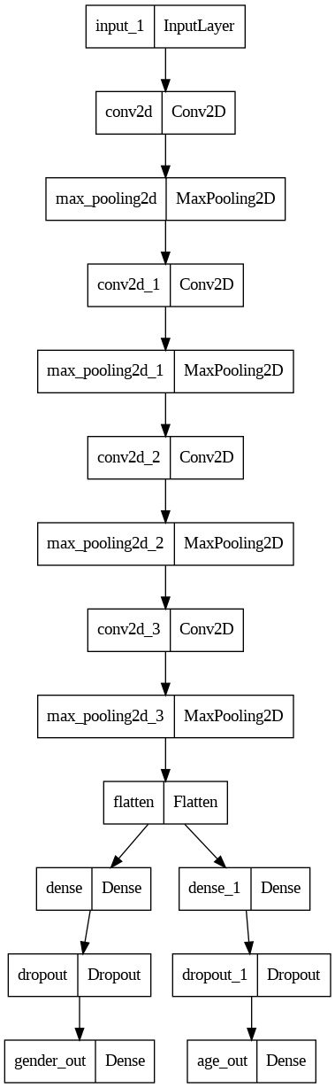
MODELLING
3/21/2024 Annual Review
9

Slide 10
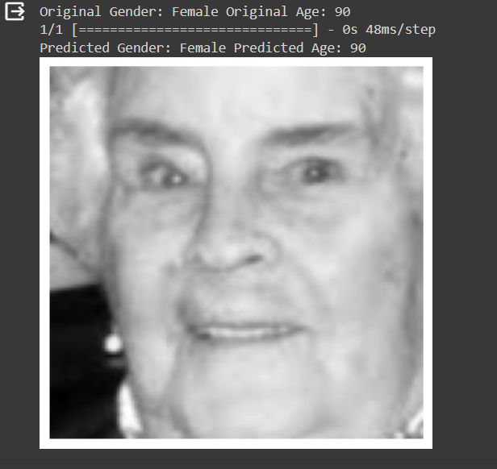
RESULS
Gender Accuracy: 90.00%
Age Mean Absolute Error (MAE): 6.5 years
Demo Link
3/21/2024 Annual Review
10

