Slide 1

CROSS-VALIDATION
A smart approach for preventing Overfitting

Slide 2





INTRODUCTION TO CROSS-VALIDATION
WHAT IS IT?
WHY IS IT IMPORTANT?
A technique to assess model generalization to unseen data.
Provides a reliable performance estimate beyond single splits.
Prevents overfitting by systematic performance evaluation.
Essential for hyperparameter tuning and model selection.

Slide 3
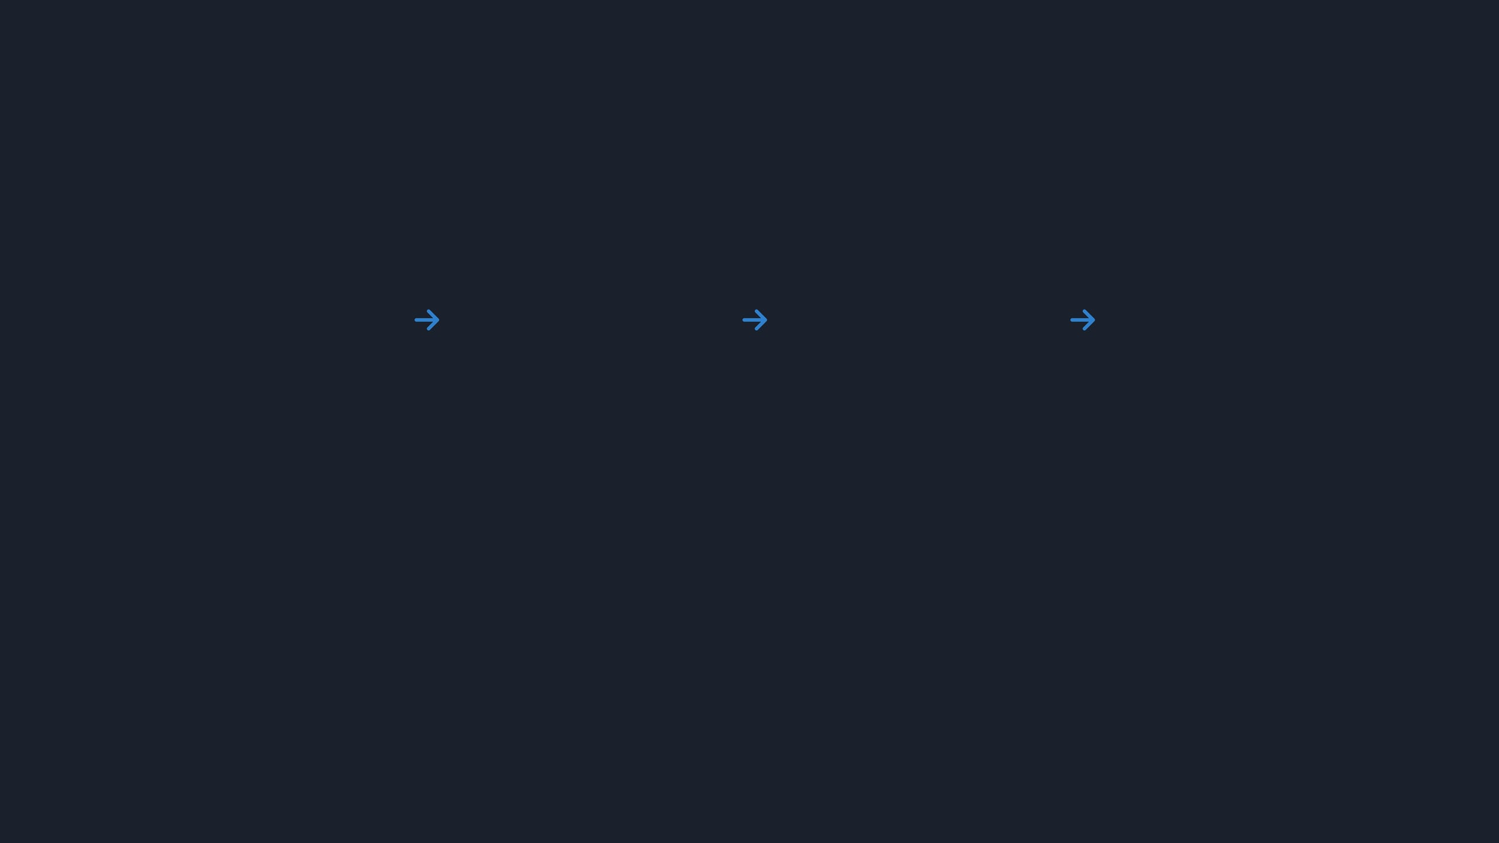





THE CORE IDEA OF CROSS-VALIDATION
STEP 1
STEP 2
STEP 3
STEP 4
Split Data
Train & Test
Repeat
Average
Divide the dataset into multiple systematic subsets.
Train on a portion and evaluate on the remaining data.
Repeat the process with different data splits.
Aggregate all metrics for a final performance score.

Slide 4






TYPES OF CROSS-VALIDATION
Holdout Method
K-Fold Cross-Validation
SIMPLE SPLIT
MOST POPULAR
Repeated K-Fold
Stratified K-Fold
ROBUST ESTIMATION
CLASS BALANCED
Leave-One-Out (LOOCV)
EXTREME K-FOLD

Slide 5
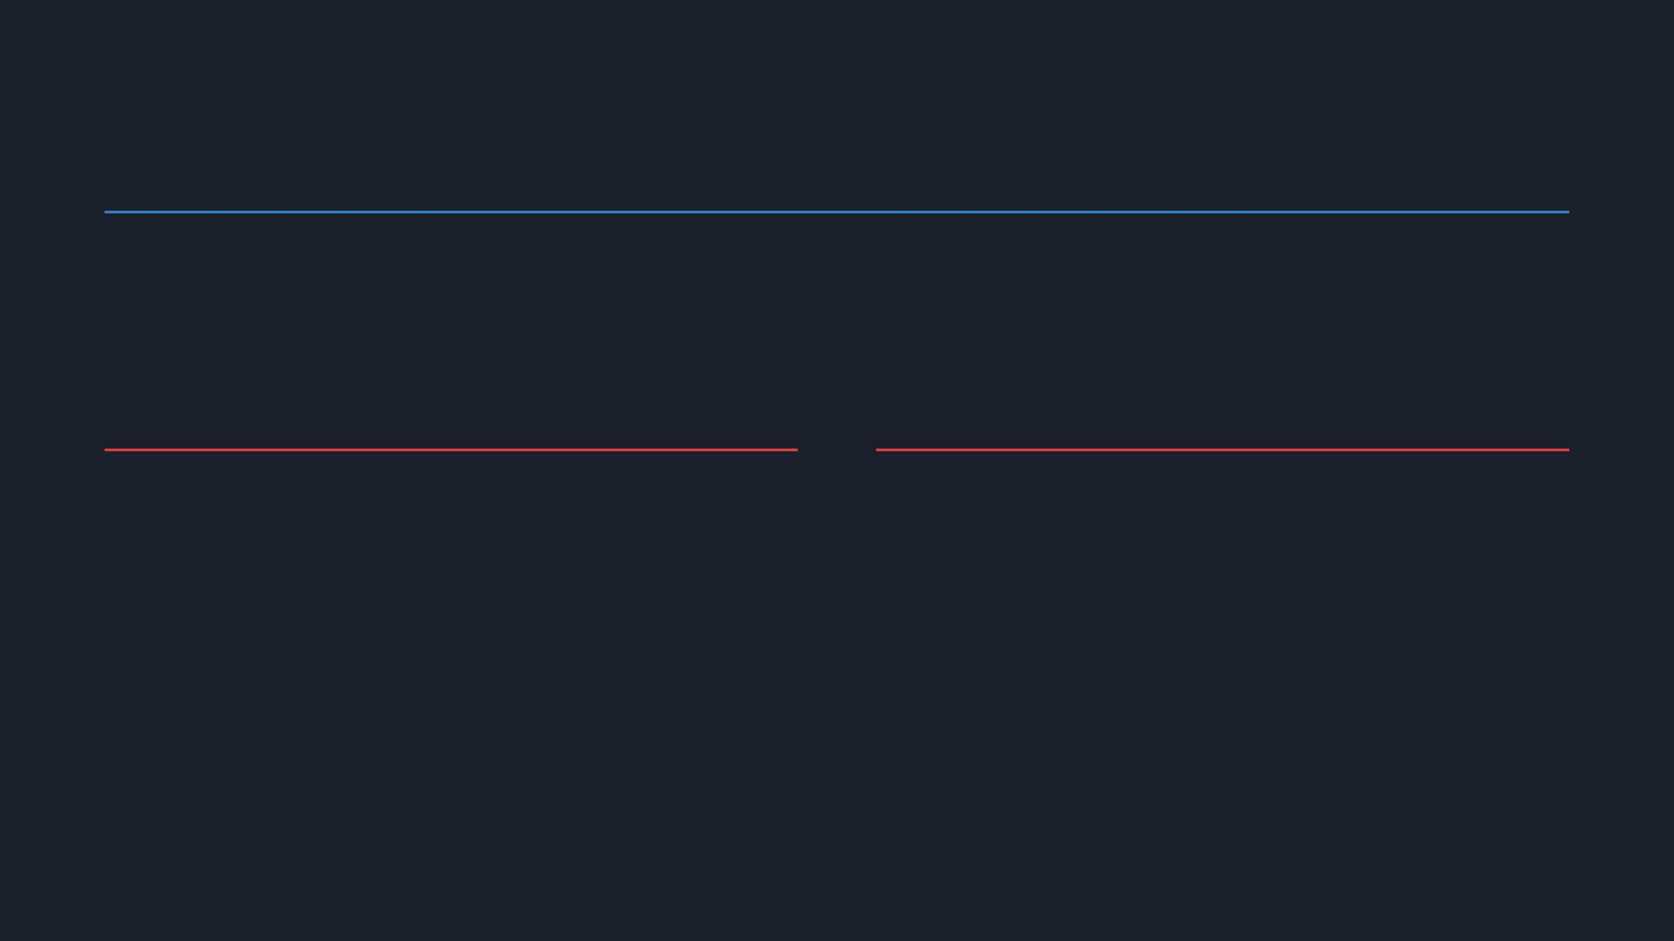


HOLDOUT METHOD
The simplest form of cross-validation that divides the dataset into a single training set and a single test set (e.g., 80/20 split).
ADVANTAGES
DISADVANTAGES
Simple to implement and understand.
High variance: results depend heavily on the split.
Computationally inexpensive; only one training cycle.
Data inefficient: part of the data is never used for training.
Fast execution for very large datasets.
Potential for biased performance estimates.

Slide 6

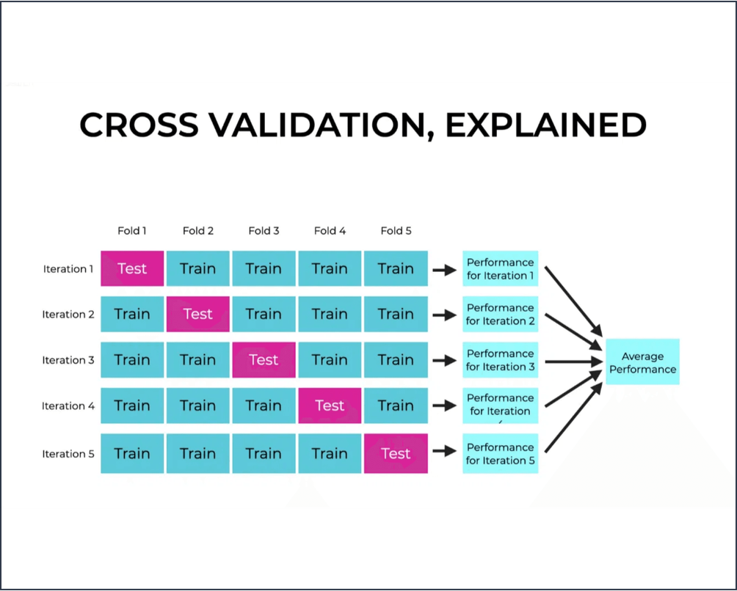
K-FOLD CROSS-VALIDATION
THE GOLD STANDARD
Divides dataset into
K equal-sized folds
(typically 5 or 10).
Iterates K times: each fold serves as the test set exactly once.
Final performance is the
average
of all K iterations.
ADVANTAGES
DISADVANTAGES
Reduces bias and variance.
High computational cost.
Uses all data for training.
Slower for large datasets.

Slide 7

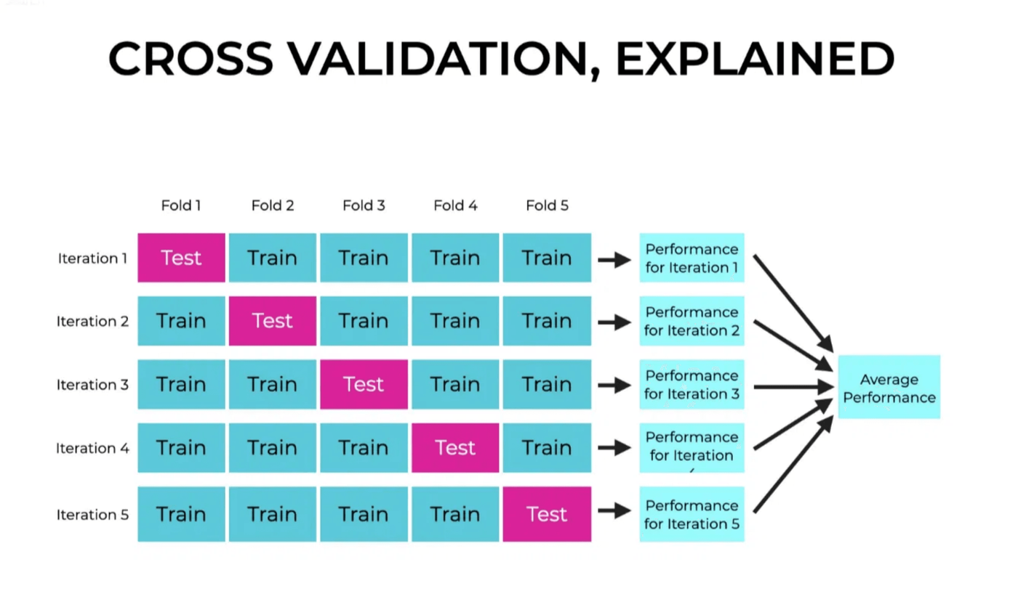




K-FOLD CROSS-VALIDATION: VISUAL WORKFLOW
THE 5-FOLD PROCESS
Data Splitting:
Dataset is divided into 5 equal folds.
Iteration:
5 rounds of training and testing.
Validation:
Each fold serves as the test set exactly once.
Final Score:
Results are averaged for a robust estimate.

Slide 8








REPEATED K-FOLD CROSS-VALIDATION
ENHANCING ROBUSTNESS
Definition:
Repeats the K-Fold procedure multiple times with different randomizations.
REPETITION 1
K-Fold Split A
Working:
Performs K-Fold
n_repeats
times and averages all results.
REPETITION 2
K-Fold Split B
REPETITION N
Advantage:
Provides a more stable estimate by reducing the impact of a single random split.
K-Fold Split Z
Final Average Score
Trade-off:
Computationally expensive; time increases linearly with repetitions.

Slide 9
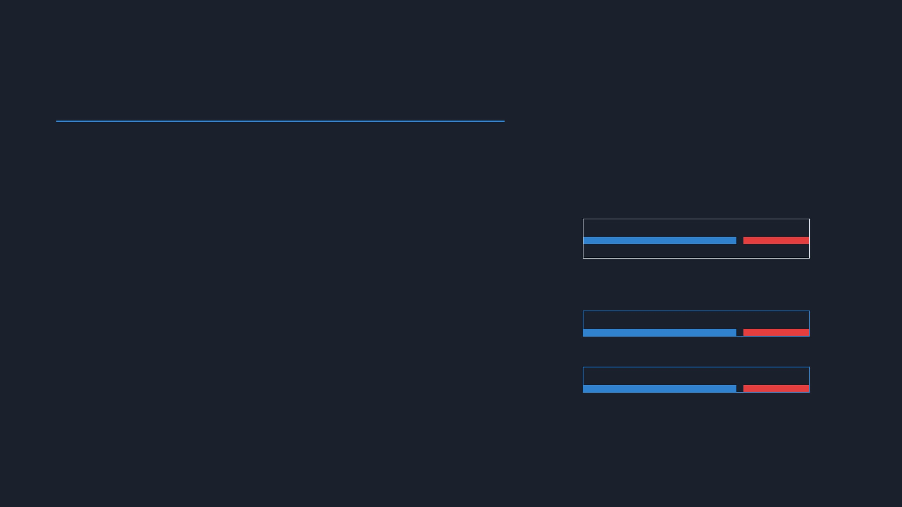



STRATIFIED K-FOLD CROSS-VALIDATION
HANDLING IMBALANCED DATA
Definition:
A variation of K-Fold that ensures each fold preserves the original class distribution.
ORIGINAL DATASET DISTRIBUTION
70% Class A | 30% Class B
Working:
Samples are selected such that the percentage of each target class is consistent across all folds.
FOLD 1 (PRESERVED RATIO)
Advantage:
Crucial for classification tasks with imbalanced datasets to prevent biased evaluation.
FOLD 2 (PRESERVED RATIO)
Limitation:
Primarily designed for classification; not directly applicable to regression problems.

Slide 10

CONCLUSION & REFERENCES
KEY TAKEAWAYS
Cross-validation is essential for building robust models that generalize well to unseen data.
Different techniques offer unique trade-offs between bias, variance, and computational cost.
K-Fold remains the industry standard, while Stratified K-Fold is critical for imbalanced classes.
Always choose your validation strategy based on dataset size and specific problem constraints.

