Slide 1
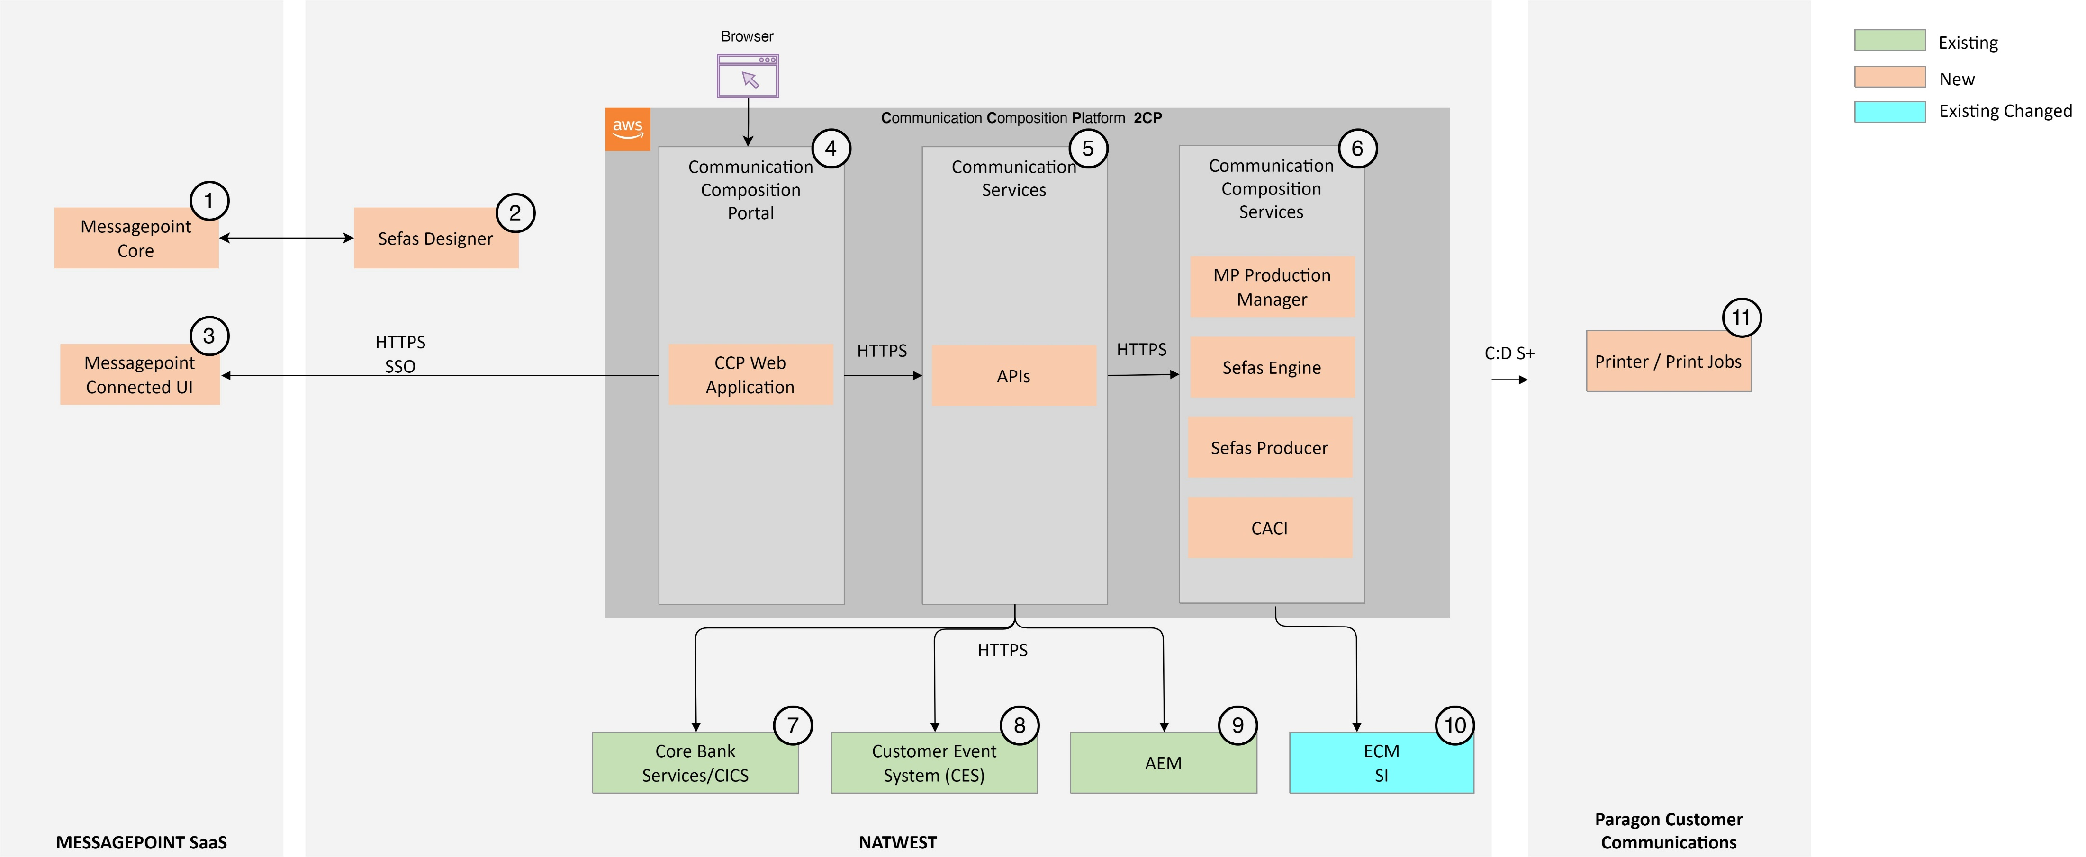




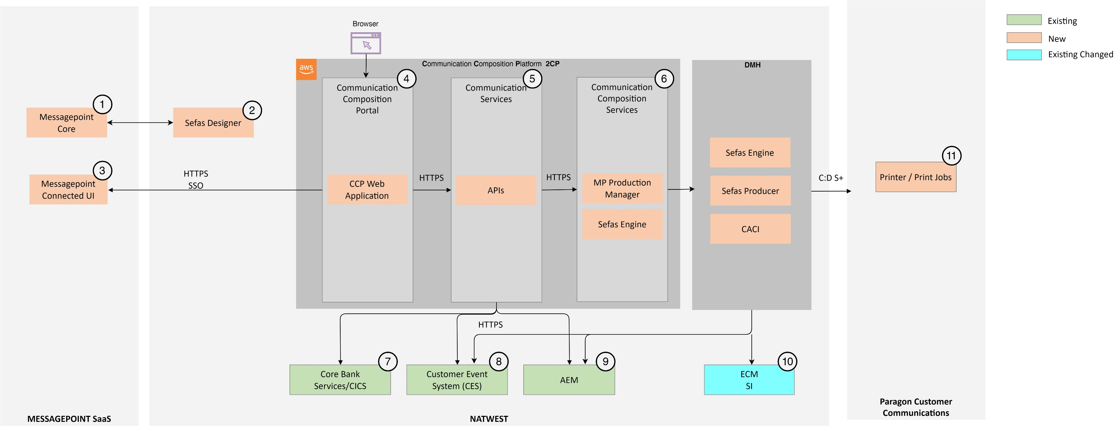
OPTION 1 - 2CP WITH POSTCOMPOSITION (STRATEGIC)
OPTION 1
OPTION 2
CONTAINERISED - EASE TO SCALE FOR MULTIPLE LOB
POSTCOMPOSITION SKELETON CAPABILITY
COMMON COTS LAYER FOR CCM OFFERINGS
PRODUCT ROADMAP TO K8S ALIGNED
POSTGRESSQL BASE
CONNECTIVITY TO PCC VIA GSS
TIMELINE TO DEVELOP FROM SCRATCH
LICENSE TO BE SECURED
LESS TIMELINE TO DEVELOP FROM EXISTING
EXISTING SETUP AND CONNECTIVITY
FACILITATE FUTURE TECHNICAL DEBT
HLSD APPROVAL AND DECISION OPTION
CLOUD READY
OPTION 2 - 2CP WITHOUT POSTCOMPOSITION (INTERIM)

