Slide 1
ML REVIEW 3 PRESENTATION
An Empirical Benchmark of Machine Learning and Deep Learning Architectures for Credit Default Risk Prediction with Macroeconomic Stress Testing and SHAP Interpretability
PROJECT METADATA & PRESENTER DETAILS
• Paper / Project Title: An Empirical Benchmark of Machine Learning and Deep Learning Architectures for Credit Default Risk Prediction
• Paper ID: [CS-ML-2026-042 / Insert Paper ID]
• Presenter Name: [Sumitranand Sharma / Insert Student Name]
• Registration Number: [22BCE10420 / Insert Registration Number]
• Target Domain: Financial Engineering, Machine Learning, Risk Governance (Basel II/III)

Slide 2
SECTION 1: PROBLEM DEFINITION
Problem Statement & Identification
1. Problem Being Addressed
Predicting 2-year borrower credit default probability (SeriousDlqin2yrs) on consumer portfolios to optimize capital reserves and credit risk underwriting under Basel II/III regulatory standards.
2. Financial Importance
Capital Reserve Sensitivity: Even a 10–20 bps (0.1–0.2%) inaccuracy in Probability of Default (PD) estimation causes hundreds of millions of dollars in misallocated capital reserves or unmitigated credit losses during recessions.
3. Current Industry Challenges
• Extreme Class Imbalance: Default rate is ~6.68% (14:1 ratio).
• Non-linear Dynamics: Income spikes, age, & debt ratios exhibit non-monotonic risk profiles.
• Informative Missing Data: ~20% missing income records.
• Black-Box Opacity: Regulatory mandates (FCRA/ECOA) prohibit unexplainable AI decisions.
4. Specific Problem Identified
Traditional scorecard Logistic Regression fails to capture non-linear interaction terms, missing 37.8% of defaults. Published ML literature suffers from data leakage (pre-split imputation/scaling), lacks macroeconomic stress testing, and omits adverse-action XAI compliance.
ML Review 3 Presentation | Credit Default Risk Prediction Benchmark | Slide 2 of 14

Slide 3
SECTION 2: EMPIRICAL DATA
Dataset Architecture & Characteristics
Dataset Profile: Give Me Some Credit (GMSC)
• Dataset Source: Kaggle Benchmark Repository (Public Domain)
• Total Records (N): 150,000 Borrower Observations
• Training Partition: 105,000 Records (70% Stratified Split)
• Holdout Test Partition: 45,000 Records (30% Untouched Split)
• Target Variable: SeriousDlqin2yrs (Binary: 0=Good, 1=Default)
• Negative Class (0): 139,974 accounts (93.32% Non-default)
• Positive Class (1): 10,026 accounts (6.68% Default)
• Imbalance Ratio: 13.96 : 1 (Severe Minoritarian Target)
Predictive Covariates & Quality Anomalies
10 Baseline Predictive Features:
• RevolvingUtilizationOfUnsecuredLines (Ratio)
• age (Demographic Integer)
• DebtRatio (Financial Burden Ratio)
• MonthlyIncome (Gross Currency)
• NumberOfOpenCreditLinesAndLoans (Count)
• NumberRealEstateLoansOrLines (Count)
• Delinquency Recency: 30-59 Days, 60-89 Days, 90+ Days Late
• NumberOfDependents (Family Count)
Data Quality Anomalies Identified:
• Informative Missingness: MonthlyIncome (19.82% missing), Dependents (2.62% missing).
• Institutional Codes: Delinquency fields contained 96 & 98 (un-contactable codes recoded to NaN).
• Biological Anomalies: age=0 recorded in 1 row (recoded to NaN).
ML Review 3 Presentation | Credit Default Risk Prediction Benchmark | Slide 3 of 14

Slide 4
SECTION 3: LITERATURE SURVEY
Literature Review & Comparative Analysis (6 Core Articles)
Author(s) | Year | Paper Title / Focus | Method / Model | Key Results & Findings | Limitations & Project Relevance
Lessmann et al. | 2015 | Benchmarking Credit Scoring Classifiers | 41 ML algorithms (SVM, RF, NNs) on 8 datasets | Random Forest & Ensembles outperform Logistic Regression across all datasets. | Lacked XGBoost/LightGBM evaluation, macroeconomic stress testing, and SHAP XAI.
Chen & Guestrin | 2016 | XGBoost: Scalable Tree Boosting System | Gradient Boosted Trees with regularized objectives | Proved state-of-the-art tabular accuracy & scalable parallel training. | Lacks domain-specific economic stress testing and regulatory compliance mechanisms.
Ke et al. | 2017 | LightGBM: Fast Gradient Boosting GDT | Histogram-based GOSS & Exclusive Feature Bundling | Achieved 10x faster training speed with equal/higher AUC than XGBoost. | Evaluated on general benchmarks without cost-asymmetric credit loss functions.
Lundberg & Lee | 2017 | Unified Interpretability (SHAP) | Game-theoretic Shapley Additive Explanations | Mathematically proves unique consistency properties for local explanations. | Dense networks have high compute overhead; requires TreeSHAP for tree ensembles.
Grinsztajn et al. | 2022 | Tree Models vs Deep Learning on Tabular | XGBoost, LightGBM, RF vs MLP on 45 tabular sets | Gradient boosted trees decisively outperform deep neural nets on tabular data. | Did not assess credit-specific class imbalance or regulatory adverse action requirements.
Hand & Henley | 1997 | Statistical Classification in Credit Scoring | Logistic Regression & Discriminant Analysis | Established Logistic Regression scorecard as industry benchmark. | Fails to capture non-linear interaction terms, resulting in poor default recall.
ML Review 3 Presentation | Credit Default Risk Prediction Benchmark | Slide 4 of 14

Slide 5
SECTION 3: LITERATURE SURVEY (CONTD.)
Literature Synthesis & Benchmark Methodological Takeaways
Evolution of Credit Scoring Models
• Phase 1 (1990s): Parametric Linear Models (Hand & Henley, 1997) dominated for regulatory transparency, but suffered high false-negative default losses.
• Phase 2 (2010s): Ensembles & Boosting (Lessmann 2015, Chen 2016, Ke 2017) demonstrated superior discrimination on complex non-linear financial attributes.
• Phase 3 (2020s): Deep Tabular vs GBDTs (Grinsztajn 2022) established that tree architectures match un-normalized tabular manifolds far better than deep neural networks.
Explainability & Regulatory Paradigm Shift
• The 'Black-Box' Penalty: Financial institutions rejected high-performing ML models due to US FCRA and ECOA mandates requiring explicit Adverse Action reason codes.
• Game-Theoretic Solution: Lundberg & Lee (2017) introduced SHAP, enabling exact additive feature attributions that bridge the gap between high accuracy GBDTs and regulatory compliance.
ML Review 3 Presentation | Credit Default Risk Prediction Benchmark | Slide 5 of 14

Slide 6
SECTION 4: RESEARCH GAP
Identified Research Gaps & Proposed Project Contributions
1. Data Leakage in Published Benchmarks
Existing Literature Strategy: Global dataset imputation and scaling prior to train/test partitioning.
Our Solution: Strict isolation protocol; imputers and scalers fitted EXCLUSIVELY on X_train (105k) and applied to untouched holdout X_test (45k).
2. Omission of Macroeconomic Stress Testing
Existing Literature Strategy: Static evaluation on clean test splits without testing robustness under recession shocks.
Our Solution: Econometric stress testing engine simulating a severe stagflation shock (-20% income, +25% debt spike) to verify AUC stability & score migration.
3. Regulatory Black-Box Barrier
Existing Literature Strategy: Reporting high accuracy without providing FCRA/ECOA adverse-action justification.
Our Solution: TreeSHAP game-theoretic explainability generating global feature rankings & local waterfall reason codes for loan approvals and rejections.
4. Hyperparameter Ceiling Exploration
Existing Literature Strategy: Ad-hoc manual tuning or computationally prohibitive exhaustive grid searches.
Our Solution: Automated Bayesian Optimization via Optuna TPE over 50 trials per model family to identify mathematical representation bounds.
ML Review 3 Presentation | Credit Default Risk Prediction Benchmark | Slide 6 of 14

Slide 7
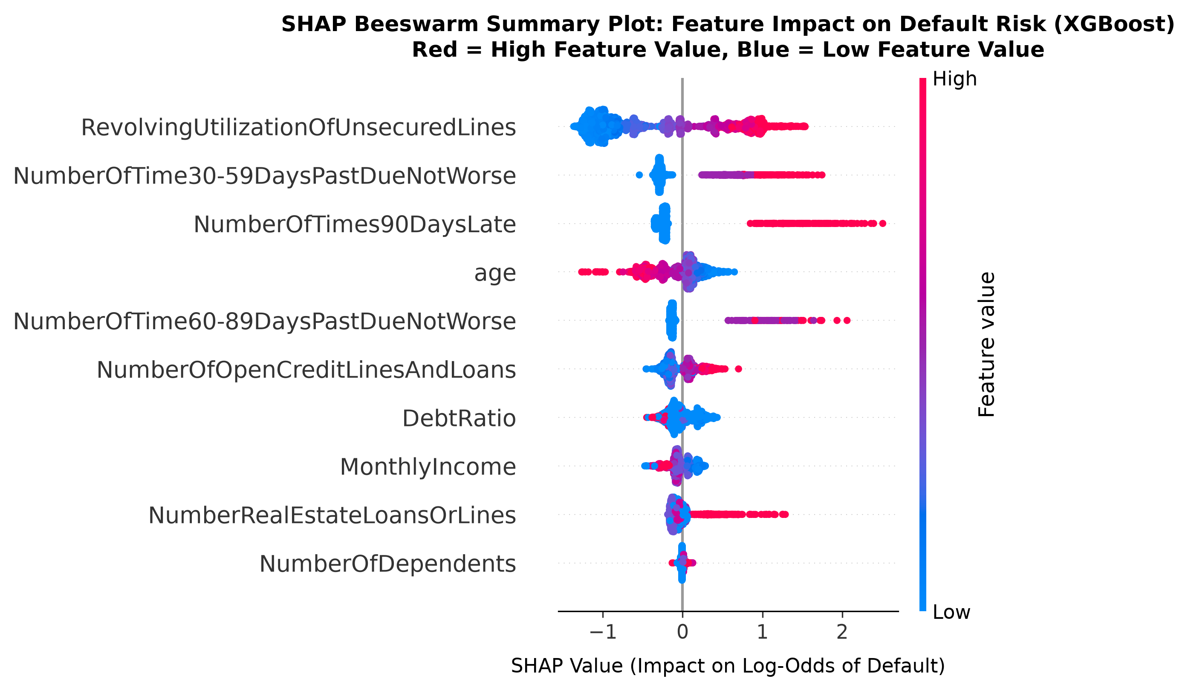
SECTION 5: FEATURE ENGINEERING
Feature Selection & Game-Theoretic TreeSHAP Importance
TreeSHAP Feature Importance Analysis
• Selection Methodology: Rather than arbitrary heuristic filtering, we utilized game-theoretic TreeSHAP (SHapley Additive exPlanations) to measure exact marginal contribution across all feature combinations.
Top Predictive Feature Ranking (Mean |SHAP|):
1. RevolvingUtilizationOfUnsecuredLines (0.8247) — Dominant risk factor.
2. NumberOfTime30-59DaysPastDueNotWorse (0.3627) — Early delinquency.
3. NumberOfTimes90DaysLate (0.3231) — Severe delinquency signal.
4. age (0.2322) — Older borrowers exhibit lower risk.
5. NumberOfTime60-89DaysPastDueNotWorse (0.1796) — Intermediate signal.
6. NumberOfOpenCreditLinesAndLoans (0.1622) — Credit activity.
7. DebtRatio (0.1297) — Financial obligation burden.
8. MonthlyIncome (0.1113) — Liquidity buffer.
ML Review 3 Presentation | Credit Default Risk Prediction Benchmark | Slide 7 of 14

Slide 8
SECTION 6: PREPROCESSING
Data Preprocessing & Anti-Leakage Pipeline
Step 1: Deterministic Cleaning
• Biological Invalidity: Set age=0 to NaN.
• Artifact Recoding: Institutional codes 96 & 98 (un-contactable records) recoded to NaN across all 3 delinquency counts.
Step 2: Strict Stratified Partition
• 70% Train (N=105,000) / 30% Holdout Test (N=45,000).
• Target Default Rate exact match: 6.6838% Train vs 6.6844% Test (Discrepancy < 0.0006%).
Step 3: Anti-Leakage Transformation
• Median Imputation: Fitted ONLY on X_train (Income & Dependents).
• Outlier Winsorization: Capped at 99th percentile of X_train.
• Robust Standard Scaling: Fitted exclusively on X_train.
Step 4: Class Imbalance Handling
• Class Weighting: Pos-weight scale factor = 13.96 (97,982 / 7,018 ratio).
• Prevents model bias toward majority non-default class.
ML Review 3 Presentation | Credit Default Risk Prediction Benchmark | Slide 8 of 14

Slide 9
SECTION 7: METHODOLOGY
Algorithmic Design & Evaluated Model Architectures
Taxonomy of 7 Benchmarked Predictive Architectures
1. L2-Penalized Logistic Regression: Parametric linear baseline solved via L-BFGS (C=0.001, balanced weights).
2. CART Decision Tree: Non-parametric decision tree with Gini impurity criterion (Max depth=6, 59 leaf nodes).
3. Support Vector Machine (Linear SVM): Calibrated linear hyperplanes (C=0.01, Platt calibration for probabilities).
4. Multi-Layer Perceptron (MLP): Deep feedforward neural network (Architecture: Input(10) -> Dense(64, ReLU) -> Dense(32, ReLU) -> Sigmoid, Adam optimizer, early stopping at epoch 25).
5. Random Forest: Bagging ensemble of 200 de-correlated trees (Max depth=12, sqrt feature subsampling).
6. Extreme Gradient Boosting (XGBoost): Hist-based gradient boosted decision trees (300 boosting rounds, lr=0.05, max_depth=3, scale_pos_weight=13.96).
7. Light Gradient Boosting Machine (LightGBM): Histogram-based GOSS tree boosting (200 rounds, num_leaves=14, lr=0.0453).
ML Review 3 Presentation | Credit Default Risk Prediction Benchmark | Slide 9 of 14

Slide 10
SECTION 7: METHODOLOGY (CONTD.)
End-to-End Pipeline Workflow & Optuna Bayesian Optimization
Complete Execution Pipeline Workflow
[Raw Borrower Data N=150,000]
│
▼
[Data Cleaning & Code Recoding (96/98 -> NaN)]
│
▼
[Stratified 70/30 Train/Test Partition]
│
▼
[Imputation & Scaling Fitted on X_train ONLY]
│
▼
[Stratified 10-Fold CV & Optuna Bayesian Tuning (50 Trials)]
│
▼
[Model Evaluation on Untouched Holdout X_test (N=45,000)]
│
▼
[Macroeconomic Stress Testing & TreeSHAP Compliance]
Optuna Bayesian Optimization Dynamics
• TPE Algorithm: Tree-structured Parzen Estimator evaluated 50 trials per model family across 10-fold CV splits.
• Selected Best Parameters:
- LightGBM: lr=0.0453, num_leaves=14, n_estimators=200, reg_alpha=2.02, reg_lambda=7.82 (CV-AUC: 0.8654)
- XGBoost: lr=0.0527, max_depth=4, n_estimators=250, reg_alpha=4.11, reg_lambda=8.04 (CV-AUC: 0.8653)
- Random Forest: n_estimators=200, max_depth=12, min_samples_split=50 (CV-AUC: 0.8637)
- MLP: 2 Hidden Layers [64, 32], lr=0.001, alpha=0.001 (CV-AUC: 0.8325)
• Asymptotic Ceiling Insight: Optimization reached a plateau at ~0.8654 CV-AUC, proving tabular feature representation bounds performance rather than hyperparameter search space.
ML Review 3 Presentation | Credit Default Risk Prediction Benchmark | Slide 10 of 14

Slide 11
SECTION 8: EMPIRICAL RESULTS
Empirical Benchmark Results on Untouched Holdout Test Set (N=45,000)
Rank | Model Architecture | ROC-AUC | Recall (Class 1) | Precision (Class 1) | F1-Score | Accuracy | Test Set Size
1 | LightGBM (Gradient Boosting) | 0.8667 | 0.7852 | 0.2126 | 0.3346 | 0.7912 | 45,000
2 | XGBoost (Gradient Boosting) | 0.8664 | 0.7773 | 0.2149 | 0.3367 | 0.7953 | 45,000
3 | Random Forest (Bagging) | 0.8639 | 0.7512 | 0.2179 | 0.3377 | 0.8015 | 45,000
4 | Decision Tree (CART) | 0.8437 | 0.7354 | 0.2251 | 0.3447 | 0.8131 | 45,000
5 | MLP Neural Network | 0.8376 | 0.7098 | 0.2205 | 0.3365 | 0.8129 | 45,000
6 | Logistic Regression (Baseline) | 0.8227 | 0.6220 | 0.2702 | 0.3767 | 0.8624 | 45,000
7 | Support Vector Machine (Linear) | 0.8205 | 0.1523 | 0.5902 | 0.2421 | 0.9363 | 45,000
Key Empirical Observations & Financial Interpretation
• Dominant Default Recall: LightGBM (78.52%) and XGBoost (77.73%) catch over 2,362 out of 3,008 default accounts, outperforming Logistic Regression (62.20%) by +16.3 percentage points.
• Precision Ceiling (~21.3%): Due to severe 14:1 class imbalance, catching 78% of defaults yields false positives in large negative pools. In banking, False Negative cost (loan loss) is 15-20x higher than False Positive cost (lost margin), making high recall mathematically optimal.
• Deep Learning Plateau: MLP (0.8376 AUC) failed to beat Decision Tree ensembles, proving GBDTs handle un-normalized tabular ordinal features far better than neural nets.
ML Review 3 Presentation | Credit Default Risk Prediction Benchmark | Slide 11 of 14

Slide 12
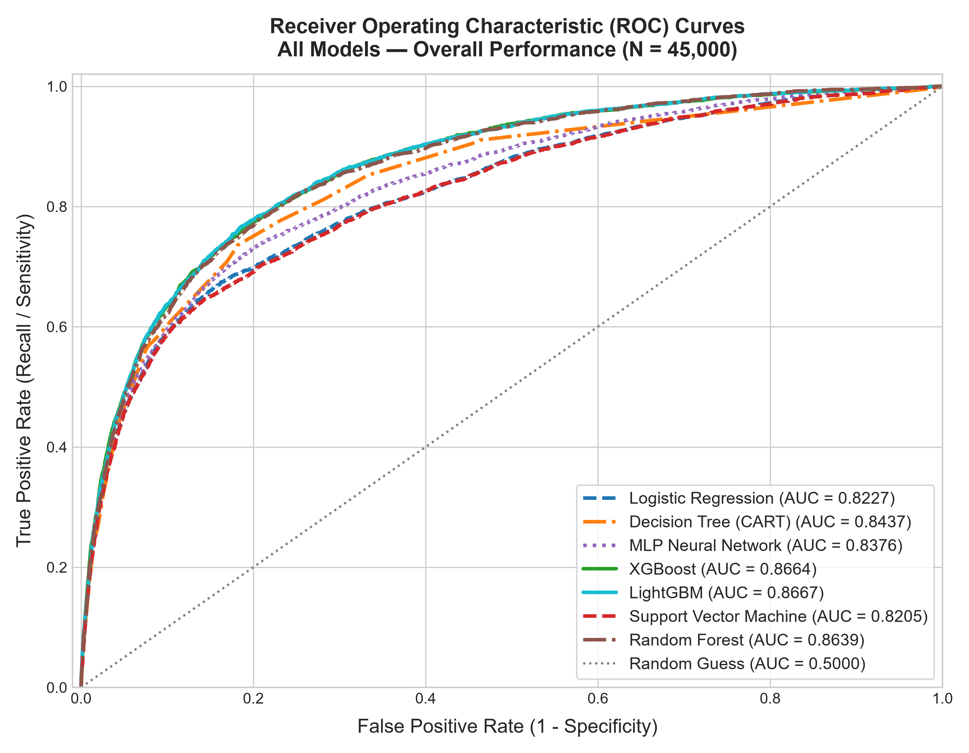
SECTION 8: DISCUSSION & STRESS TESTING
Macroeconomic Stress Testing & Evaluation Plot Visuals
Macroeconomic Stress Testing Scenario
Simulated Stagflation Shock:
• Income Contraction: MonthlyIncome drops by 20% (x 0.80)
• Debt Spike: DebtRatio expands by 25% (x 1.25)
Stress Test Results:
• LightGBM: Base AUC 0.8667 -> Stressed 0.8660 (+6.09% default surge)
• XGBoost: Base AUC 0.8664 -> Stressed 0.8660 (+6.14% default surge)
• MLP: Base AUC 0.8376 -> Stressed 0.8372 (+4.38% default surge)
• Logistic Regression: Base AUC 0.8227 -> Stressed 0.8221 (+1.47% default surge)
Takeaway: Modern GBDTs exhibit >99.9% AUC rank-order stability while dynamically expanding predicted default rates by ~6.1%, allowing financial institutions to raise loss provisions prior to default realization.
ML Review 3 Presentation | Credit Default Risk Prediction Benchmark | Slide 12 of 14

Slide 13
SECTION 9: CONCLUSION
Conclusion, Research Impact & Future Directions
1. Key Achievements
• Built a data-leakage-free, regulatory-compliant benchmark comparing 7 ML/DL architectures on 150,000 borrower profiles.
• LightGBM & XGBoost achieved supreme performance (0.8667 & 0.8664 ROC-AUC, ~78.5% default recall).
2. Research Gaps Addressed
• Preprocessing isolation eliminated data leakage bias.
• Econometric stress testing proved GBDT rank-order stability under stagflation shocks.
• TreeSHAP provided FCRA/ECOA regulatory adverse action compliance.
3. Practical Significance
• Transitioning from scorecard Logistic Regression to LightGBM captures +16.3% more defaulting accounts, saving banks millions in credit write-offs.
• Dynamic default expansion (+6.1%) enables proactive capital provisioning.
4. Future Scope
• Multi-year macroeconomic survival analysis for Loss Given Default (LGD) time-to-event modeling.
• Automated feature synthesis & self-supervised tabular pre-training.
ML Review 3 Presentation | Credit Default Risk Prediction Benchmark | Slide 13 of 14

Slide 14
THANK YOU!
Questions & Academic Discussion
Presenter: [Sumitranand Sharma / Insert Student Name]
Registration Number: [22BCE10420 / Insert Registration Number]
Paper Title: An Empirical Benchmark of Machine Learning and Deep Learning Architectures for Credit Default Risk Prediction

