Slide 1
E-COMMERCE · COMPUTER VISION · CAPSTONE
Visual Product Similarity & Image-Based Recommendation System
Amazon-style “Similar items” and search-by-image over 58,891 real product photos — no text, tags or titles involved.
ResNet50 · EfficientNet-B0 · FAISS · SQLite · Streamlit · github.com/kishorverse/visual-product-similarity-recommendation-system
Notes:
Self-introduction (about 3 minutes, separate from the project). Then: my project builds the visual-search engine behind Amazon's 'Similar items' and image search. Given only a photo, it finds visually similar products in a catalog of almost 59 thousand eBay product photos in about a millisecond.

Slide 2
DOMAIN & PROBLEM
When shoppers think in pictures, keyword search fails
The domain
Problem statement
Online marketplaces list millions of products. Their titles, descriptions and tags are often noisy, incomplete or misleading. For fashion, furniture and home décor, the look of a product is what the shopper actually wants.
Build a computer-vision system that finds and recommends visually similar products using only product images — like Amazon’s “Similar items” and image search.
Visual Product Similarity · 2
Notes:
Domain in 3 lines: marketplaces have millions of listings, the text metadata is unreliable, and in visual categories the shopper cares about style, shape and colour. Problem in 1 line: recommend visually similar products from the image alone.

Slide 3
OBJECTIVES
Four things the system must do
1 · Embed
2 · Search fast
Turn every product photo into a high-quality visual vector with a pretrained CNN.
Index the vectors with FAISS for millisecond nearest-neighbour search.
3 · Rank & filter
4 · Prove it
Return the Top-K similar products, with category, price and stock filters.
Measure Precision@K and Recall@K, inspect results visually, ship a Streamlit app.
Visual Product Similarity · 3
Notes:
Objective in 2 lines: extract visual embeddings with deep learning and build a fast similarity search that returns ranked Top-K products for any input image, then prove the quality with Precision@K and Recall@K.

Slide 4
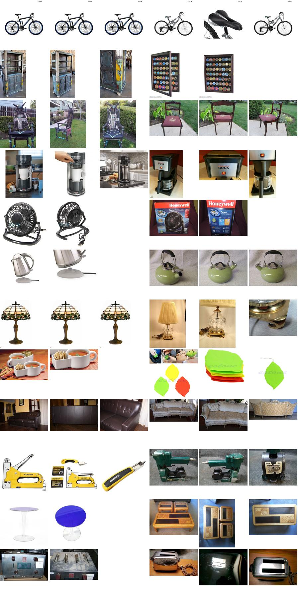
DATASET
Stanford Online Products: real eBay listings
60,502
11,316
12
photos (test split)
products
categories
Every listing has 2–12 photos from different angles. That gives two levels of truth: the category and the exact product. So I can test whether a different photo finds the same item, not just “another chair”.
Song et al., CVPR 2016 · 60× the brief’s 1,000-image minimum
Visual Product Similarity · 4
Notes:
I chose Stanford Online Products, one of the datasets in the brief, and used the official test split - the standard retrieval benchmark. Each product has several photos, so the strictest test is whether one photo retrieves the other photos of the same listing.

Slide 5
DATA CLEANING & PREPROCESSING
2.7 % removed — mostly re-uploaded photos
Check | Why | Removed
Decodes fully | corrupt files | 0
Min side ≥ 64 px · not blank | slivers, blanks | 4
RGB + resize to 320 px | ~0.5 % greyscale | —
Same photo twice in a listing | duplicates | 1,536
Same photo across listings | stock photos | 71
58,891
clean photos of 11,311 products
Duplicates matter: in leave-one-out testing an identical copy would be “found” at #1 for free.
Scaling the duplicate search: 60k images = 1.8 billion pairs. A 64-bit hash split into 5 chunks means only images sharing a chunk are compared (pigeonhole principle).
Visual Product Similarity · 5
Notes:
There are no nulls or outliers in an image dataset, so cleaning means validating every file in parallel. The big finding was duplicates: 1,607 photos were re-uploads, which would inflate the evaluation. Two hashes within 4 bits must share at least one of 5 chunks exactly, so only those are compared.

Slide 6
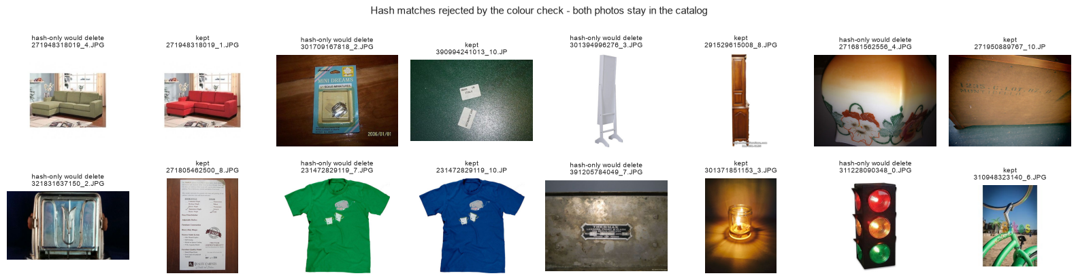
EDA FINDING
A hash alone would have deleted 1,205 good photos
Why: the dHash is greyscale, so colour variants (red vs green sofa) and dark, low-contrast photos collide.
Fix: confirm a match only if no pixel of the 16×16 colour thumbnails differs by more than 48 levels.
Visual Product Similarity · 6
Notes:
My first version used the perceptual hash plus a greyscale check; reviewing removed pairs showed it deleted colour variants. An average colour difference didn't work either, because a variant changes only part of the image. The final rule checks that no single pixel differs much. It saved 1,205 legitimate photos.

Slide 7
APPROACH
Five steps from photo to recommendation
1
2
3
4
5
Clean
Embed
Index
Search
Evaluate
validate, resize, dedupe
CNN, head removed, L2-norm
FAISS HNSW + exact Flat
cosine Top-K, filters, rank
Precision@K, Recall@K
One code path for the pipeline, the notebooks and the app: src/ modules, a SQLite catalog (FAISS row → photo → product) and Streamlit on top.
Visual Product Similarity · 7
Notes:
This is the pipeline, exactly the five steps from the brief. One command, python -m src.pipeline, runs it end to end in about 8 minutes on my laptop GPU. A normalised SQLite database maps each FAISS row back to its photo and product.

Slide 8
MODELS & WHY
Pretrained CNNs with the classifier removed
ResNet50
EfficientNet-B0
ImageNet V2 weights · fc → Identity · GeM pooling · 2048-d vector
ImageNet V1 weights · classifier → Identity · average pooling · 1280-d vector
• Why pretrained: ImageNet features already describe shape, texture and colour — no labels needed.
• Why remove the head: the 1,000 class scores are ImageNet-specific; the pooled features are general.
• L2-normalised: unit vectors make inner product = cosine similarity, which FAISS searches exactly.
• Engineering: fp16 + 4 loader workers ≈ 400 photos/s; single queries in fp32 (found a 3 s stall per thread).
Visual Product Similarity · 8
Notes:
Both backbones are from the brief. A pretrained model works for retrieval without training, and removing the classifier gives a general visual descriptor. Mixed precision speeds up bulk extraction, but profiling the app showed a 3 second first-call cost per thread, so single queries run in fp32 (about 25 ms).

Slide 9
TUNING · ABLATION STUDY
One pooling layer gave the biggest gain
Change (1,000-product subset) | ResNet50 | EfficientNet-B0
Resize whole photo vs center-crop | +0.046 | +0.036
GeM pooling vs average pooling | +0.040 | −0.014
Flip test-time augmentation | +0.007 | +0.001
Mean change in product Recall@1
0.559 → 0.602
ResNet50 product Recall@1 on the full catalog after switching to GeM — enough to overtake EfficientNet-B0.
Visual Product Similarity · 9
Notes:
Tuning here means preprocessing and pooling choices, tested on a 1,000-product subset. GeM pooling helped ResNet50 a lot but hurt EfficientNet, so pooling is set per backbone. On the full catalog the change took ResNet50 from 0.559 to 0.602, the largest single improvement in the project.

Slide 10
VECTOR SEARCH · FAISS
HNSW: 24× faster, 99.96 % the same answer
Index (58,891 × 2048-d) | ms / query | Top-10 vs exact
HNSW efSearch = 16 | 0.43 | 98.68 %
HNSW efSearch = 64 | 0.99 | 99.85 %
HNSW efSearch = 128 (used) | 1.58 | 99.96 %
HNSW efSearch = 512 | 5.54 | 100.00 %
Flat (exact brute force) | 37.5 | 100 %
HNSW is a navigable graph: search cost grows roughly with log(N), so the gap widens at marketplace scale.
efSearch is the one speed/accuracy knob, tuned on real vectors.
Visual Product Similarity · 10
Notes:
Flat is exact brute force, used as ground truth; HNSW is the graph index the app serves. At efSearch 128 it returns 99.96 percent of the exact top 10 in about 1.6 ms versus 37 ms for brute force.

Slide 11
SIMILARITY MATCHING, RANKING & FILTERING
FAISS returns photos — shoppers want products
Group by product
Similar items
Filters inside FAISS
Fetch 8× more photo hits than K, keep each product’s best photo, rank by cosine similarity.
Query = the mean of all the product’s photo embeddings; the product itself is excluded.
Category, price, in-stock via an ID selector, so K results still come back for narrow filters.
Price, rating and stock are simulated (fixed seed) — the dataset ships images and labels only.
Visual Product Similarity · 11
Notes:
FAISS indexes photos, but a results page should show each product once, so I over-fetch and group by product. For Similar items I average a product's photo embeddings. Filters run inside the FAISS search, so a narrow filter still returns a full page. Price and stock are simulated, and the app says so.

Slide 12
EVALUATION METRIC & WHY
Leave-one-out over all 58,891 photos, at two levels
Product level
Category level
Relevant = another photo of the same listing. Recall@K = is one in the top-K? The standard metric for this benchmark — the hardest test.
Relevant = same category. Precision@K = share of the top-K that fits — what a shopper sees on a results page.
Why these: a recommendation strip shows K items, so quality at K is what matters. Each photo queries all others; the photo itself is excluded.
Visual Product Similarity · 12
Notes:
A Similar items strip shows a fixed number of items, so quality within the top K is what matters. Every photo queries all the others. At product level, Recall@K is the hit rate, as papers on this dataset report it; the notebook also has the classic recall formula and mAP.

Slide 13
FINAL MODEL · RESNET50 (GEM) + HNSW
Results on the full catalog
0.602
0.917
99 %
Product Recall@1
Category Precision@1
Edited shopper photo → right product #1
random: 0.00007
random: 0.088
300 crops, rotations, colour shifts
Model | Product R@1 | Product R@10 | Category P@10
ResNet50 (GeM) | 0.602 | 0.761 | 0.799
EfficientNet-B0 | 0.568 | 0.728 | 0.791
Visual Product Similarity · 13 · HNSW search ~1 ms, 99.98 % of exact top-10
Notes:
ResNet50 with GeM pooling wins on every metric, so it's the default. For 60 percent of photos the closest match among 58 thousand is another photo of the same listing; random gets 0.00007. 92 percent of first results are the right category. A simulated shopper photo finds the right product first 99 percent of the time.

Slide 14
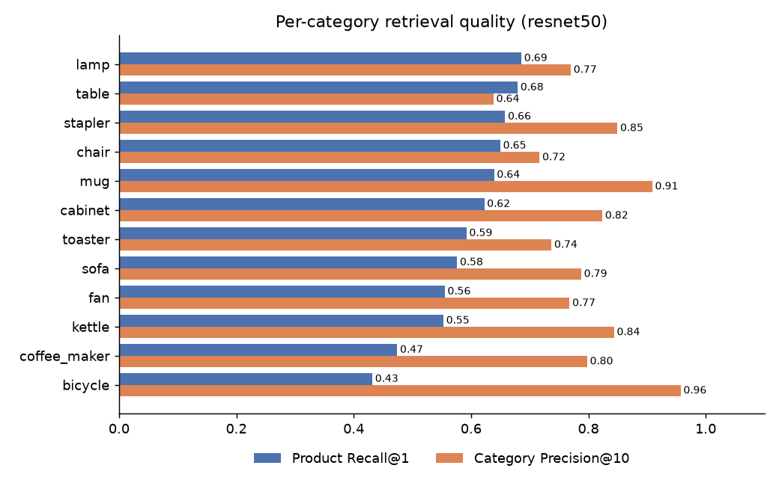
INSIGHTS BY CATEGORY
Bicycles: easiest category, hardest product
Category P@10 0.96 but product R@1 only 0.43: bikes only look like bikes, yet one bike is hard to tell from another — and listings include many close-ups.
Lamps and tables lead on product recall: designs vary a lot, so each item stands out.
Confusions make sense: sofa → chair, table ↔ cabinet, coffee maker ↔ kettle.
Visual Product Similarity · 14
Notes:
Bicycle has the highest category precision but the lowest product recall: every bike is clearly a bike, but telling one listing's bike from another is hard. Coffee makers and kettles have the same issue. The category confusions are between things that share materials and settings.

Slide 15
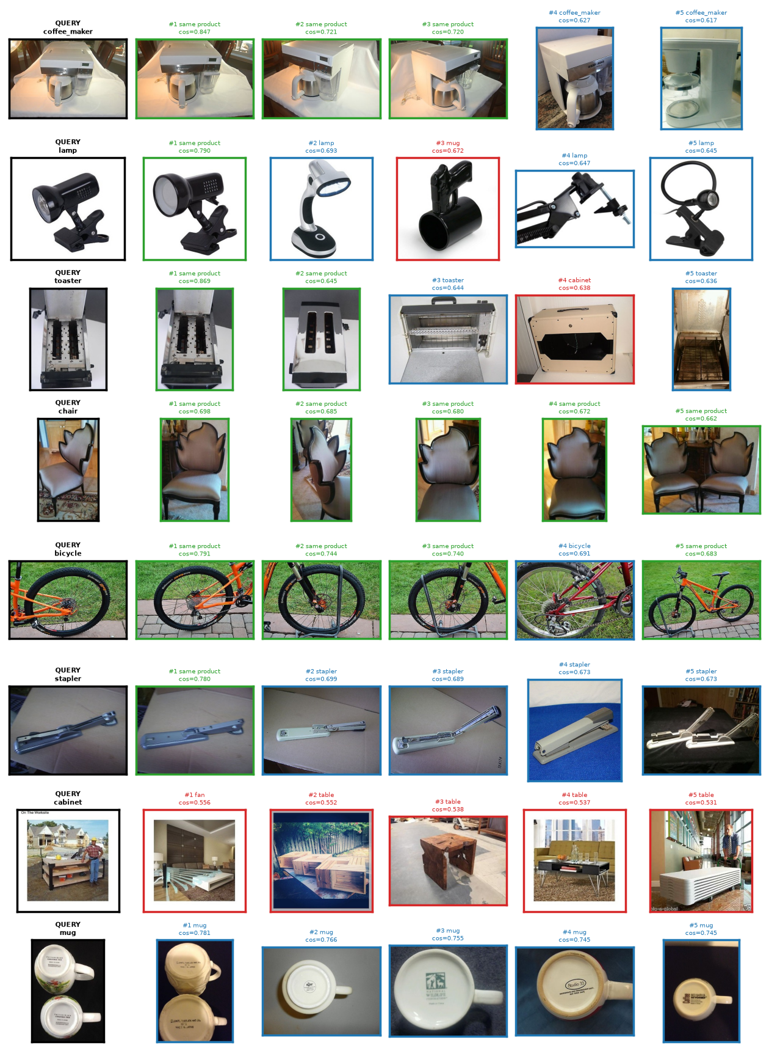
VISUAL INSPECTION
Other angles of the same product come first
Green = same product · blue = same category · red = different category.
Even misses are sensible: a black clip-lamp finds black plastic clamps; a mug-bottom photo finds mug bottoms.
Real failures: the scene dominates (a seller beside a cabinet), look-alikes from other sellers, texture close-ups.
Visual Product Similarity · 15
Notes:
Each row is a query photo and its top five. The orange bicycle query is a wheel close-up, yet the full-bike photo of the same listing still ranks in the top five. Real failures come from generic ImageNet features, which is the main future-work item.

Slide 16
DELIVERABLE · STREAMLIT APP + SQL
Four pages, one shared search engine
Image search
Similar items
Upload, camera or catalog photo → Top-K products, timings, sorting.
Paginated catalog of 11,311 products, photo gallery, “also viewed” strip.
Evaluation
How it works
Metrics by K, model comparison, per-category, visual inspection.
Pipeline, cleaning stats, search usage from the search_logs table.
SQLite, 3NF: categories → products → product_images → image_embeddings (FAISS row → photo), with foreign keys and indexes on category, price and stock.
Visual Product Similarity · 16
Notes:
Live demo here if time allows: upload a photo on Image search, then click Find similar on a result. The catalog is a normalised SQLite database; EXPLAIN QUERY PLAN confirms the filter queries use the indexes.

Slide 17
CONCLUSION
Images alone are enough to recommend well
• A pretrained CNN, with no training and no text, finds the same product from another photo 60 % of the time among 58,891 photos.
• 92 % of first results are the right category; distorted shopper photos still hit the right product 99 % of the time.
• FAISS HNSW keeps search around 1 ms with no measurable accuracy loss.
• The biggest wins came from the data and design choices — colour-aware dedupe and GeM pooling — not a bigger model.
Visual Product Similarity · 17
Notes:
Visual embeddings alone give strong product matching, search is effectively instant at this scale, and the improvements that mattered most came from examining the data and testing design choices carefully.

Slide 18
BUSINESS SUGGESTIONS & NEXT STEPS
Where this pays off — and what to build next
For the business
Next technical steps
• “Similar items” on every page — works even with bad titles
• Camera search for discovery when words fail
• Flag duplicate and stock-photo listings across sellers
• Out-of-stock? Show the closest in-stock look-alike
• Fine-tune on the SOP train split (metric learning)
• Object-detection crop before embedding
• IVF-PQ compression for millions of products
• A/B test click-through on the “also viewed” strip
Visual Product Similarity · 18
Notes:
The system works even when metadata is poor, so it can power Similar items across the catalog and camera search. The duplicate detector can flag re-used stock photos. Because filters run inside the search, an out-of-stock product can always show the closest in-stock alternative.

Slide 19
Thank you — questions?
Code, notebooks and README:
github.com/kishorverse/visual-product-similarity-recommendation-system
Run it: python scripts/download_dataset.py → python -m src.pipeline → streamlit run app/streamlit_app.py
Dataset: Song, Xiang, Jegelka & Savarese, “Deep Metric Learning via Lifted Structured Feature Embedding”, CVPR 2016
Notes:
Likely mock questions: why cosine similarity (scale-invariant; with unit vectors it equals the dot product), why HNSW over IVF (no training step and high recall at this size), what GeM pooling does (a power mean that emphasises strong activations), how filters work with ANN (an ID selector inside the search), and why not fine-tune (the brief asks for pretrained embeddings; it's the top next step).

