Slide 1

Quality Analysis on Refrigerator

Slide 2
About us
NAME : KISHOR MONDAL
QUALIFICATION : MBA
NAME : VINOD KOTHWAL
QUALIFICATION : MBA

Slide 3
Contents :
Introduction
Tools (Libraries) used
Website URL’s for Web-Scrapping
Raw Data
Data Cleaning and Data Manipulation
Cleaned Data
EDA (Uni, Bi and Multi - variate Data analysis using graphs)
Observations
Challenges
Conclusion

Slide 4
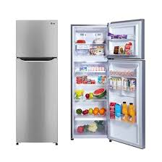
Introduction :
A refrigerator is one of the most important pieces of equipment in the kitchen for keeping foods safe.
From this project,we are intrested to provide good insights to choose better refrigerator to smothen life.
It is an essential appliance found in almost every kitchen and is used for both residential and commercial purposes.

Slide 5
Which refrigerator should I BUY?

Slide 6







Tools (Libraries) Used :
Requests
Beautiful Soup
Pandas
Numpy
Matplotlib
Seaborn
Plotly.express

Slide 7
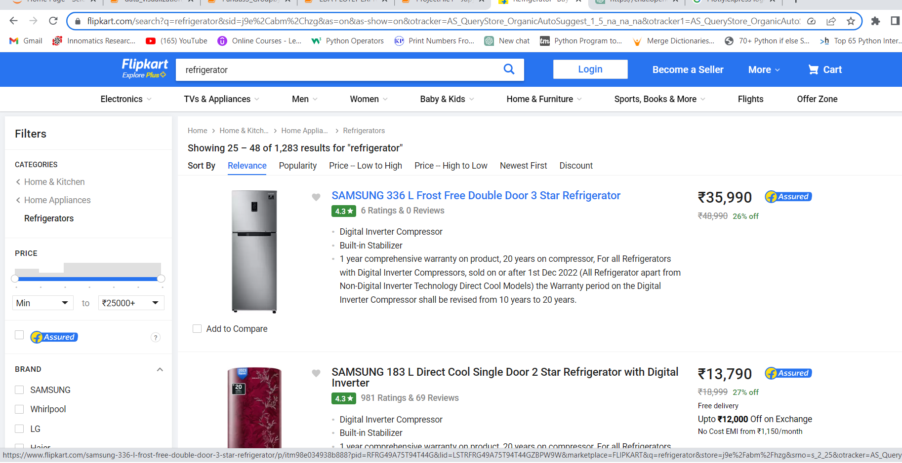
Website URL’s for Web-Scrapping :
https://www.flipkart.com/search?q=refrigerator&sid=j9e%2Cabm%2Chzg&as=on&as-show=on&otracker=AS_QueryStore_OrganicAutoSuggest_1_5_na_na_na&otracker1=AS_QueryStore_OrganicAutoSuggest_1_5_na_na_na&as-pos=1&as-type=HISTORY&suggestionId=refrigerator%7CRefrigerators&requestId=f864db2d-c7c7-41b8-bbb5-70887bac7f27&page=2

Slide 8
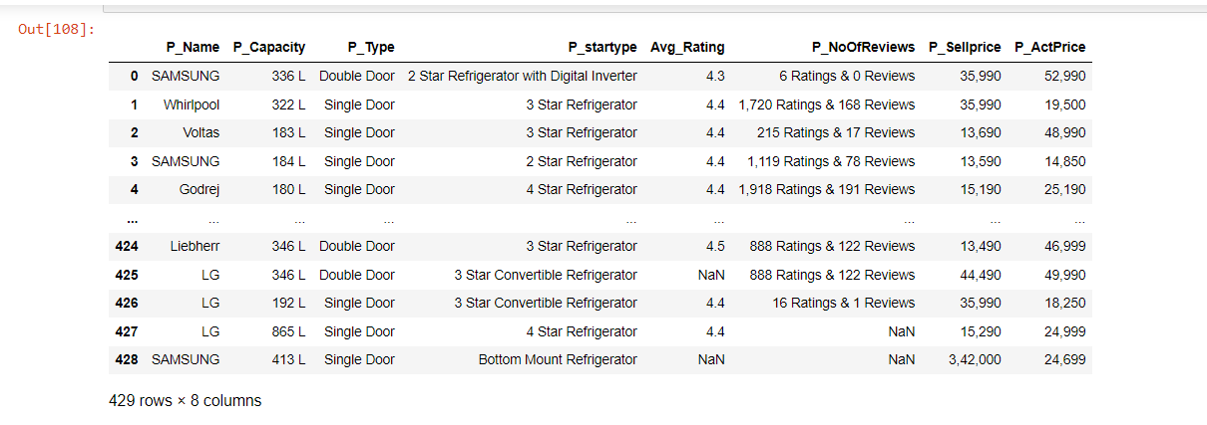
Raw data from website :
Insights : We got 429 rows and 8 columns in the Raw data.

Slide 9


Data Cleaning Steps :
We have Segrigated values as required.
Replaced NULL values using different techniques like Measures of central tendency,
indexing,fillna methods.
Droped duplicate rows.
Updated datatypes of a columns into as required.

Slide 10
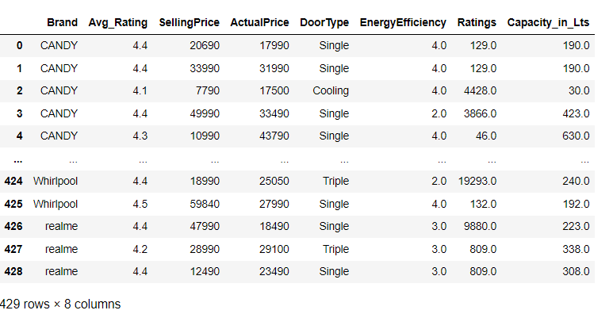
Cleaned Dataframe :

Slide 11

Data Visualization :
Representing data into pictorial format.
We have come across Uni-variate,Bi-variate and Multi Variate while analysing and Visualizating the data.

Slide 12
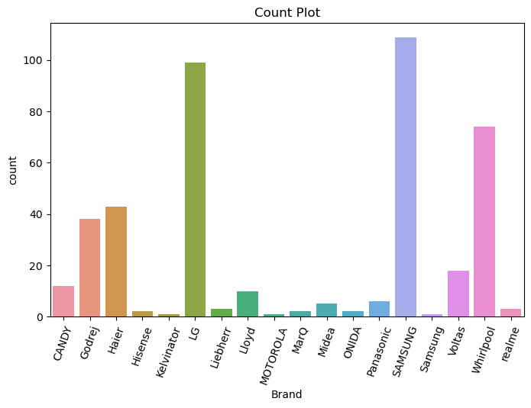
Different type’s of refrigerator products by the company’s?
Samsung is the leading company having huge
variety of products

Slide 13
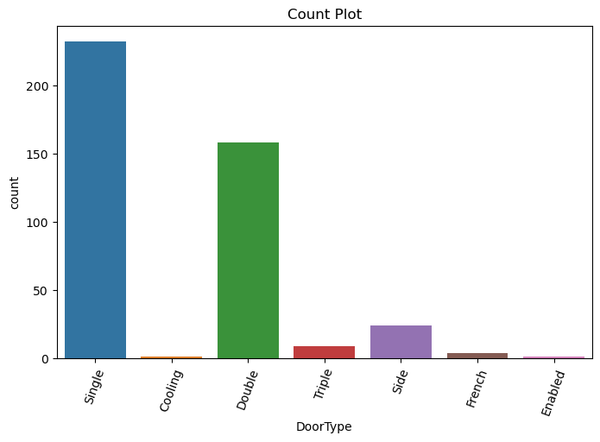
Majority of the user’s looking for which type of door type in refrigerator?
Single door is most wanted.

Slide 14
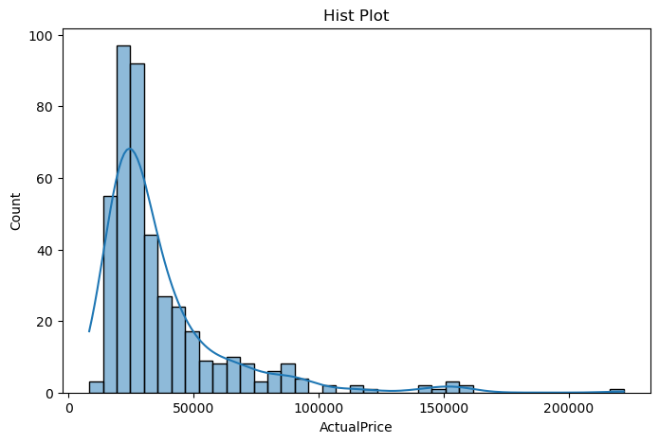
What is the price range of refrigerator?
Most of the products are in range between Rs 20K to 30K

Slide 15
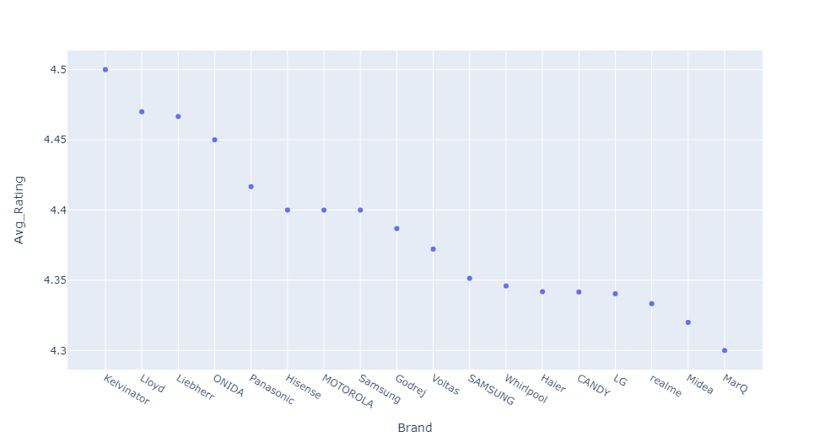
Quality refrigerator?
Kelvinator is most trusted product in the market by users

Slide 16
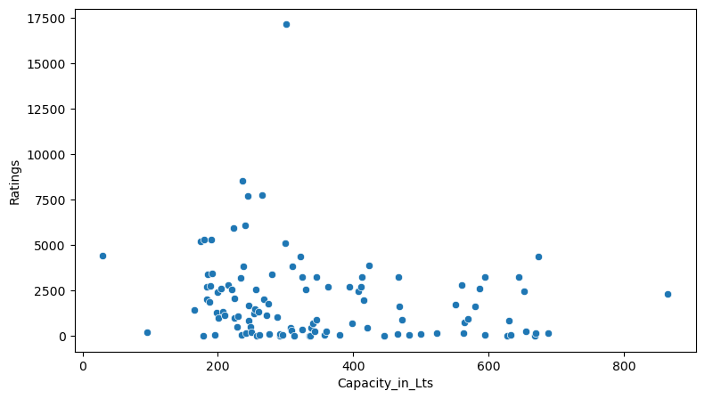
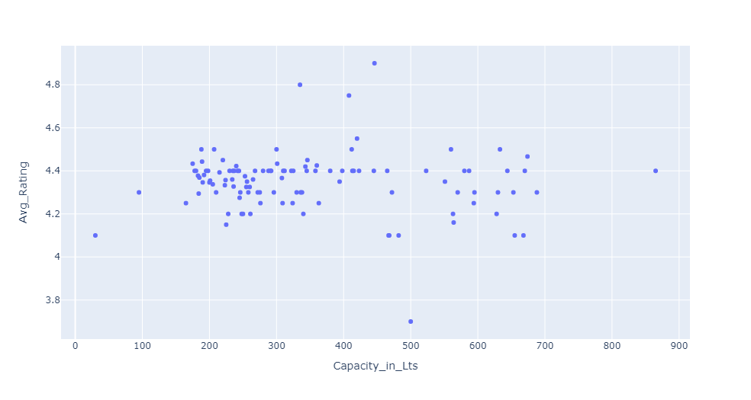
Suggest us capacity of a refrigerator is more durable?
Capacity between 200 to 400 are suggestible

Slide 17
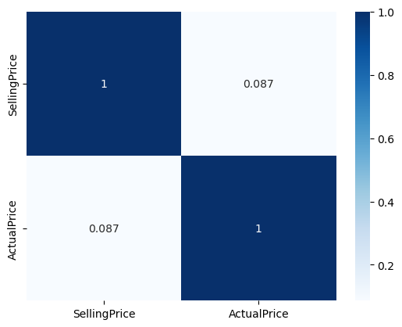
Relation between actual and selling price?
Less Positive Co-Relation

Slide 18
Challenges faced :
Data extracting from container.
Formatting extracting data using RegeX method.
Plotting charts, which one to use for a particular data analysis point.

Slide 19
Conclusion :
Most selling products are in 20K to 30K
Most trusted company is Kelvinator
Single door refrigerator are more preferred by users

Slide 20


Slide 21

THANK YOU

