Slide 1

Analysis of Employee Attrition
Insights from the Employee Dataset
KISHOR KUMAR VUNNA
9059002602
Kishor.vunna@rediffmail.com

Slide 2
Introduction
Objective:
To analyze factors affecting employee attrition and provide actionable insights.
Dataset Overview:
Brief description of the dataset (e.g., number of records, features)

Slide 3
Data Set
The dataset provided contains 1,470 records with 35 features related to employee attrition. The key features include: Age: Employee age in years
Attrition: Whether the employee has attrited (Yes/No)
Business Travel: Travel frequency for business (Travel Rarely , Travel Frequently , Non-Travel)
Department: Department the employee works in
Distance From Home: Distance from home to office in miles
Education: Education level (1 = 'Below College', 2 = 'College', 3 = 'Bachelor', 4 = 'Master', 5 = 'Doctor')
Education Field: Field of education
Gender: Gender of the employee

Slide 4
Data Set
Job Involvement: Job involvement rating (1 = 'Low', 2 = 'Medium', 3 = 'High', 4 = 'Very High')
Job Level: Job level (1 = 'Entry Level', 2 = 'Mid Level', 3 = 'Senior Level', 4 = 'Director', 5 = 'Manager')
Job Role: Job role of the employee
Job Satisfaction: Job satisfaction rating (1 = 'Very Dissatisfied', 2 = 'Dissatisfied', 3 = 'Neutral', 4 = 'Satisfied', 5 = 'Very Satisfied')
Marital Status: Marital status of the employee
Monthly Income: Monthly income of the employee
Num Companies Worked: Number of companies the employee has worked for
Over Time: Whether the employee works overtime (Yes/No)
Performance Rating: Performance rating of the employee (1 = 'Low', 2 = 'Good', 3 = 'Excellent', 4 = 'Outstanding')

Slide 5
Data Set
Relationship Satisfaction: Relationship satisfaction rating (1 = 'Very Dissatisfied', 2 = 'Dissatisfied', 3 = 'Neutral', 4 = 'Satisfied', 5 = 'Very Satisfied')
Stock Option Level: The number of stock options held by the employee
Total Working Years: Total number of years worked
Training Times Last Year: Number of training times last year
Work Life Balance: Work-life balance rating (1 = 'Bad', 2 = 'Good', 3 = 'Better', 4 = 'Best')
Years At Company: Number of years at the company
Years In Current Role: Number of years in the current role
Years Since Last Promotion: Number of years since the last promotion
Years With Curr Manager: Number of years with the current manager
Based on the provided dataset and the objective of analyzing factors affecting employee attrition, here are some key insights and actionable recommendations:

Slide 6
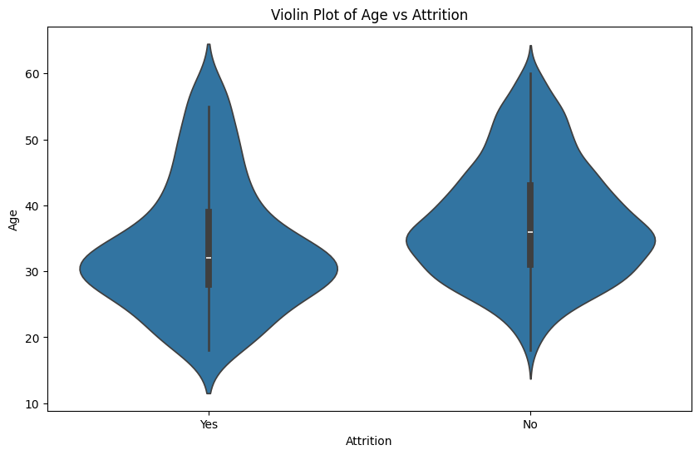
Age and Attrition
Attrition is highest among younger employees aged 18-35 years.
Recommendation: Implement targeted retention strategies for younger employees, such as mentorship programs and career development opportunities

Slide 7
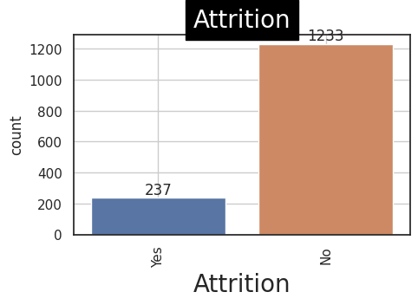
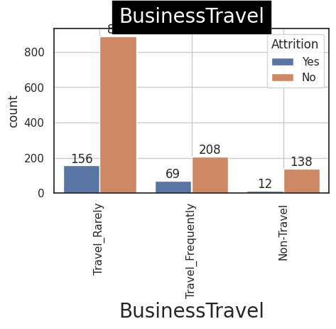
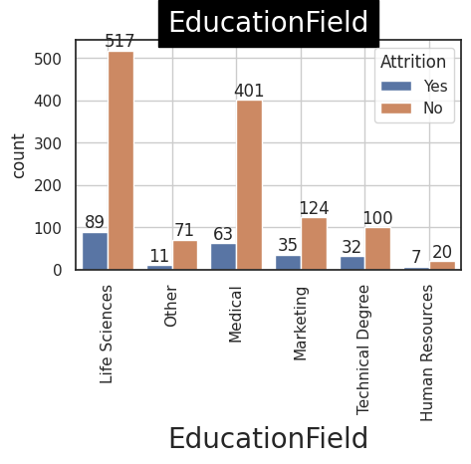
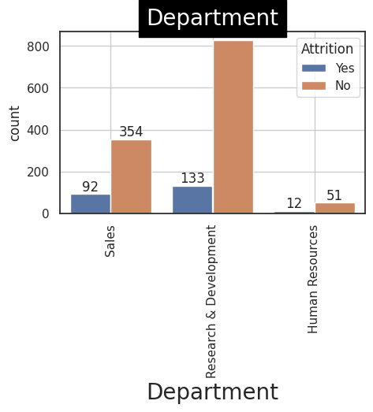

Slide 8
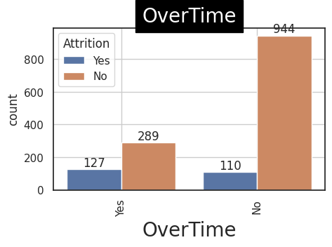
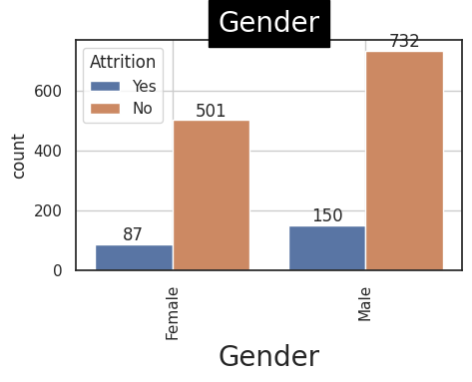
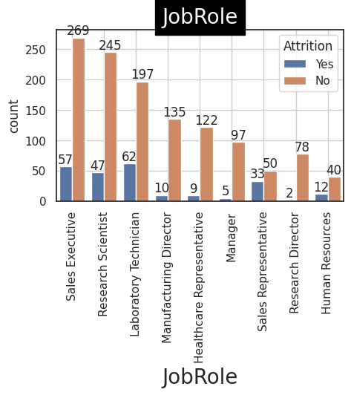
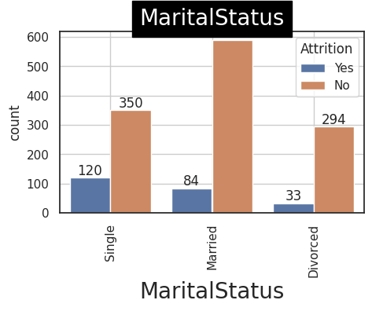

Slide 9
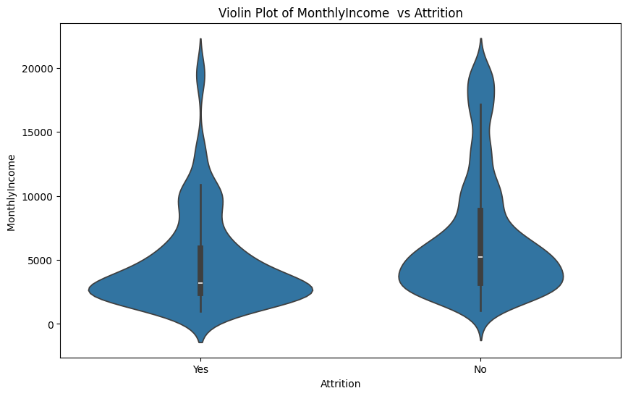
Income and Attrition
As monthly income increases, attrition decreases.
Recommendation: Regularly review and adjust compensation for employees, especially those in high-risk age groups, to ensure competitive salaries and reduce attrition.

Slide 10
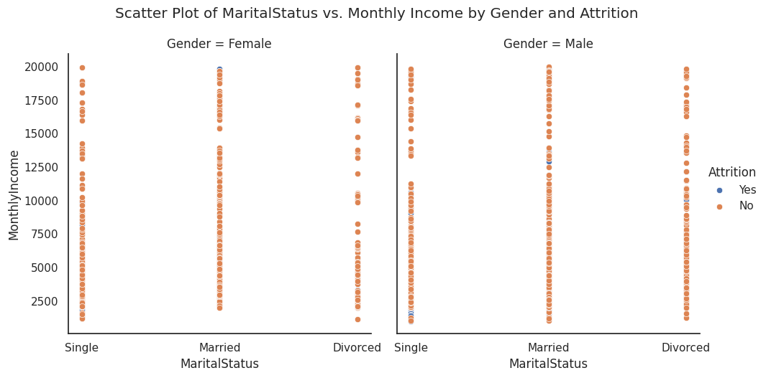
Marital Status and Attrition
Attrition is lower for divorced employees, especially women
Recommendation:
Understand the unique needs and challenges faced by different marital status groups and provide appropriate support and benefits.

Slide 11
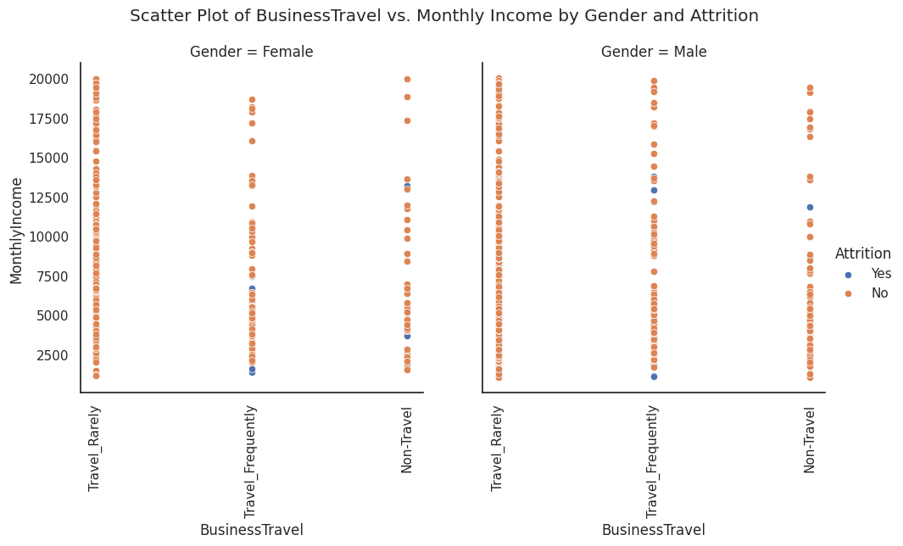
Business Travel and Attrition
Attrition is higher for employees who frequently travel for business, especially women.
Recommendation: Implement policies to manage work-life balance for employees who travel frequently, such as flexible schedules or remote work options.

Slide 12
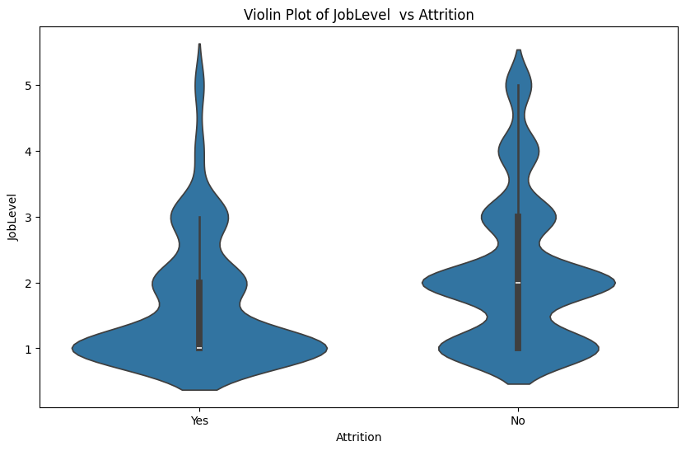
Job Level and Attrition
Attrition is highest for employees in entry-level or junior positions (job level 1).
Recommendation: Provide clear career paths and growth opportunities for employees in lower-level roles to increase job satisfaction and reduce attrition.

Slide 13
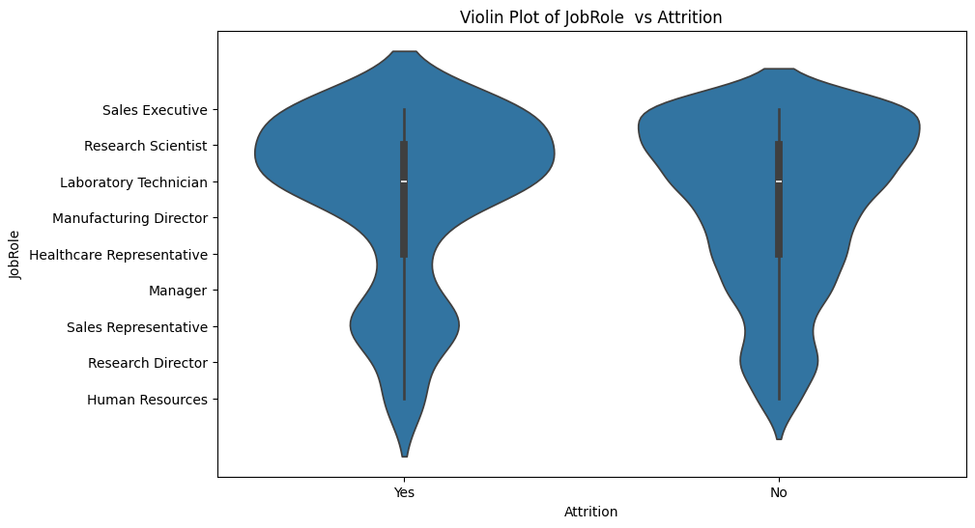
Job Role and Gender
Women in managerial, research director, and laboratory technician roles have lower attrition rates.
Men in sales expert positions have higher attrition rates.
Recommendation: Analyze job roles that are more attractive or suitable for employees of different genders and tailor retention strategies accordingly.
By focusing on these key factors and implementing targeted retention strategies, organizations can reduce employee attrition and maintain a stable and engaged workforce

Slide 14
Data Overview
Key Features: List important features such as: Employee demographics (age, gender, marital status)
Job-related attributes (job level, job role, monthly income)
Work conditions (travel frequency, years in current role)

Slide 15
Data Preprocessing
Steps Taken : Handling missing values
Encoding categorical variables (e.g., Label Encoding)
Feature scaling (e.g., Min-Max Scaling or Standardization)

Slide 16
Exploratory Data Analysis (EDA)
Visuals: Include graphs such as:Bar charts showing attrition rates by gender and job role.
Box plots comparing monthly income across different job levels
Violin plots provide more information than box plots by showing the entire distribution of the data, including its shape and density. This is particularly beneficial when analyzing datasets that may have multiple modes or when the distribution is not uniform

Slide 17
Key Insights
Attrition is highest among younger employees (18-35 years).
Higher monthly income correlates with lower attrition

Slide 18
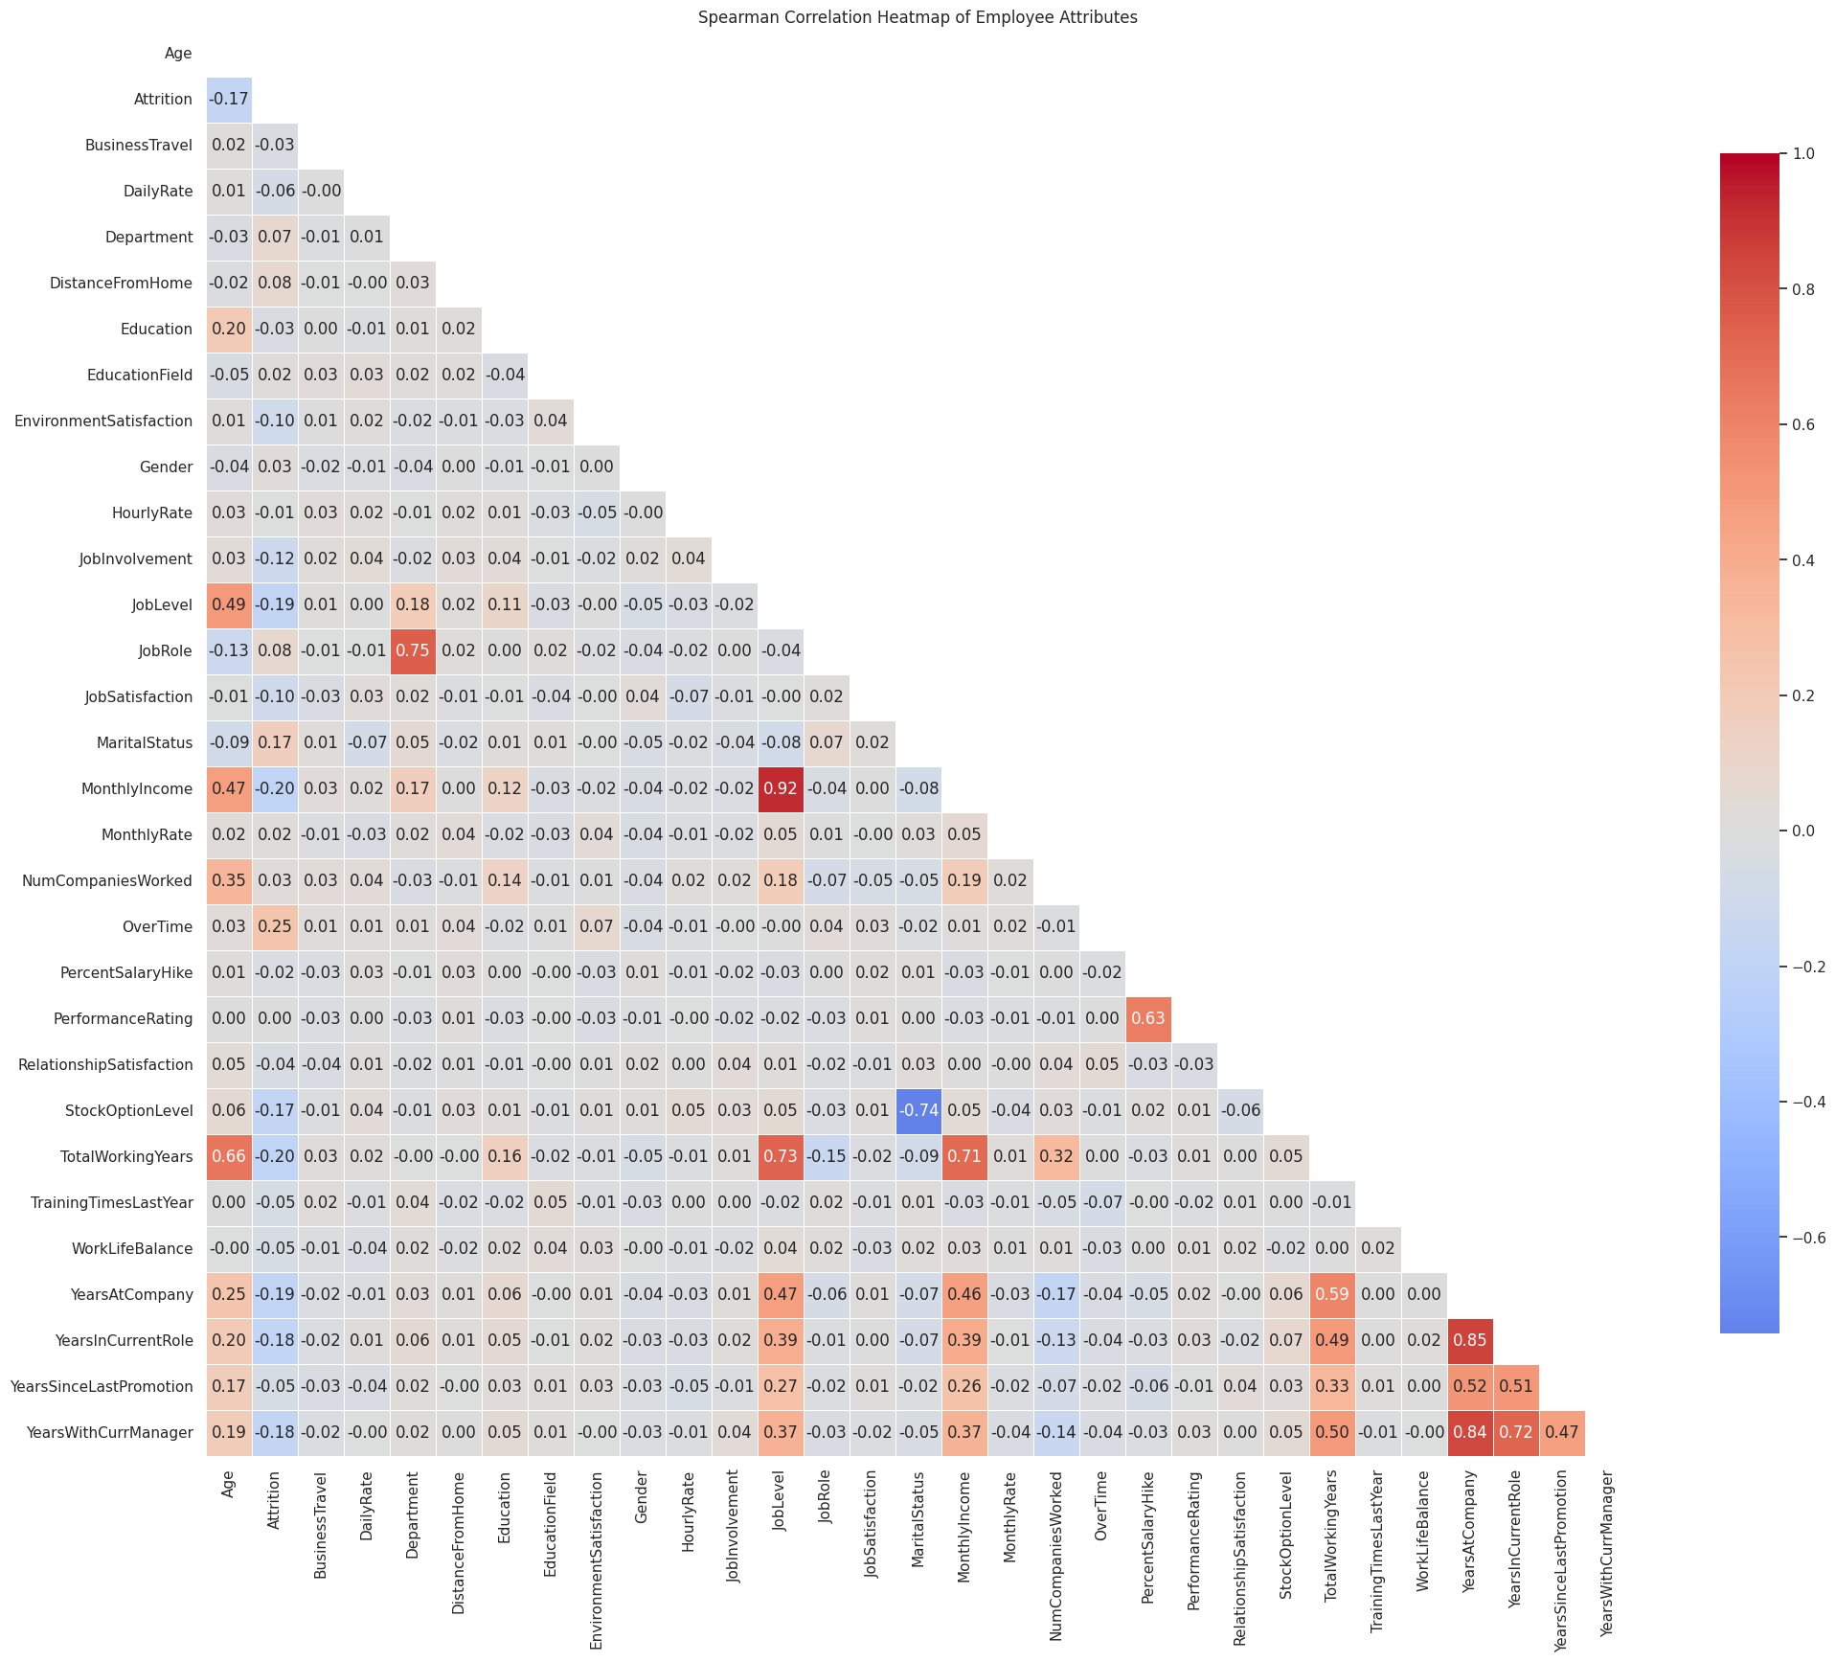
Correlation Analysis
Heatmap: Display a heatmap of feature correlations.
Key Findings:
High correlation between Monthly Income and Job Level.
Relationships among tenure-related features (e.g., years in current role).

Slide 19
High Correlation Analysis
Monthly Income & Job Level:
There is a significant positive correlation between Monthly Income and Job Level. This indicates that as employees advance to higher job levels, their monthly income tends to increase. Higher job levels often come with greater responsibilities and, consequently, higher compensation.
Years in Current Role, Years at Company, Years with Current Manager & Years in Current Role:
These features are likely to be highly correlated with each other. For example, Years In Current Role, Years At Company, and Years With Curr Manager are all measures of tenure and experience within the organization. Employees who have been in their current role for a long time are likely to have also been with the company for a longer duration and may have had the same manager for a significant period. This correlation can indicate employee stability and experience

Slide 20
Model Selection
Gradient Boosting Classifier
Reason for Choice: Effective for classification tasks, handles non-linear relationships well.

Slide 21
Hyperparameter Tuning
Method: Grid Search for hyperparameter optimization.
Parameters Tuned: Learning rate
Number of estimators
Maximum depth
Minimum samples split and leaf

Slide 22
Model Evaluation
Metrics Used: Accuracy, Precision, Recall, F1-Score
Confusion Matrix: Include a confusion matrix to visualize model performance.
Key Results: Highlight the accuracy achieved after tuning
[[241 4]
[ 36 13]]
precision recall f1-score support
0.0 0.87 0.98 0.92 245
1.0 0.76 0.27 0.39 49
accuracy 0.86 294
macro avg 0.82 0.62 0.66 294
weighted avg 0.85 0.86 0.84 294

Slide 23
Insights and Recommendations
Importance of job level and income.
Recommendations: Strategies for employee retention (e.g., salary adjustments, career development programs)

Slide 24
Conclusion
Summary:
Demographic Insights: The dataset contains diverse demographic information, including age, gender, marital status, and job roles, which can influence employee experiences and career progression.
Working Years and Job Tenure: Variables such as Total Working Years, Years At Company, and Years In Current Role were analyzed to understand their relationship with employee retention and satisfaction. It was found that longer tenure often correlates with higher job satisfaction but may also lead to stagnation in career growth for some employees.
Promotion and Career Development: The variables Years Since Last Promotion and Years With Curr Manager were examined to assess how promotion frequency affects employee morale and turnover rates. Employees with longer durations without promotions tended to express lower satisfaction levels.
Outlier Management: Outliers in the dataset were identified and managed using the percentile method. This ensured that extreme values did not skew the analysis, leading to more accurate insights.
Predictive Modeling: Initial predictive modeling efforts indicated that certain demographic and tenure-related variables significantly predict employee turnover, suggesting areas for targeted interventions

Slide 25
Conclusion
Future Work:
Deeper Analysis of Job Roles: Further research could delve into the specific job roles and their unique challenges. Understanding how different positions affect employee satisfaction and turnover could inform tailored retention strategies.
Longitudinal Studies: Conducting longitudinal studies to track changes in employee satisfaction and turnover over time would provide insights into trends and the long-term effectiveness of interventions
Impact of External Factors: Investigating external factors (e.g., economic conditions, industry trends) that may influence employee behavior and satisfaction could enhance the understanding of turnover dynamics.
Employee Engagement Surveys: Implementing regular employee engagement surveys could provide qualitative insights that complement quantitative data, helping to identify underlying issues affecting morale and retention
Diversity and Inclusion Analysis: Further exploration of how diversity and inclusion initiatives impact employee satisfaction and retention across different demographics would be beneficial.
By addressing these areas, organizations can enhance their understanding of employee dynamics, leading to improved retention strategies and overall workplace satisfaction.

