Slide 1
IBM University Engagement Project Submission
“Exploring the Power of Agentic AI with IBM Granite and LangFlow”
Smart Heritage Conservation Platform for Ahmedabad’s Walled City & Modhera

Slide 2
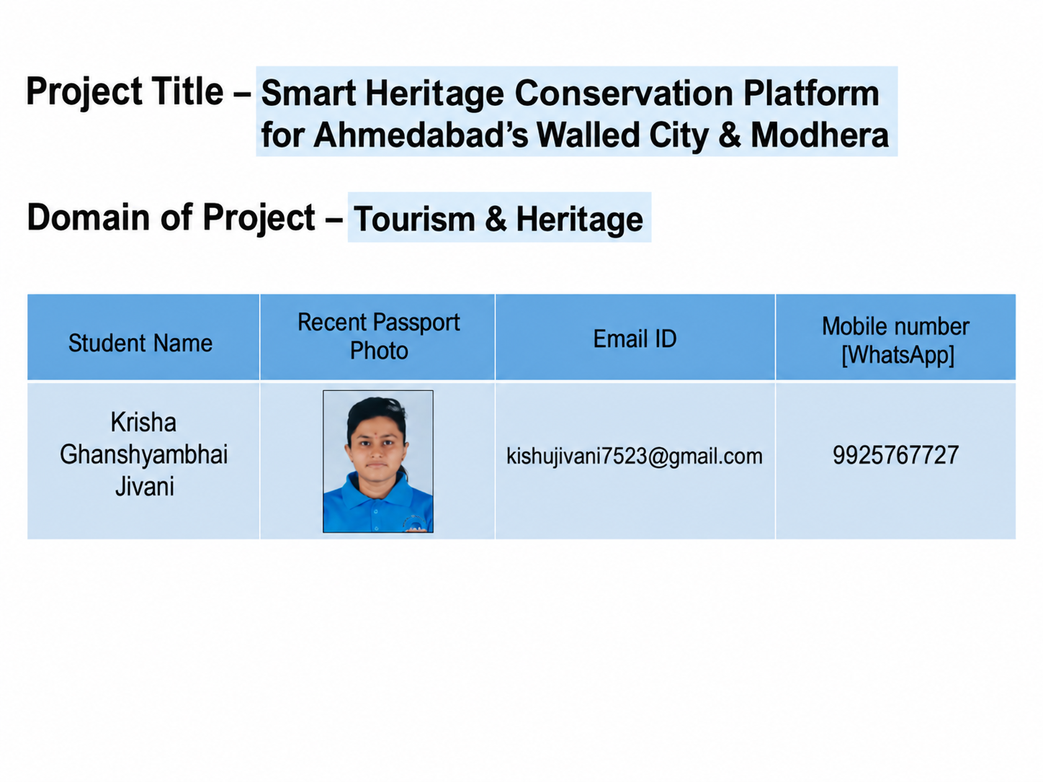
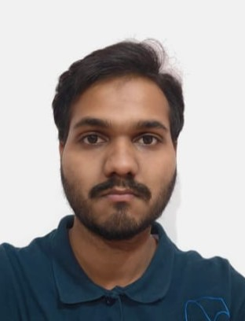
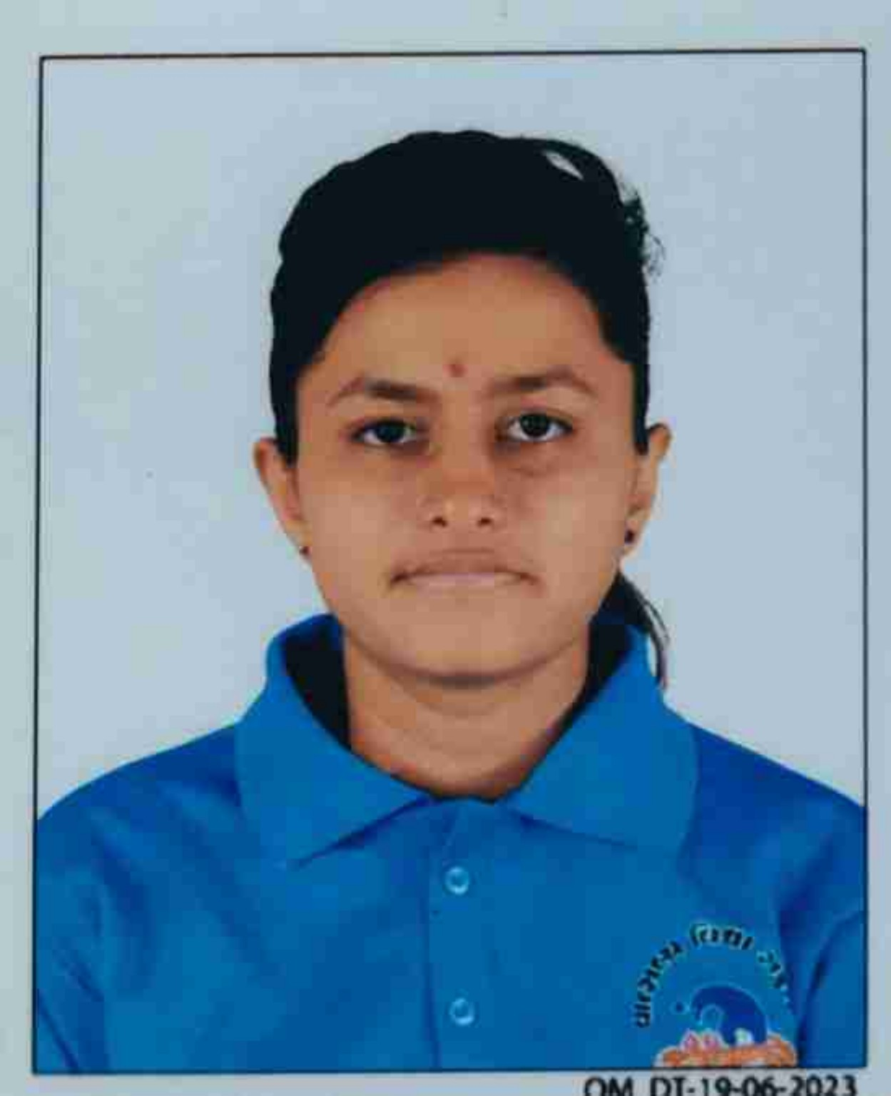

Slide 3
Problem Statement -
The Challenge
Gujarat’s UNESCO heritage sites, including Ahmedabad’s Walled City and Modhera Sun Temple, face conservation risks from urban encroachment, weathering, and unmanaged tourist footfall, alongside underutilized digital storytelling for visitors.
The Objective
Build Agentic AI solutions that monitor heritage site structural health, manage visitor flow, and deliver immersive, personalized cultural storytelling experiences.
Suggested AI Agents
• Structural Health Monitoring Agent
• Visitor Flow Management Agent
• Personalized Heritage Storytelling Agent
• Encroachment Detection Agent
• Conservation Reporting Dashboard Agent

Slide 4
Proposed Solution -
The proposed solution is HeritageAI, a smart conservation platform that brings together five specialized Agentic AI modules for Ahmedabad’s Walled City and Modhera Sun Temple.
The platform combines structural monitoring, visitor-flow analysis, heritage storytelling, encroachment detection, and automated conservation reporting. Data such as IoT sensor readings, visitor counters, satellite/drone imagery, and historical information is processed by specialized AI agents to support timely conservation decisions.
The overall pipeline is: Data Collection → AI Agents → Analysis → Decision → Conservation Action.

Slide 5
Technology Used
IBM watsonx.ai / IBM Granite – Used for natural-language understanding, reasoning, personalized storytelling, and AI-driven conservation insights.
IBM Cloud – Provides the cloud environment for building, deploying, and scaling the HeritageAI solution.
LangFlow – Used for visually designing and orchestrating Agentic AI workflows.
AI Data Sources – IoT sensors, visitor counters, satellite imagery, drone feeds, and historical/heritage data support the different conservation agents.
Agentic AI – Coordinates specialized agents so the system can monitor, analyze, prioritize, and produce conservation-oriented outputs.

Slide 6
LangFlow Components Used – HeritageAI
1) Chat Input – Interface where users enter their queries, preferences, or meal details (text/voice/image).
2) IBM watsonx AI Agent - Processes user input using Granite models to generate personalized nutrition insights and recommendations.
3) Name of IBM Granite model - Granite-4.0-8B-Instruct → Fast, efficient for real-time diet recommendations
4) Chat output -Displays AI-generated responses such as diet plans, nutritional analysis, and health suggestions.
5) File component - Stores and retrieves user data, meal logs, and nutritional datasets for analysis and tracking.
6) Add name of any other component used.
1) Input / Data Collection – Receives visitor information, sensor data, imagery, and heritage queries.
2) IBM watsonx.ai Agent – Processes inputs and coordinates AI reasoning for conservation tasks.
3) IBM Granite LLM – Supports natural-language understanding, reasoning, and personalized heritage storytelling.
4) Specialized Agent Modules – Structural Health Monitor, Visitor Flow Manager, Heritage Storyteller, Encroachment Detector, and Conservation Reporter.
5) Output / Reporting – Produces alerts, visitor-flow insights, personalized stories, and prioritized conservation reports.

Slide 7
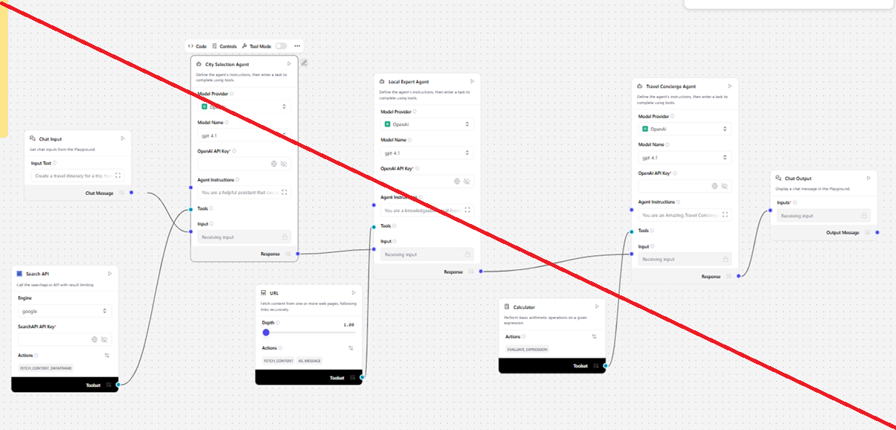
LangFlow Workflow – HeritageAI
DATA COLLECTION
IoT sensors
Visitor counters
Satellite / drone feeds
Historical data
AI ORCHESTRATION
IBM watsonx.ai
IBM Granite LLM
LangFlow
5 SPECIALIZED AGENTS
Structural Health
Visitor Flow
Storytelling
Encroachment
Reporting
ANALYSIS & DECISION
Risk analysis
Flow management
Personalized stories
Priority assessment
CONSERVATION ACTION
Alerts
Reports
Visitor guidance
Conservation decisions
Data → AI Agents → Analysis → Decision → Conservation Action

Slide 8
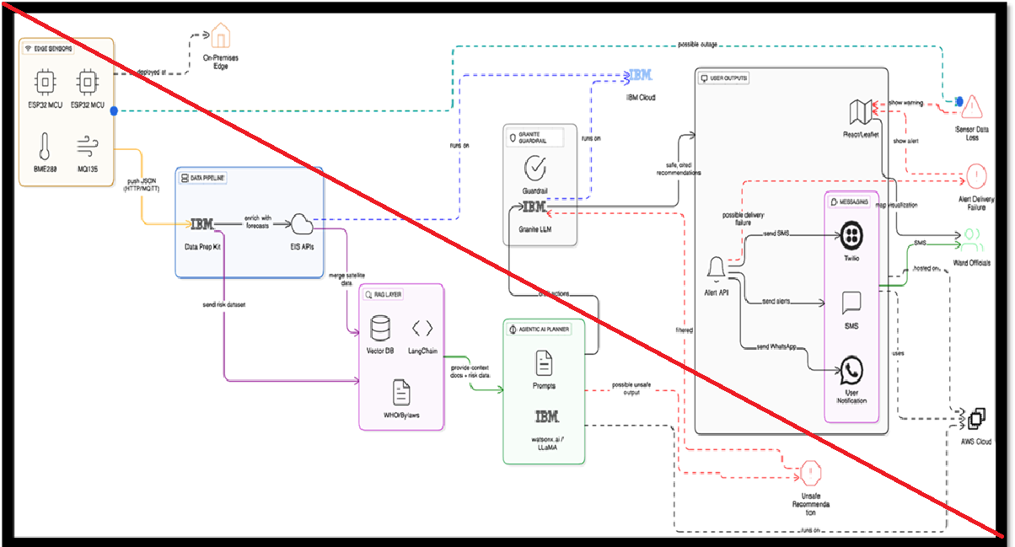
Architecture Blueprint – HeritageAI
DATA LAYER
IoT Sensors | Visitor Counters | Satellite / Drone Imagery | Heritage Data
AI / ORCHESTRATION LAYER
LangFlow + IBM watsonx.ai + IBM Granite LLM
AGENT LAYER
Structural Health | Visitor Flow | Storytelling | Encroachment | Conservation Reporting
OUTPUT / ACTION LAYER
Risk Alerts | Visitor Guidance | Personalized Stories | Conservation Reports

Slide 9

Role of Agentic AI in the Solution
Agentic AI enables HeritageAI to function as an intelligent, coordinated system rather than a simple chatbot. Each specialized agent performs a focused task while contributing to a common conservation workflow.
• Structural Health Monitoring Agent – monitors structural integrity using sensor and computer-vision inputs.
• Visitor Flow Management Agent – analyzes visitor density and helps route visitors to reduce structural impact.
• Personalized Heritage Storytelling Agent – generates narratives from historical data on demand.
• Encroachment Detection Agent – analyzes satellite/drone imagery for unauthorized structures in buffer zones.
• Conservation Reporting Agent – synthesizes multi-agent information into prioritized reports for stakeholders.

Slide 10


Token Usage
Token usage data not provided in the supplied project files.
·
·
·

Slide 11
Novelty and Uniqueness
The proposed HeritageAI platform combines Agentic AI with heritage conservation in a single coordinated solution.
Multi-Agent Intelligence – Five specialized agents collaborate across structural health, visitor flow, storytelling, encroachment, and reporting.
Preventive Conservation – Continuous monitoring and AI analysis can surface risks before they become larger conservation problems.
Smart Visitor Management – Visitor-flow analysis supports safer movement and reduced impact on heritage structures.
Personalized Cultural Storytelling – Historical information can be transformed into on-demand narratives for visitors.
Unified Conservation Reporting – Multi-agent findings are synthesized into prioritized reports for conservation stakeholders.

Slide 12
GitHub Link
GitHub repository link was not provided in the supplied project data.
When available, add the public repository URL here. The submission template requests the working GitHub URL and project files such as app.json, problem statement PDF, presentation PPTX, and other project files.
·
·
·

Slide 13
Future Scope
1. Expand monitoring coverage – Extend the platform to additional heritage monuments and protected zones across Gujarat.
2. Real-time sensor integration – Connect more structural and environmental sensors for continuous health monitoring.
3. Advanced visitor management – Improve live crowd-density analysis and intelligent visitor routing.
4. Multilingual cultural storytelling – Expand personalized heritage narratives for more languages and visitor groups.
5. Predictive conservation – Use accumulated monitoring data to identify emerging risks and support proactive conservation planning.
6. Wider stakeholder integration – Connect conservation reports and alerts with heritage authorities and site-management teams.
·
·
·

Slide 14
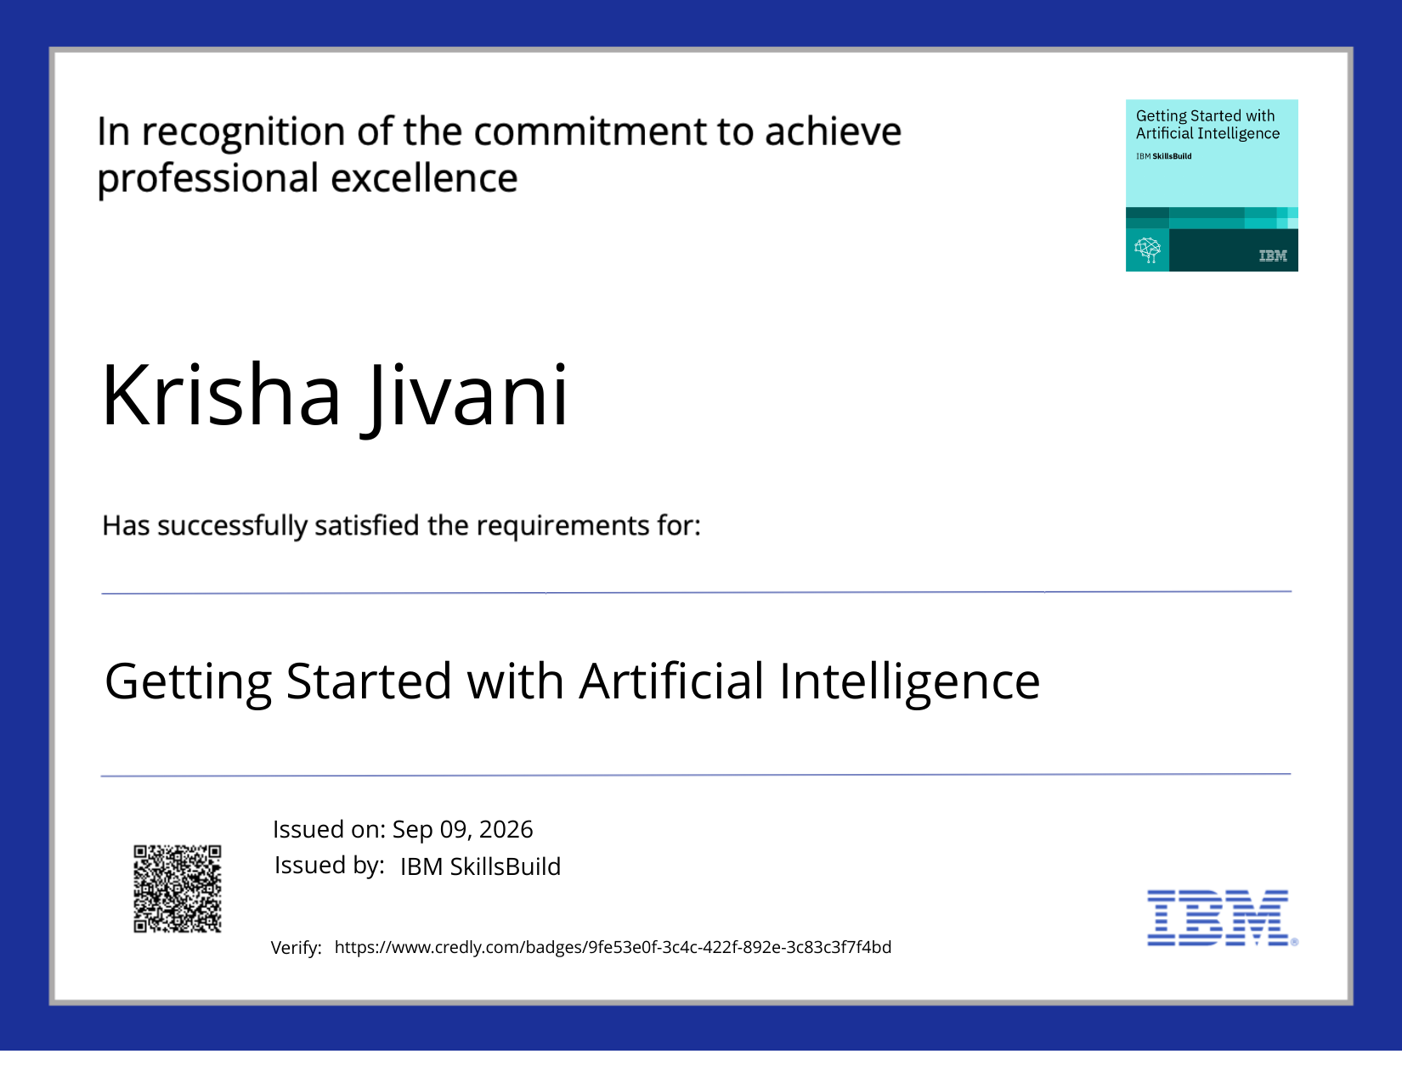
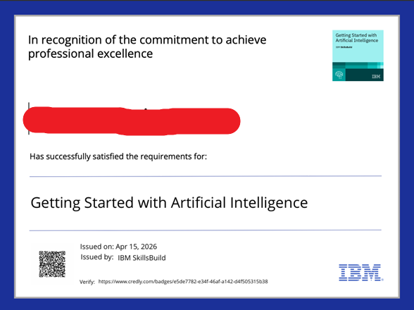
Certificates Earned:

Slide 15
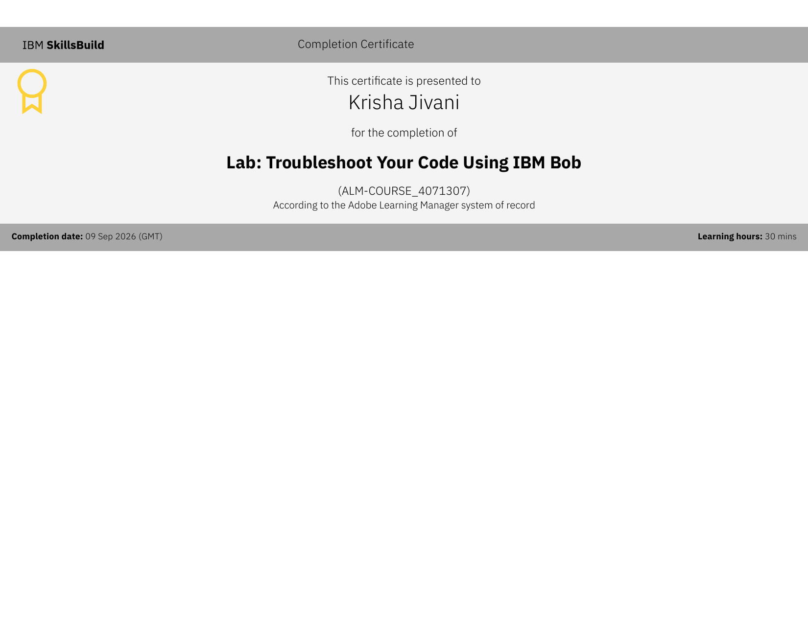

Certificates Earned:

Slide 16

Thank You
Smart Heritage Conservation Platform

