Slide 1
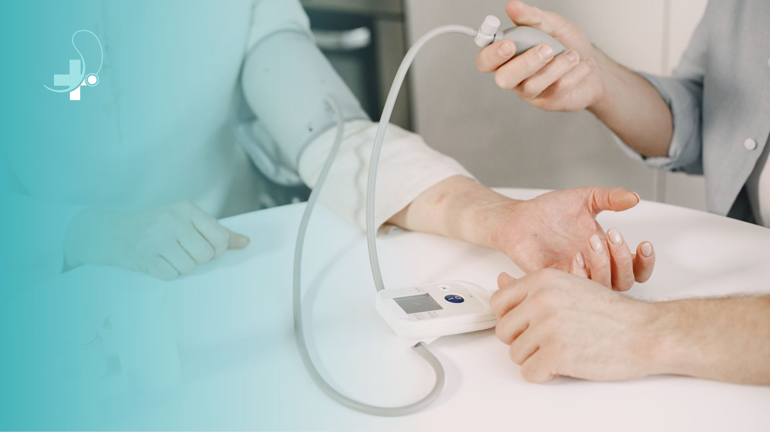
Group
3
REAL LIFE LAB (RLL) PROJECT
PROJECT:
Clinical Automation System
Presented By :
1. Ishwarya K (2587901)
2. Jammula Bhargavi (2587422)
3. Shoib Akhter (2587657)
4. Jayashree M (2587409)
5. Kamireddy veda sivani (2587501)
6. Kappa Sathwik Goud (2587523)
7. Katele Lalitha (2587633)
8. Kishu Kumar (2587532)

Slide 2
CONTENTS
Title
Contents
Modules
Objective
Introduction
Database Schema
Software Requirements
XYZ Medicals
Testing Reports
Conclusion
Thank You

Slide 3
Modules
Name | Domain | Modules
1. Ishwarya K | FSD Doctor | Doctor
2. Jammula Bhargavi | FSD Pharmacy | Medicine & Not found
3. Shoib Akhter | FSD Login | Login & Logout
4. Jayashree M | FSD Patient | Book Appointment
5. Kamireddy veda sivani | FSD Appointment | History
6. Kappa Sathwik Goud | FSD Register | Register & Home
7. Katele Lalitha | FSD Pharmacy | Pharmacist , Footer & Navbar
8. Kishu Kumar | FSD Reset | Reset Password & Side Bar

Slide 4

Objective
Development of a dynamic and responsive web application using Java full stack technologies User-Friendly
Patient appointment book and management
Role based access and functionalities: like Doctor, front office executive ,pharmacist.

Slide 5

Introduction
This project aims to develop a user-friendly healthcare management system designed to streamline communication and improve efficiency within a medical setting. This system caters to various user roles.
Clinical Automation System has
Patient
front-office executive
Doctor
Pharmacist

Slide 6
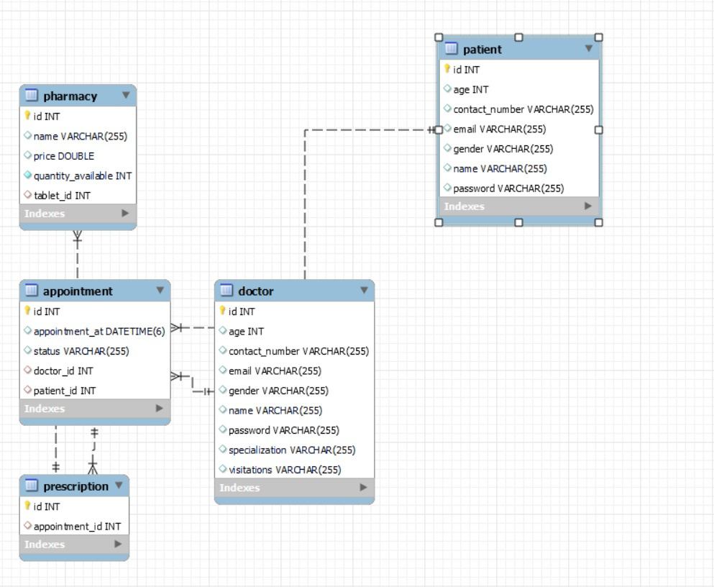
DATABASE SCHEMA

Slide 7





Software Requirements
Spring Tool
Visual Studio Code
MySQL Workbench
Testing: Postman, JUnit

Slide 8
Outcome
Efficient Medication Management
Enhanced Patient Experience
Streamlined Appointment Management
Intuitive User Interface

Slide 9

XYZ Medicals

Slide 10
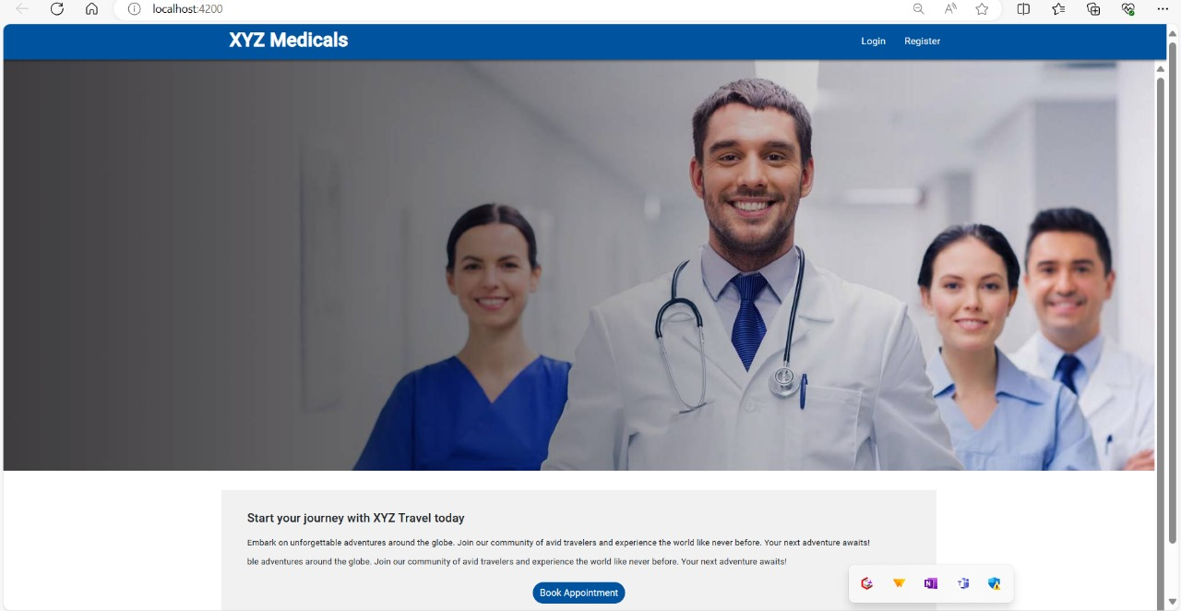
Home Page
Home page is the first interface you get to see when you get into the site.
Through the home page you can navigate to the login page and the register page.
A patient can also book the appointment by clicking on the book appointment option

Slide 11
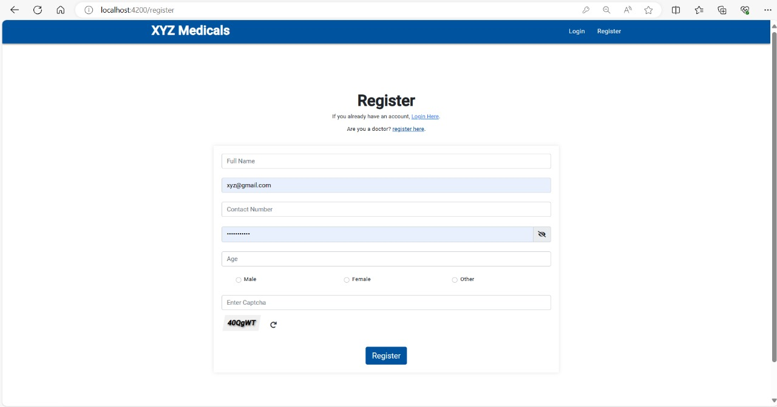
Register
This is the Register page where one can enter the credentials and other required criteria to get registered and can proceed for the login after registering.
Even a Doctor can register himself through this register page.
Captcha needs to be verified after entering the required criteria to register succesfully.

Slide 12
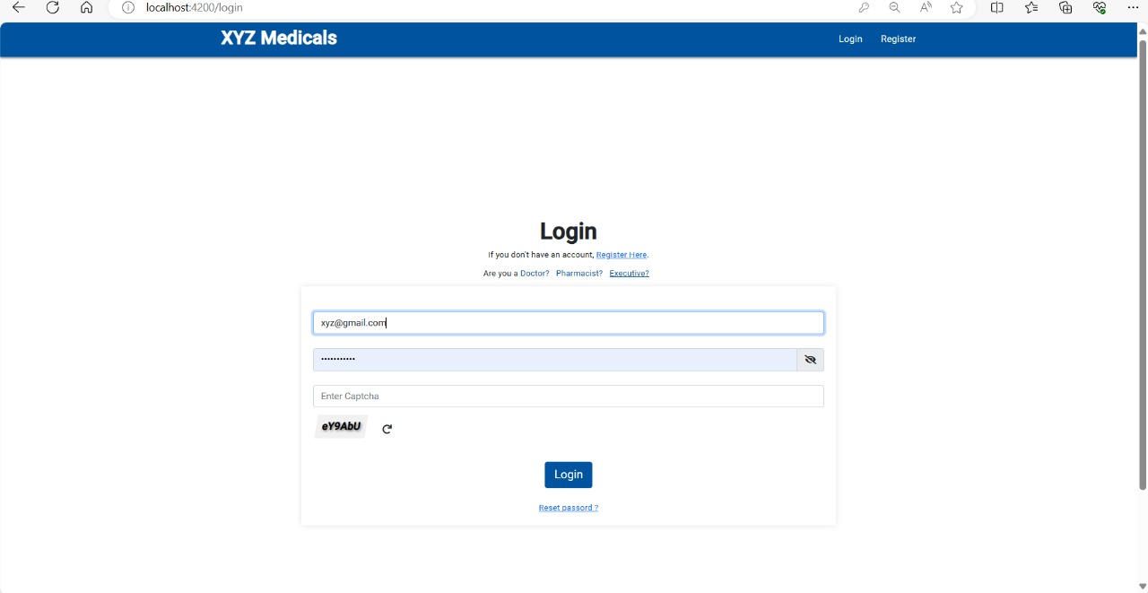
Login
This is the front desk Interface where Doctor, Executive and Pharmacist can login
If they do not have any
account, they can register
themselves first
There is an option also for reset password

Slide 13
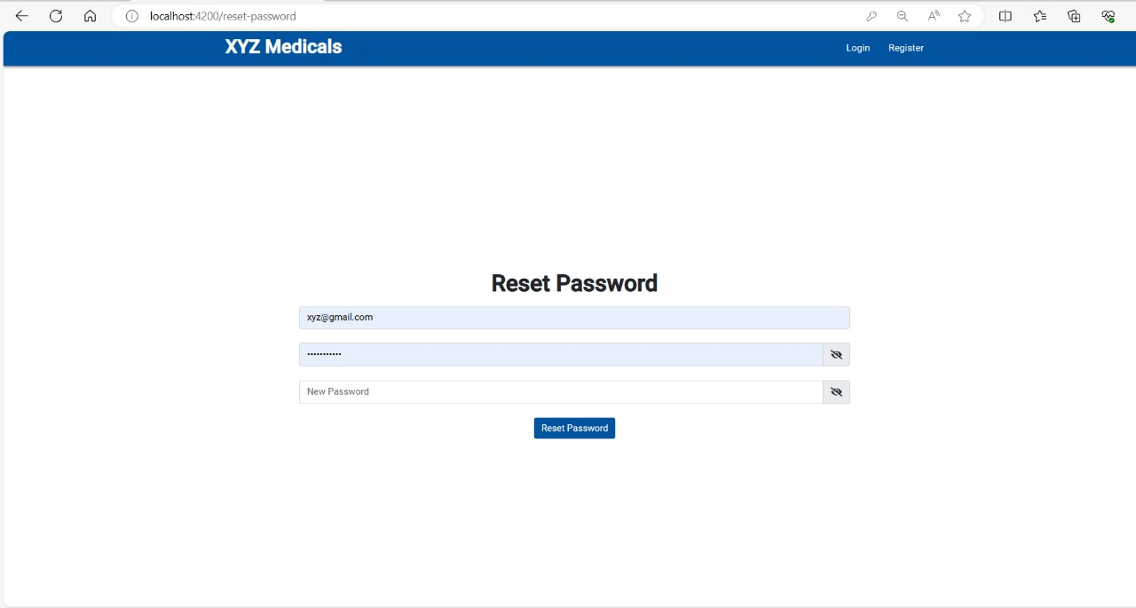
Reset Password
Allows user to reset their passwords if forgotten or compromised
This page provides a form for users to enter user email I'd and set a new password after clicking the reset link

Slide 14
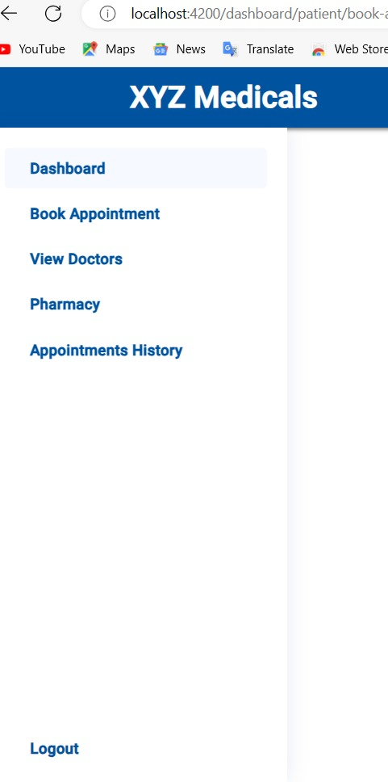
Side Bar
Provide navigation and quick access to key features throughout the application.
Simplify interaction by organizing related functionalities within a convenient sidebar menu

Slide 15

Doctor
Doctors can access the system using a secure login process.
View Appointments: Doctors can view a list of their upcoming appointments, including patient details, appointment time.
Appointment management : The ability to view appointment details and manage their schedule..

Slide 16
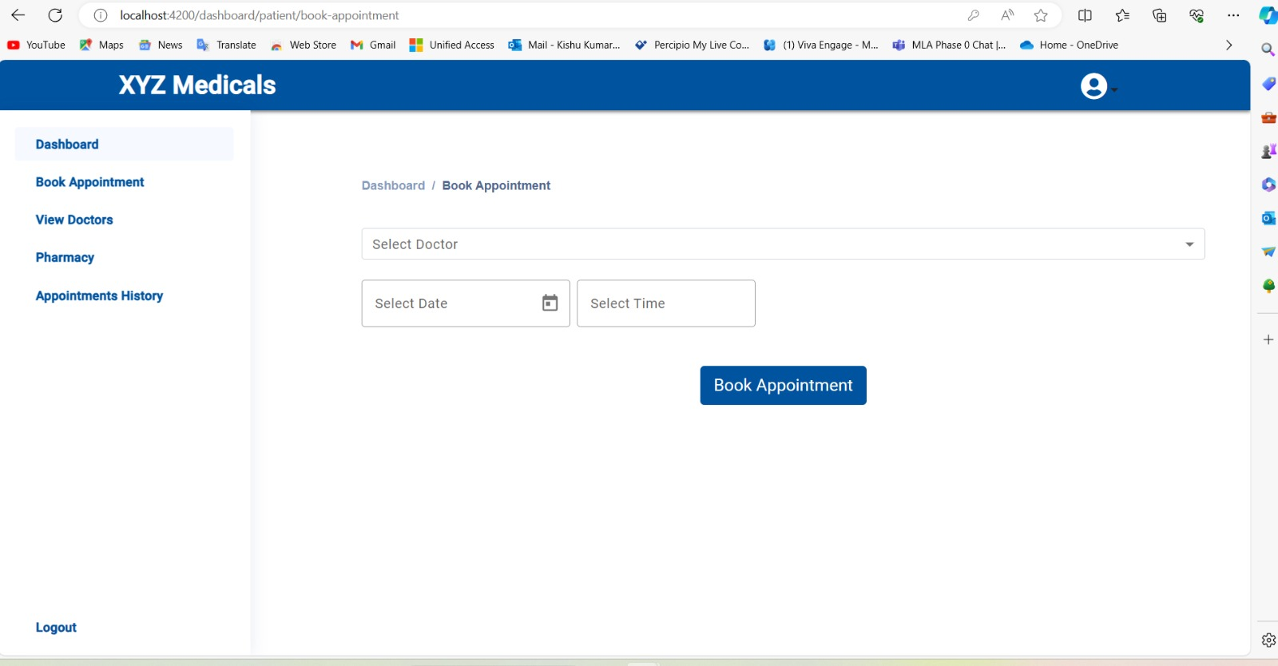
Book Appointment
Patients can view doctor availability (timings) and book appointments with specific doctors.
Front-Office Executives can also book appointments for patients on their be half.
The system should manage appointment slots to avoid conflicts.

Slide 17
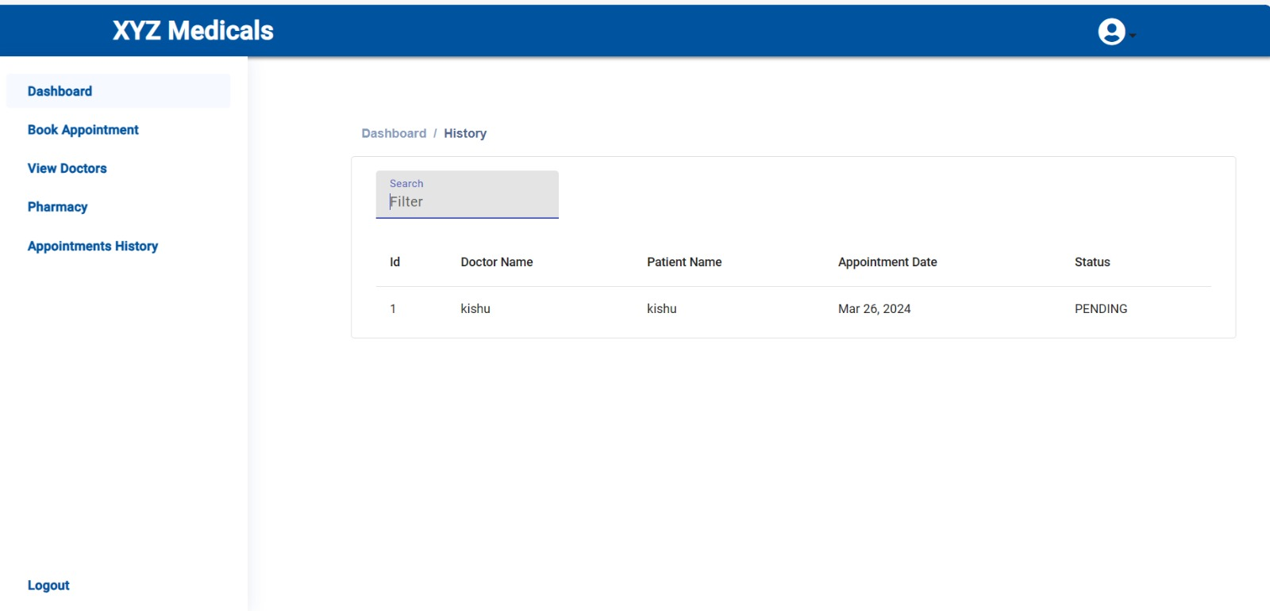
Appointment History
The Patient appointment history provides a list of a patient's past and upcoming appointments.
Allow patients to view details like doctor, date, time, and appointment status.
search the filter to check the appointments booked by patient and the status whether its accepted or pending

Slide 18

Pharmacist
The Pharmacy Module is a key component of the healthcare appointment booking system, allowing patients and doctors to manage medications.
Manage medicines (CRUD operations):
Create new medicines
Read existing medicine information.
Update medicine details (e.g., stock, price).
Delete medicine entries (if applicable).
Search medicines by name for quick access.
View medicine list to monitor inventory.
Apply a 10% discount on medicine prices for patients.

Slide 19
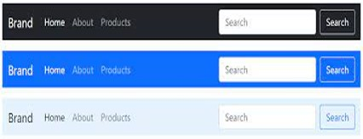
Navbar
A navigation bar, often referred to as a navbar, is a crucial component in web development used to provide navigation links to various sections or pages of a website.
It typically appears at the top of a webpage and may contain links, buttons, icons, or other interactive elements that allow users to navigate through the site easily.

Slide 20

Medicine
Pharmacists start the process of adding a new medicine by selecting the "Add Medicine" and fill out a form or provide necessary information about the new medicine.
This may include:
- Medicine name
- Price per unit
- Tax information

Slide 21

Testing Reports

Slide 22
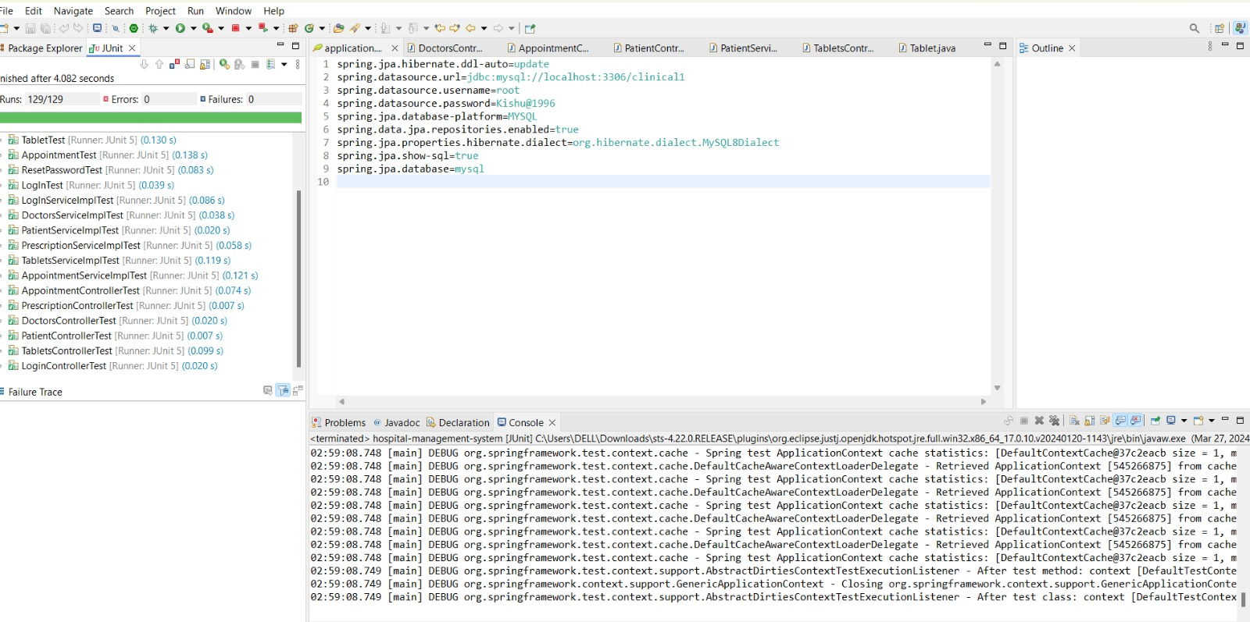
Unit Testing Report

Slide 23

Postman Testing Reports

Slide 24
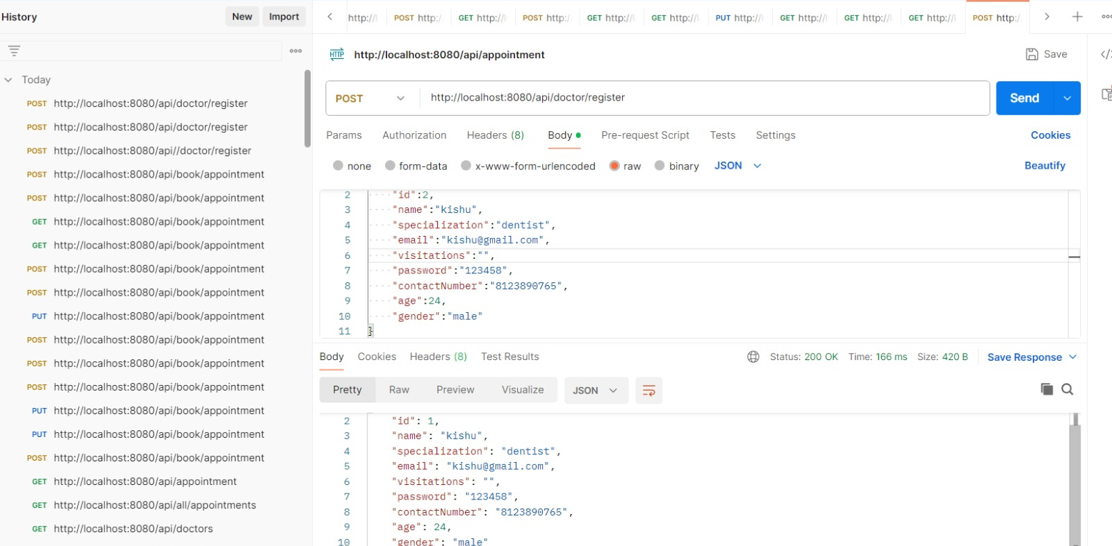
Doctor Register

Slide 25
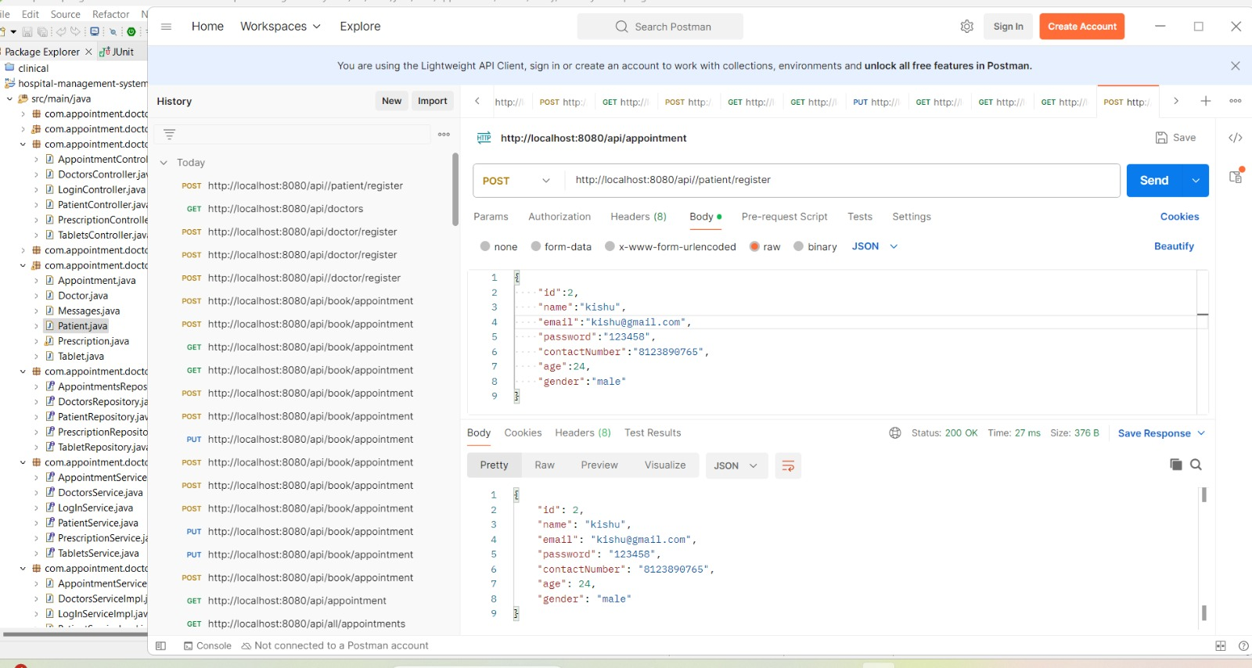
Patient Register

Slide 26
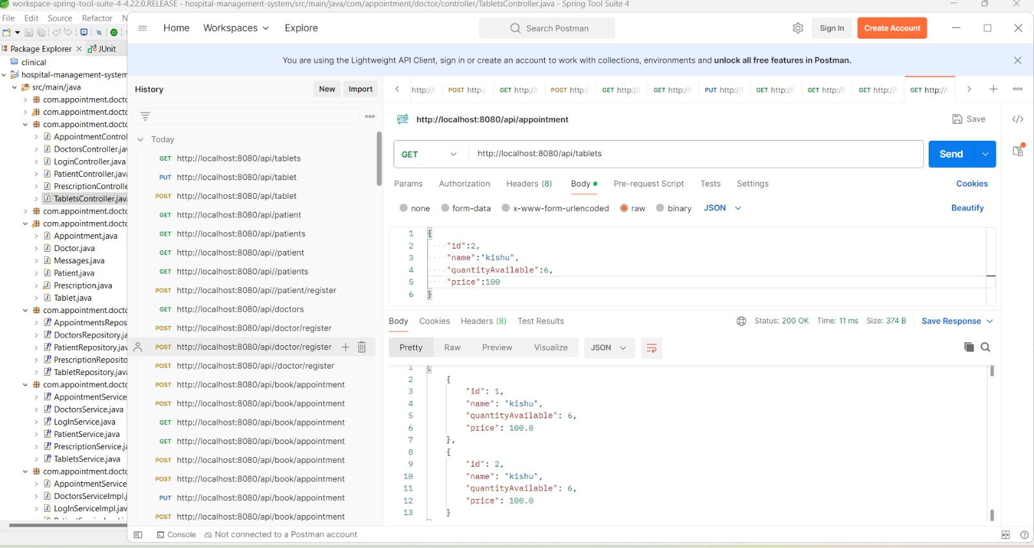
Medicine

Slide 27
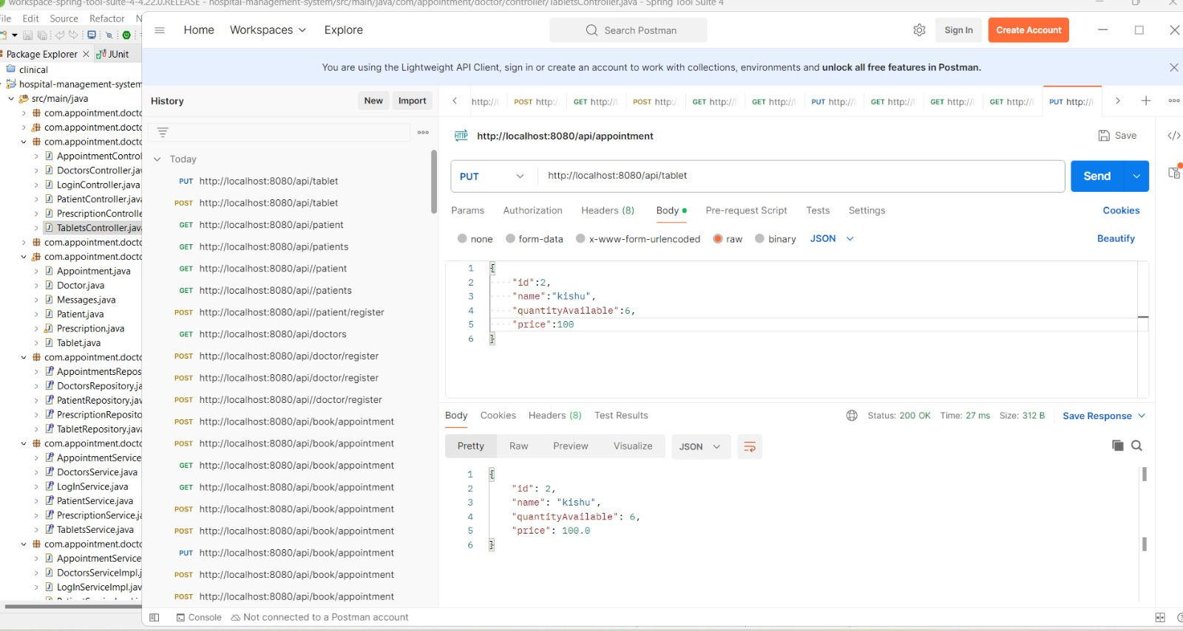
Medicine

Slide 28
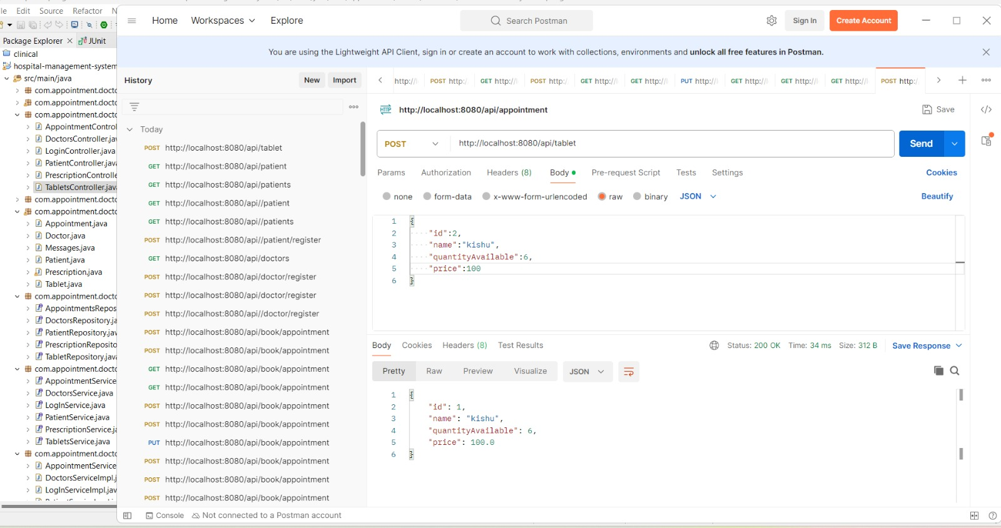
Medicine

Slide 29
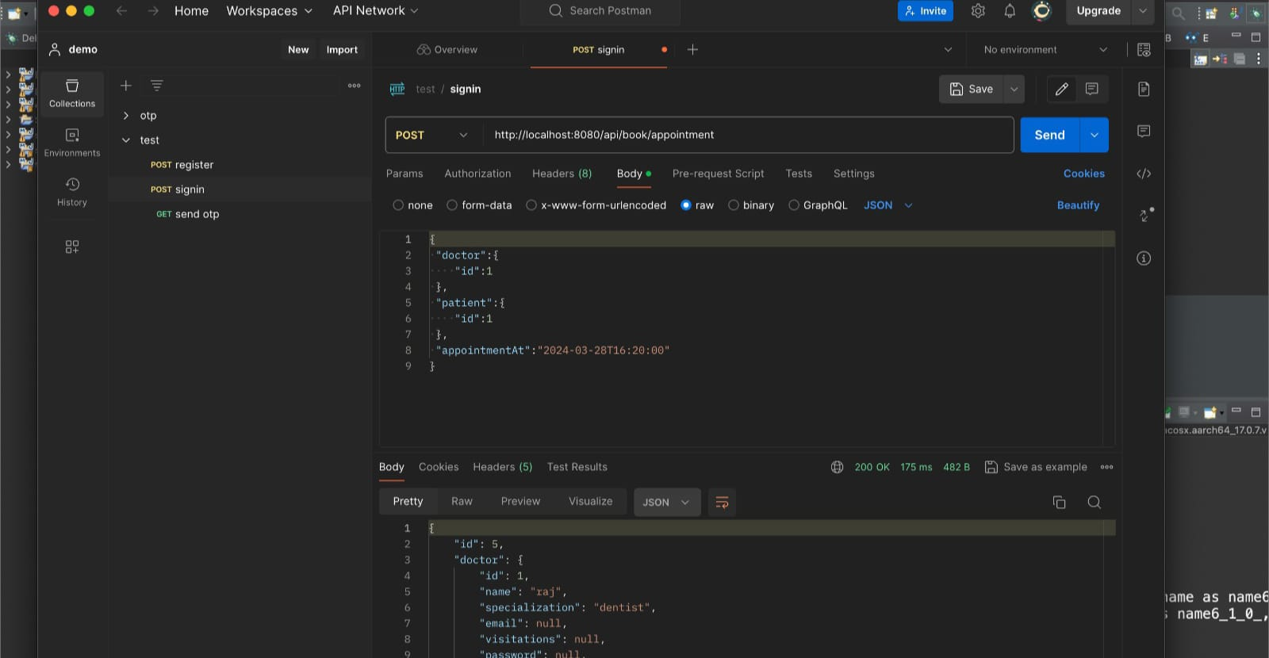
Appointment

Slide 30
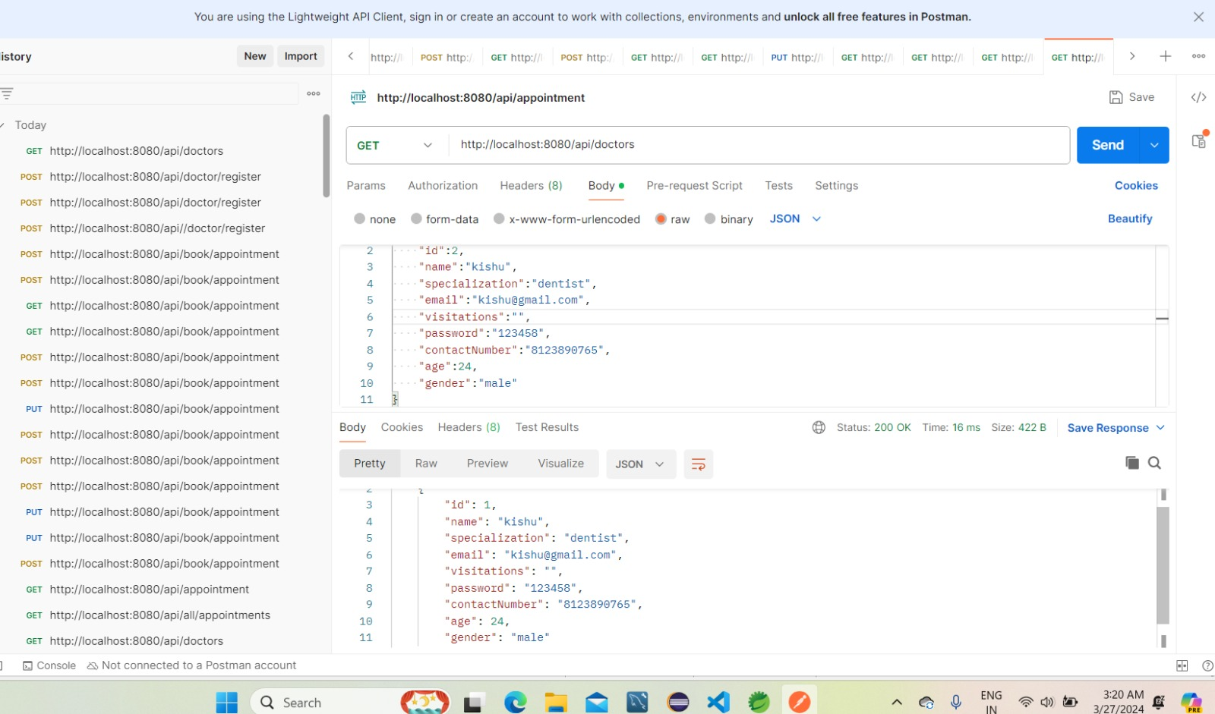
Doctor

Slide 31
CONCLUSION
Summarize the project's potential to improve healthcare appointment management. Briefly mention the benefits for patients, doctors, front-office staff, and pharmacists. Open the floor for questions and discussion
With the secure login mechanisms , appointment bookings and medical managements the way healthcare services are managed and delivered for the positive outcomes and overall patient experience.

Slide 32
THANK YOU

