Slide 1
FINANCIAL ANALYSIS
TATA MOTORS
A comparative study of FY 2023–24 and FY 2024–25
Prepared by: Kishu Kumar Singh & Gurpalakpreet Kaur
Chandigarh University

Slide 2
02
Project Overview
PURPOSE, SCOPE AND APPROACH
01
Study Tata Motors’ consolidated financial performance over two financial years.
02
Analyse revenue, profit, liquidity, leverage and cash generation.
03
Use Microsoft Excel for calculations and charts, Word for the report, and PowerPoint to communicate findings.
04
Primary source: Tata Motors Integrated Annual Report 2024–25.
02

Slide 3
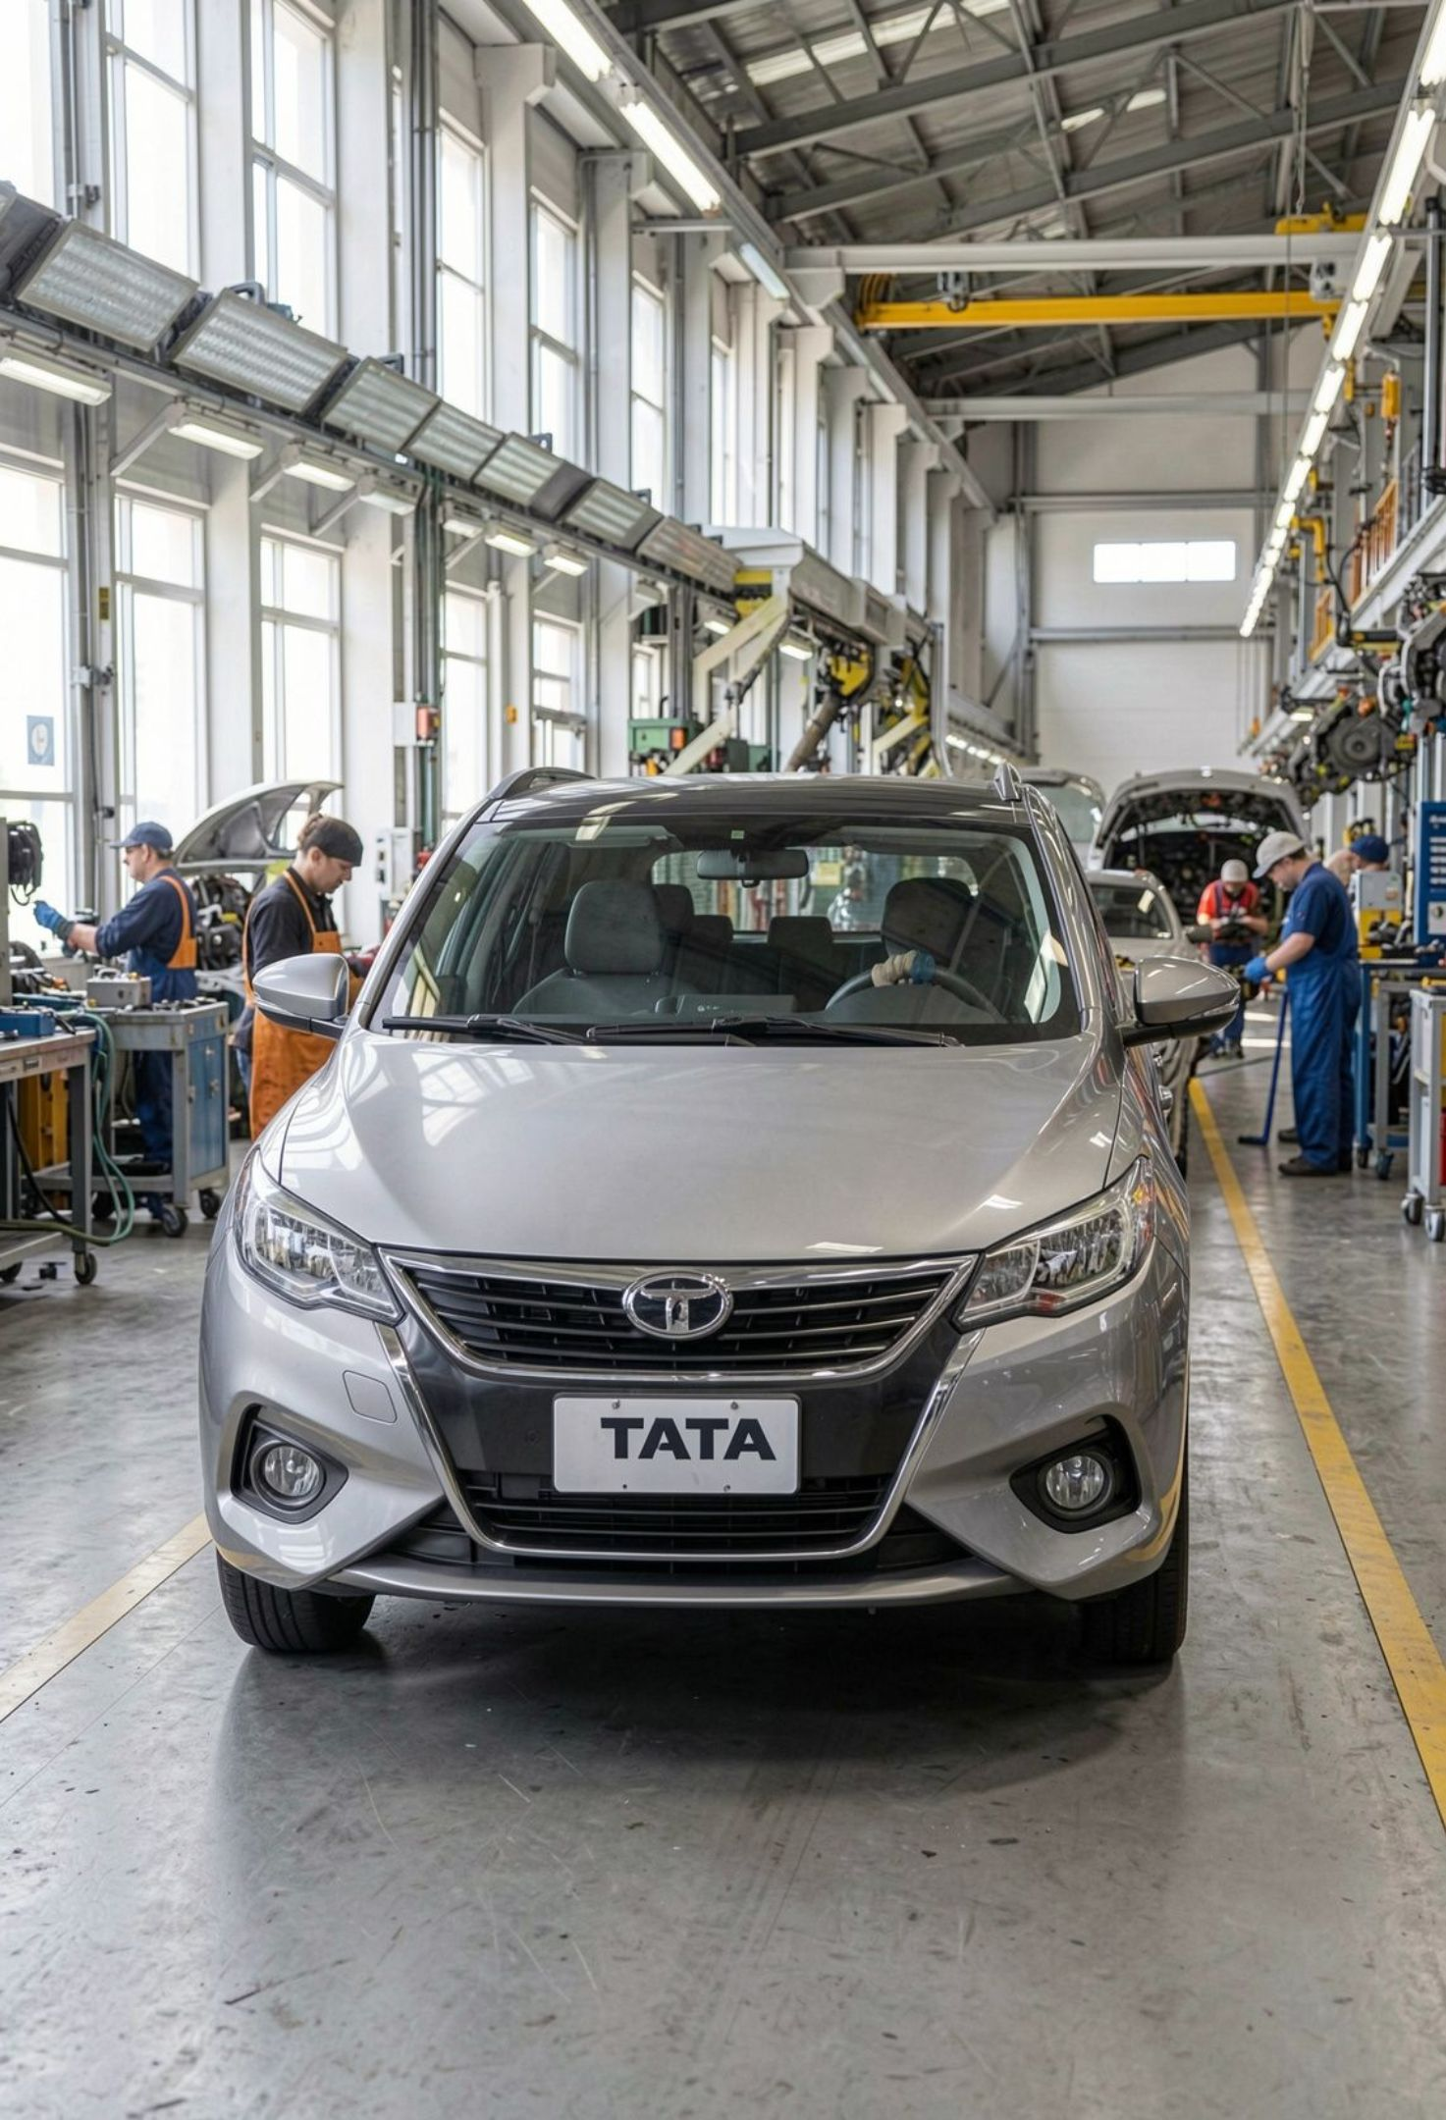
Company Profile
A MAJOR INDIAN AUTOMOTIVE BUSINESS
Tata Motors has served passenger and commercial mobility markets in India and internationally.
Its portfolio has included passenger vehicles, commercial vehicles and international operations through Jaguar Land Rover.
The automotive sector is capital-intensive and sensitive to demand, costs, product mix, technology and regulation.
Financial analysis helps assess growth, profitability, liquidity and the capacity to fund future investment.
03

Slide 4
Financial Snapshot
CONSOLIDATED FIGURES, ₹ CRORE UNLESS STATED
₹4,39,695
₹28,149
FY25 Revenue
FY25 Profit for Year
+1.3% vs FY24
vs ₹31,807 crore in FY24
13.1%
₹22,348 cr
Underlying EBITDA Margin
Auto Free Cash Flow
vs 14.1% in FY24
Positive in FY25
Key message: revenue grew modestly, while profit and underlying EBITDA margin declined. Cash generation remained positive.
04

Slide 5
Revenue and Profit Trend
FY24 COMPARED WITH FY25
INDICATOR | FY 2023–24 | FY 2024–25 | CHANGE / DIRECTION
Revenue from operations | 434,016 | 439,695 | ↑ 1.3%
Operating profit (reported highlight) | 68,831 | 65,848 | ↓
Profit before tax | 28,429 | 33,780 | ↑
Profit for the year | 31,807 | 28,149 | ↓ 11.5%
Finance cost | 7,642 | 4,999 | ↓
Interpretation: stronger PBT did not translate into higher profit for the year; tax and other items also affect final profit.
05

Slide 6
Profitability Analysis
MARGINS INDICATE PRESSURE ON UNDERLYING PERFORMANCE
MEASURE | FY24 | FY25 | WHAT IT SUGGESTS
Revenue growth | — | 1.3% | Modest top-line growth
Operating profit / revenue | 15.86% | 14.98% | Reported margin declined
Profit for year / revenue | 7.33% | 6.40% | Lower net margin
Underlying EBITDA margin | 14.1% | 13.1% | Down 1.0 percentage point
Focus area: cost discipline, product mix, productivity and sustained demand.
06

Slide 7
Liquidity Analysis
ABILITY TO COVER SHORT-TERM OBLIGATIONS
INDICATOR | FY24 | FY25 | INTERPRETATION
Current assets (₹ crore) | 167,718 | 159,811 | Decreased
Current liabilities (₹ crore) | 173,616 | 166,684 | Decreased
Current ratio | 0.97 | 0.96 | Below 1 in both years
Quick ratio | 0.69 | 0.68 | Below 1 after excluding inventory
A large automotive group may operate with substantial supplier credit, but working capital should be monitored carefully.
07

Slide 8
Solvency and Cash Flow
LEVERAGE INDICATORS IMPROVED
Total liabilities-to-equity
Automotive debt/equity
declined from about 2.98x in FY24 to 2.08x in FY25.
improved from 0.9x to 0.6x.
Automotive net position
Automotive free cash flow
moved from ₹16,022 crore net debt in FY24 to ₹1,018 crore net cash in FY25.
remained positive at ₹22,348 crore, although below FY24’s ₹26,925 crore.
08

Slide 9




Key Findings
WHAT THE ANALYSIS TELLS US
Revenue growth
Profitability
Liquidity
Leverage and cash flow
Revenue growth was positive but limited to around 1.3%.
Profit for the year fell by approximately 11.5%, and underlying EBITDA margin declined.
Liquidity ratios were below 1, highlighting the importance of working-capital management.
Leverage improved and automotive free cash flow remained positive.
09

Slide 10
Recommendations
ACTIONS TO SUPPORT SUSTAINABLE PERFORMANCE
01
Control operating costs and improve manufacturing productivity.
02
Manage inventory, receivables and short-term liabilities carefully.
03
Prioritise capital investment that delivers long-term returns.
04
Continue investing in product quality, safety, technology and lower-emission mobility.
05
Use clear, consistent financial metrics when communicating results.
10

Slide 11
Thank you

