Slide 1

Credit Card Fraud Detection

Slide 2
Objective:
It is important that credit card companies are able to recognize fraudulent credit card transactions hence my major objective is to successfully identify the fraudulent transaction made by credit cards.
Benefits:
Detection of upcoming fraud transaction.
Customers aren’t charged for items they didn’t purchase.
Helps in easy flow of transactions.
Manual inspection if fraud is identified .

Slide 3
Data Source :-
Kaggle – Link
Contents :-
- The datasets contains transactions made by credit cards in September 2013 by european cardholders.
- This dataset presents transactions that occurred in two days, where we have 492 frauds out of 284,807 transactions.
- The dataset is highly unbalanced, the positive class (frauds) account for 0.172% of all transactions.
- It contains only numeric- The datasets contains transactions made by credit cards in September 2013 by european cardholders.
- This dataset presents transactions that occurred in two days, where we have 492 frauds out of 284,807 transactions.
- The dataset is highly unbalanced, the positive class (frauds) account for 0.172% of all transactions.
- It contains only numerical input variables which are the result of a PCA transformation.
- Unfortunately, due to confidentiality issues, we cannot provide the original features
- Features V1, V2, ... V28 are the principal components obtained with PCA
- The only features which have not been transformed with PCA are 'Time' and 'Amount'.

Slide 4
- Feature 'Time' contains the seconds elapsed between each transaction and the first transaction in the dataset.
- The feature 'Amount' is the transaction Amount, this feature can be used for example-dependant cost-senstive learning. - - --- Feature 'Class' is the response variable and it takes value 1 in case of fraud and 0 otherwise.al input variables which are the result of a PCA transformation.
- Unfortunately, due to confidentiality issues, we cannot provide the original features
- Features V1, V2, ... V28 are the principal components obtained with PCA
- The only features which have not been transformed with PCA are 'Time' and 'Amount'.
- Feature 'Time' contains the seconds elapsed between each transaction and the first transaction in the dataset.
- The feature 'Amount' is the transaction Amount, this feature can be used for example-dependant cost-senstive learning. - - --- Feature 'Class' is the response variable and it takes value 1 in case of fraud and 0 otherwise.

Slide 5
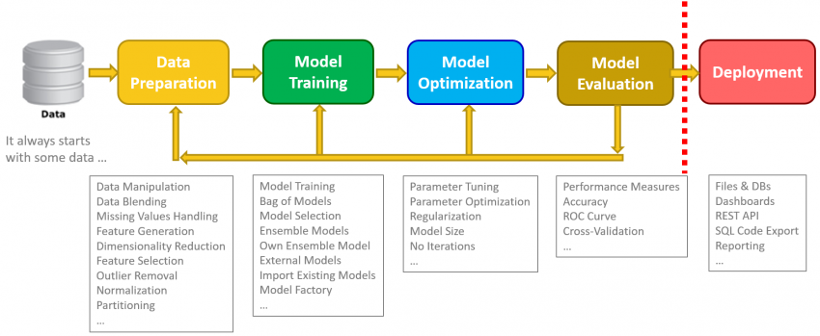
Architecture

Slide 6
Steps Performed:
Step 1 : Data Preprocessing:
First glance of data : Data is checked for imbalancement.
As we can clearly see that data-set is heavily imbalanced as a event of fraud is highly rare
or uncommon.
Different relationship with target variables is checked:
Analyzing amount of money used in fraud and non-fraud transaction i.e. (Target)
Checking correlation of target with other variables.
 | Class | Values | Percent
 | Non-fraud | 172080 | 99.790653
 | Fraud | 360 | 0.208767

Slide 7
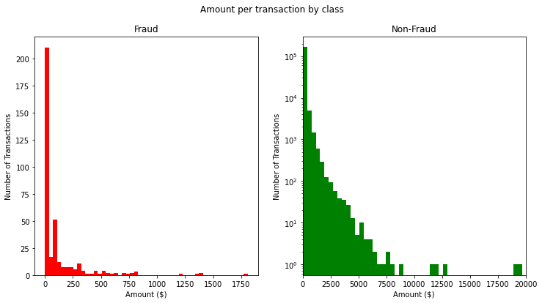
From the above graph we can clearly observe that fraud transaction are mostly with lesser amount except few outliers
Due to few outliers we in above graph saw higher mean of fraud transactions.

Slide 8
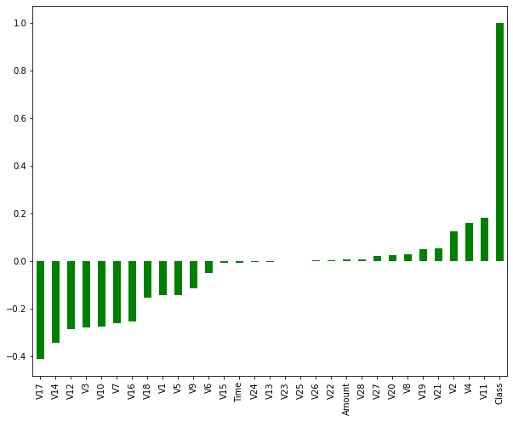
Above graph shows the correlation of different variables with our target which shows variable V11 and V4 having highest positive correlation and V17 and V14 having highest negative correlation.

Slide 9
.
Treatment of imbalanced data:-
Under sampling:
1) Random under sampling
- 2) Under sampling using Imblearn
3) Near Miss
Advantages:-
Since the sample size of majority class is decreased by under sampling the training time and complexity of the model is decreased to a large extent.
Disadvantages:-
Since the data points are reduced, it might happen that during the removal of data points many important points get deleted which decreases the prediction capability of the fitted model, due to poor training.
Oversampling:
1) Random oversampling
2) Oversampling using Imblearn
3) SMOTE(Synthetic Minority Oversampling)
Advantages:-
Since the number of data points in minority class increases there is a high possibility for the model to learn from the data points in minority class of training set.
Disadvantages:-
Uncontrolled oversampling can lead to more training time and model complexity thus diminishing the predictive capability of the model.

Slide 10
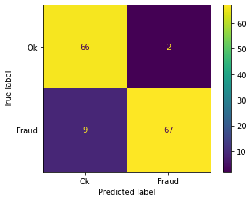
Model Training:-
For training first I used different resampling techniques and then train them with KNN and Logistic.
For every resampling technique I train two models one with KNN and other with Logistic.
Above is one confusion matrix we can observe from KNN with down sampling:-

Slide 11
The upper right box is type 1 error(False (+ve)) i.e. transaction which were valid but predicted fraud which are 2.
The lower left box is type 2 error(False (-ve)) i.e. transaction which were fraud but predicted valid which are 9.
In this problem statement our goal is to reduce type 2 error i.e. falsely predicted fraud transaction as valid.
Hence we need to focus on increasing recall value which is TP/TP+FN.
For every resampling technique these confusion matrix with different performance metrics were observed.

Slide 12
Overview of performances of some of models after Under sampling with different methods:-
Logistic Imblearn under:-
precision recall f1-score support
Ok 0.96 0.96 0.96 68
Fraud 0.96 0.96 0.96 76
accuracy 0.96 144
macro avg 0.96 0.96 0.96 144
weighted avg 0.96 0.96 0.96 144
KNN Near Miss:-
precision recall f1-score support
Ok 0.88 0.97 0.92 68
Fraud 0.97 0.88 0.92 76
accuracy 0.92 144
macro avg 0.93 0.93 0.92 144
weighted avg 0.93 0.92 0.92 144

Slide 13
Overview of performances of some of models after Over sampling with different methods:-
Logistic Imblearn Over:-
precision recall f1-score support
0 1.00 1.00 1.00 1400
1 1.00 1.00 1.00 1444
accuracy 1.00 284
macro avg 1.00 1.00 1.00 2844
weighted avg 1.00 1.00 1.00 2844
Logistic SMOTE:-
precision recall f1-score support
0 1.00 1.00 1.00 1400
1 1.00 1.00 1.00 1444
accuracy 1.00 2844
macro avg 1.00 1.00 1.00 2844
weighted avg 1.00 1.00 1.00 2844

Slide 14
Models for anomaly detection
Now I am going to try out some models which is used in anomaly detection.
Basically they are made in such a way that it handles the unbalanced data and works good.
Models to be used are:-
1) Local Outlier Factor(LOF) Algorithm:
The LOF algorithm is an unsupervised outlier detection method which computes the local density deviation of a given data point with respect to its neighbors.
It considers local outliers that have a substantially lower density than their neighbors.
2) Isolation Forest Algorithm :
This algorithm is based on the fact that anomalies are data points that are few and different.
As a result of these properties, anomalies are susceptible to a mechanism called isolation.
This method is an algorithm with a low linear time complexity and a small memory requirement.
It builds a good performing model with a small number of trees using small sub-samples of fixed size, regardless of the size of a data set.
.

Slide 15
Performance overview of anomaly models:
The model Isolation Forest throws total: 325 errors and detected a total of 65 frauds out of 492
Classification Report :
precision recall f1-score support
0 1.00 1.00 1.00 142177
1 0.29 0.29 0.29 227
accuracy 1.00 142404
macro avg 0.64 0.64 0.64 142404
weighted avg 1.00 1.00 1.00 142404
The model Local Outlier Factor throws total: 455 errors and detected a total of 0 frauds out of 492
Classification Report :
precision recall f1-score support
0 1.00 1.00 1.00 142177
1 0.00 0.00 0.00 227
accuracy 1.00 142404
macro avg 0.50 0.50 0.50 142404
weighted avg 1.00 1.00 1.00 142404

Slide 16
Conclusion :
For our anomaly detection models we used half our dataset as it was huge for my local machine. I used 142177 rows.
Performance:
Isolation Forest
It detected a total of 65 frauds out of 492 and thrown a total of 325 errors.
The detection of fraud cases is around 29 %.
Local Outlier Factor
It detected a total of 0 frauds out of 492 and thrown a total of 455 errors.
The detection of fraud cases is around 0 %.
We can also improve on this accuracy by increasing the sample size or hyper parameter tuning the model , however at the cost of computational expense.

Slide 17
FAQ
Q1) What’s the source of data?
Kaggle
Q 2) What was the type of data?
Only Numerical values
Q 3) What’s the complete flow you followed in this Project?
From data preprocessing till performance evaluation
Q 4) Was data Imbalanced? What approach used for correction?
Data was highly imbalanced.
Refer slide 9 for different approach used for handling imbalanced data.

Slide 18
Q 5) What techniques were you using for data pre-processing?
Removing unwanted attributes
Visualizing relation of independent variables with each other and output variables
Scaling the data
Q 6) What model is used and which is selected as best?
KNN and logistic is used with different sampling techniques.
All gave good performance with under sampling but using this we lost much data.
Training cant be performed with oversampling on local system as the dataset was huge.
In Anomaly detector models Isolation Forest worked pretty good detecting around 29%
of fraud case.

