Slide 1
You are Invited
♥

Slide 2
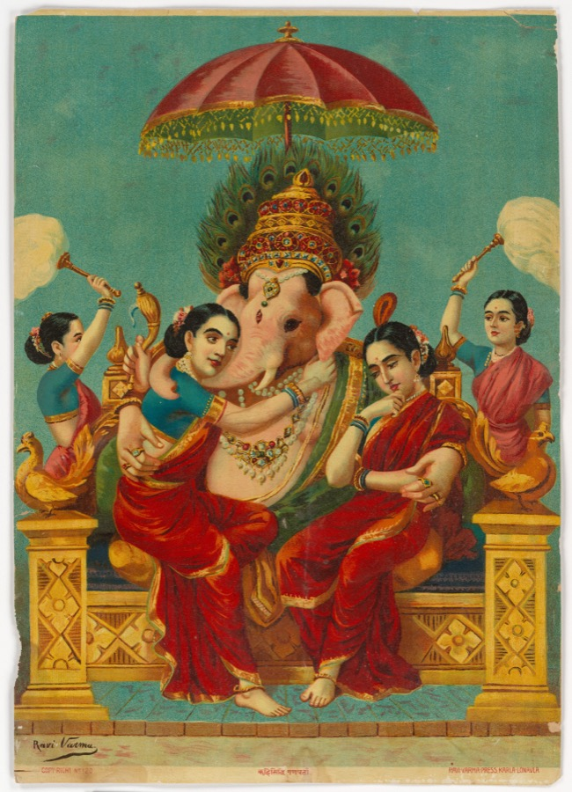
श्री गणेशाय नमः
✧
Kislaya
&
Kanak
Baat Pakki

Slide 3

SAVE THE DATE
23rd October 2026
2:00 PM ONWARDS

Slide 4
With the Blessings of
Our Beloved Parents
✧
GROOM'S PARENTS
Ravindra Nath Roy & Smt. Aishwarya Roy
BRIDE'S PARENTS
Sikandar Prasad & Smt. Madhuri Devi

Slide 5
JOIN US
Engagement Venue
✧
Terapanth Bhawan
Railway Station Road,
Araria, Bihar
Navigate to Venue

Slide 6
With Love & Blessings
We can't wait to share the beginning of our forever with you. Your presence and blessings mean the world to us.
✧
Our Family
TOGETHER WITH OUR FAMILIES
♥

