Slide 1
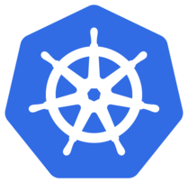
Kubernetes

Slide 2
Kubernetes Cluster
Let’s spawn a cluster first
Notes:
gcloud beta container clusters create mycluster \
--cluster-version=latest \
--machine-type=n1-standard-1 \
--num-nodes=3 \
--image-family=cos-stable
Create ingress and ingress-tls resources
Ingress.yaml can be executed directly
For tls support, ns3 ns should be created
Followed by secret creation:
kubectl create secret tls tls-secret --cert=/home/kislay/tls.cert --key=/home/kislay/tls.key -n ns3
Followed by ingress-tls.yaml create

Slide 3
Need for Kubernetes
Container Orchestration

Slide 4
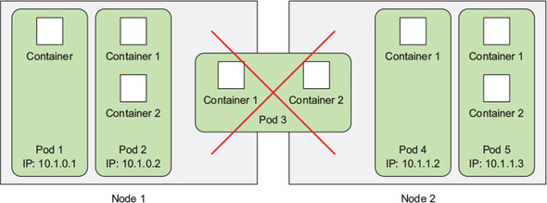
Pod
Set of containers which stay together
Share many of the Linux namespaces
One primary container and other are sidecars
Notes:
Example of sidecar: logging, authentication

Slide 5
Creating a Pod
Using kubectl -f create
View logs using kubectl logs
kubectl port-forward <pod> <hostPort>:<containerPort>

Slide 6
ReplicaSet
Ensures that desired number of pods keep running
Support for readiness and liveness probes
Notes:
Demonstrate killing the process to see replicaset brings it up

Slide 7
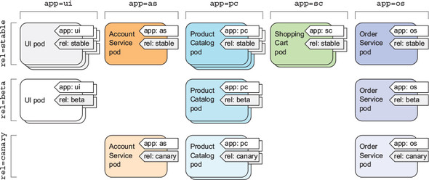
Labels
Helps you organize K8s resources

Slide 8
Labels contd...
Overwrite labels as
kubectl label pod <pod> <key>=<value> --overwrite

Slide 9
Service
Used to expose pods
Can be used for exposing external services too
Three types are available:
  ClusterIP
  NodePort
  LoadBalancer

Slide 10
Namespaces
Segregate Kubernetes resources

Slide 11
Ingresses
Runs at L4/L7
Can be used for:
  Redirection
  Timeout
  TLS
  Session Affinity

Slide 12
Volumes
TODO

Slide 13
ConfigMap & Secrets
Key-value store
Values can be injected as env vars
Can be attached as volumes

Slide 14
RBAC
Restriciting access (secrets) to specific roles

