Slide 1
DATA SCIENCE MASTER
Virtual Internship Report
KISLAY SINGH
B.Tech (Computer Science and Engineering)
IILM University, Greater Noida
April – June 2026 | 8 Weeks

Slide 2
Candidate & Program Overview
Candidate Details
Student Name: Kislay Singh
Degree: B.Tech (Computer Science and Engineering)
University: IILM University, Greater Noida
Academic Batch: 2026–2027
Internship Profile
Program: AICTE – EduSkills Virtual Internship
Internship Domain: Siemens Data Science Master
Duration: 8 Weeks (April – June 2026)
AICTE Student ID: STU699804c3be2561771570371
Kislay Singh | IILM University, Greater Noida | Data Science Master Internship • 2

Slide 3
Program & Organization Context
EduSkills is the organization identified on the internship offer letter and completion certificate.
The programme is presented as an AICTE – EduSkills Virtual Internship and carries Ministry of Education, AICTE and National Internship Portal branding.
The completion certificate identifies SIEMENS as the supporting organization for the Data Science Master Virtual Internship.
The certificate confirms successful completion of the 8-week internship during April–June 2026.
Kislay Singh | IILM University, Greater Noida | Data Science Master Internship • 3

Slide 4
Learning Context & Purpose
Industry-Relevant Learning
The offer letter states that the internship is designed to provide industry-relevant skills and strengthen confidence in the subject area.
Practical Exposure
The programme combines structured learning with practical exposure, giving the student an opportunity to connect academic knowledge with applied learning.
Kislay Singh | IILM University, Greater Noida | Data Science Master Internship • 4

Slide 5
Internship Structure & Evaluation
Week-wise Plan
The internship follows a structured week-wise learning plan.
Weekly Assessments
Weekly assessments track progress and understanding.
Project Work
Selected modules require project documentation and assignments.
Final Assessment
The final week includes a Final Assessment Test.
Overall Evaluation
Final grade is based on weekly assessments, project submissions and the final test.
Kislay Singh | IILM University, Greater Noida | Data Science Master Internship • 5

Slide 6
Learning Journey
01
02
03
Structured Learning
Follow the week-wise internship plan.
Practical Exposure
Apply concepts through practical exposure.
Assessment
Complete weekly assessments.
04
05
06
Documentation
Submit required project documentation and assignments.
Final Test
Appear for the Final Assessment Test.
Completion
Receive the Virtual Internship Certificate after successful completion.
Kislay Singh | IILM University, Greater Noida | Data Science Master Internship • 6

Slide 7
Expected Learning Outcomes
Stronger understanding of the Data Science Master learning domain.
Improved ability to connect structured learning with practical exposure.
Better consistency in completing assessments and technical assignments.
Experience in documenting project-related work in a formal manner.
Improved confidence in presenting and evaluating technical learning.
A foundation for applying data science knowledge in future academic projects.
Kislay Singh | IILM University, Greater Noida | Data Science Master Internship • 7

Slide 8
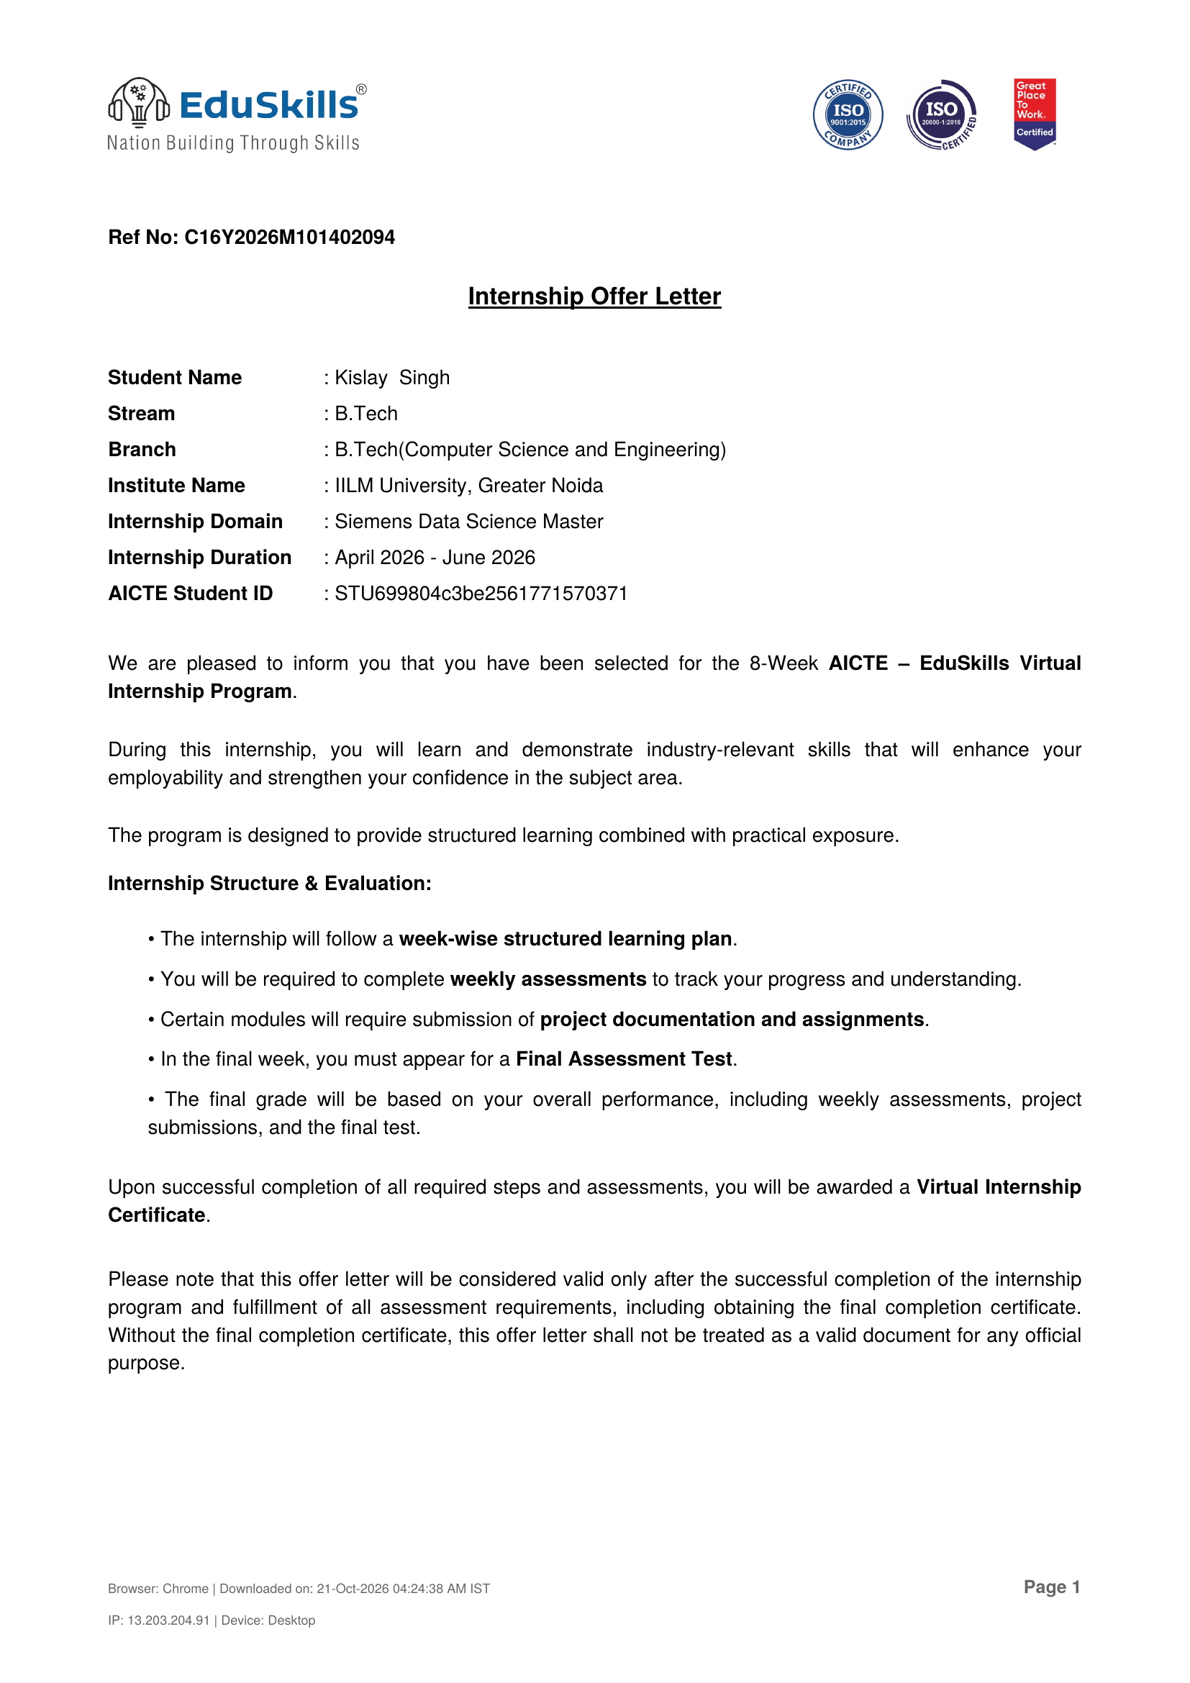
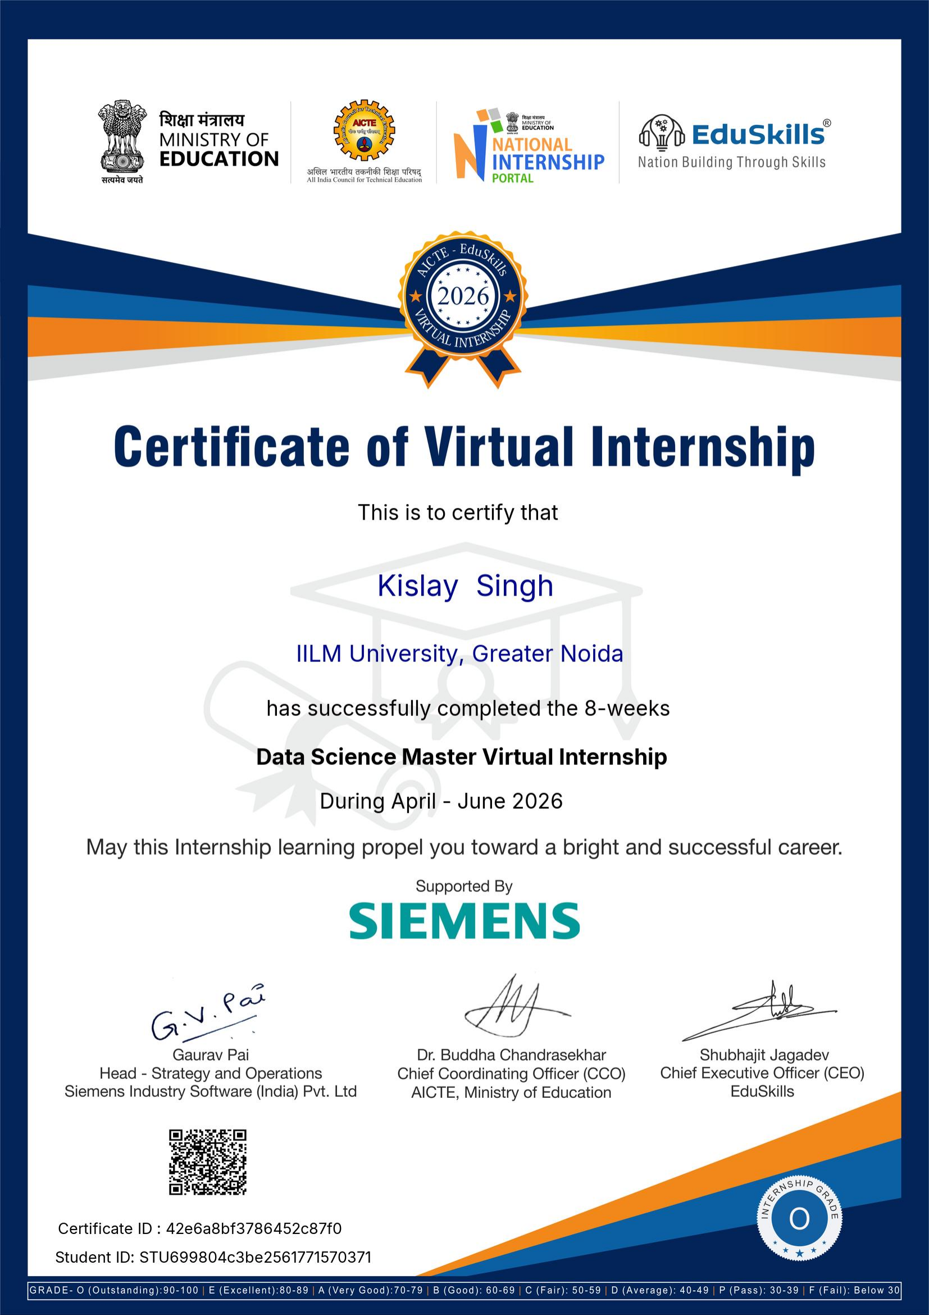
Official Internship Documents
Offer Letter and Completion Certificate
INTERNSHIP OFFER LETTER
CERTIFICATE OF VIRTUAL INTERNSHIP
Kislay Singh | IILM University, Greater Noida | Data Science Master Internship • 8

Slide 9
Official Verification Details
Offer Letter
Reference No.: C16Y2026M101402094
Internship Domain: Siemens Data Science Master
Duration: April 2026 – June 2026
AICTE Student ID: STU699804c3be2561771570371
Completion Certificate
Certificate: Data Science Master Virtual Internship
Student: Kislay Singh
Institute: IILM University, Greater Noida
Supported by: SIEMENS
Certificate ID: 42e6a8bf3786452c87f0
Student ID: STU699804c3be2561771570371
Kislay Singh | IILM University, Greater Noida | Data Science Master Internship • 9

Slide 10
THANK YOU
KISLAY SINGH
B.Tech (Computer Science and Engineering)
IILM University, Greater Noida
Data Science Master Virtual Internship | April – June 2026

