Slide 1

Minor Project Final Defense 1st
Hamro Quiz
Presented By:
Suman Tiwari
Pramod Gurung
Kismat Bahadur Chhetri
Supervisor: Er. Bikash Bhattarai

Slide 2
Introduction
“Hamro Quiz” :
is a web-based application with general questions about current affairs and computers.
It has multiple-choice questions with a time limit and it also calculates scores for each correct answer.

Slide 3
Problem Statement
The old system of having quizzes was paper-based and was not dynamic. Once the question was printed on the paper, we are unable to quickly change or modify the quiz system.
It was unreliable, inaccurate, and more time-consuming.

Slide 4
Objectives
The main objectives of this web-based quiz application named “Hamro Quiz” are:
To reduce manual efforts.
To manage the quiz test more efficiently.

Slide 5
Literature Review
(Xue, 2006), adapted the online examination system using a mode known as "B/W Mode". A web server was used to control the tests and provide information to students. The main goal of the study is to reduce the use of paper and develop a test system that is safe to use. Among the features utilized was only allowing the system to be used after receiving the application from students.
(Perugia), 2008)studied e-learning in courses at the University of Perugia, known as e-stadium. The study consisted of two stages, students’ application for online tests or tests that are made directly to students. The study took two years with four-semester examinations to graduate students in computer science. Their study focused on the effectiveness of the system used by students. And students are more satisfied with this process.
On Comparing our project with other similar application, we come to conclude with following.
Features | Quiz Faber | Easy Test Maker | Hamro Quiz
Better User interface | NO | NO | YES
Login System | NO | YES | YES
More informative | YES | NO | YES

Slide 6
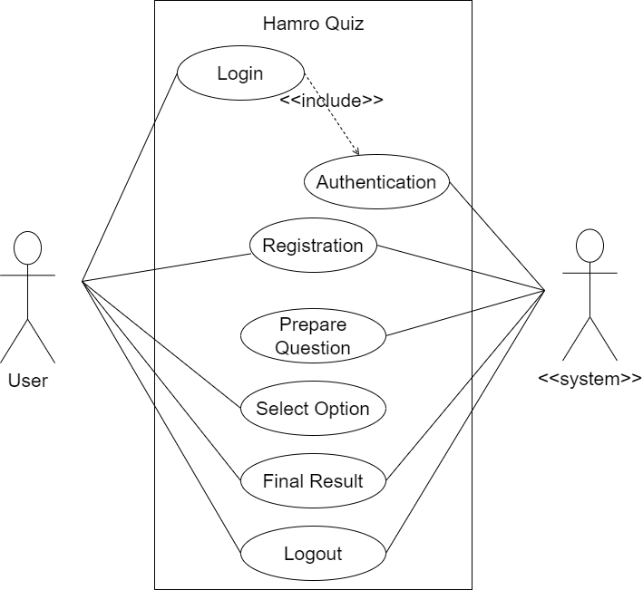
Use Case Diagram

Slide 7
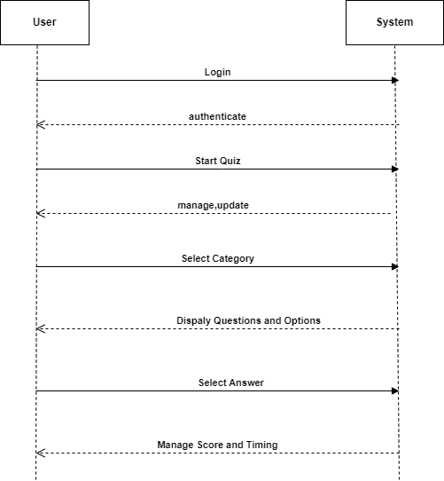
System Sequence Diagram

Slide 8
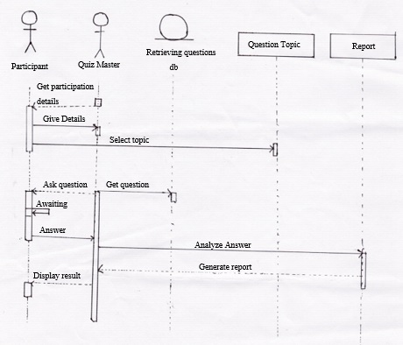
Sequence Diagram

Slide 9
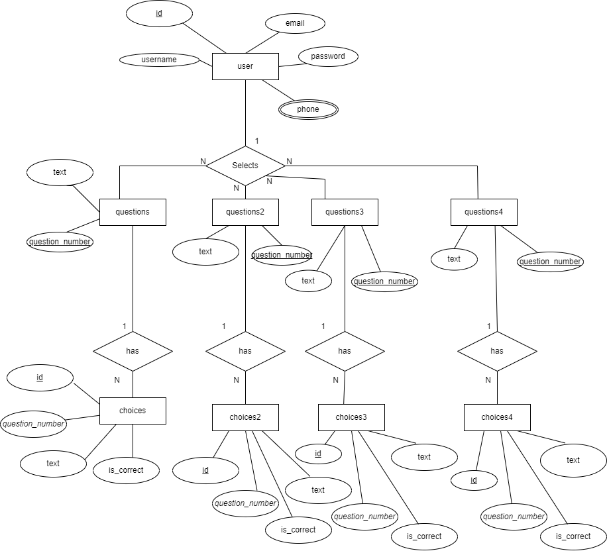
ERD

Slide 10
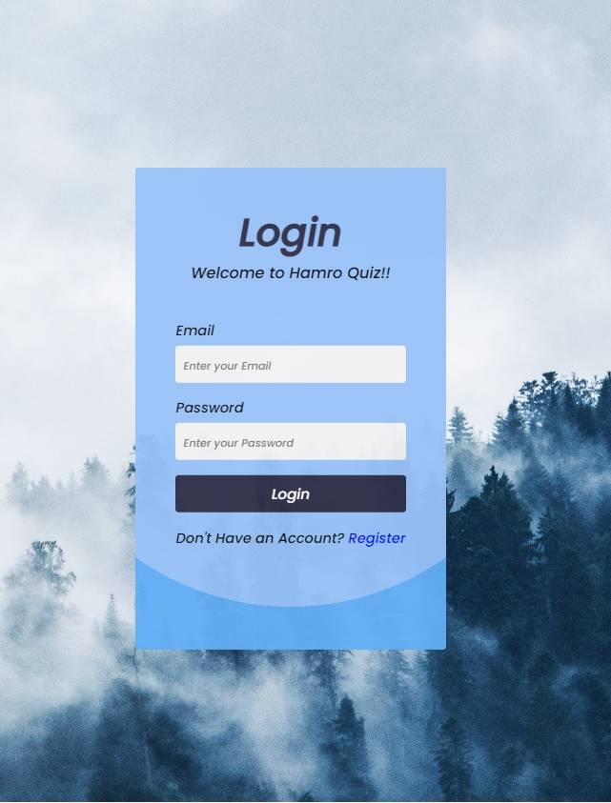
Wireframes
- LOGIN PAGE

Slide 11
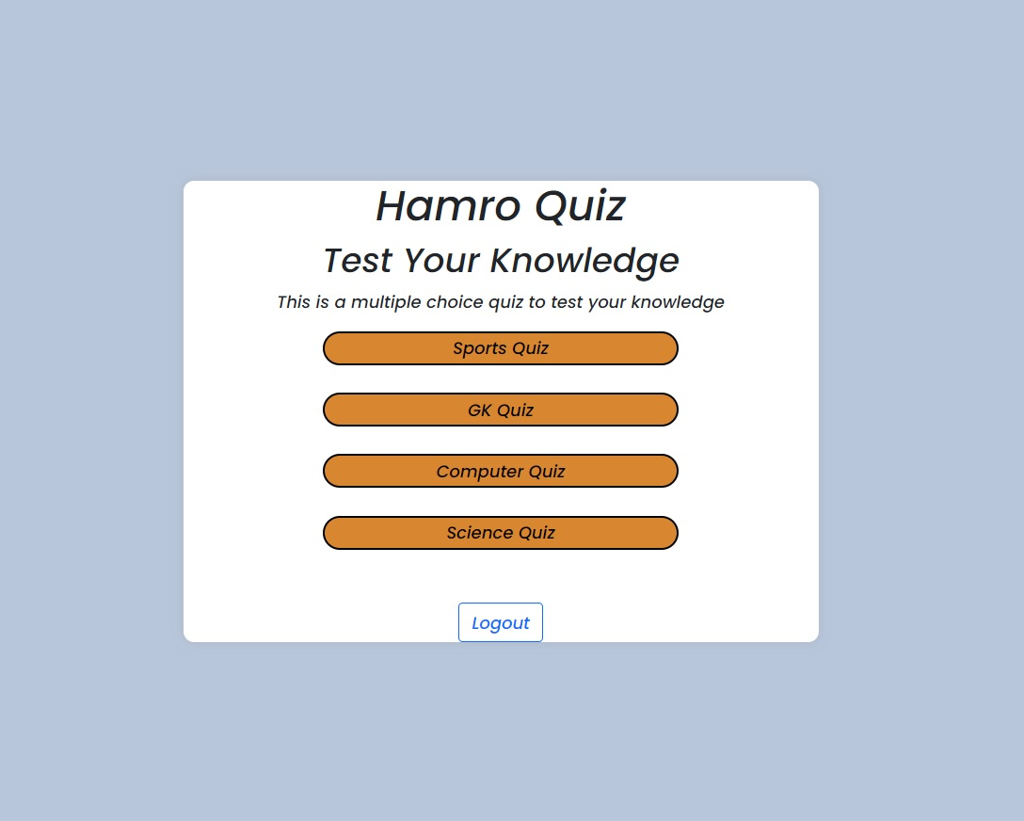
Wireframes

Slide 12
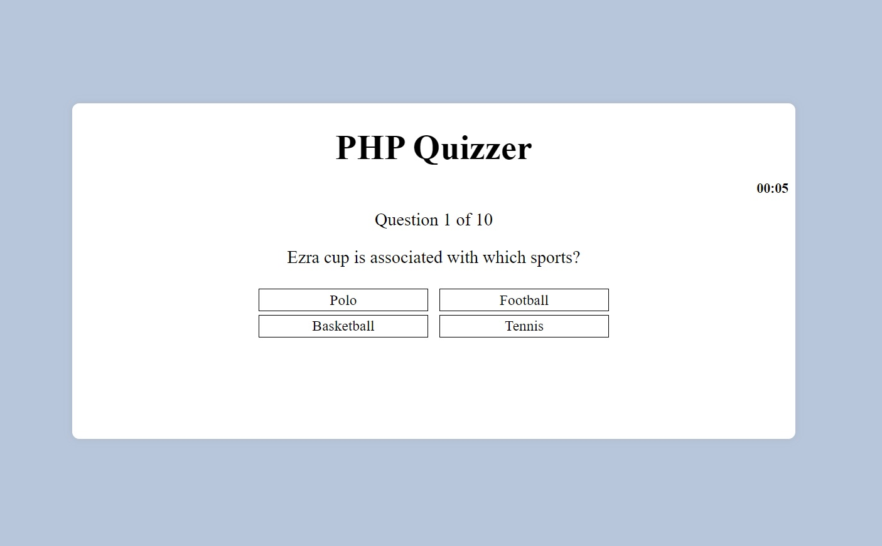
Wireframes

Slide 13

Wireframes
TRY AGAIN

Slide 14
Thank You! Any Queries?

