Slide 1
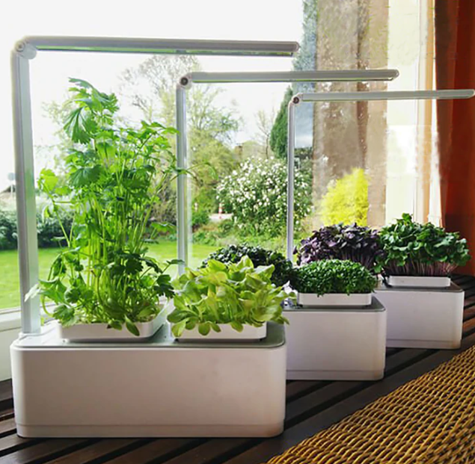
Final Presentation
Teammates
- Sahin Yunus
- CihanVevaud Quentin Maurice
- Soual Kilian
- Lee June Young
ⓒSaebyeol Yu. Saebyeol’s PowerPoint

Slide 2
Contents
01
Security Check
02
Temperature Control
03
Light Control
04
Watering Control
05
Overall Flowchart

Slide 3
Part 1,
Security Control
How it works
- Based on SC_state, State machine controls the overall system
- Buzzer make noises when there is a intruder when security is up.
- Security goes down when user makes correct button sequence.
- Has a reset button to put security up again.

Slide 4
Part 1,
Security Control
Issues broke through
- Taking button inputs in while(1) block in main function did not work.
- It was due to sensitive timing control of sonic sensor
ㄴsonic sensor calculates distance with speed of sound and timer.
- Thus, button input is received from interrupt ports.

Slide 5
Part 1,
Security Control

Slide 6
Part 2,
Temperature Control
How it works
- Works on separate board ATmega16
- Measures temperature and calls function.
- LCD functions are defined in separate header file.
- Constant standards decide if it‘s too cold or too hot
- if too hot, fan runs => cooling()
- if too cold, led turns on => heating()
*couldn‘t find right device for heating, LED is to show the heating function is called

Slide 7
Part 2,
Temperature Control
Issues broke through
- Struggled finding appropriate example for temperature sensor
- Droped existing sensor DHT11 and tried different sensor LM35.
- It workd perfect

Slide 8
Part 2,
Temperature Control

Slide 9
Part 3,
Light Control
How it works
- ADC measures the brightnnes
- light() compares the hardcoded standard and current brightness
- LED turns on and off based on measured brightness

Slide 10
Part 3,
Light Control
Issues broke through
- Struggled finding appropriate example for LED and LCD
- Found right example eventually and made it working right away

Slide 11
Part 3,
Light Control

Slide 12
Part 4,
Watering Control
How it works
- Intended to notify user that it‘s time to water the plant
- Displays string with USART every 10 second
- Planned to measure the humidity in soil, but couldn‘t find right solution
- Thus, the system uses hardcoded humidity value

Slide 13
Part 4,
Watering Control

Slide 14
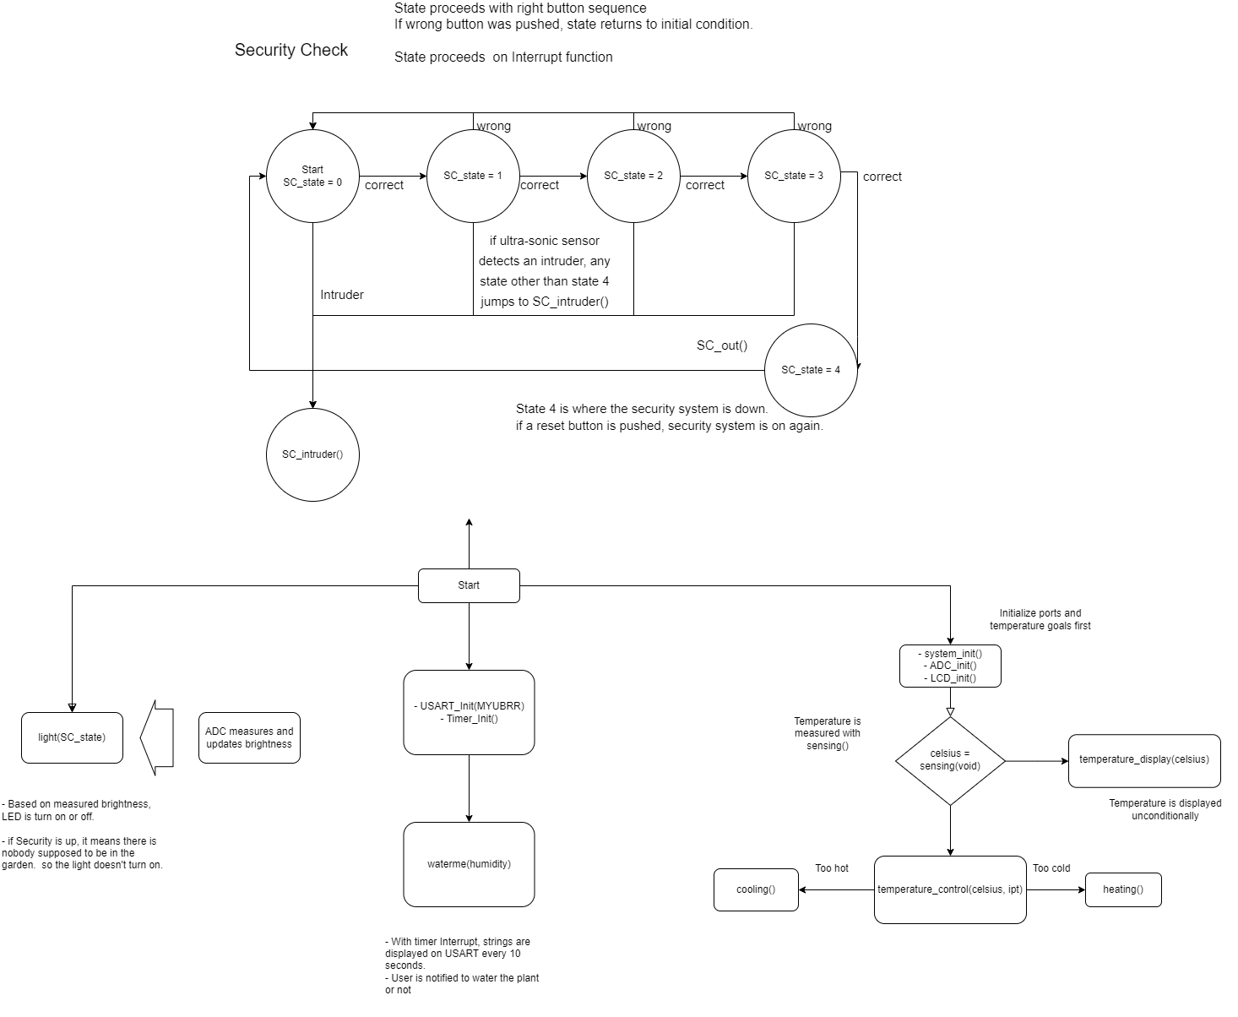
Part 5,
Overall Flowchart

