Slide 1
Object Tracking in Video Sequences
Chris Shirk
cshirk@ieee.org

Slide 2
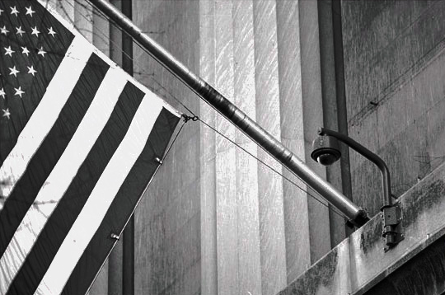
Rise of Public Video Surveillance
Rapid technological progress and recent world events have given rise to sudden spike in adoption of public surveillance systems
The United Kingdom has installed over 1.5 million cameras in response to terrorist bombings
The Washington DC Metropolitan Police Department operates a network of almost a thousand cameras as a result of 9/11

Slide 3
Is Public Video Surveillance Effective?
Impossible for skilled observers to provide full attention to >2 things at a time
Typically many, many screens per observer
Simply too much raw video for analysts to provide effective real-time intelligence
Largest meta-study on 46 studies of public video surveillence found no beneficial impact on crime reduction for any installation in the United States

Slide 4

Questionable Value
Expenditures high, but benefit low
Not a good value for the taxpayer
How can we fix this?

Slide 5
Solution
Reduce amount of video sent to analysts by algorithmically culling video sequences we are less likely to care about
Object tracking provides metadata that can be used in the culling process

Slide 6
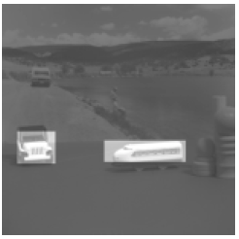
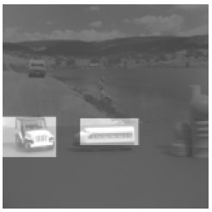
Object Tracking Challenges
Complicated by several factors...
Object collision
Object occlusion
New / dead tracks

Slide 7
Overview of the algorithm
Four main stages:
Wavelet transform
Camera motion normalization
Object isolation
Track / Object matching and conflict resolution

