Slide 1
Web Design & Development
Understanding URL &
Learn How to Use Different CSS Selector Type

Slide 2
Understanding URL
When we have html code like following:
<img src=“SOME URL“ />
<a href=“SOME URL"> </a>
Or CSS code like:
background: url(../img/pdf.png) no-repeat;
list-style: url(./img/bullet2.png) inside;
We need to specify the URL.
How do we know the URL of an object (a file, or a link)?

Slide 3
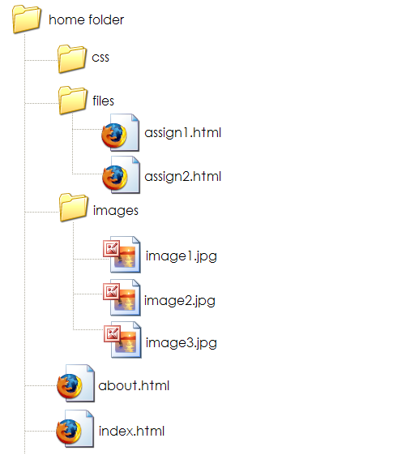
Understanding URL
Assume we have following folders and files

Slide 4
Understanding URL
If we want to insert "image1.jpg“ in the "assign2.html" file, then the html code will be:
<img src="../images/image1.jpg" />

Slide 5
Using Different CSS Selectors
Type Selector
  redefines the look of a specific tag
  A type selector matches every instance of the element type in the document tree
  E.g. body {background-color: #000000;}
Class Selector
  can apply to any tag
  E.g. .indent{margin-right:5%;margin-left: 5%;}
  In HTML, <p class=“indent”>
ID Selector
  E.g. #myId {color: #38608A;}
  In HTML, <h1 id="myId">some text..</h1>
Notes:
pseudo-classes are used in CSS selectors to allow information external to the HTML source (e.g. the fact that an anchor has been visited or not) to classify elements.

Slide 6
Using Different CSS Selectors
Grouping
  When several selectors share the same declarations, they may be grouped into a comma-separated list.
  e.g. h1, h2, h3 {font-family: Georgia;}
Universal selector
  The universal selector, written "*", matches the name of any element type.
  e.g. * {border: 2px;}

Slide 7
Using Different CSS Selectors
Descendant selector
  Sometimes, you want selectors to match an element that is the descendant of another element in the document tree
  (e.g., "Match those EM elements that are contained by an H1 element").
  Descendant selectors express such a relationship in a pattern.
  A descendant selector is made up of two or more selectors separated by whitespace.
  e.g. h1 em {color: blue;}

Slide 8
Using Different CSS Selectors
When to use which?
  Use “type selector” when you want to apply certain style for all occurrences of a certain tag
  Use “ID selector” if you want to apply the style for only one occurrence of a certain tag
  Use “class selector” if you want to apply the style for many (but not all) occurrences of a certain tag; OR if you want to apply the style for more than one type of tags

Slide 9
Using Different CSS Selectors
When to use which? (cont.)
  Use “Grouping” When several selectors share the same declarations
  Use “Universal selector” if you want all the tags in your web documents have some common style (for example, all tags don’t have any margin)
  Use “Descendant selectors” if you want selectors to match an element that is the descendant of another element

Slide 10
Using Different CSS Selectors
Practice
  Save the HTML file at the following address to your local hard drive:
  http://www.cs.pitt.edu/~mehmud/cs134-2084/exercise/orion.html
  Add following CSS rules into orion.html as internal stylesheet:
  *, h1, h2, h6,
  h1, h2, h6
  , p, .yellowBG, #topcontent, ul li a, #selectedli
  I explain how you should add them

