Slide 1
More SQL

Slide 2
Agenda
Finish subqueries, correlated queries.
Grouping and aggregation
Creating a schema
Modifying the database
Defining views

Slide 3
Subqueries Returning Relations
You can also use: s > ALL R
s > ANY R
EXISTS R
Product ( pname, price, category, maker)
Find products that are more expensive than all those produced
By “Gizmo-Works”
SELECT name
FROM Product
WHERE price > ALL (SELECT price
FROM Purchase
WHERE maker=‘Gizmo-Works’)

Slide 4
Conditions on Tuples
SELECT DISTINCT Company.name
FROM Company, Product
WHERE Company.name= Product.maker
AND (Product.name,price) IN
(SELECT Purchase.product, Purchase.price)
FROM Purchase
WHERE Purchase.buyer = “Joe Blow”);
May not work in SQL server...

Slide 5
Correlated Queries
Movie (title, year, director, length)
Find movies whose title appears more than once.
correlation
SELECT DISTINCT title
FROM Movie AS x
WHERE year <> ANY
(SELECT year
FROM Movie
WHERE title = x.title);
Note (1) scope of variables (2) this can still be expressed as single SFW

Slide 6
Complex Correlated Query
Product ( pname, price, category, maker, year)
Find products (and their manufacturers) that are more expensive than all products made by the same manufacturer before 1972
Powerful, but much harder to optimize !
SELECT DISTINCT pname, maker
FROM Product AS x
WHERE price > ALL (SELECT price
FROM Product AS y
WHERE x.maker = y.maker AND y.year < 1972);

Slide 7
Aggregation
SELECT Avg(price)
FROM Product
WHERE maker=“Toyota”
SQL supports several aggregation operations:
SUM, MIN, MAX, AVG, COUNT

Slide 8
Aggregation: Count
SELECT Count(*)
FROM Product
WHERE year > 1995
Except COUNT, all aggregations apply to a single attribute

Slide 9
Aggregation: Count
COUNT applies to duplicates, unless otherwise stated:
SELECT Count(category) same as Count(*)
FROM Product
WHERE year > 1995
Better:
SELECT Count(DISTINCT category)
FROM Product
WHERE year > 1995

Slide 10
Simple Aggregation
Purchase(product, date, price, quantity)
Example 1: find total sales for the entire database
SELECT Sum(price * quantity)
FROM Purchase
Example 1’: find total sales of bagels
SELECT Sum(price * quantity)
FROM Purchase
WHERE product = ‘bagel’

Slide 11
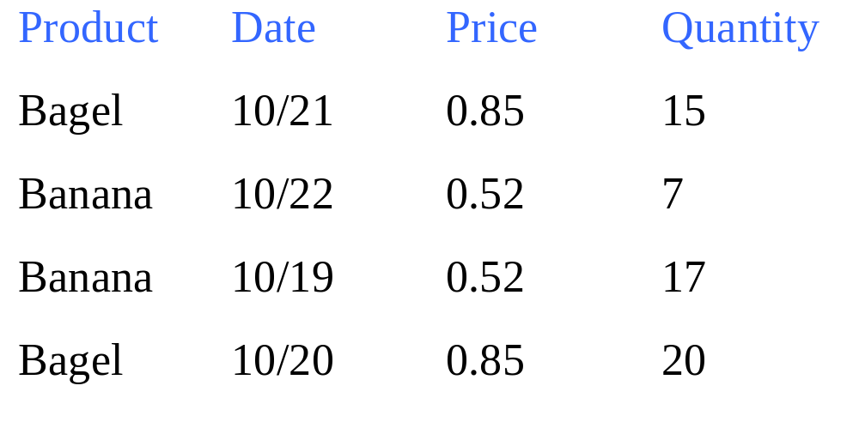
Simple Aggregations
Purchase

Slide 12
Grouping and Aggregation
Usually, we want aggregations on certain parts of the relation.
Purchase(product, date, price, quantity)
Example 2: find total sales after 10/1 per product.
SELECT product, Sum(price*quantity) AS TotalSales
FROM Purchase
WHERE date > “10/1”
GROUPBY product
Let’s see what this means…

Slide 13
Grouping and Aggregation
1. Compute the FROM and WHERE clauses.
2. Group by the attributes in the GROUPBY
3. Select one tuple for every group (and apply aggregation)
SELECT can have (1) grouped attributes or (2) aggregates.

Slide 14
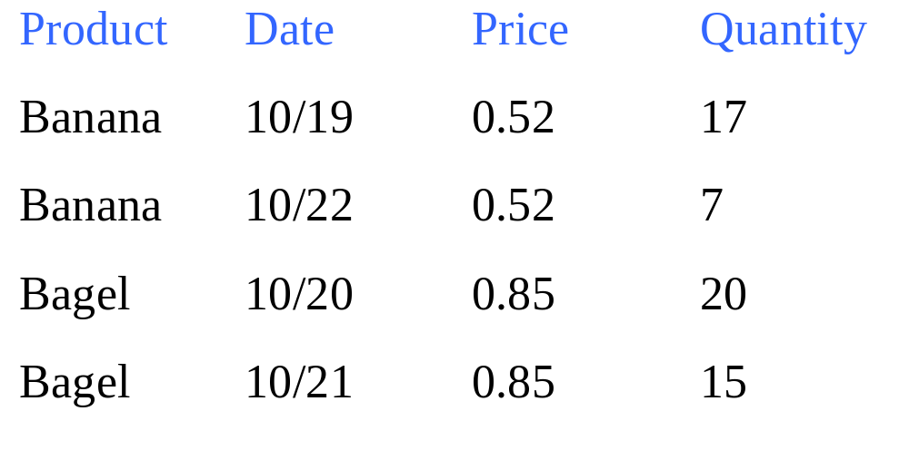
First compute the FROM-WHERE clauses (date > “10/1”) then GROUP BY product:

Slide 15
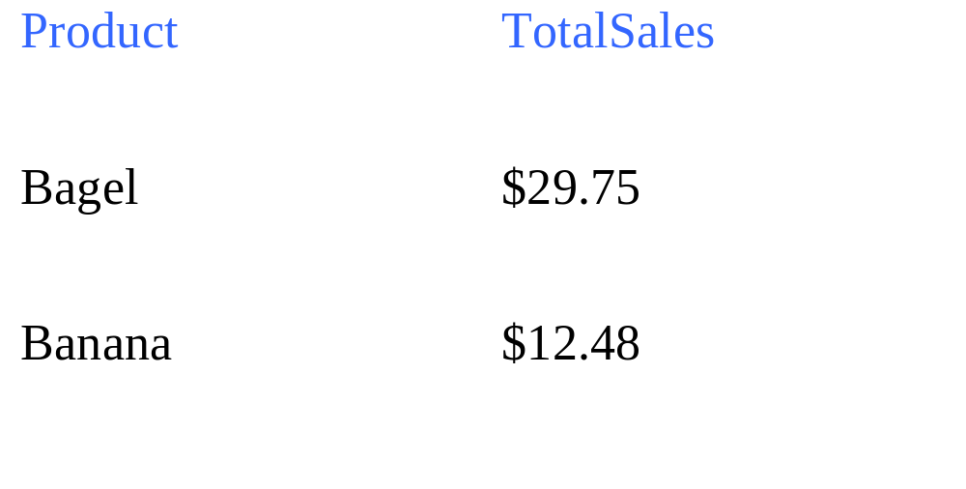
Then, aggregate
SELECT product, Sum(price*quantity) AS TotalSales
FROM Purchase
WHERE date > “10/1”
GROUPBY product

Slide 16
GROUP BY v.s. Nested Queries
SELECT product, Sum(price*quantity) AS TotalSales
FROM Purchase
WHERE date > “10/1”
GROUP BY product
SELECT DISTINCT x.product, (SELECT Sum(y.price*y.quantity)
FROM Purchase y
WHERE x.product = y.product
AND y.date > ‘10/1’)
AS TotalSales
FROM Purchase x
WHERE x.date > “10/1”

Slide 17
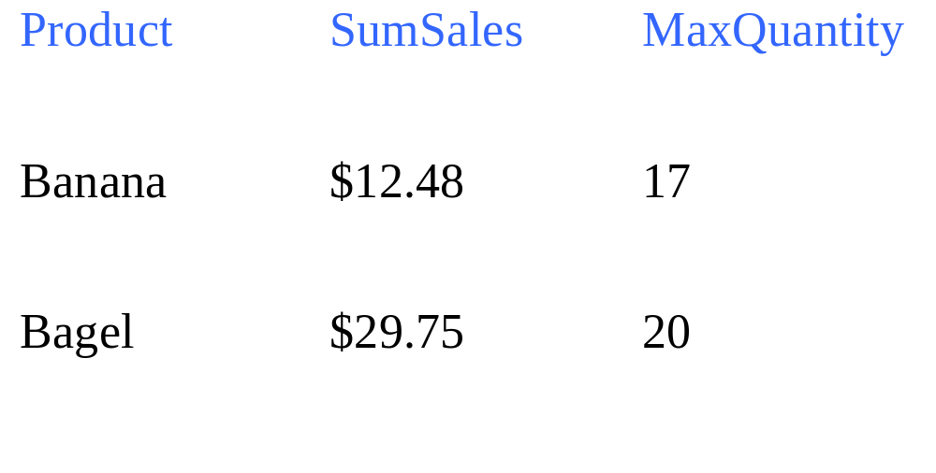
Another Example
For every product, what is the total sales and max quantity sold?
SELECT product, Sum(price * quantity) AS SumSales
Max(quantity) AS MaxQuantity
FROM Purchase
GROUP BY product

Slide 18
HAVING Clause
Same query, except that we consider only products that had
at least 100 buyers.
SELECT product, Sum(price * quantity)
FROM Purchase
WHERE date > “9/1”
GROUP BY product
HAVING Sum(quantity) > 30
HAVING clause contains conditions on aggregates.

Slide 19
General form of Grouping and Aggregation
SELECT S
FROM R₁,…,R_{n}
WHERE C1
GROUP BY a₁,…,a_{k}
HAVING C2
S = may contain attributes a₁,…,a_{k} and/or any aggregates but NO OTHER ATTRIBUTES
C1 = is any condition on the attributes in R₁,…,R_{n}
C2 = is any condition on aggregate expressions
Why ?

Slide 20
General form of Grouping and Aggregation
SELECT S
FROM R₁,…,R_{n}
WHERE C1
GROUP BY a₁,…,a_{k}
HAVING C2
Evaluation steps:
Compute the FROM-WHERE part, obtain a table with all attributes in R₁,…,R_{n}
Group by the attributes a₁,…,a_{k}
Compute the aggregates in C2 and keep only groups satisfying C2
Compute aggregates in S and return the result

Slide 21
Aggregation
Author(login,name)
Document(url, title)
Wrote(login,url)
Mentions(url,word)

Slide 22
Find all authors who wrote at least 10 documents:
Attempt 1: with nested queries
This is
SQL by
a novice
SELECT DISTINCT Author.name
FROM Author
WHERE count(SELECT Wrote.url
FROM Wrote
WHERE Author.login=Wrote.login)
> 10

Slide 23
Find all authors who wrote at least 10 documents:
Attempt 2: SQL style (with GROUP BY)
This is
SQL by
an expert
SELECT Author.name
FROM Author, Wrote
WHERE Author.login=Wrote.login
GROUP BY Author.name
HAVING count(wrote.url) > 10
No need for DISTINCT: automatically from GROUP BY

Slide 24
Find all authors who have a vocabulary over 10000 words:
SELECT Author.name
FROM Author, Wrote, Mentions
WHERE Author.login=Wrote.login AND Wrote.url=Mentions.url
GROUP BY Author.name
HAVING count(distinct Mentions.word) > 10000
Look carefully at the last two queries: you may
be tempted to write them as a nested queries,
but in SQL we write them best with GROUP BY

Slide 25
INTERSECT and EXCEPT:
Not in SQL Server
(SELECT R.A, R.B
FROM R)
INTERSECT
(SELECT S.A, S.B
FROM S)
SELECT R.A, R.B
FROM R
WHERE
EXISTS(SELECT *
FROM S
WHERE R.A=S.A and R.B=S.B)
(SELECT R.A, R.B
FROM R)
EXCEPT
(SELECT S.A, S.B
FROM S)
SELECT R.A, R.B
FROM R
WHERE
NOT EXISTS(SELECT *
FROM S
WHERE R.A=S.A and R.B=S.B)

Slide 26
Null Values and Outerjoins
If x=Null then 4*(3-x)/7 is still NULL
If x=Null then x=“Joe” is UNKNOWN
In SQL there are three boolean values:
  FALSE = 0
  UNKNOWN = 0.5
  TRUE = 1

Slide 27
Null Values and Outerjoins
C1 AND C2 = min(C1, C2)
C1 OR C2 = max(C1, C2)
NOT C1 = 1 – C1
Rule in SQL: include only tuples that yield TRUE
SELECT *
FROM Person
WHERE (age < 25) AND
(height > 6 OR weight > 190)
E.g.
age=20
height=NULL
weight=200

Slide 28
Null Values and Outerjoins
Unexpected behavior:
Some Persons are not included !
SELECT *
FROM Person
WHERE age < 25 OR age >= 25

Slide 29
Null Values and Outerjoins
Can test for NULL explicitly:
  x IS NULL
  x IS NOT NULL
Now it includes all Persons
SELECT *
FROM Person
WHERE age < 25 OR age >= 25 OR age IS NULL

Slide 30
Null Values and Outerjoins
Explicit joins in SQL:
Product(name, category)
Purchase(prodName, store)
Same as:
But Products that never sold will be lost !
SELECT Product.name, Purchase.store
FROM Product JOIN Purchase ON
Product.name = Purchase.prodName
SELECT Product.name, Purchase.store
FROM Product, Purchase
WHERE Product.name = Purchase.prodName

Slide 31
Null Values and Outerjoins
Left outer joins in SQL:
Product(name, category)
Purchase(prodName, store)
SELECT Product.name, Purchase.store
FROM Product LEFT OUTER JOIN Purchase ON
Product.name = Purchase.prodName

Slide 32
Product
Purchase
Name | Category
Gizmo | gadget
Camera | Photo
OneClick | Photo
ProdName | Store
Gizmo | Wiz
Camera | Ritz
Camera | Wiz
Name | Store
Gizmo | Wiz
Camera | Ritz
Camera | Wiz
OneClick | NULL

Slide 33
Outer Joins
Left outer join:
  Include the left tuple even if there’s no match
Right outer join:
  Include the right tuple even if there’s no match
Full outer join:
  Include the both left and right tuples even if there’s no match

Slide 34
Modifying the Database
Three kinds of modifications
Insertions
Deletions
Updates
Sometimes they are all called “updates”

Slide 35
Insertions
General form:
INSERT INTO R(A1,…., An) VALUES (v1,…., vn)
Example: Insert a new purchase to the database:
INSERT INTO Purchase(buyer, seller, product, store)
VALUES (‘Joe’, ‘Fred’, ‘wakeup-clock-espresso-machine’,
‘The Sharper Image’)
Missing attribute → NULL.
May drop attribute names if give them in order.

Slide 36
Insertions
INSERT INTO PRODUCT(name)
SELECT DISTINCT Purchase.product
FROM Purchase
WHERE Purchase.date > “10/26/01”
The query replaces the VALUES keyword.
Here we insert many tuples into PRODUCT

Slide 37
Insertion: an Example
Product(name, listPrice, category)
Purchase(prodName, buyerName, price)
prodName is foreign key in Product.name
Suppose database got corrupted and we need to fix it:
Purchase
Product
prodName | buyerName | price
camera | John | 200
gizmo | Smith | 80
camera | Smith | 225
name | listPrice | category
gizmo | 100 | gadgets
Task: insert in Product all prodNames from Purchase

Slide 38
Insertion: an Example
INSERT INTO Product(name)
SELECT DISTINCT prodName
FROM Purchase
WHERE prodName NOT IN (SELECT name FROM Product)
name | listPrice | category
gizmo | 100 | Gadgets
camera | - | -

Slide 39
Insertion: an Example
INSERT INTO Product(name, listPrice)
SELECT DISTINCT prodName, price
FROM Purchase
WHERE prodName NOT IN (SELECT name FROM Product)
name | listPrice | category
gizmo | 100 | Gadgets
camera | 200 | -
camera ?? | 225 ?? | -
Depends on the implementation

Slide 40
Deletions
Example:
DELETE FROM PURCHASE
WHERE seller = ‘Joe’ AND
product = ‘Brooklyn Bridge’
Factoid about SQL: there is no way to delete only a single
occurrence of a tuple that appears twice
in a relation.

Slide 41
Updates
Example:
UPDATE PRODUCT
SET price = price/2
WHERE Product.name IN
(SELECT product
FROM Purchase
WHERE Date =‘Oct, 25, 1999’);

Slide 42
Data Definition in SQL
So far we have see the Data Manipulation Language, DML
Next: Data Definition Language (DDL)
Data types:
Defines the types.
Data definition: defining the schema.
Create tables
Delete tables
Modify table schema
Indexes: to improve performance

Slide 43
Data Types in SQL
Characters:
  CHAR(20) -- fixed length
  VARCHAR(40) -- variable length
Numbers:
  INT, REAL plus variations
Times and dates:
  DATE, DATETIME (SQL Server only)
To reuse domains:
CREATE DOMAIN address AS VARCHAR(55)

Slide 44
Creating Tables
Example:
CREATE TABLE Person(
name VARCHAR(30),
social-security-number INT,
age SHORTINT,
city VARCHAR(30),
gender BIT(1),
Birthdate DATE
);

Slide 45
Deleting or Modifying a Table
Deleting:
Example:
DROP Person;
Exercise with care !!
Altering: (adding or removing an attribute).
ALTER TABLE Person
ADD phone CHAR(16);
ALTER TABLE Person
DROP age;
Example:
What happens when you make changes to the schema?

Slide 46
Default Values
Specifying default values:
CREATE TABLE Person(
name VARCHAR(30),
social-security-number INT,
age SHORTINT DEFAULT 100,
city VARCHAR(30) DEFAULT ‘Seattle’,
gender CHAR(1) DEFAULT ‘?’,
Birthdate DATE
The default of defaults: NULL

Slide 47
Indexes
REALLY important to speed up query processing time.
Suppose we have a relation
Person (name, age, city)
Sequential scan of the file Person may take long
SELECT *
FROM Person
WHERE name = “Smith”

Slide 48
Indexes
Create an index on name:
B+ trees have fan-out of 100s: max 4 levels !
Adam | Betty | Charles | …. | Smith | ….

Slide 49
Creating Indexes
Syntax:
CREATE INDEX nameIndex ON Person(name)

Slide 50
Creating Indexes
Indexes can be created on more than one attribute:
CREATE INDEX doubleindex ON
Person (age, city)
Example:
SELECT *
FROM Person
WHERE age = 55 AND city = “Seattle”
Helps in:
SELECT *
FROM Person
WHERE city = “Seattle”
But not in:

Slide 51
Creating Indexes
Indexes can be useful in range queries too:
B+ trees help in:
Why not create indexes on everything?
CREATE INDEX ageIndex ON Person (age)
SELECT *
FROM Person
WHERE age > 25 AND age < 28

Slide 52
Defining Views
Views are relations, except that they are not physically stored.
For presenting different information to different users
Employee(ssn, name, department, project, salary)
Payroll has access to Employee, others only to Developers
CREATE VIEW Developers AS
SELECT name, project
FROM Employee
WHERE department = “Development”

Slide 53
A Different View
Person(name, city)
Purchase(buyer, seller, product, store)
Product(name, maker, category)
We have a new virtual table:
Seattle-view(buyer, seller, product, store)
CREATE VIEW Seattle-view AS
SELECT buyer, seller, product, store
FROM Person, Purchase
WHERE Person.city = “Seattle” AND
Person.name = Purchase.buyer

Slide 54
A Different View
We can later use the view:
SELECT name, store
FROM Seattle-view, Product
WHERE Seattle-view.product = Product.name AND
Product.category = “shoes”

Slide 55
What Happens When We Query a View ?
SELECT name, Seattle-view.store
FROM Seattle-view, Product
WHERE Seattle-view.product = Product.name AND
Product.category = “shoes”
SELECT name, Purchase.store
FROM Person, Purchase, Product
WHERE Person.city = “Seattle” AND
Person.name = Purchase.buyer AND
Purchase.poduct = Product.name AND
Product.category = “shoes”

Slide 56
Types of Views
Virtual views:
  Used in databases
  Computed only on-demand – slow at runtime
  Always up to date
Materialized views
  Used in data warehouses
  Precomputed offline – fast at runtime
  May have stale data

Slide 57
Updating Views
How can I insert a tuple into a table that doesn’t exist?
Employee(ssn, name, department, project, salary)
CREATE VIEW Developers AS
SELECT name, project
FROM Employee
WHERE department = “Development”
If we make the
following insertion:
INSERT INTO Developers
VALUES(“Joe”, “Optimizer”)
It becomes:
INSERT INTO Employee
VALUES(NULL, “Joe”, NULL, “Optimizer”, NULL)

Slide 58
Non-Updatable Views
CREATE VIEW Seattle-view AS
SELECT seller, product, store
FROM Person, Purchase
WHERE Person.city = “Seattle” AND
Person.name = Purchase.buyer
How can we add the following tuple to the view?
(“Joe”, “Shoe Model 12345”, “Nine West”)
We need to add “Joe” to Person first, but we don’t have all its attributes

