Slide 1
web forms

Slide 2
Focus of the last lecture was on HTML Lists & Tables
We learnt how to extend our Web pages by adding a few more tags
Specifically, we discussed various types of lists that can be added to a Web page – un-ordered, ordered and definition lists
And also, about tables: about various tags used in a table and their associated attributes

Slide 3
Today’s Lecture
We will try to understand the utility of forms on Web pages
We will find out about the various components that are used in a form
We will become able to build a simple, interactive form

Slide 4
Interactive Forms (1)
Without forms, a Web site is “read-only” – it just provides information to the user
Forms enable the user to provide information to the Web site. For example, the user can:
  Perform searches on Web site
  Give comments
  Ask for info that is not available on the Website
  Place order for goods and services

Slide 5
Interactive Forms (2)
Can be simple or very complex
Can fill a whole page or just a single line
Can contain a single element or many
Are always placed between the <BODY> and </BODY> tags of a Web page

Slide 6
Interactive Forms (3)
Are GUI-based
May contain:
  Text fields
  Check boxes
  Buttons
  Scrollable lists

Slide 7
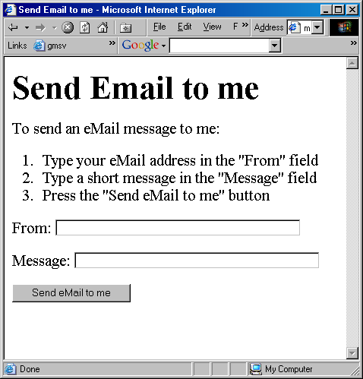
A Simple
Example of
Interactive
Forms

Slide 8
Code for that Example
<HTML>
<HEAD>
<TITLE>Send Email to me</TITLE>
</HEAD>
<BODY>
<H1>Send Email to me</H1>
Code for the instructions
Code for the form
</BODY>
</HTML>

Slide 9
A Simple
Example of
Interactive
Forms

Slide 10
Code for the Instructions
<P>To send an eMail message to me:</P>
<OL>
<LI>Type your eMail address in the &quot;From&quot; field</LI>
<LI>Type a short message in the &quot;Message&quot; field</LI>
<LI>Press the &quot;Send eMail to me&quot; button</LI>
</OL>

Slide 11
A Simple
Example of
Interactive
Forms

Slide 12
Code for the Form
<FORM name="sendEmail" method="post" action="sendMailScriptURL">
Elements of the form
</FORM>

Slide 13
<FORM name="sendEmail" method="post" action="sendMailScriptURL">
Elements of the form
</FORM>
name: Name given to the form
method: Forms can be submitted through two alternate methods – GET & POST
action: Specifies the URL that is accessed when the form is being submitted

Slide 14
Server-Side Scripts
Are programs that reside on Web servers
Receive info that a user enters in a form
Process that info and take appropriate action
Examples:
  CGI scripts on Unix servers
  ASP scripts on Windows servers
  PHP/Java

Slide 15
A Simple
Example of
Interactive
Forms

Slide 16
Elements of the Form (1)
<P>From: <INPUT type="text" name=“sender" size="50"></P>
<P>Message: <INPUT type="text" name="message" size="50"></P>

Slide 17
A Simple
Example of
Interactive
Forms

Slide 18
Elements of the Form (2)
<P><INPUT type="hidden" name="receiver" value="altaf@vu.edu.pk"></P>
<P><INPUT type="hidden" name=“subject” value=“eMail from the form”></P>
<P><INPUT type="submit“ name="sendEmail" value="Send eMail to me"></P>

Slide 19
A Simple
Example of
Interactive
Forms

Slide 20
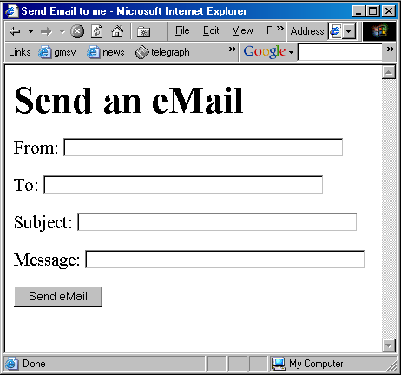

Slide 21
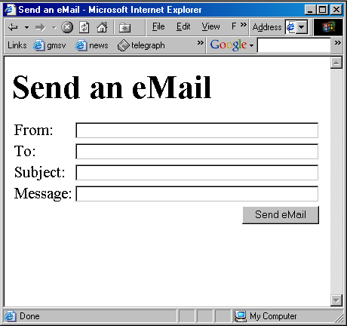

Slide 22
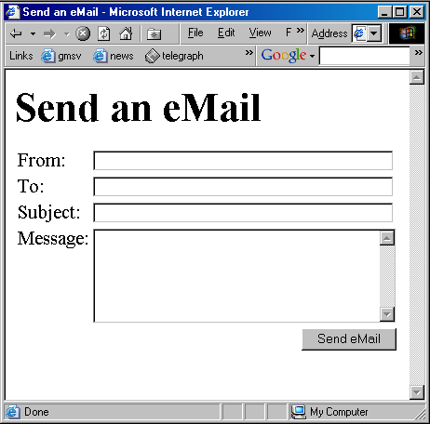

Slide 23
<TEXTAREA name=“message” cols=“38” rows=“6”
>
</TEXTAREA>

Slide 24
<FORM name="sendEmail" method="post" action=“sendMailScriptURL">
<table><tr>
<td>From: </td>
<td><INPUT type="text" name="sender" size="50"></td>
</tr><tr>
<td>To: </td>
<td><INPUT type="text" name="receiver" size="50"></td>
</tr><tr>
<td>Subject: </td>
<td><INPUT type="text" name="subject" size="50"></td>
</tr><tr>
<td valign="top">Message: </td>
<td><TEXTAREA name="message" cols="38"rows="6"> </TEXTAREA></td>
</tr><tr>
<td colspan="2" align="right">
<INPUT type="submit" name="sendEmail" value="Send eMail">
</td>
</tr></table>
</FORM>

Slide 25
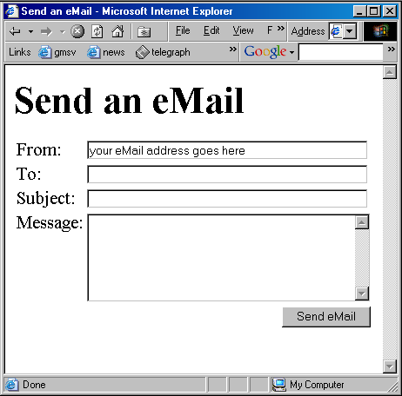

Slide 26
<INPUT type=“text” name=“sender” size=“50” value=“your eMail address goes here”
>

Slide 27
Review of the Tags Used in Forms

Slide 28
<FORM
name=“nameOfTheForm”
method=“get” or “post”
action=“URL”
>
Elements of the form
</FORM>

Slide 29
Single-Line Text Input Field
<INPUT
type=“text”
name=“fieldName”
size=“widthInCharacters”
maxlength=“limitInCharacters”
value=“initialDefaultValue”
>

Slide 30
Hidden Input
<INPUT
type=“hidden” name=“fieldName”
value=“value”
>

Slide 31
Submit Button Input
<INPUT
type=“submit” name=“buttonName”
value=“displayedText”
>

Slide 32
Multi-Line Text Input Area
<TEXTAREA
name=“areaName”
cols=“widthInCharacters”
rows=“numberOfLines”
>
initial default value
</TEXTAREA>

Slide 33
This was a review of the new tags (and associated attributes) that we have used in today’s examples
There are many more tags that can be used in a form
Let us take a look at a few

Slide 34
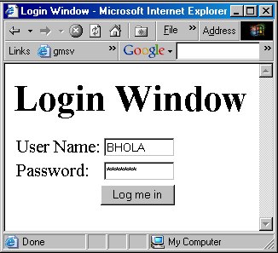

Slide 35
<form name="login" method="post" action="loginScript">
<table><tr>
<td>User Name: </td>
<td>
<input type="text" name="userName" size="10">
</td>
</tr><tr>
<td>Password: </td>
<td>
<input type="password" name="password" size="10">
</td>
</tr><tr>
<td colspan="2" align="right">
<input type="submit" name="login" value="Log me in">
</td>
</tr></table>
</form>

Slide 36
Password Input Field
<INPUT
type=“password”
name=“fieldName”
size=“widthInCharacters”
maxlength=“limitInCharacters”
value=“initialDefaultValue”
>

Slide 37
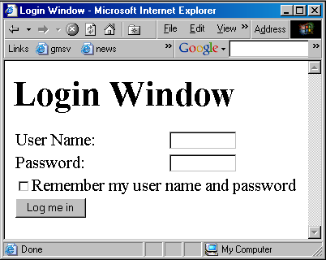

Slide 38
<form name="login" method="post" action="loginScript">
<table><tr>
<td>User Name: </td>
<td>
<input type="text" name="userName" size="10">
</td>
</tr><tr>
<td>Password: </td>
<td>
<input type="password" name="password" size="10">
</td>
</tr><tr>
<td colspan="2">
<input type="checkbox" name="remember" value="remember">
Remember my user name and password<br>
</td>
</tr><tr>
<td colspan="2">
<input type="submit" name="login" value="Log me in">
</td>
</tr></table>
</form>

Slide 39
Checkbox Input Element
<INPUT
type=“checkbox”
name=“checkboxName”
checked
value=“checkedValue”
>

Slide 40
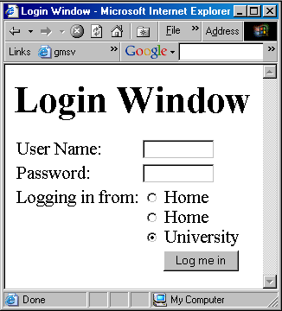
Office

Slide 41
<form name="login" method="post" action="loginScript">
<table><tr>
<td>User Name: </td>
<td>
<input type="text" name="userName" size="10">
</td>
</tr><tr>
<td>Password: </td>
<td>
<input type="password" name="password" size="10">
</td>
</tr><tr>
<td valign="top">Logging in from:</td>
<td>
<input type="radio" name="from" value="home"> Home<br>
<input type="radio" name="from" value="office"> Home<br>
<input type="radio" name="from" value="university" checked> University
</td>
</tr><tr>
<td colspan="2" align="right">
<input type="submit" name="login" value="Log me in">
</td>
</tr></table>
</form>

Slide 42
Radio Button Input Element
<INPUT
type=“radio”
name=“radioButtonName”
checked
value=“selectedValue”
>

Slide 43
What is the difference between checkboxes and radio buttons?

Slide 44
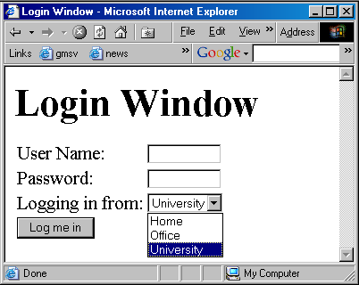

Slide 45
<form name="login" method="post" action="loginScript">
<table><tr>
<td>User Name: </td>
<td><input type="text" name="userName" size="10"></td>
</tr><tr>
<td>Password: </td>
<td>
<input type="password" name="password" size="10">
</td>
</tr><tr>
<td valign="top">Logging in from:</td>
<td>
<select size="2" name="from">
<option value="home"> Home
<option value="office"> Office
<option value="university" selected> University
</select>
</td>
</tr><tr>
<td colspan="2">
<input type="submit" name="login" value="Log me in">
</td>
</tr></table>
</form>

Slide 46
Select from a (Drop Down) List
<SELECT
name=“listName”
size=“numberOfDisplayedChoices”
multiple
>
  <OPTION value=“value1”> text1
  <OPTION value=“value2” selected> text2
  <OPTION value=“value3”> text2
…
…
</SELECT>

Slide 47
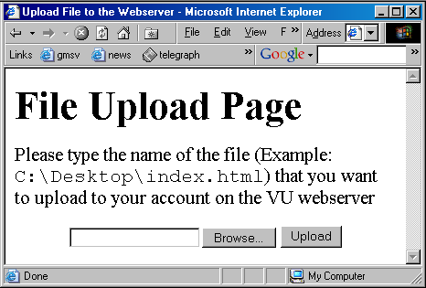

Slide 48
File Upload Input Element
<INPUT
type=“file”
name=“buttonName”
value=“nameOfSelectedFile”
enctype=“fileEncodingType”
>

Slide 49
<form name=“uploadForm” method=“post” action=“uploadScript”
<input type=“file” name=“uploadFile” enctype=“multipart/form-data”
>
<input type=“submit” name=“submit” value=“Upload”
>
</form>

Slide 50
Reset Button Input Element
(Resets the contents of a form to default values)
<INPUT
type=“reset”
value=“dispalyedText”
>

Slide 51
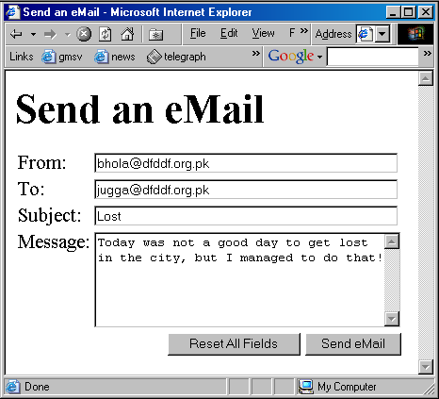

Slide 52
Assignment # 4
Create a simple Web page to provide electronic greeting message service on the Internet. Your Web page should contain:
  The heading of the Web page
  Input fields to capture information (i.e. names and email addresses) about the sender and the receiver of the message
  List of the available greeting messages
  Button to send the card
More info about this assignment is available on the CS101 Web page

Slide 53
Today’s Lecture was the …
We looked at the utility of forms on Web pages
We found out about the various components that are used in a form
We became able to build a simple, interactive form

Slide 54
Next Web Dev Lecture:
More Complex Form
Today we started our discussion on interactive forms
During the next Web Dev Lecture we continue this discussion and learn ways of constructing more complex interactive forms
We may also get our first taste of JavaScript during that lecture

Slide 55
Next lecture
Attribute selectors
  [title]
  {
  color:blue;
  }
  Or
  [name=search]
  {
  border:5px solid green;
  }

Slide 56
Next Lecture
JavaScript with forms
        questions

