Slide 1

Weekly Progress - 1/10/2019

Slide 2
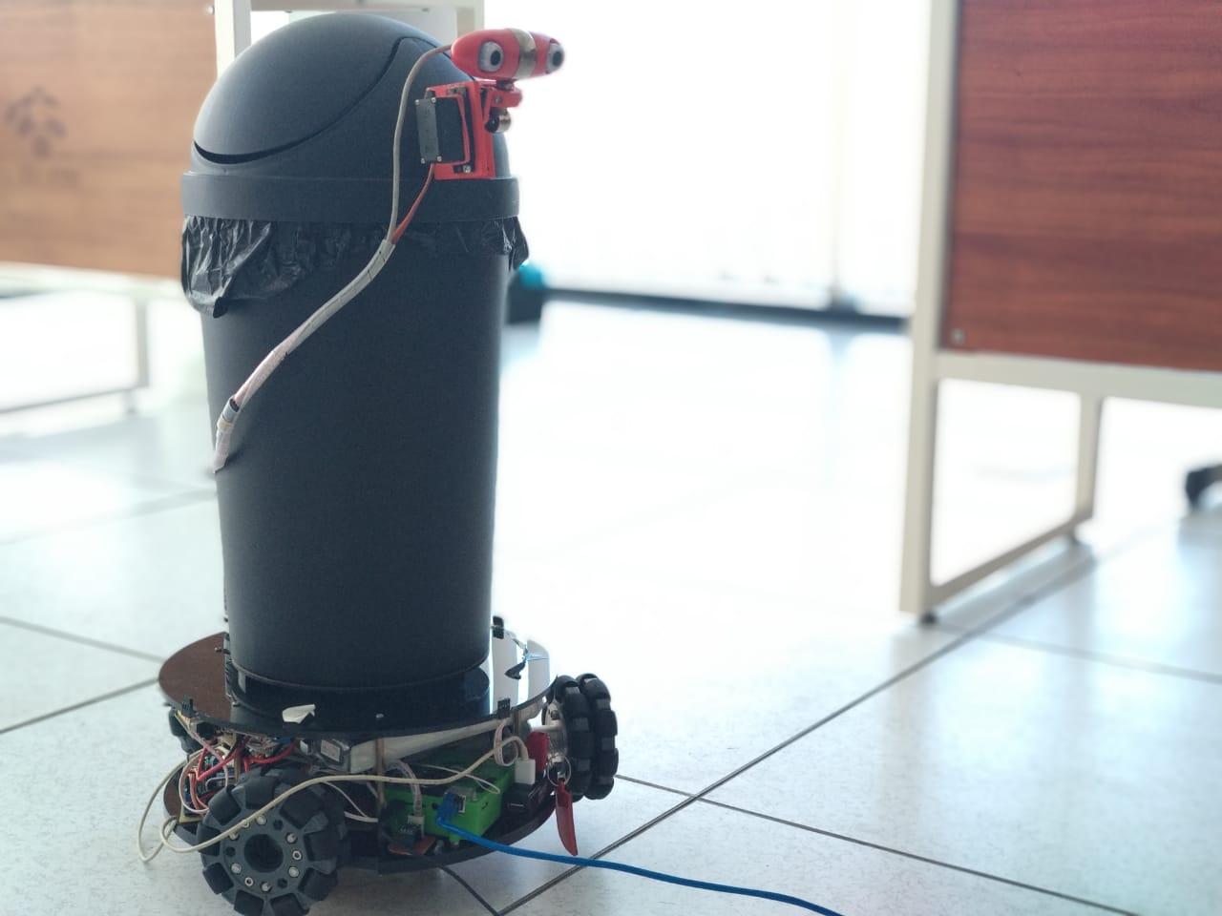
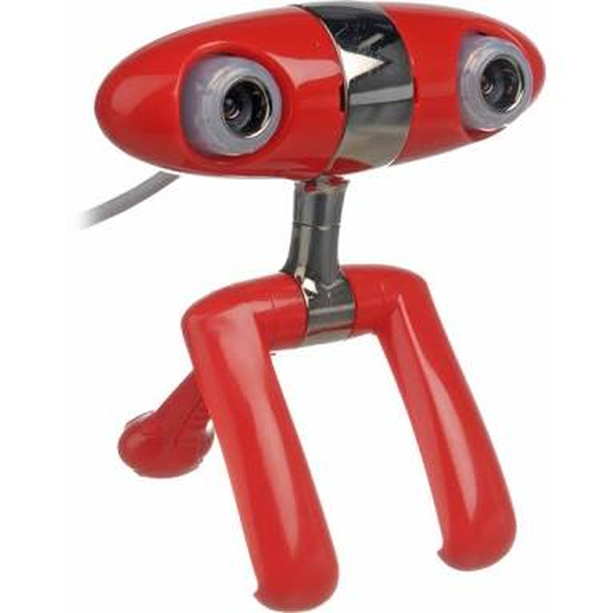
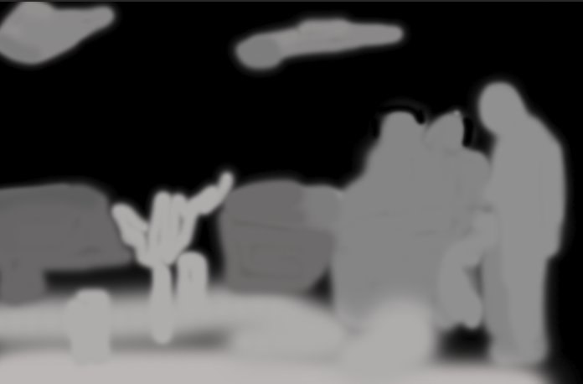
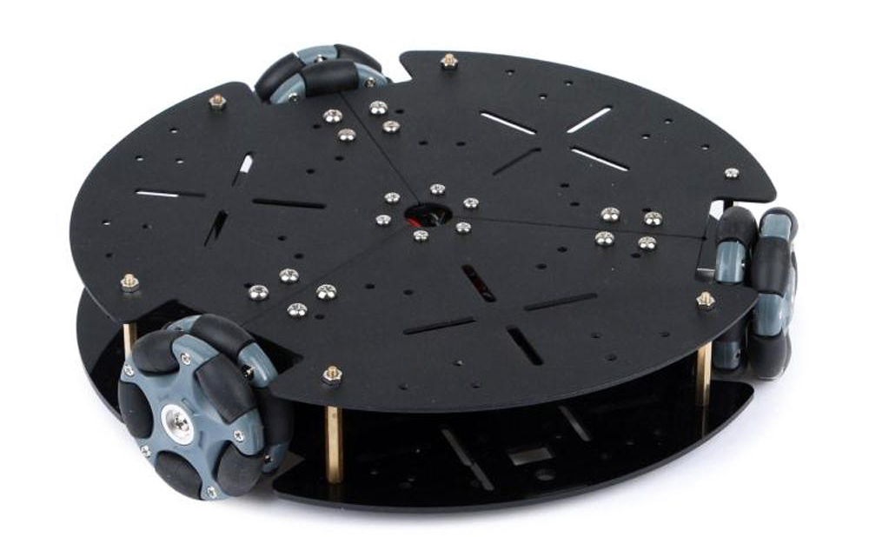
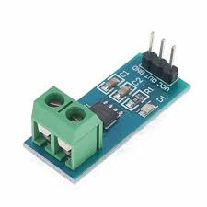
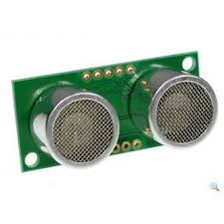
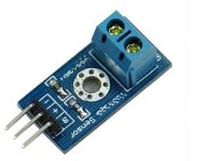
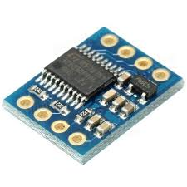
Full Operated MTBR
Object Detection
Navigation
Interaction
Communication
Detection
Stereo Matching
Depth Image
Human Upper Body
Prediction
Classification
Local Mapping
Persuasif
Decision Making
IoT
2020191006 - Kisron

Slide 3
Already Done
Installing ROS and QT Creator
Access camera using ROS
Create simple publisher subscriber (txt and img)
Try rosserial to send data form arduino to PC
Looks for journals reference
Stereo Calibration
2020191006 - Kisron

Slide 4
On going
Looking for reference journal
Learning Process to getting Depth images
Getting Depth Images
2020191006 - Kisron

Slide 5
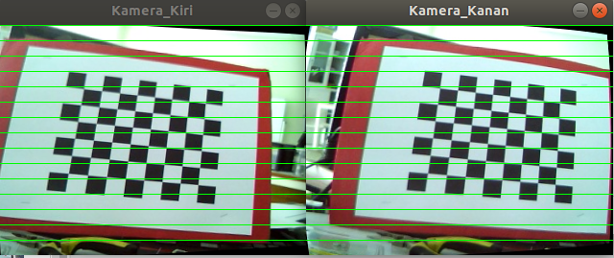
Calibration

Slide 6
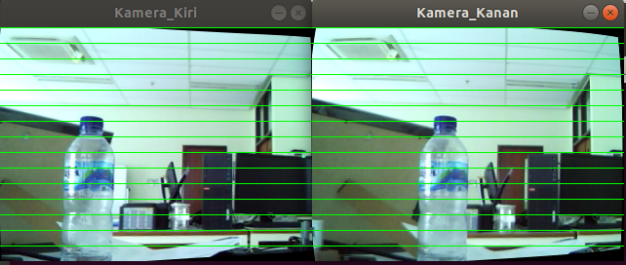
Image Rectification

Slide 7
Next task
- Stereo Matching
- Depth Image
Try research that has been made before in ROS platform :
- Object Detection
- Navigation
- Communication (my project)
2020191006 - Kisron

