Slide 1

Weekly Progress - 14/4/2020

Slide 2
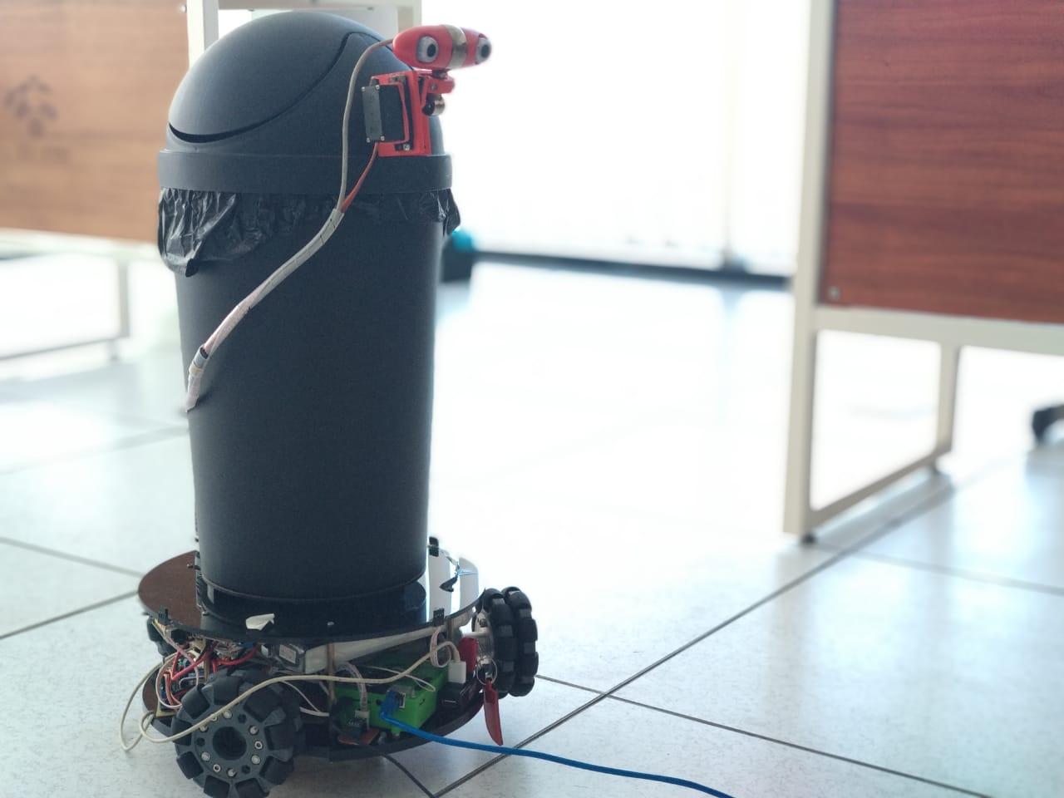
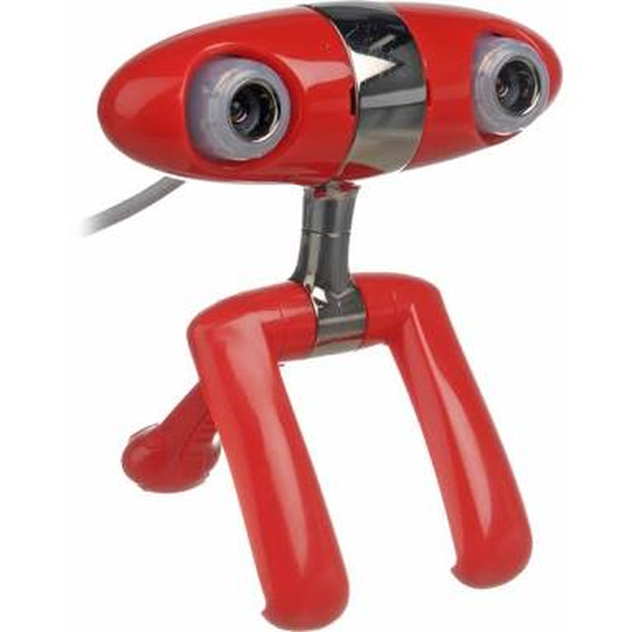
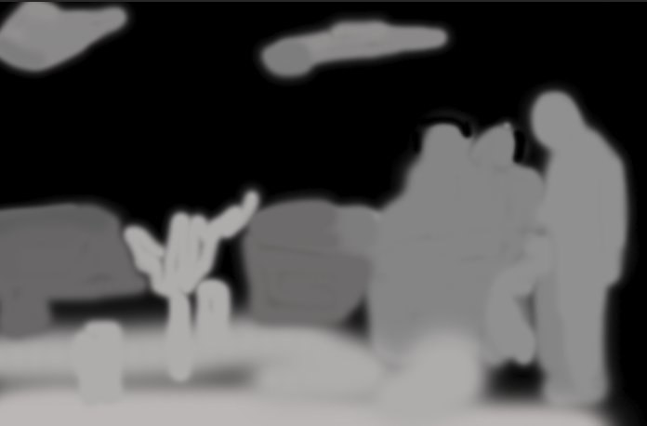
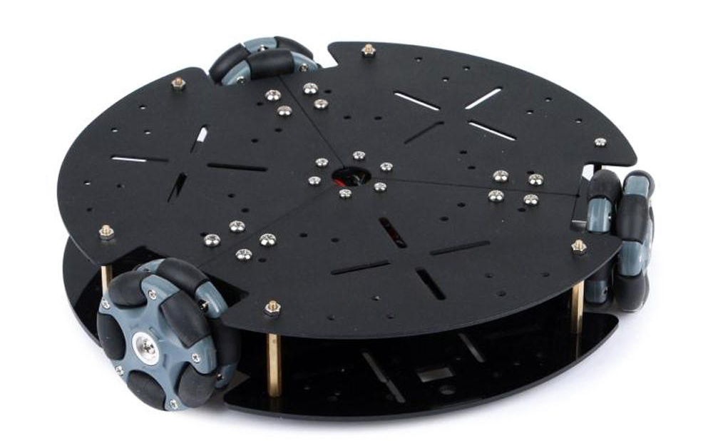
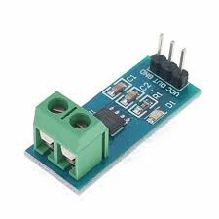
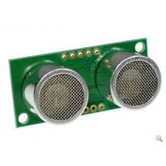
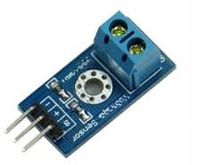
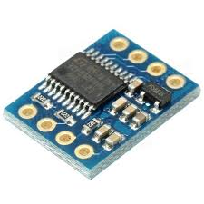
Full Operated MTBR
Object Detection
Navigation
Interaction
Communication
Detection
Stereo Matching
Depth Image
Human Upper Body
Prediction
Classification
Local Mapping
Persuasif
Decision Making
IoT
2020191006 - Kisron

Slide 3
Already Done
Installing ROS and QT Creator
Access camera using ROS
Create simple publisher subscriber (txt and img)
Try rosserial to send data form arduino to PC
Trash detection using Haar Cascade
program is uploaded in github
https://github.com/kisron86/atracbot
2020191006 - Kisron

Slide 4
On going
Convert irfan's program to ROS environment
Trash Classification using SVM method
1. Exctract Feature using HOG and GLCM
2. Training SVM
3. Testing
2020191006 - Kisron

Slide 5
Problem
1. Erorr library in ROS (solved)
2. Error Library for stereo function (use opencv2, but in ROS is opencv 3 installed)
3. Work hour internet doesn't stable
Solution
1. https://roboticsbackend.com/ros-include-cpp-header-from-another-package/
2. Install Opencv version 2
3. work at night 01.00 - 06.00

Slide 6
Next task
- Programming Trash Classification using SVM Method
- Prepare for international conference
2020191006 - Kisron

