Slide 1


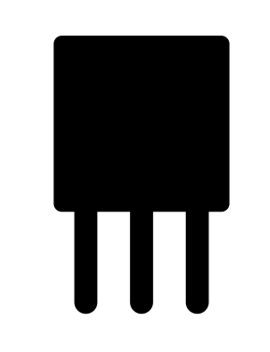
Device
Platform
Application
고객사
Application
Portal
RPC

