Slide 1


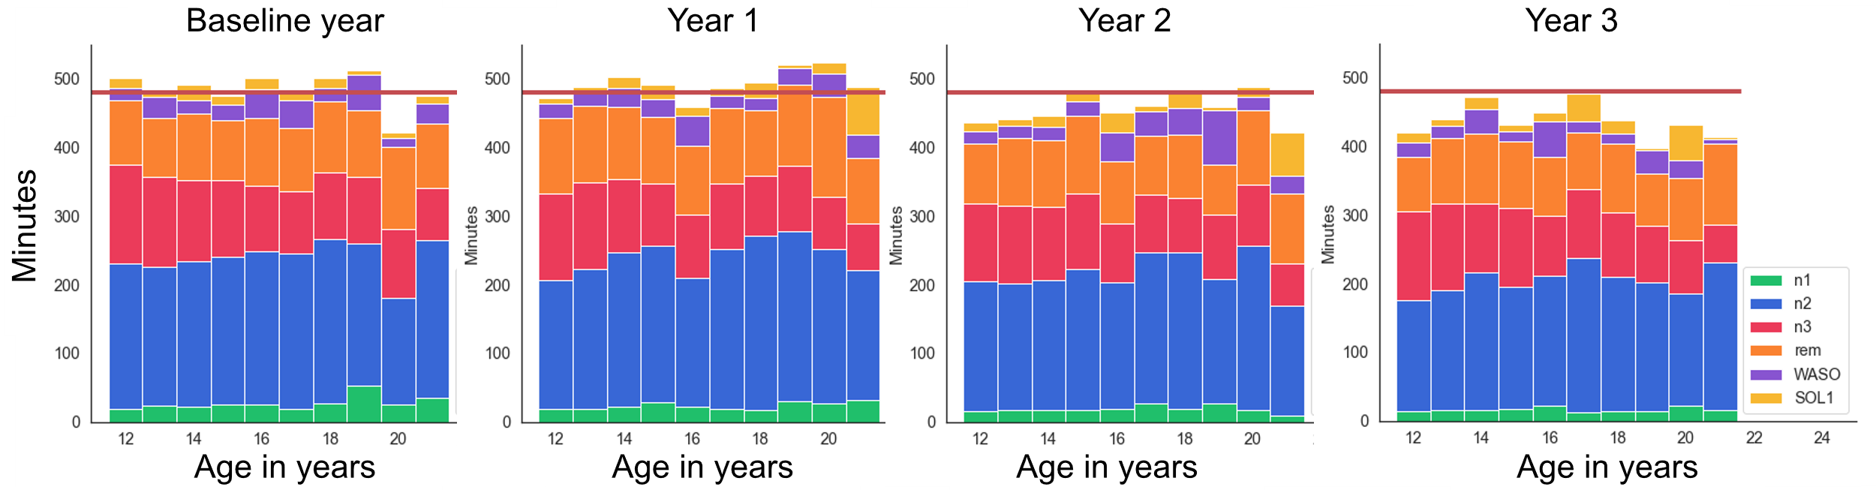
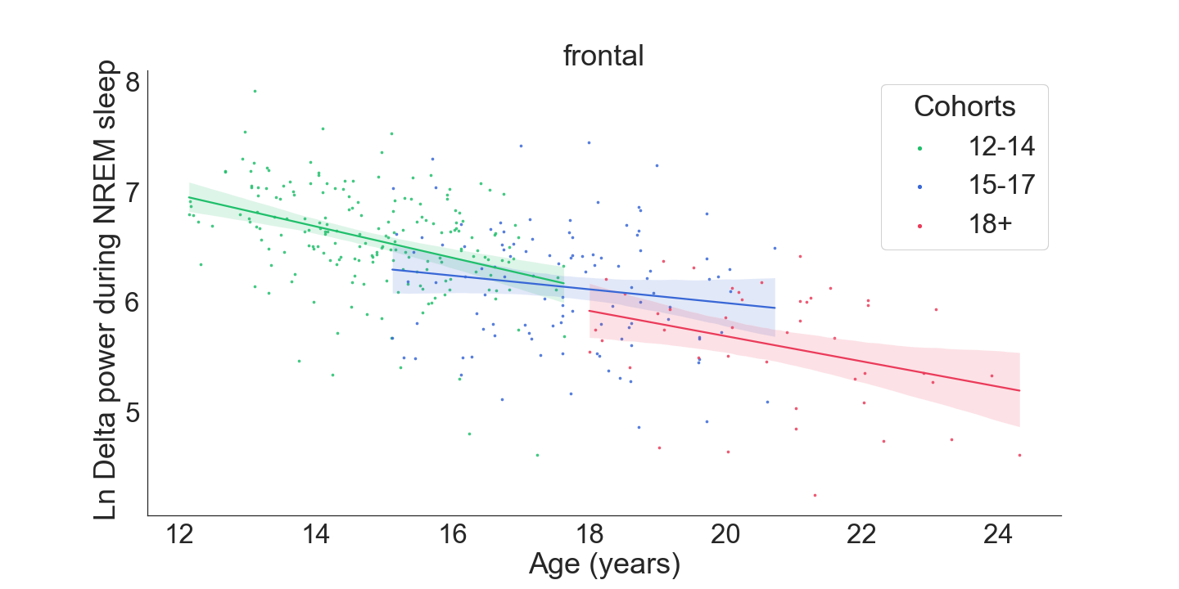
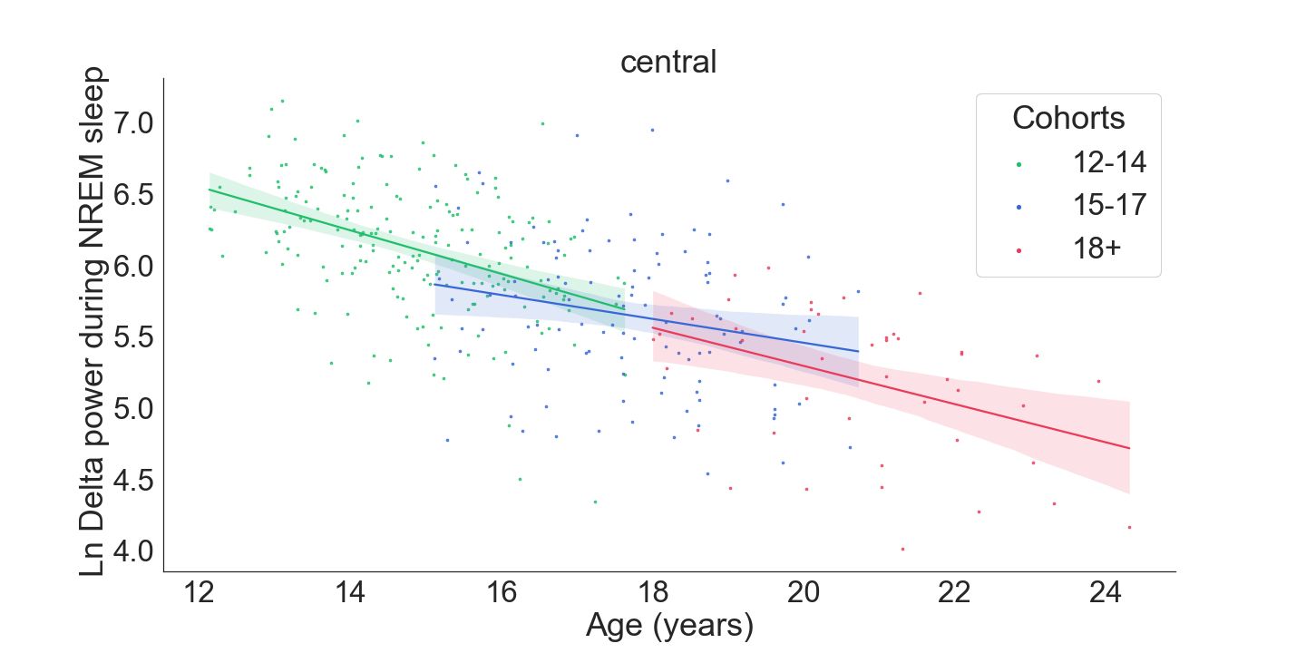
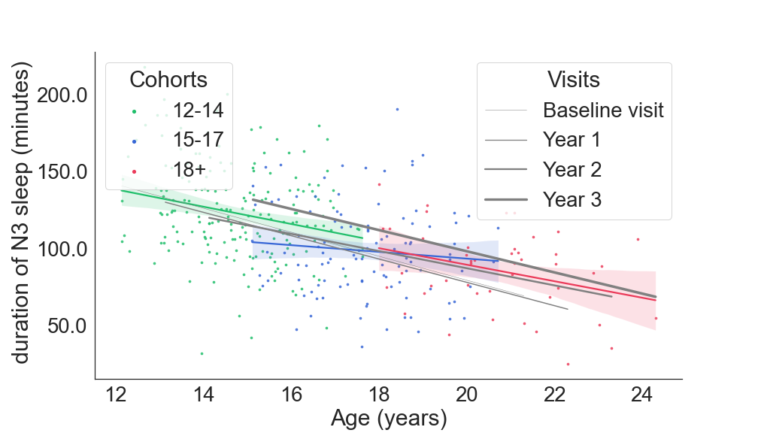
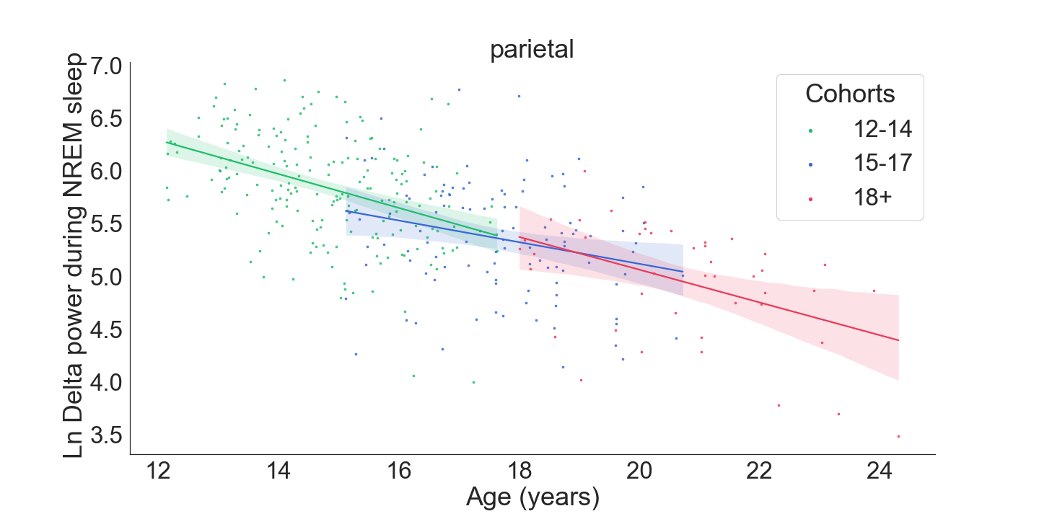
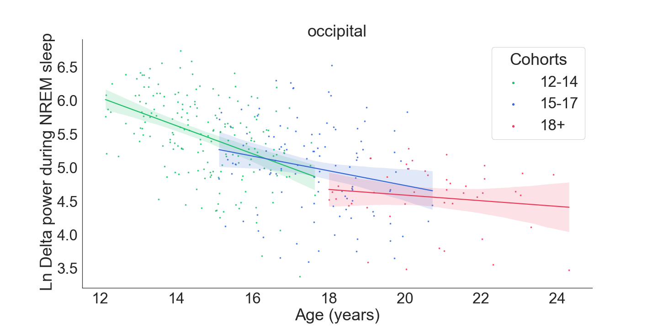
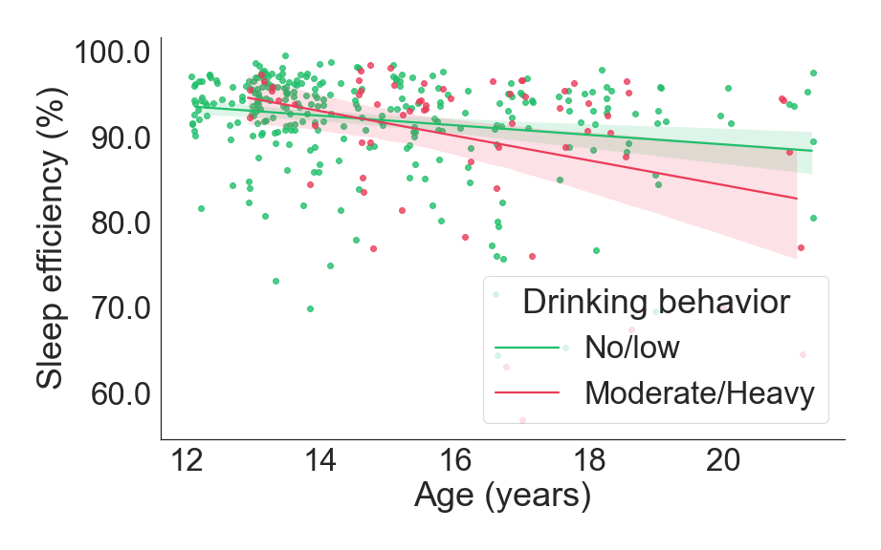
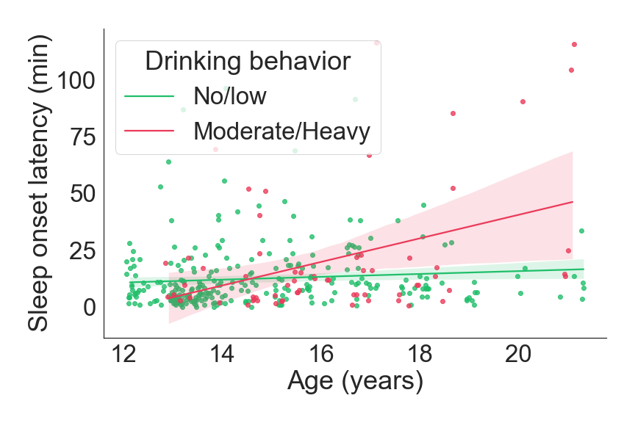
Developmental trajectory of functional sleep measures and how they are impacted by alcohol exposure in adolescence.
Orsolya Kiss, PhD¹, Massimiliano de Zambotti¹, PhD, Dilara Yuksel, PhD¹, Aimée Goldstone¹, Emil Schaefer ¹, Ian M Colrain ¹, Brant P Hasler ², Peter L. Franzen², Duncan B Clark² PhD, and Fiona C Baker¹, PhD.
¹ Center for Health Sciences, SRI International, Menlo Park, California
² University of Pittsburgh School of Medicine, Pittsburgh, PA, USA
Introduction
Results
Adolescence is accompanied by major social, behavioral, neural and cognitive changes, including profound changes in sleep and circadian processes¹.
Bedtime progressively becomes later, and sleep duration becomes shorter across adolescence². Prior studies found that prepubertal children (mean age 11.3 years) had less NREM and REM sleep EEG spectral power than mature adolescents (mean age 14.1 years) across a range of frequencies³.
The developmental changes have been linked to synaptic pruning in different brain circuits⁴, to the progressively lower build-up in homeostatic sleep pressure during wakefulness, and to the altered circadian regulation during puberty⁵.
Rates of alcohol use rise dramatically across adolescence and alcohol consumption in adults and older adolescents disrupts sleep architecture and EEG, as well as sleep homeostasis.
Our Objective: To investigate 1. age-related differences in polysomnographic and sleep electroencephalographic (EEG) measures, considering sex, and scalp topography in adolescence, 2. examine how the onset of (moderate/high) alcohol consumption affects trajectories of sleep.
Sleep Structure
a.
NREM Slow wave activity
N3 SLEEP
b.
Participants
**
Older adolescents had more N2 (χ2(1) = 4.590, p = 0.032) and less N3 sleep (χ2(1) = 5.966, p = 0.015) (Figure 1 b).
The WASO (χ2(1) = 4.456, p = 0.035) and N1 (χ2(1) = 18.576, p < 0.001) sleep decreased across annual assessments within participants.
The total sleep time (TST) shortened on the within subject level with every yearly visit (Figure 1 a) at all ages (χ2(1) = 35.750, p < 0.001).
Being in the moderate/high drinking category was significantly related to less efficient sleep (SE) and longer sleep onset (SOL) in older participants. (Figure 1 c, d).
Family history of substance use was significantly associated with shorter TST (χ2(1) = 5.394, p = 0.020).
Delta power was highest at frontal sites and lowest at the occipital site. Age was negatively associated with delta power activity, with a lower decline in the older (18+-year-old) cohort at the occipital electrode) (Figure 2).
We included 94 participants in the special polysomnographic (PSG) sub-study of the NCANDA study, conducted at SRI International and the University of Pittsburgh Medical Center. All participants were no/low drinkers at baseline and completed three additional annual follow-up visits (participants were 12.0 - 21.9 years at baseline).
Effects of alcohol
 | Male 57.44% (n = 54) | Female 42. 55 % (n = 40)
Age (y) | 15.09 (2.21) | 15.10 (2.38)
Body mass index percentile ª | 60.84(26.23) | 51.48 (27.86)
Ethnicity (n)
Caucasian | 40 | 30
Asian | 9 | 9
African American | 3 | 1
Other/undeclared | 2 | 0
Pubertal development score ^{b} | 2.70 (0.69) | 3.10 (0.74)
Drinking behavior (n)
Baseline year | 0 moderate/high | 0 moderate/high
Year 1 visit | 6 moderate/high | 8 moderate/high
Year 2 visit | 13 moderate/high | 11 moderate/high
Year 3 visit | 19 moderate/high | 14 moderate/high
c.
*
conclusion
Results from this longitudinal analysis show substantial differences both in sleep architecture and EEG as a function of aging across adolescence. In particular, older, more mature adolescents had less N3 sleep and lower EEG power across slow and fast frequency bands than younger adolescents, likely reflecting the process of synaptic pruning in the brain across development⁶.
The initiation of moderate-high substance use perturb the normal trajectory of development, with changes both in the sleep quality and EEG power, affecting mainly the REM sleep.
Alcohol's effect on sleep during adolescence is of particular concern given that this age group shows both dramatic increases in alcohol consumption and significant developmental changes in the central nervous system.
Methods
STANDARD POLYSOMNOGRAPHY (PSG):using Compumedics Grael HD PSG system (Compumedics Abbotsford, Victoria, Australia), including electroencephalogram (EEG), submental electromyogram (EMG), bipolar electrooculogram (EOG) and electrocardiogram (ECG). 30s epochs were visually scored according to the guidelines of the Academy of Sleep Medicine.
Sleep macrostructure and power spectral analysis (PSA) within NREM and REM sleep was used to evaluate the longitudinal overnight electroencephalographic (EEG) sleep recordings.
We performed linear mixed effects models (LMMs). The models included age (baseline age of the participant measured at the first visit), year of the visit (corresponds to the within-subject change in age), sex (male/female), alcohol use (low/no, moderate/high), family history of alcohol use (yes/no), marijuana use, and all the two-way interaction terms of sex, age, alcohol intake, and marijuana use.
d.
References
(1) de Zambotti, M., Goldstone, A., Colrain, I. M., & Baker, F. C. (2018). Insomnia disorder in adolescence: Diagnosis, impact, and treatment. Sleep Med Rev, 39, 12-24. doi:10.1016/j.smrv.2017.06.009
(2) Baker, F. C., Willoughby, A. R., de Zambotti, M., Franzen, P. L., Prouty, D., Javitz, H., . . . Colrain, I. M. (2016). Age-Related Differences in Sleep Architecture and Electroencephalogram in Adolescents in the National Consortium on Alcohol and Neurodevelopment in Adolescence Sample. Sleep, 39(7), 1429-1439. doi:10.5665/sleep.5978
(3) Jenni, O. G., & Carskadon, M. A. (2004). Spectral analysis of the sleep electroencephalogram during adolescence. Sleep, 27(4), 774-783.
(4) Feinberg, I., & Campbell, I. G. (2010). Sleep EEG changes during adolescence: an index of a fundamental brain reorganization. Brain and Cognition, 72(1), 56-65.
(5) Jenni, O. G., Achermann, P., & Carskadon, M. A. (2005). Homeostatic sleep regulation in adolescents. Sleep, 28(11), 1446-1454.
(6) Buchmann, A., Ringli, M., Kurth, S., Schaerer, M., Geiger, A., Jenni, O. G., & Huber, R. (2011). EEG sleep slow-wave activity as a mirror of cortical maturation. Cerebral Cortex, 21(3), 607-615.
SUPPORT:XY; Contact: orsolya.kiss@sri.com

