Slide 1

Data Analysis for Movie Recommendations
Group 4:
Dhruv Jani
Dhruvil Patel
Karan Issrani
Mohit Gupta
Yaw Frempong

Slide 2
Dataset
IMDB MovieLens is a dataset of movie rating collected by GroupLens Research
200,000 + ratings
9,000 movies
600 users
Dataset Features/Fields of Interest:
Title
Genre
Tag
Rating(1-5 stars)

Slide 3
Business Problem/Opportunity
Building a recommendation algorithm to:
Providing customers with personalized recommendations
Increase user retention
Increase watch time
Recommendations are a core feature to content providers like:
Hulu
Netflix
Amazon Prime Video
Disney+
Notes:
Recommendation algorithms are at the core of the Netflix, Prime and Hulu products. They provide our members with personalised suggestions to reduce the amount of time and frustration to find something great content to watch.

Slide 4
Domain Knowledge
Recommendation Systems:
Utilize machine learning
Suggest the best product for potential buyers
Recommendations are made based on:
Current user behavior
Past preferences
Notes:
Recommender systems are Machine Learning techniques that serve the best advice for a potential buyer. They suggest the most relevant items to buy and, as a result, increase a company's revenue. These suggestions are based on users' behaviour and history that contain information on their past preferences.

Slide 5
Research Objectives and Questions
Design our own recommendation system by:
Preprocessing data from MovieLens dataset
Use AWS Sagemaker to make our recommendation algorithm.
Utilize our algorithm to answer the following questions:
What did the user like in the past?
What will the user like in the future?
Notes:
We plan to preprocess the data and design our own recommendation system, choosing our algorithm. We are trying to describe the taste in movies for an individual based on the previous observations we obtain a trend and predict a movie based on the data we have. For this, we will make use of ML Algorithms in AWS Sagemaker. By doing this we aim to answer the following questions: What did the user like in the past ?(describe the user) What will the user like in the future? (Prediction)

Slide 6
Data Understanding - Overview
The Data we have was divided in 4 different files. The link of the data we used is https://files.grouplens.org/datasets/movielens/ml-latest-small.zip
The data is divided into links.csv, movies.csv, tags.csv and ratings.csv
We used the primary key Movie ID to merge these data files and form our data set. Our data set consists of 200000+ entries.
The dataset merged_data.csv has all the data in it. Our data has: movieId, imdbId, tmdbId, title, genres, rating, userId, tag, timestamp, and userId column names respectively.

Slide 7
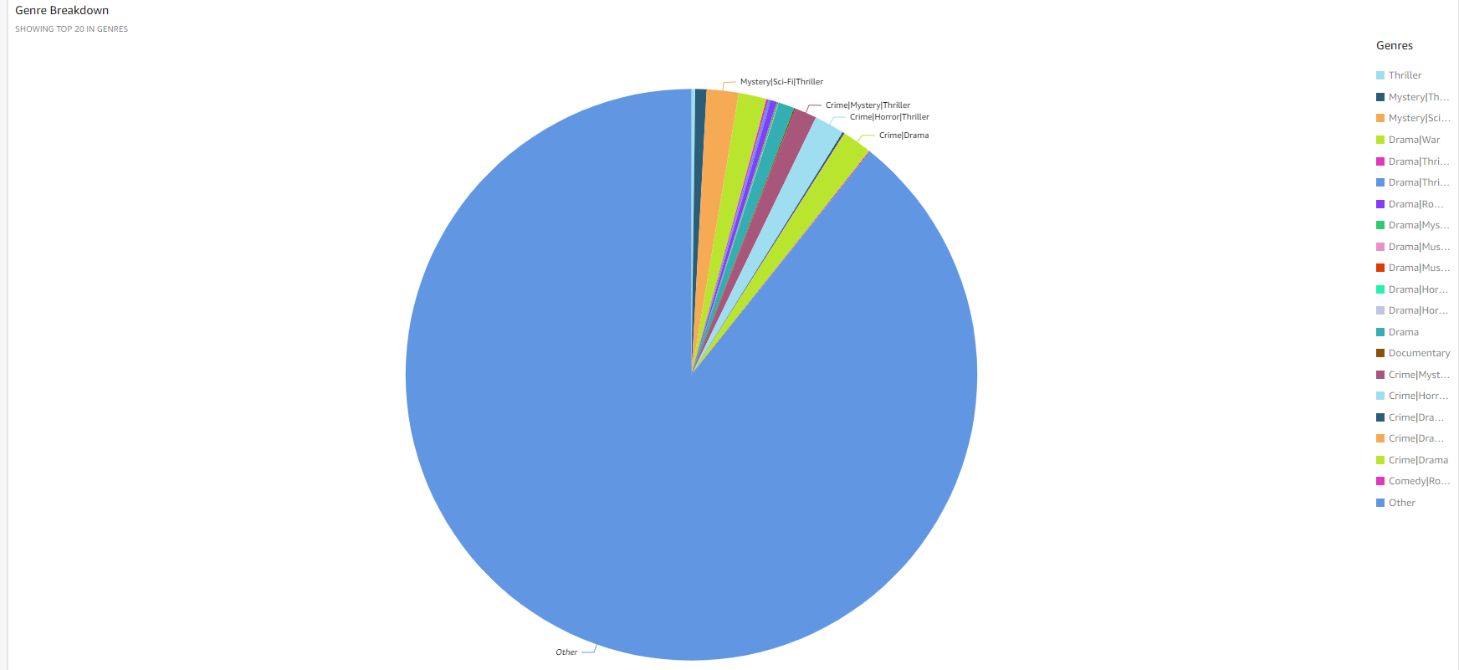
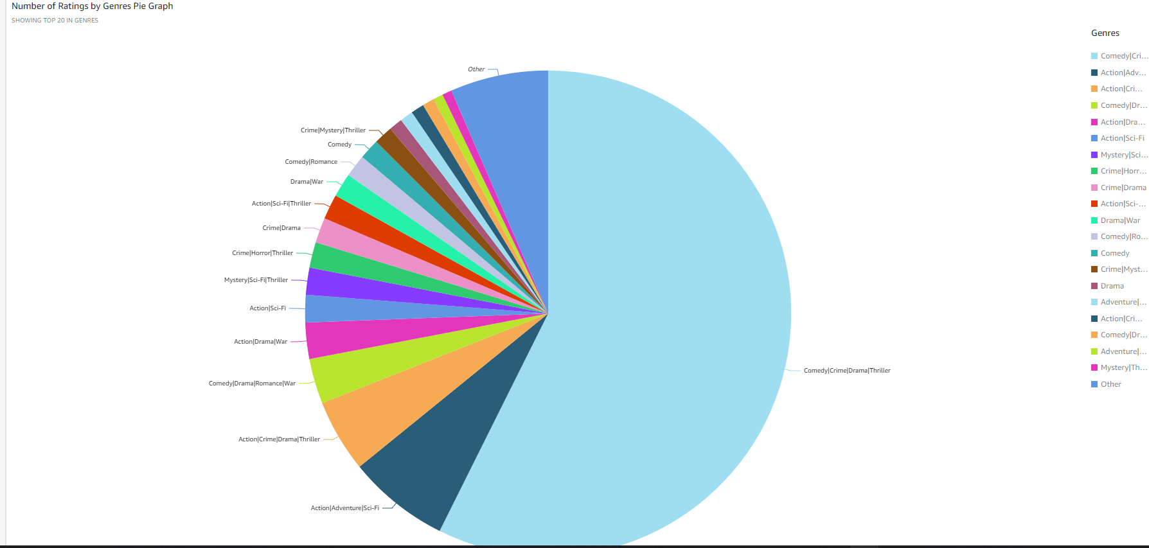
Data Understanding - Exploratory Data Analysis
The graph here is the pie chart for representing the movies by genres. Here we can see that a large number of movies don't have one unique genre. But lie in the others category. The others category here represents that a large proportion of movies has more than one genre.
Here we plot the pie diagram to represent the number of ratings by genres. This is an interesting plot which shows us that which genres united together gives the best combination and has the highest rating. Our data says that the movies having genres like Comedy, Criminal, Drama and Thriller are the highest rated movies among users. The movies with Action genre precede these choices. The least preferred genre would be a combination of Criminal, Mystery, Thriller and Adventure movies. These features give the recommendation system a clear idea of what the preferences are in similar audience.

Slide 8
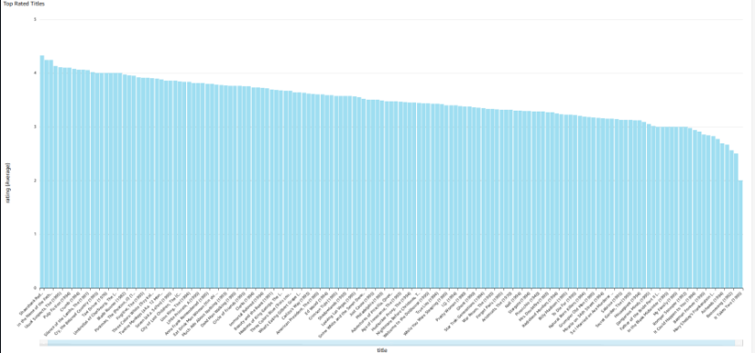
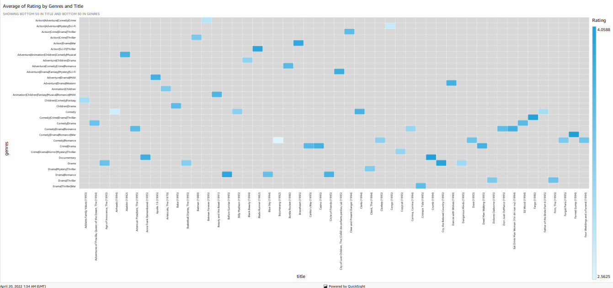
Data Understanding - Exploratory Data Analysis
Here we plot the pie diagram to represent the number of ratings by genres. This is an interesting plot which shows us that which genres united together gives the best combination and has the highest rating. Our data says that the movies having genres like Comedy, Criminal, Drama and Thriller are the highest rated movies among users. The movies with Action genre precede these choices. The least preferred genre would be a combination of Criminal, Mystery, Thriller and Adventure movies. These features give the recommendation system a clear idea of what the preferences are in similar audience.
The most important relation of all is the title and ratings analysis. This graph shows us the average ratings for a movie out of 5. The favourites and relevant favourites can be mapped through this. Our main aim is to take the users input and based on the input give similar movies that might be the users favourite or are rated similar by the other users.

Slide 9
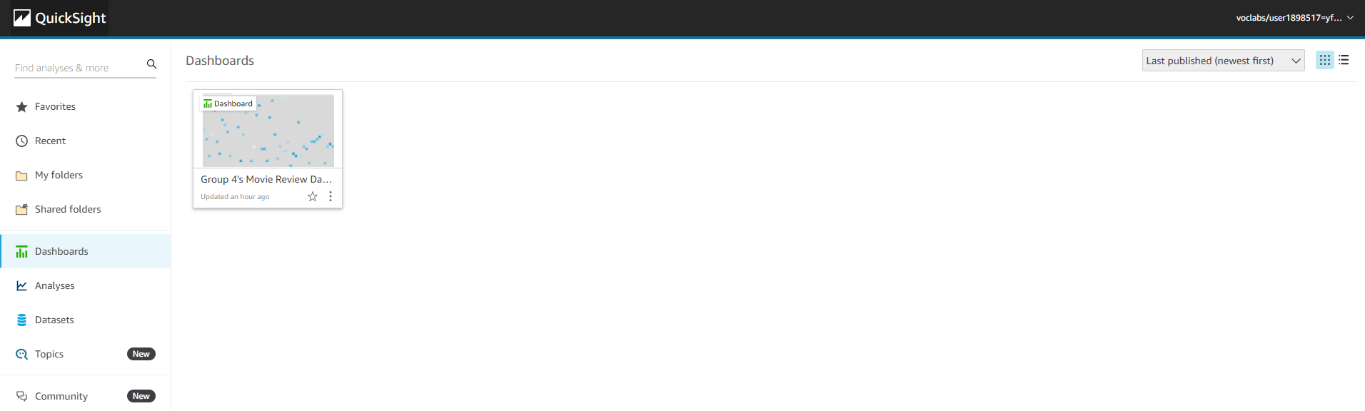
Data Understanding - Dashboard

Slide 10
Data Preparation
We used SageMaker for the data preparation process and data cleaning process. Imports such as np, matplot, seaborn, boto3, os, pandas, sklearn etc.are used.
For getting the dataset we store our csv file in a bucket and convert them to dataframes, Merging all the dataframes will give us the dataset.
We keep MovieID as the primary key for movies.csv. JSON code can be written to fetch the data. Data Preparation is completed.
For Data cleaning we rule out the unliked movies and define the attributes required to better simulate data gathered by a video-on-demand platform.
The data is as per our requirements and data cleaning is accomplished

Slide 11
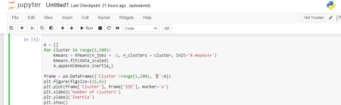
Machine Learning
K-means Clustering algorithm
SKLearn Python library
Notes:
Here, We selected the KMeans Clustering algorithm. k-means clustering is a vector quantization method that seeks to partition n observations into k clusters, with each observation belonging to the cluster with the nearest mean (cluster centers or cluster centroid), which serves as the cluster's prototype. As a result, the data space is partitioned into Voronoi cells. Within-cluster variances (squared Euclidean distances) are minimized by k-means clustering, but regular Euclidean distances are not, which is the more difficult Weber problem: the mean optimizes squared errors, while only the geometric median reduces Euclidean distances. Using k-medians and k-medoids, for example, better Euclidean solutions can be obtained. We made use of the K-means clustering algorithm from sklearn python library.

Slide 12
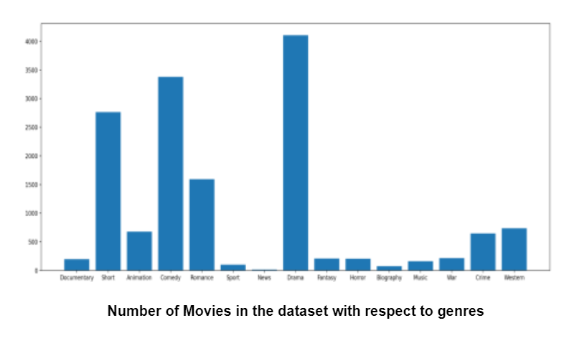
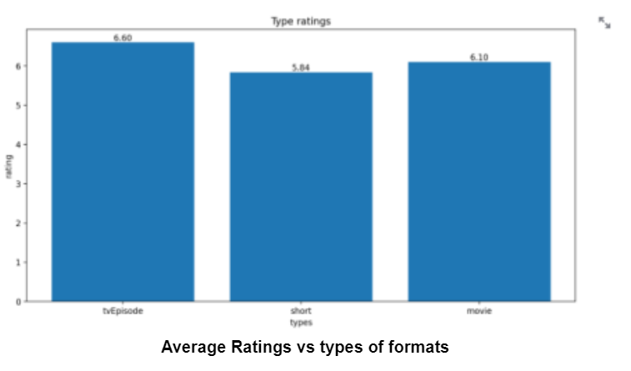
Analytics
UI: Streamlit
Analysis of our dataset
Notes:
We also gave our code a front end to make the model interactive. We made use of Streamlit for this UI. Streamlit is a python library making it easy to make our Machine Learning models interactive. Here, we plotted a few analytical graphs and also took the users input to make real-time recommendations.

Slide 13
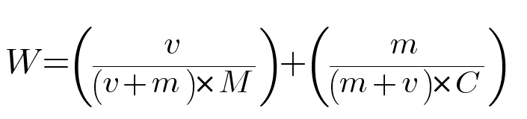
Evaluation
Three components of our recommendation logic:
1. Weighted scores
2. Clustering
3. Weighted rating system:
M = Mean for the video format
v = number of votes for the video format
m = minimum votes required to be counted
C = the mean vote across the whole dataset
Notes:
We broke the code into three portions to make recommendations.
1) weighted scores
2) clustering
3) the last function To begin, we'll utilize a weighted rating system to assign a rating to each piece of data based on the average rating and number of votes.
The following is the formula for calculating weighted rating:
We use the Weighted rating formula for our analysis
W=(v/(v+m) * M) + (m/(m+v) * C)
Where:
M = Mean for the video format
v = number of votes for the video format
m = minimum votes required to be counted
C = the mean vote across the whole dataset

Slide 14
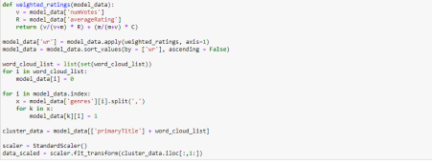
Optimization
Boolean column for all genres
1 or 0
38 total columns created.
Use scalar to standardize/normalize genres data
mean = 0
standard deviation = 1
Notes:
We need a boolean column for all the Genres for that we'll make a new column for each genre and assign a value of 1 or 0 to it based on the value. There will be a total of 38 columns created. We'll use a scaler to standardize the data in the all genres column. It converts the data so that the mean is 0 and the standard deviation is 1. In a nutshell, it normalizes the data. For data with negative values, standardization is beneficial. It uses a typical normal distribution to organize the data.

Slide 15
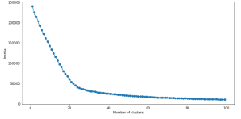
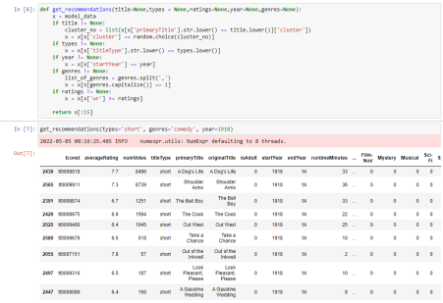
Results
Elbow graph to find feasible 'k' value
Ideally, K = 23
genre-based recommendation using k-means clustering:
5 parameters
Movie/Show name
Video format
Rating(minimum required)
Year
Genre
Will recommend up to 10 titles
Notes:
1) We make the famous elbow graph for our data and try to see which value of k is feasible for us.
2) When we see the graph we see that we that after k=23 the values go down linearly. For further process, We will make use of K=23. Now we'll utilize the k-means cluster to forecast the clustering result. This will assist us in making genre-based recommendations.
3)We consider 5 parameters for our recommendation. At least one argument must be presented. A title is a movie/show name, a type is a video format, a rating is the minimum rating required, a year is a specific year search, and a genre is a genre name, and it will recommend up to 10 titles based on the arguments provided

Slide 16
Future Work
In the future, We can do regression analysis on the data. The dataset had a lot of movies without a genre. We will try to label the data there. We can also shift to graphical databases for processing unstructured data. Further enhancements are possible to give it a professional-looking UI.
For making our rating analysis more feasible we would like to introduce more inclusions in the rating scenario such as:
Viewer's Gender
Viewer's Age
Viewer's Ethnicity
Viewer's Location(Country)

Slide 17
Comments
The data we selected was not from Kaggle, but it was the official data from IMDb. The dataset was huge. The free instance of Sagemaker won’t process so much data. So we reduced the size of our data. The datasets were tab spaced versions and had a const id column, making it easy to merge 2 datasets and make a dataset we require.
The dataset we merged had a single column of genres. As we wanted separate values. We added more columns to the dataset and each column represented a genre. The input in these columns was boolean to make it easier for us to process the data. We also removed some null values present in the dataset.
As the dataset was otherwise clean, We didn’t have to deal with outliers of any kind.
The IMDB has some movies whose genre is not known. We can't categorize this data and we need further information on these movies to know the genre. We leave them as N for now.
Notes:
1. Did you create any new additional features/variables?
Yes, We created a few features for our genres.
2. What was the process you used for evaluation? What was the best result?
We used the K-means clustering algorithm till convergence and then we used the clusters for further recommendation analysis.
3. What were the problems you faced? How did you solve them?
If this is a funded project then you can freely use the AWS resources. In college-level instances, you can't have a large dataset and you can’t build a pipeline. The data cant is kept in s3 because for every access you will call the S3 storage. This may incur charges on your account. The dataset we choose must have appropriate data. If not, the accuracy of the model declines. To develop a project like this you need to have knowledge of Machine Learning algorithms and AWS. We used a private account for our process and made which caused fewer problems. We selected the datasets which had appropriate data and were from a legitimate source.
4. What future work would you like to do?
In the future, We can do regression analysis on the data. The dataset had a lot of movies without a genre. We will try to label the data there. We can also shift to graphical databases for processing unstructured data. Further enhancements are possible to give it a professional-looking UI.
5. Instructions for individuals that may want to use your work
1. Make sure you install all the necessary python libraries before working on the code.
2. Find a good dataset with enough rows and relevant columns. 3. While creating an S3 Bucket and a new notebook instance make sure to use a new IAM role and store data in a random s3 bucket.
4. Use a good processing instance for higher processing power. 5. There are 2 Jupyter notebooks. You can use our code on your local machine as well as a notebook for AWS instance.
6. Read about the boto library for using AWS.
7. We created a separate python file for Streamlit.

Slide 18
Comments Cont.
1. Did you create any new additional features/variables?
Yes, We created a few features for our genres.
2. What was the process you used for evaluation? What was the best result?
We used the K-means clustering algorithm till convergence and then we used the clusters for further recommendation analysis.
3. What were the problems you faced? How did you solve them?
Data limitations
Cost
Notes:
1. Did you create any new additional features/variables?
Yes, We created a few features for our genres.
2. What was the process you used for evaluation? What was the best result?
We used the K-means clustering algorithm till convergence and then we used the clusters for further recommendation analysis.
3. What were the problems you faced? How did you solve them?
If this is a funded project then you can freely use the AWS resources. In college-level instances, you can't have a large dataset and you can’t build a pipeline. The data cant is kept in s3 because for every access you will call the S3 storage. This may incur charges on your account. The dataset we choose must have appropriate data. If not, the accuracy of the model declines. To develop a project like this you need to have knowledge of Machine Learning algorithms and AWS. We used a private account for our process and made which caused fewer problems. We selected the datasets which had appropriate data and were from a legitimate source.
4. What future work would you like to do?
In the future, We can do regression analysis on the data. The dataset had a lot of movies without a genre. We will try to label the data there. We can also shift to graphical databases for processing unstructured data. Further enhancements are possible to give it a professional-looking UI.
5. Instructions for individuals that may want to use your work
1. Make sure you install all the necessary python libraries before working on the code.
2. Find a good dataset with enough rows and relevant columns. 3. While creating an S3 Bucket and a new notebook instance make sure to use a new IAM role and store data in a random s3 bucket.
4. Use a good processing instance for higher processing power. 5. There are 2 Jupyter notebooks. You can use our code on your local machine as well as a notebook for AWS instance.
6. Read about the boto library for using AWS.
7. We created a separate python file for Streamlit.

Slide 19
Comments Cont.
4. Instructions for individuals that may want to use your work:
Make sure you install all the necessary python libraries before working on the code.
Find a good dataset with enough rows and relevant columns.
While creating an S3 Bucket and a new notebook instance make sure to use a new IAM role and store data in a random s3 bucket.
Use a good processing instance for higher processing power.
There are 2 Jupyter notebooks. You can use our code on your local machine as well as a notebook for AWS instance.
Read about the boto library for using AWS.
We created a separate python file for Streamlit.
Notes:
1. Did you create any new additional features/variables?
Yes, We created a few features for our genres.
2. What was the process you used for evaluation? What was the best result?
We used the K-means clustering algorithm till convergence and then we used the clusters for further recommendation analysis.
3. What were the problems you faced? How did you solve them?
If this is a funded project then you can freely use the AWS resources. In college-level instances, you can't have a large dataset and you can’t build a pipeline. The data cant is kept in s3 because for every access you will call the S3 storage. This may incur charges on your account. The dataset we choose must have appropriate data. If not, the accuracy of the model declines. To develop a project like this you need to have knowledge of Machine Learning algorithms and AWS. We used a private account for our process and made which caused fewer problems. We selected the datasets which had appropriate data and were from a legitimate source.
4. What future work would you like to do?
In the future, We can do regression analysis on the data. The dataset had a lot of movies without a genre. We will try to label the data there. We can also shift to graphical databases for processing unstructured data. Further enhancements are possible to give it a professional-looking UI.
5. Instructions for individuals that may want to use your work
1. Make sure you install all the necessary python libraries before working on the code.
2. Find a good dataset with enough rows and relevant columns. 3. While creating an S3 Bucket and a new notebook instance make sure to use a new IAM role and store data in a random s3 bucket.
4. Use a good processing instance for higher processing power. 5. There are 2 Jupyter notebooks. You can use our code on your local machine as well as a notebook for AWS instance.
6. Read about the boto library for using AWS.
7. We created a separate python file for Streamlit.

Slide 20
Conclusion
Thank You

