Slide 1


NEXT GEN EMPLOYABILITY PROGRAM
CREATING A FUTURE-READY WORKFORCE
Student Name :
Vaishnavi Kistapuram
College Name :
Student ID :
INDUR INSTITUTE OF ENGINEERING AND TECHNOLOGY
STU664790827ed0f1715966082

Slide 2
CAPSTONE PROJECT SHOWCASE
Project Title
Digital Payment Wallet (Paytm Clone) with MERN Technology
Abstract | Problem Statement | Project Overview | Proposed Solution | Technology Used | Modelling & Results | Conclusion | Q&A

Slide 3
Abstract
1
Integration: Leverage the MERN stack (MongoDB, Express.js, React.js, Node.js) to build a seamless digital wallet payment system, ensuring secure and efficient storage, processing, and retrieval of transaction data.
2
User Experience: Employ to create a responsive and intuitive user interface, offering users a smooth and interactive experience while managing their digital transactions.
3
Backend Functionality: Utilize and to develop a robust backend that handles transaction processing, user authentication, and security features, ensuring the safety and reliability of the payment system.
4
Data Management: Implement MongoDB for scalable and flexible data storage, enabling efficient management of user accounts, transaction history, and payment records.

Slide 4


Problem Statement
In today’s digital landscape, existing payment methods often fall short in terms of security, efficiency, and user experience. With the rise of online transactions, there is an urgent need for a modern digital wallet payment system. Leveraging the MERN stack (MongoDB, Express.js, React.js, Node.js), we aim to create a solution that ensures:
Security: Protecting users' sensitive financial data from breaches and unauthorized access.
Efficiency: Enabling real-time, seamless transaction processing with minimal latency.
User Experience: Providing an intuitive and responsive interface for users, ensuring ease of use and satisfaction.
Integration: Facilitating easy integration with various e-commerce platforms and services.
This project addresses these challenges by developing a comprehensive digital wallet system that enhances the overall online payment experience.

Slide 5

Project Overview
Objective: Develop a secure and efficient digital wallet payment system using MongoDB, Express.js, React.js, and
User Authentication: Implement robust user authentication with multi-factor authentication to ensure security.
Transaction Processing: Enable real-time transaction processing with support for multiple payment methods.
User Interface: Design an intuitive and responsive UI using for an optimal user experience.
Data Management: Utilize MongoDB for secure and scalable storage of user and transaction data.

Slide 6
Proposed Solution
User Authentication and Authorization: Implement secure user authentication using JWT (JSON Web Tokens) and multi-factor authentication, ensuring that only authorized users can access their wallets and perform transactions.
Seamless Transaction Handling: Develop a robust backend with and to handle real-time transactions efficiently, supporting various payment methods and ensuring quick processing with minimal latency.
Intuitive User Interface: Utilize to build a responsive and user-friendly interface, providing users with an easy and engaging experience while managing their digital wallets and conducting transactions.
Secure Data Management: Use MongoDB to store user data and transaction history securely, ensuring data integrity and implementing encryption to protect sensitive information.
Integration Capabilities: Design APIs that enable seamless integration with third-party services and e-commerce platforms, extending the functionality of the digital wallet and allowing for broader use cases.

Slide 7
Technology used
MongoDB: A NoSQL database for storing user information, transaction history, and wallet data securely and efficiently.
Express.js: A web application framework for to build the backend API, handle requests and responses, and manage transactions.
React.js: A JavaScript library for creating a responsive and intuitive front-end user interface, ensuring a smooth user experience across devices.
Node.js: A runtime environment for executing JavaScript on the server-side, used to build the backend logic, handle real-time transactions, and ensure fast processing.
JSON Web Tokens (JWT): A standard for securely transmitting information between parties, used for user authentication and authorization to protect sensitive data.

Slide 8
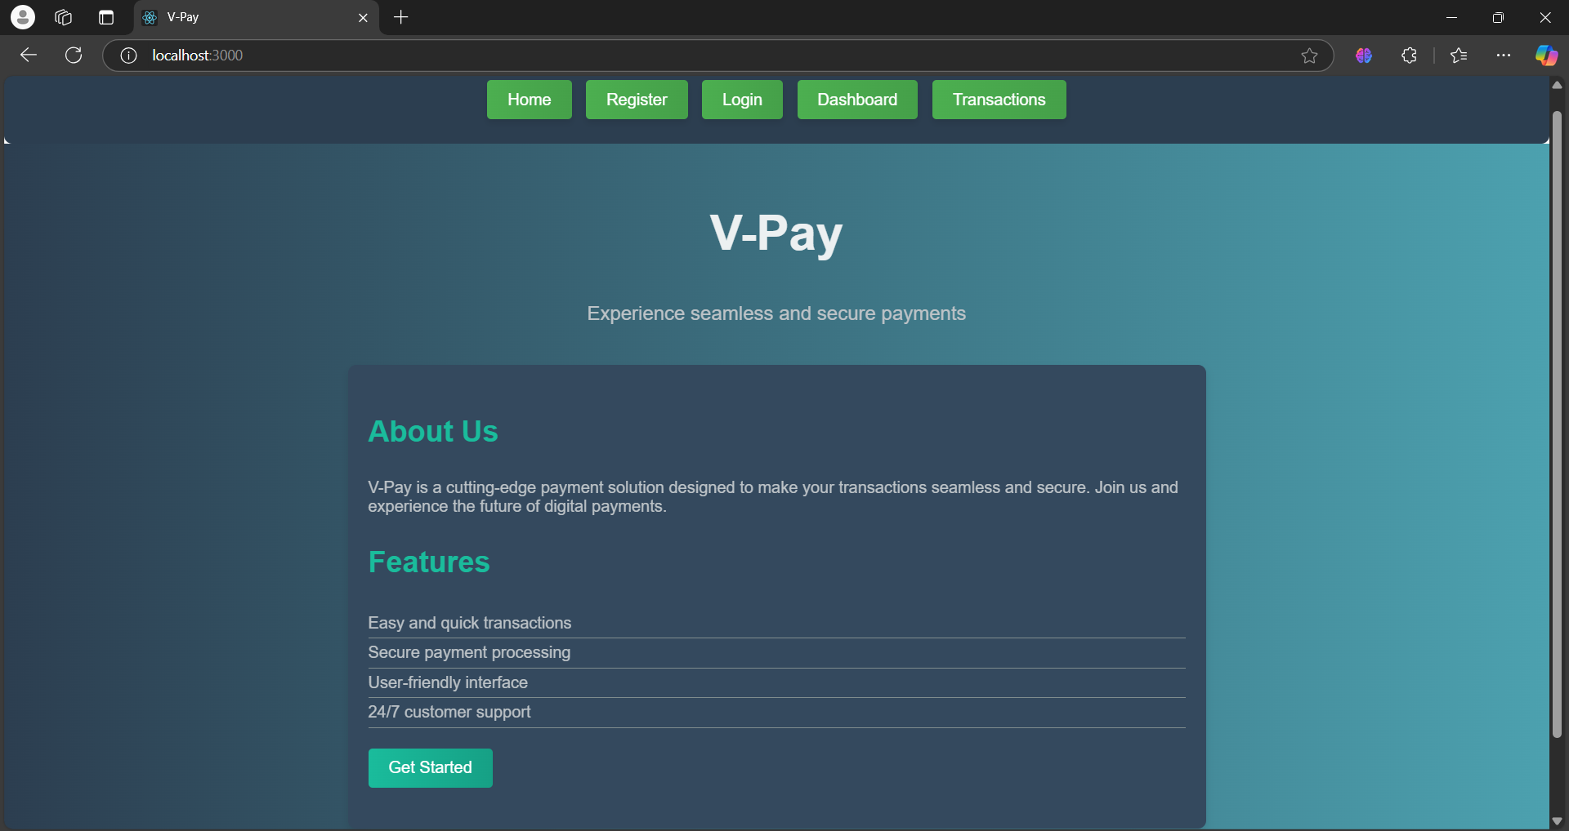
Modelling & Result

Slide 9
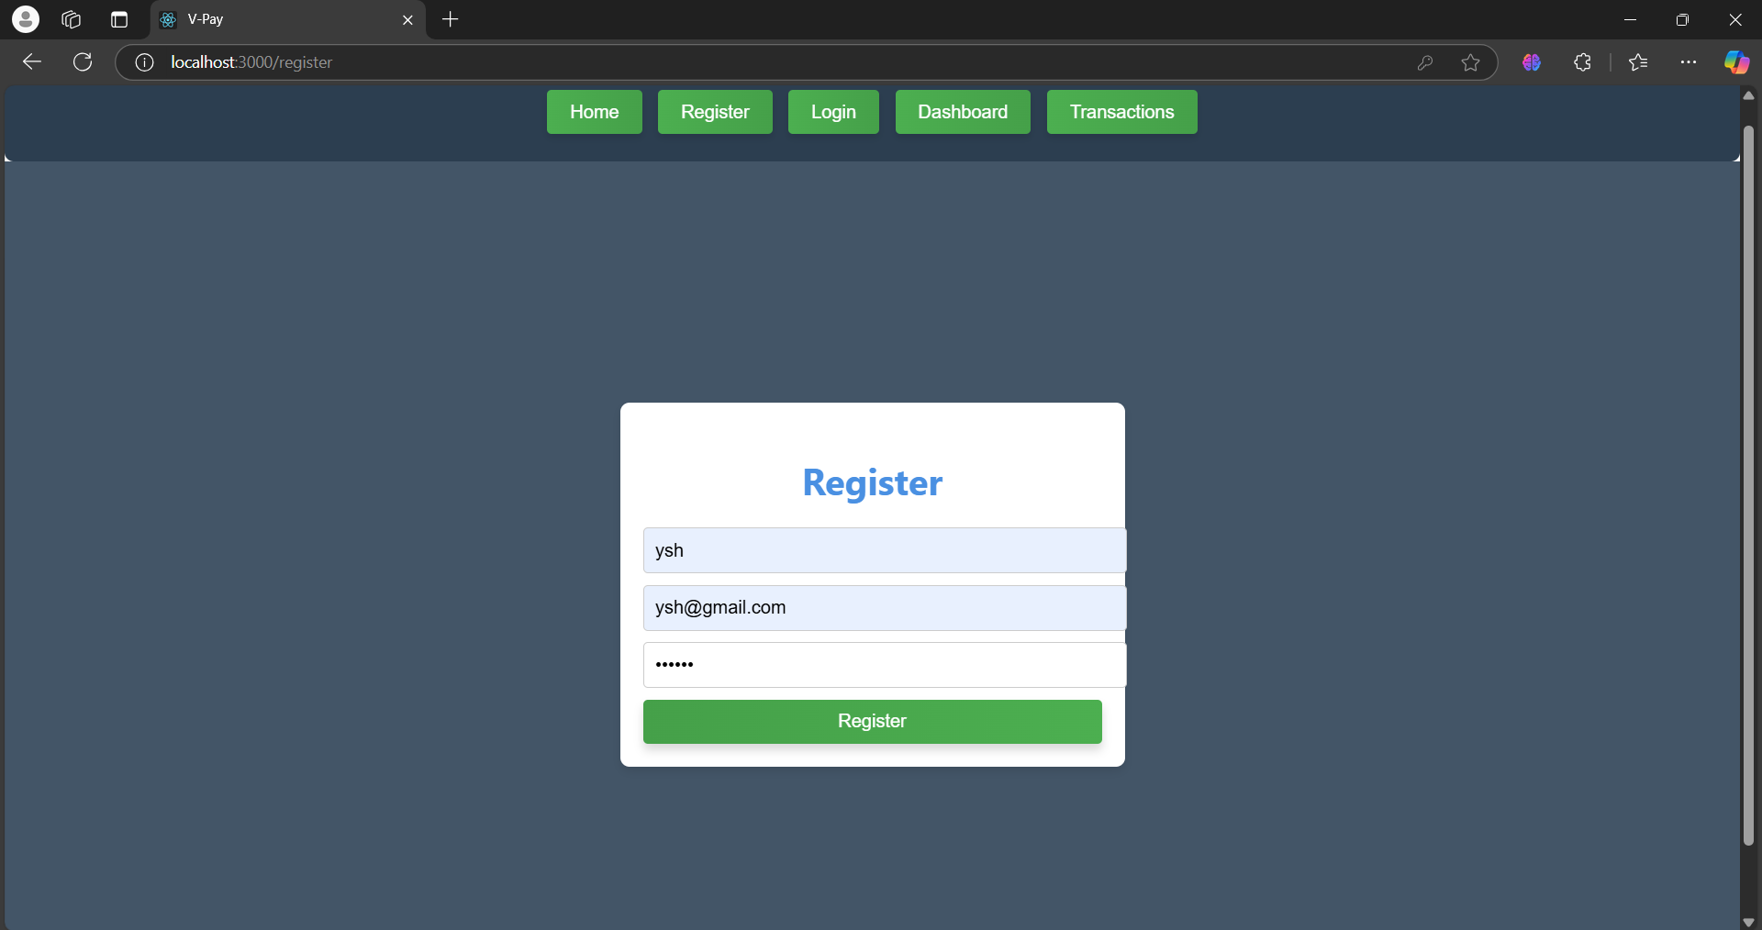
Modelling & Result

Slide 10
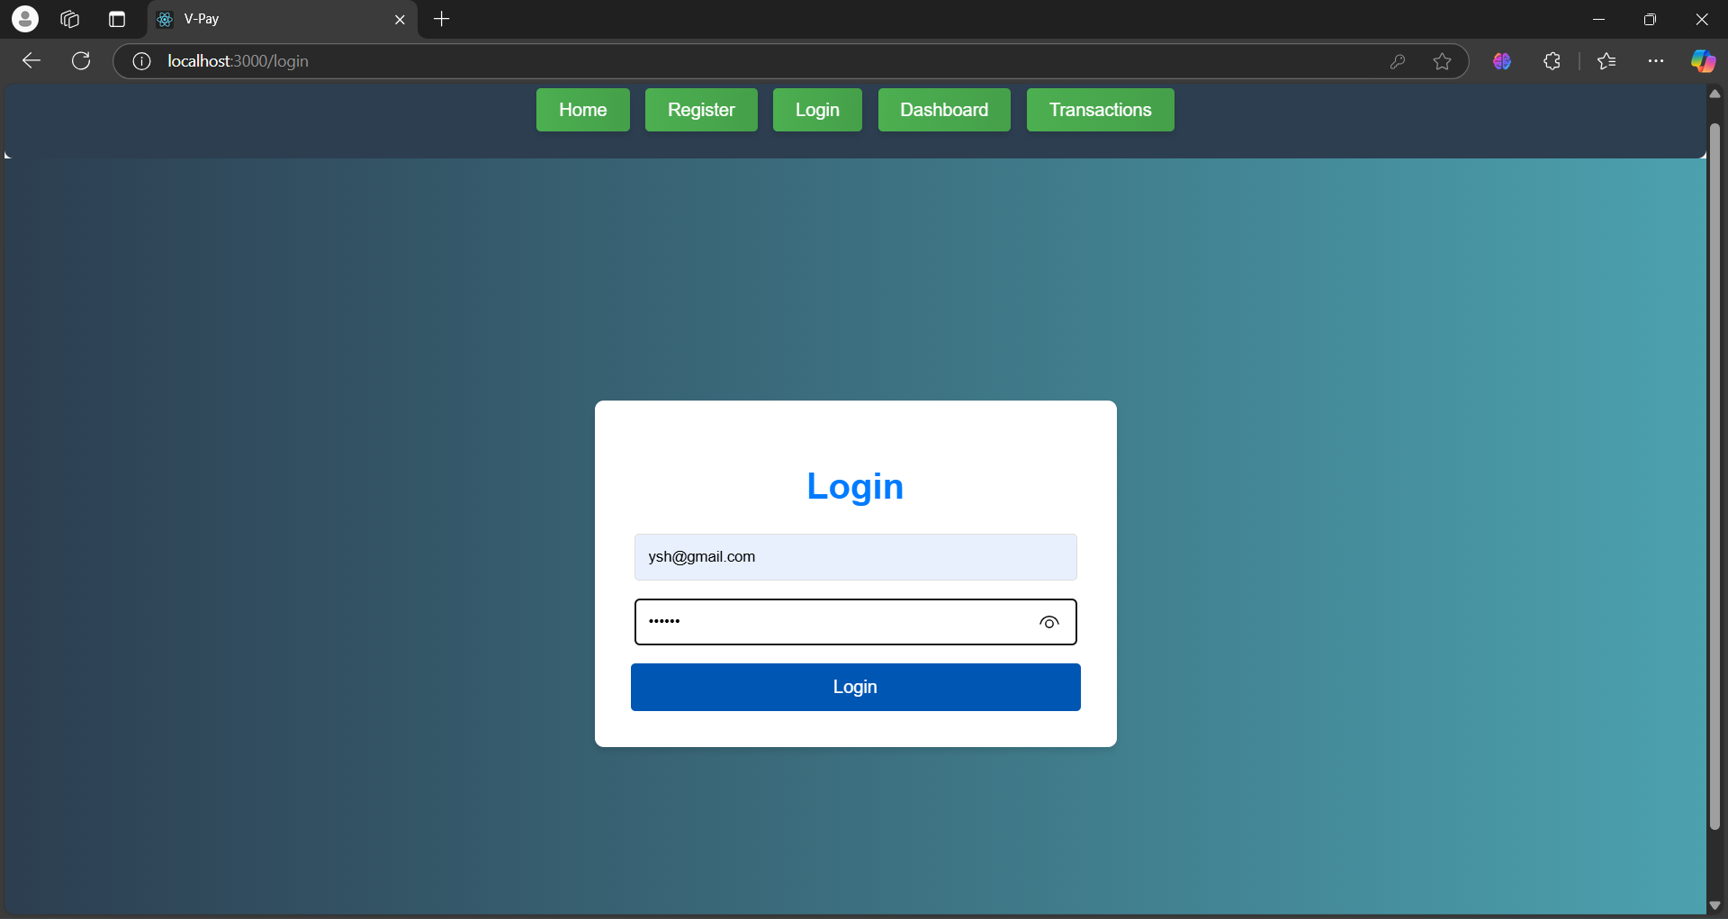
Modelling & Result

Slide 11
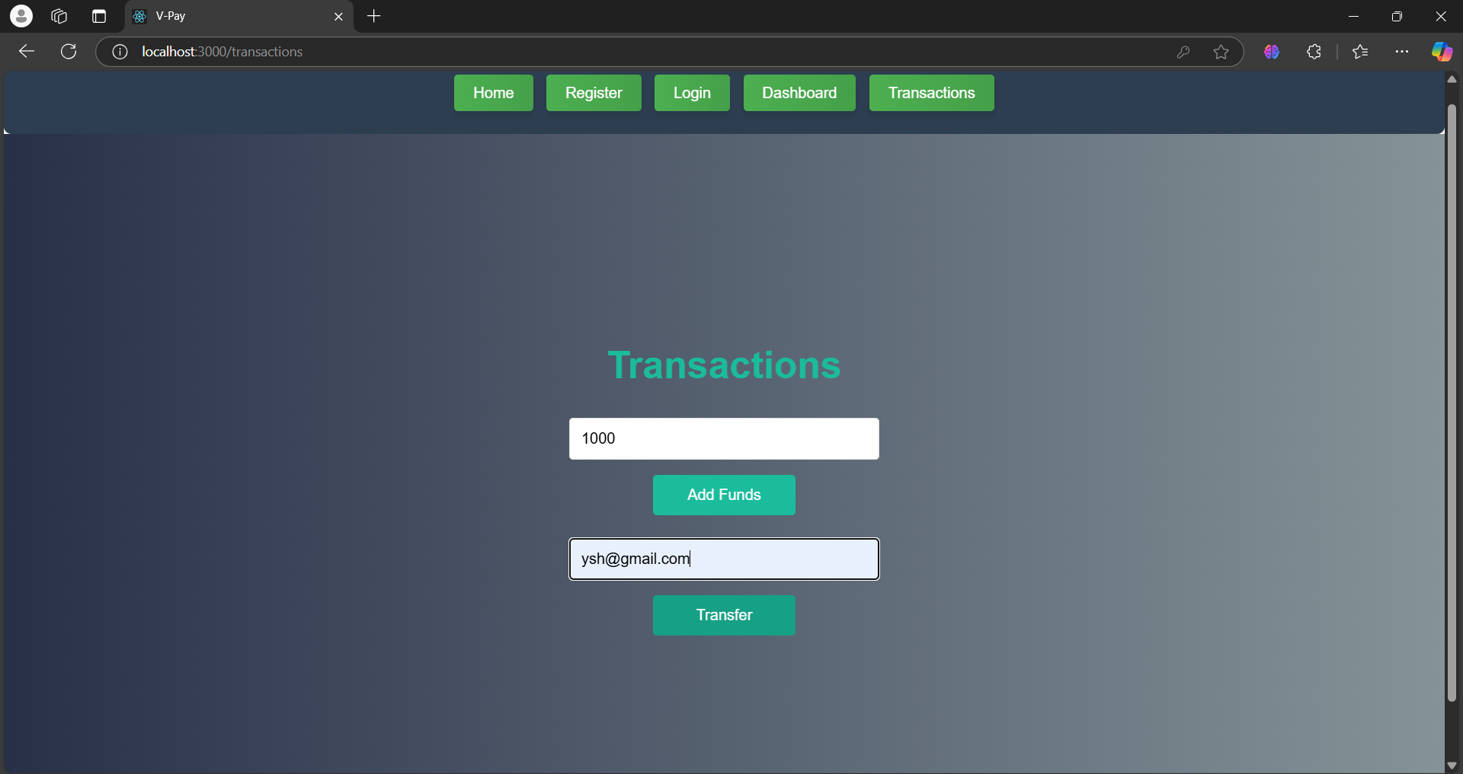
Modelling & Result

Slide 12
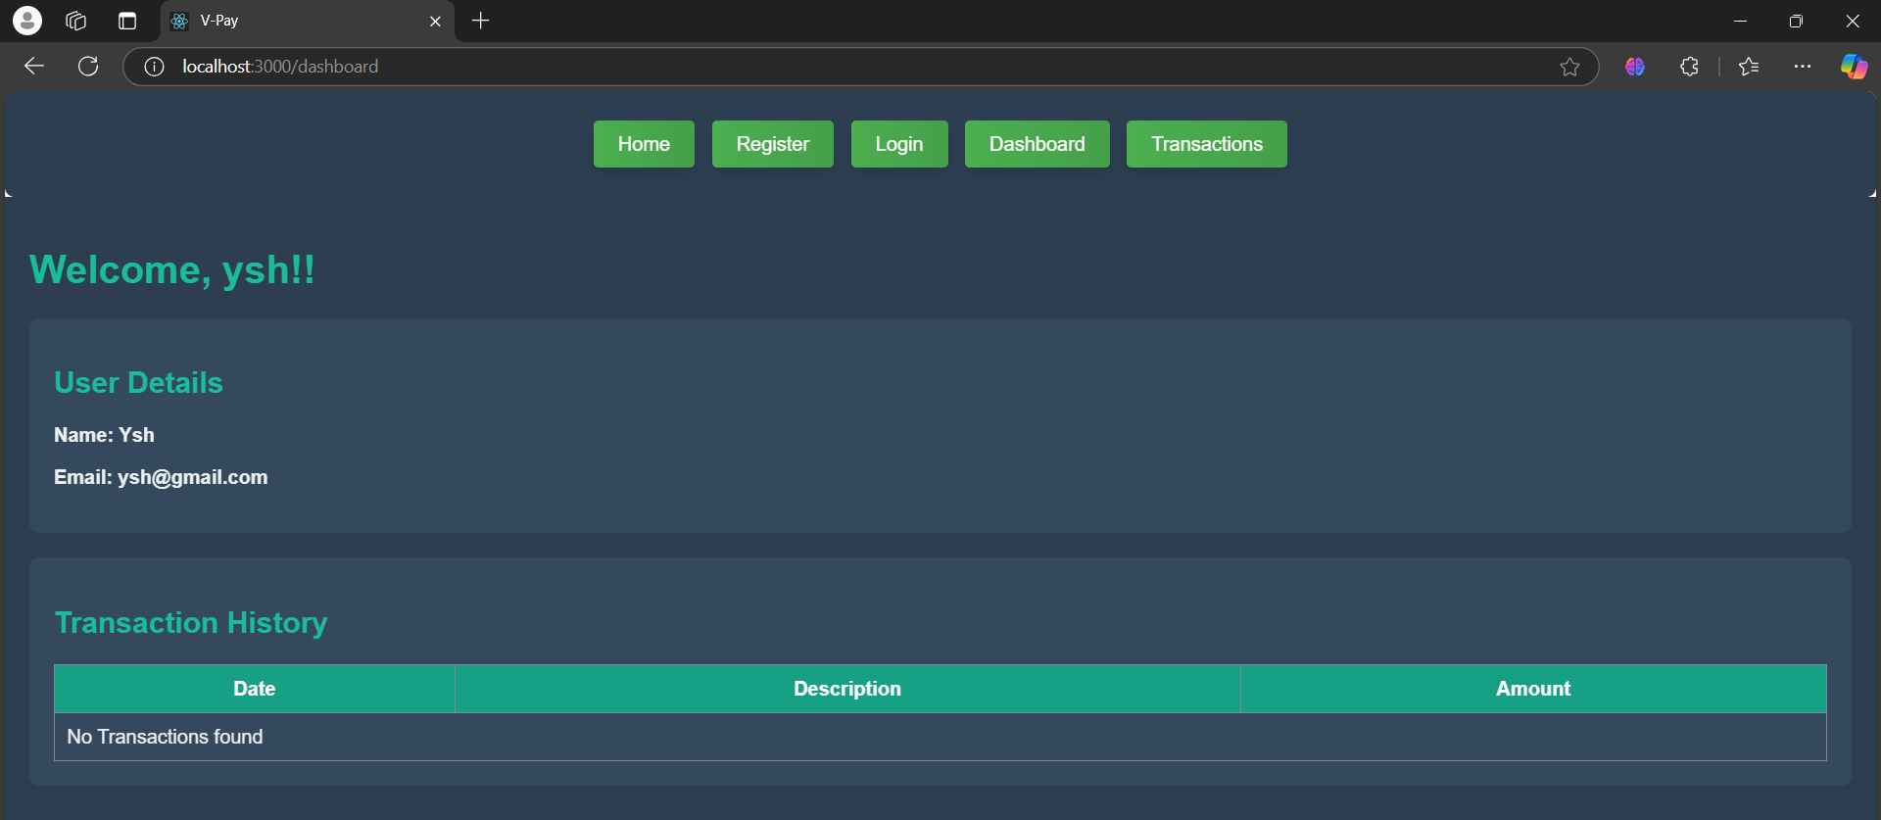
Modelling & Result

Slide 13

Conclusion
Enhanced Security: Robust authentication and secure data storage protect users' financial information.
Real-Time Processing: Efficient backend ensures quick, reliable transactions, enhancing user satisfaction.
User-Friendly: Responsive interface provides a seamless experience across devices.
Scalable: MongoDB allows for flexible, scalable data management as user data grows.
Versatile Integration: APIs enable easy integration with third-party services and e-commerce platforms.

Slide 14


Notes:
Thank You !!

