Slide 1
목 차
Ⅰ.
Ⅱ.
Ⅲ.
Ⅳ.
Feature Engineering
앙상블 모델링
Public Score & Private Score
개인 소감

Slide 2
Feature Engineering
Name -> Title(Master,Miss,Ms,Mme,Mlle,Mrs,Mr, Rare)
Age -> Pclass, Parch ,SibSp
FamilySize -> SibSp + Parch + 1
Ticket -> (prefiex)
Cabin -> removed all

Slide 3
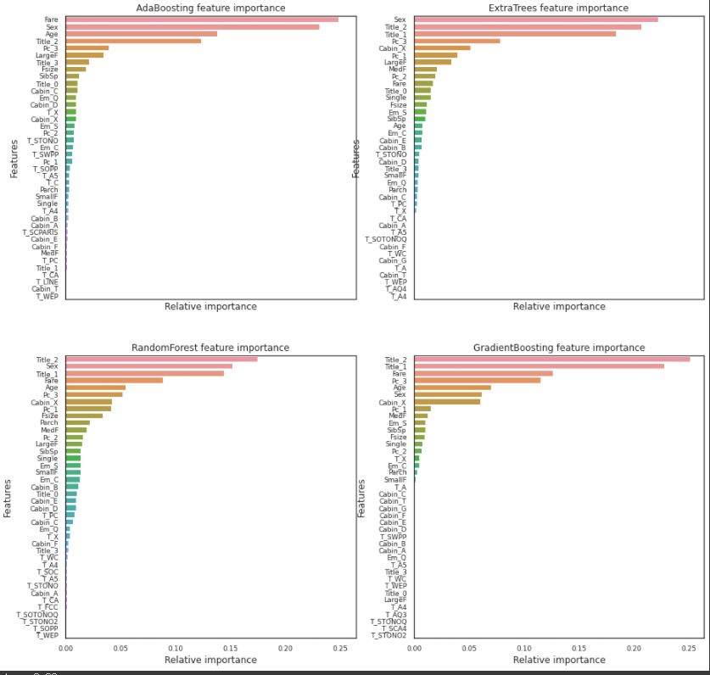
Cabin 제거 전

Slide 4
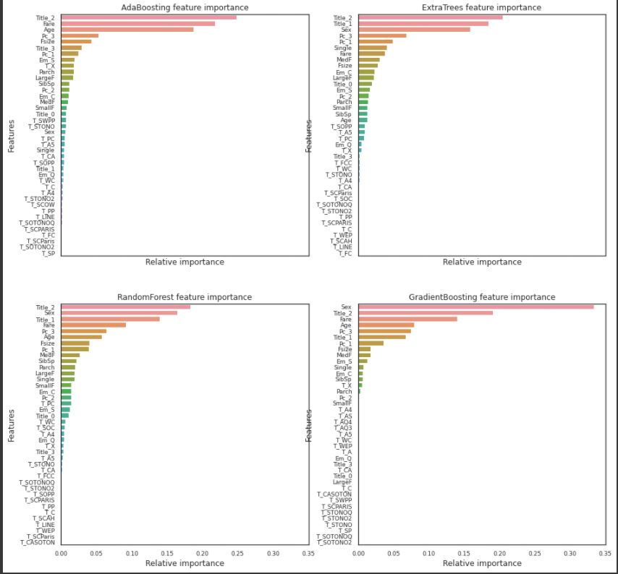
Cabin 제거 후

Slide 5
모델링
AdaBoost
RandomForest
Ensemble
ExtraTrees
(Voting)
GradientBoost
SVC
파라미터n_estimators/learning_rate/max_depth/min_samples_leaf/max_features

Slide 6
Public Score & Private Score
0.76076
0.80382

Slide 7
개인 소감

Slide 8
감사합니다!

