Slide 1
AFYALINK
Presented by Arnold Kisuri

Slide 2
TEAM PROJECT
Aaron Loeb
1
Cahaya Dewi
2
Claudia Alves
3
Ketut Susilo
4

Slide 3
PROJECT OVERVIEW
What is AfyaLink?
Healthcare management system
Patient tracking and program management
Designed for healthcare providers
Problem Statement:
Need for efficient patient management
Program enrollment tracking
Healthcare service coordination

Slide 4
TECHNOLOGY STACK
Frontend:
React/Next.js
Material-UI
Modern JavaScript
Backend:
Flask (Python)
SQLAlchemy
JWT Authentication
Database:
SQLite with migration support

Slide 5
DEVELOPMENT APPROACH
Full-stack Development
RESTful API Architecture
Component-based Frontend
Modular Backend Design
Database-first Approach

Slide 6
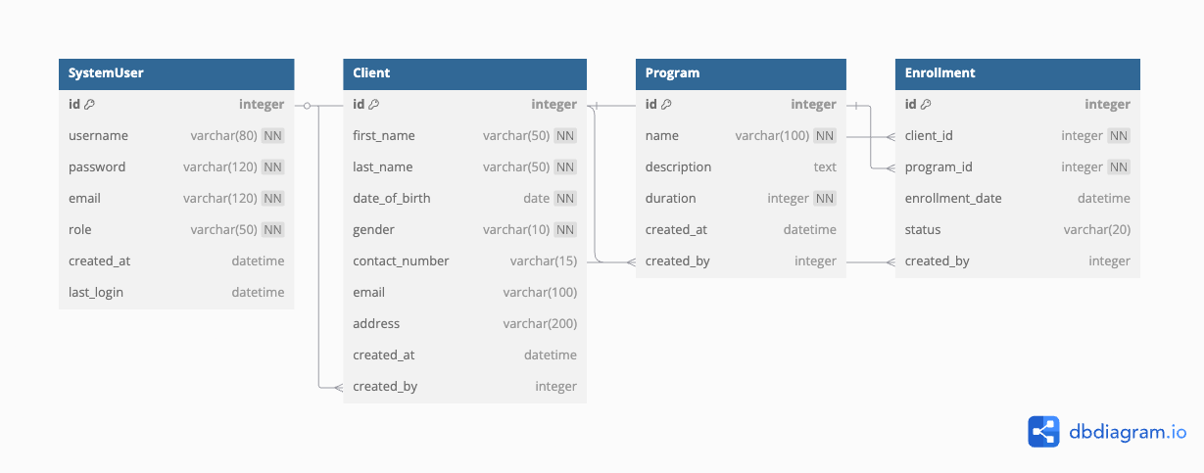
DATABASE DESIGN (PART 1)

Slide 7
DATABASE DESIGN (PART 1)
Key Relationships:
SystemUser to Client (One-to-Many)
SystemUser to Program (One-to-Many)
Client to Program (Many-to-Many through Enrollment)

Slide 8
API ARCHITECTURE
RESTful Endpoints:
/api/doctors (User management)
/api/clients (Patient management)
/api/programs (Program management)
/api/enrollments (Enrollment management)
Authentication Flow

Slide 9
FRONTEND ARCHITECTURE
Component Structure:
Layout Components
Feature Components
Reusable UI Components
State Management
Routing System

Slide 10
AUTHENTICATION SYSTEM
JWT Implementation
Login Flow
Token Management
Security Measures

Slide 11
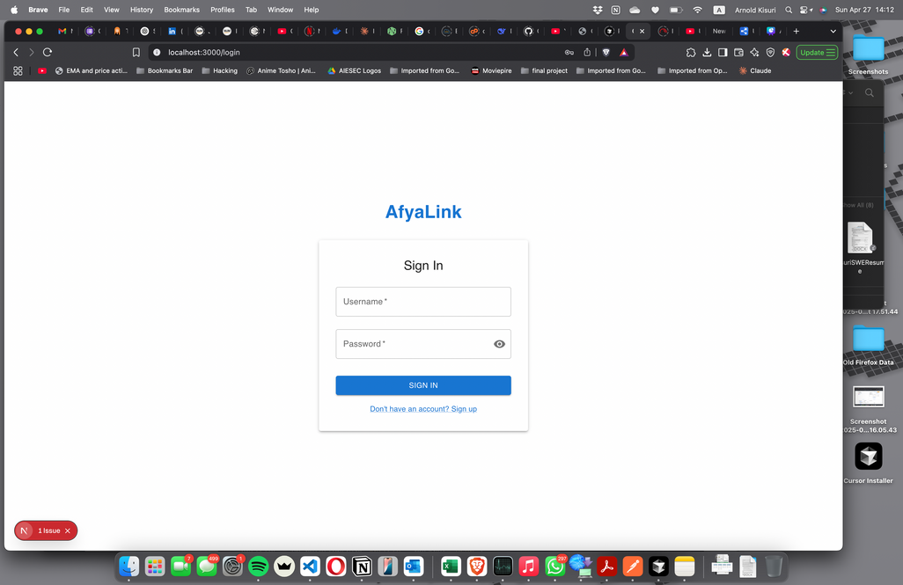
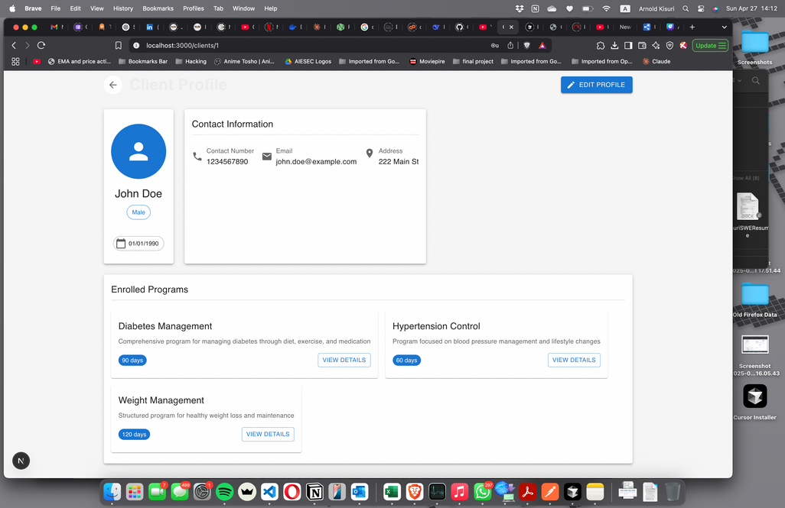
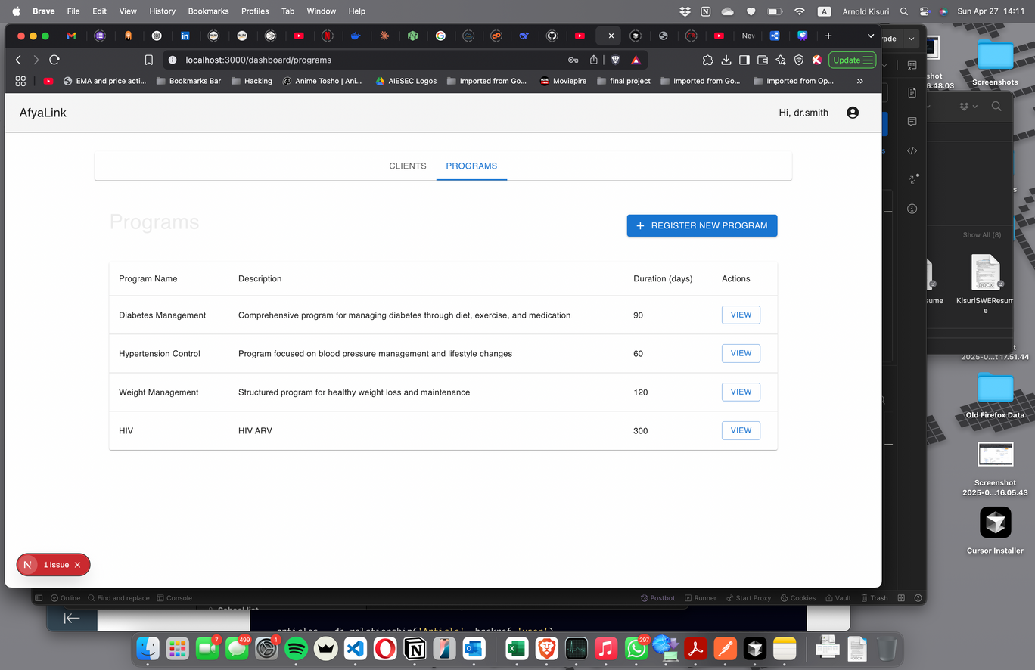
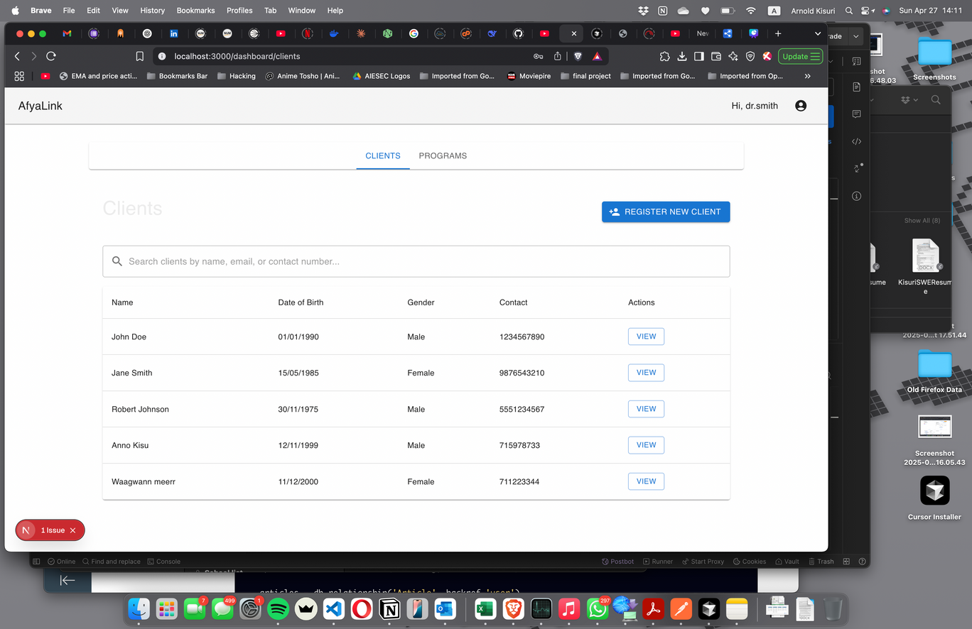
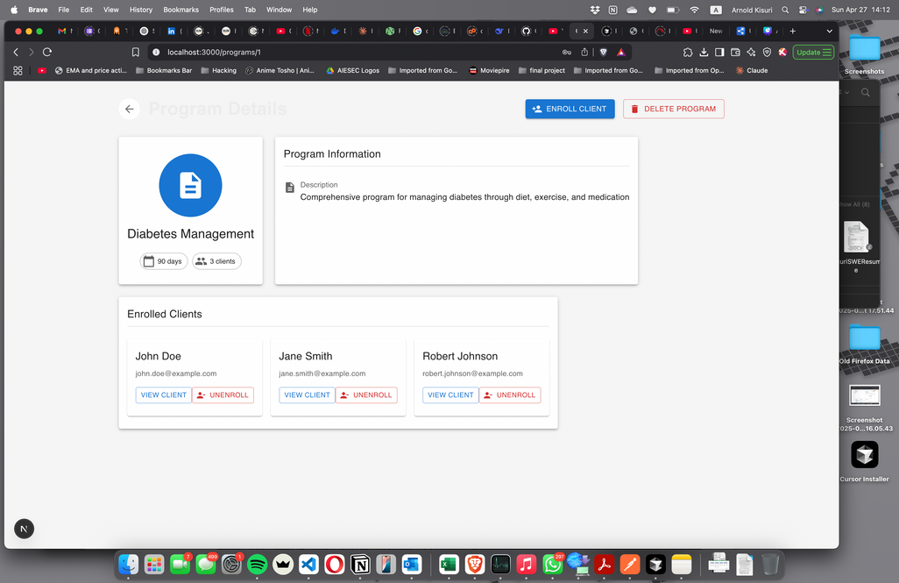
USER INTERFACE DESIGN

Slide 12
KEY FEATURES (PART 1)
User Management:
Registration
Authentication
Role-based Access
Client Management:
Registration
Profile Management
Search and Filter

Slide 13
KEY FEATURES (PART 2)
Program Management:
Creation
Modification
Duration Tracking
Enrollment System:
Program Assignment
Status Tracking
History Management

Slide 14
SECURITY IMPLEMENTATION
Password Hashing
JWT Token Security
API Protection
Data Validation

Slide 15
CHALLENGES AND SOLUTIONS
Authentication Issues
JWT token validation errors (422 errors)
Token management and expiration handling
Secure session management
Solution: Implemented proper JWT configuration and error handlers

Slide 16
CONCLUSION
Q&A

Slide 17
THANK
YOU

