Slide 1
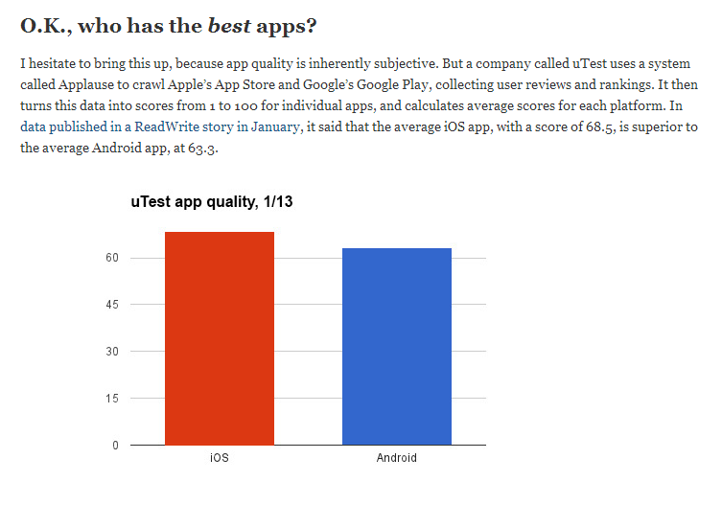
Why iOS
http://techland.time.com/2013/04/16/ios-vs-android/

Slide 2
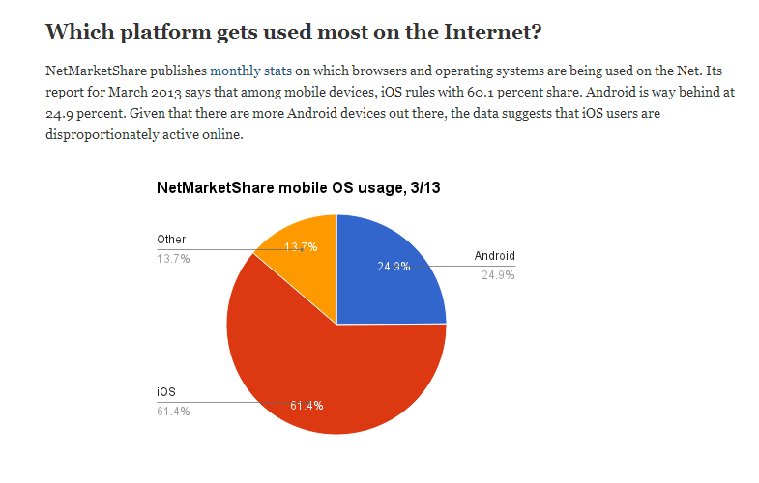

Slide 3
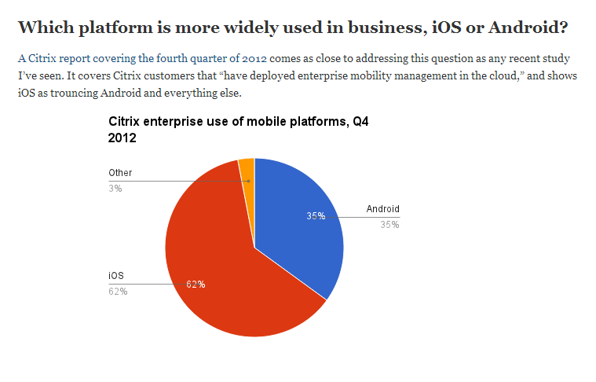

Slide 4
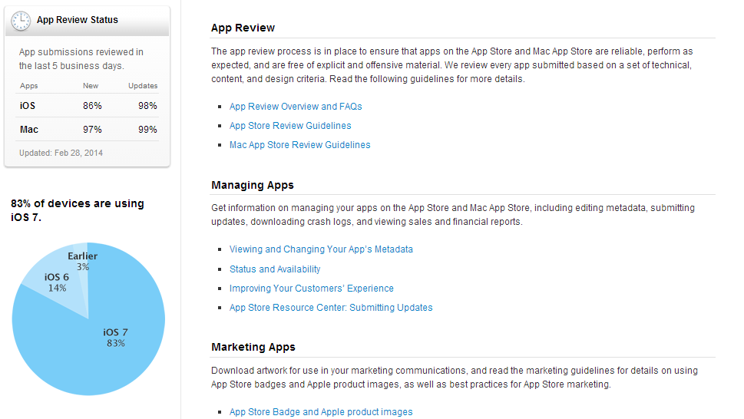
Why iOS7?
https://developer.apple.com/support/appstore/
http://appleinsider.com/articles/13/12/31/ios-7-now-installed-on-78-of-active-apple-handheld-devices

Slide 5
PhoneGap 2.1
http://www.youtube.com/watch?v=GcYKhPRt-hY

Slide 6
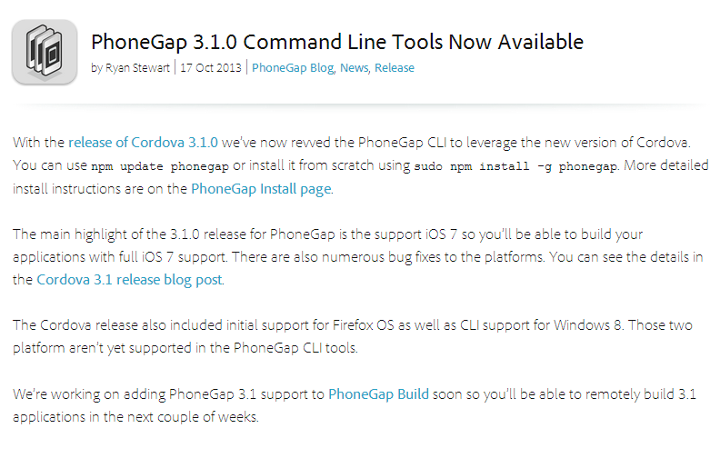
PhoneGap 3.1
http://phonegap.com/blog/2013/10/17/phonegap-310-release/

Slide 7
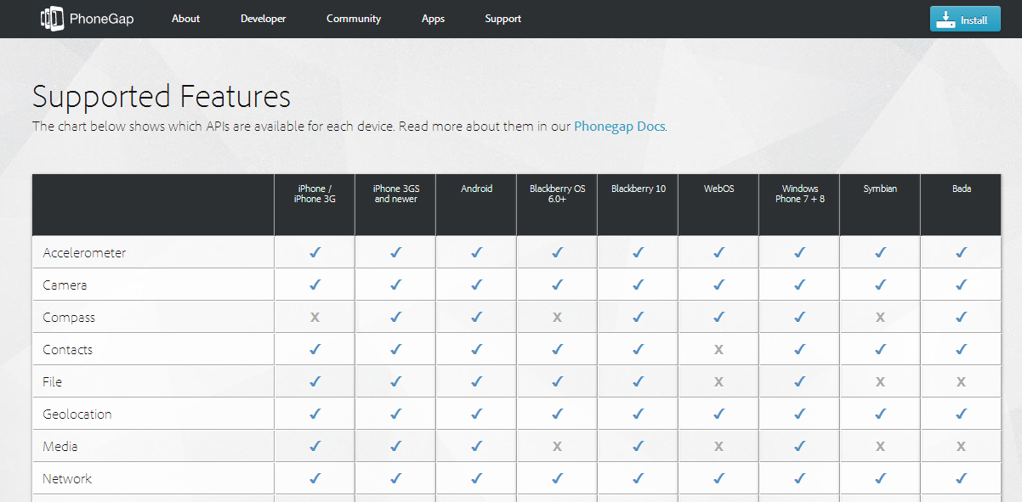
http://phonegap.com/about/feature/

Slide 8
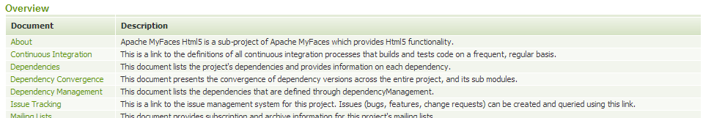
Apache
http://myfaces.apache.org/html5/project-info.html

Slide 9
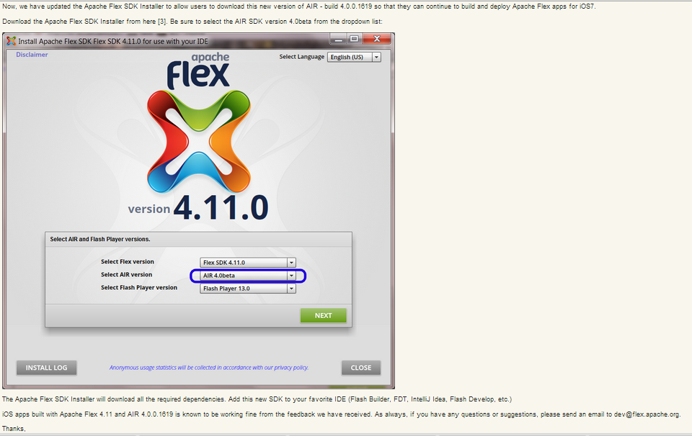
https://blogs.apache.org/flex/entry/building_apache_flex_apps_for

Slide 10
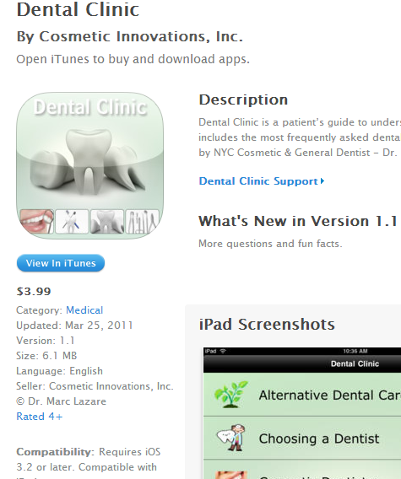
Dental Clinic by Cosmetic Innovations, Inc.
https://itunes.apple.com/us/app/dental-clinic/id391794242?mt=8

Slide 11
Dr. Sunil Dental Clinic
http://www.drsunildental.com/

Slide 12
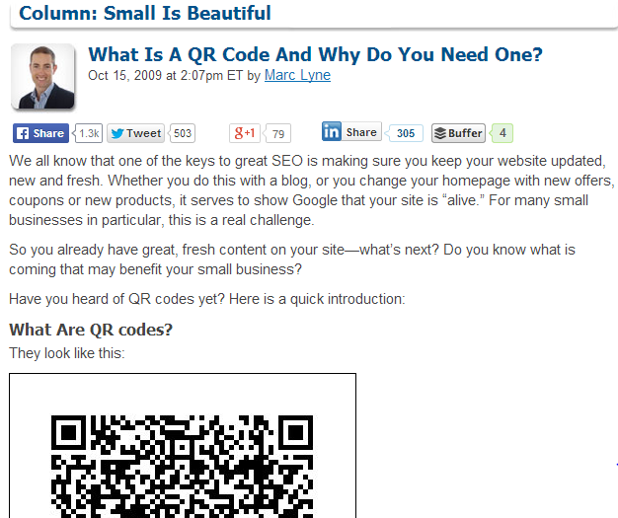
QR code
http://searchengineland.com/what-is-a-qr-code-and-why-do-you-need-one-27588

Slide 13
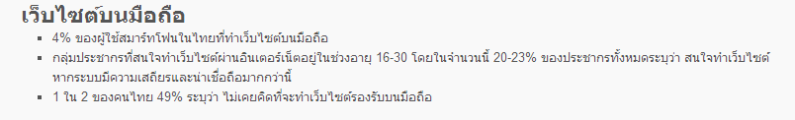
Why Smartphone?
http://www.atimedesign.com/webdesign/%E0%B8%A7%E0%B8%87%E0%B8%81%E0%B8%B2%E0%B8%A3%E0%B8%AA%E0%B8%A1%E0%B8%B2%E0%B8%A3%E0%B9%8C%E0%B8%97%E0%B9%82%E0%B8%9F%E0%B8%99%E0%B9%84%E0%B8%97%E0%B8%A2%E0%B8%81%E0%B8%B1%E0%B8%9A%E0%B9%80%E0%B8%A7/

Slide 14
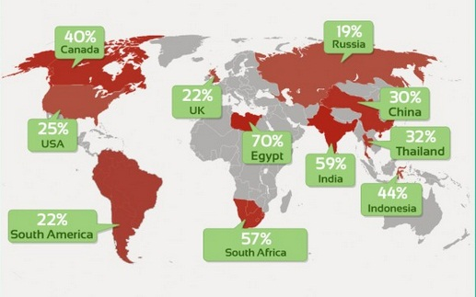
http://thumbsup.in.th/2013/04/increase-mobile-users-push-web-responsive-design/

