Slide 1
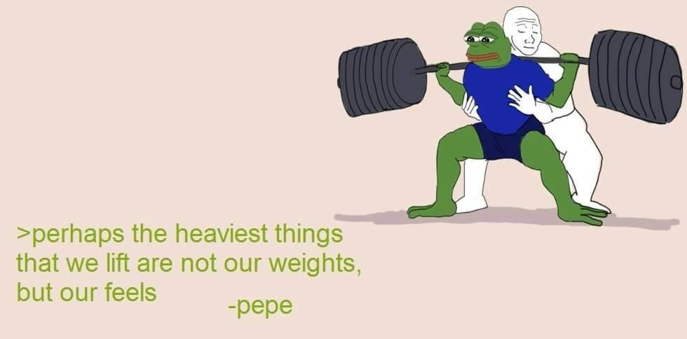
Calories Counter
Kittima taetiengtum

Slide 2
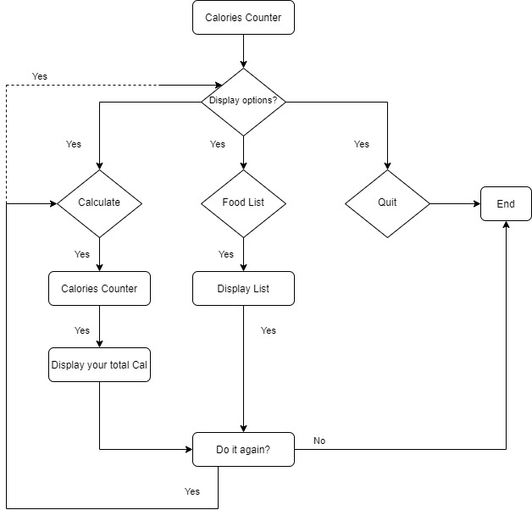
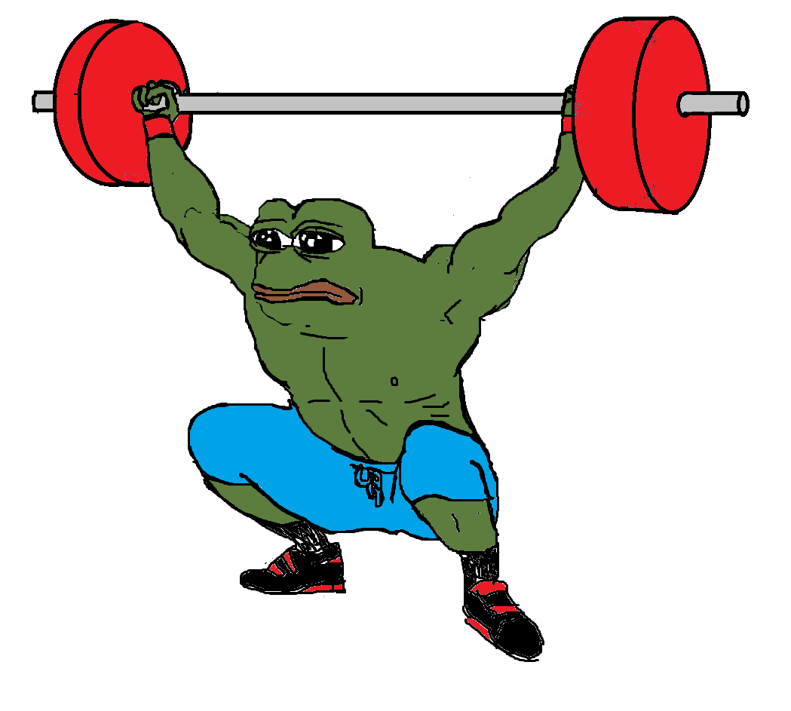
User Flow Diagram

Slide 3
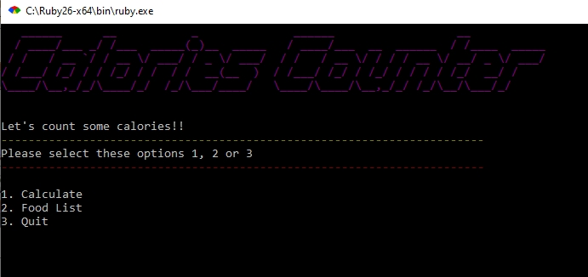
Walkthrough
• Standard basic calories counter
• App objective – to calculate your calories intake to see if you go exceed amount of calories per day already or not
• There will be a food list (for example)

Slide 4
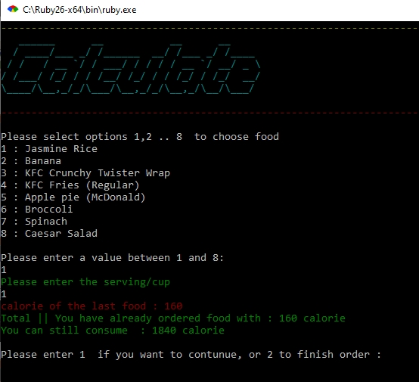
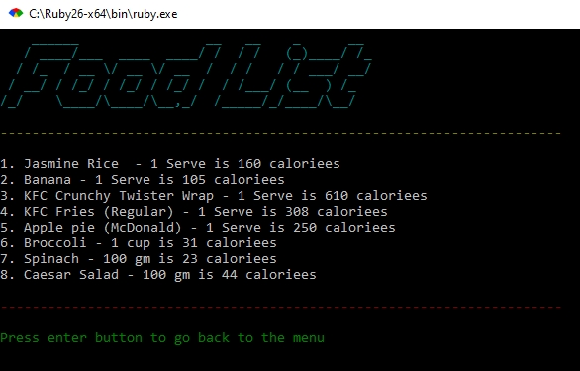
Walkthrough

Slide 5


Challenges
• Do actual Coding
• Gathering Ideas

