Slide 1

Quantum Machine Learning
Classification of Handwritten Digits
Nico Hofmann | M.Sc. Software Engineering | Winter Semester 2025/26

Slide 2
Agenda
Dataset Exploration
Feature Reduction
Encoding Circuit Selection
Observable Selection
Final Pipeline & Evaluation
(Optional) Accelerated Hyperparameter Search

Slide 3
Dataset Exploration

Slide 4
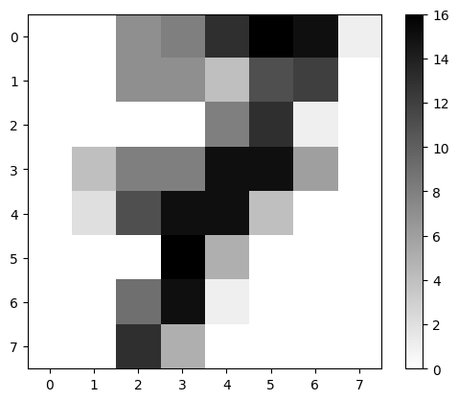
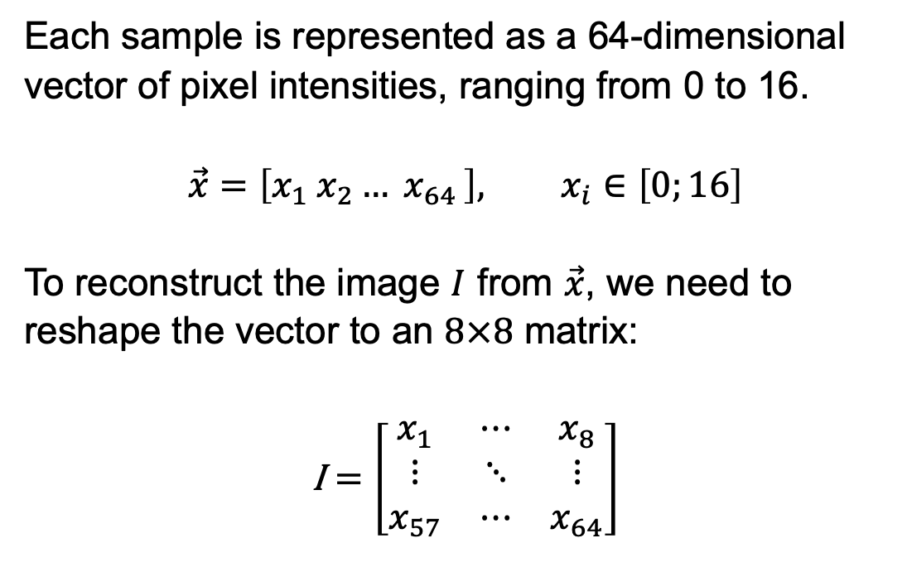
Dataset Exploration
Each sample is represented as a 64-dimensional vector of pixel intensities, ranging from 0 to 16.
$$\vec{x}=\left[x_{1} x_{2}{… x}_{64}\right], x_{i}∈\left[0;16\right]$$
To reconstruct the image $I$ from $\vec{x}$, we need to reshape the vector to an $8×8$ matrix:
$$\text{I}=\left[\begin{matrix}x_{1} & ⋯ & x_{8} \\ ⋮ & ⋱ & ⋮ \\ x_{57} & ⋯ & x_{64}\end{matrix}\right]$$

Slide 5
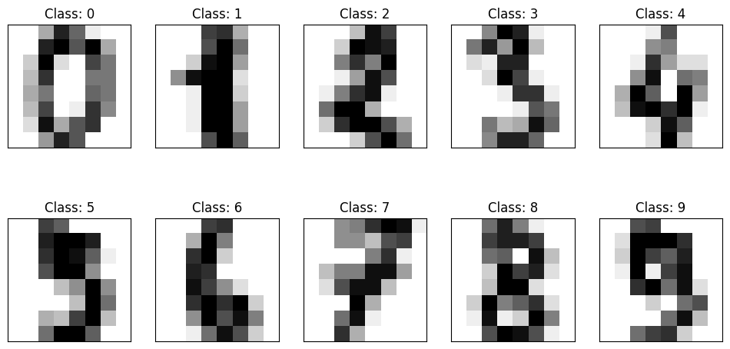
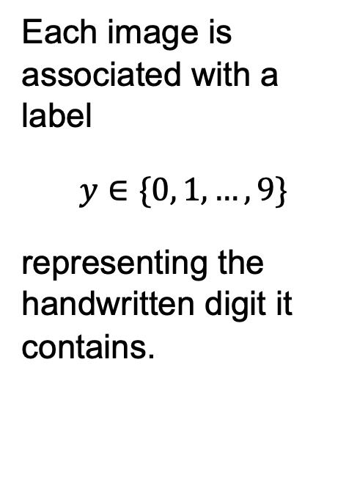
Dataset Exploration
Each image is associated with a label
$$y∈\{0, 1, …, 9\}$$
representing the handwritten digit it contains.

Slide 6
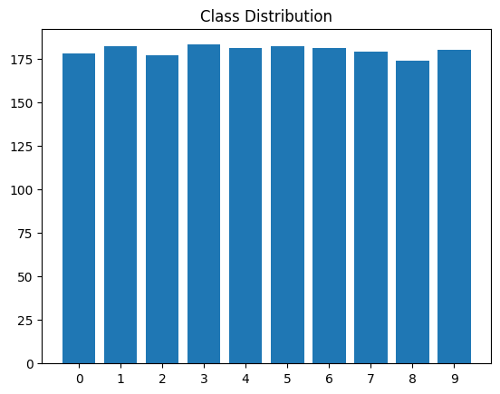
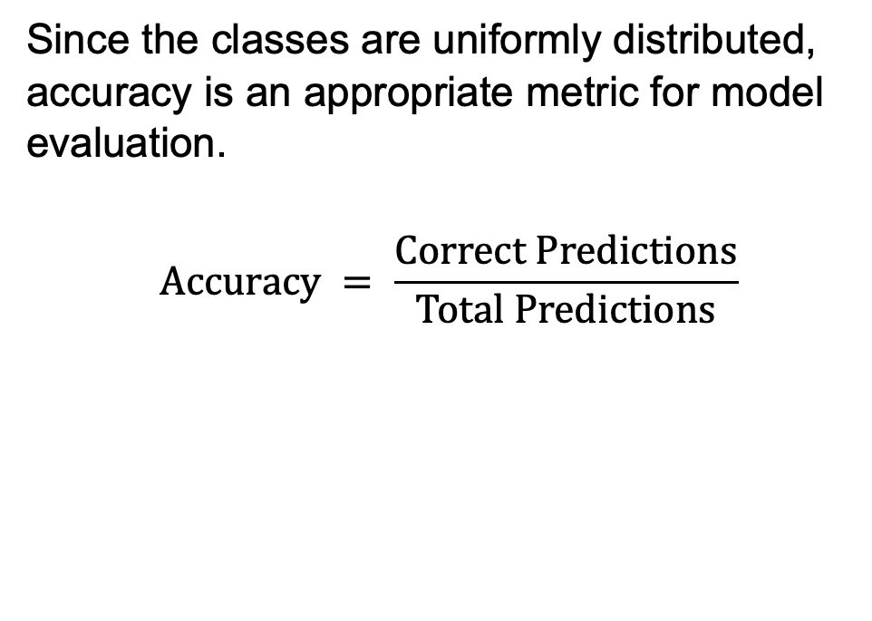
Dataset Exploration
Since the classes are uniformly distributed, accuracy is an appropriate metric for model evaluation. $$Accuracy = \frac{Correct Predictions}{Total Predictions}$$

Slide 7
Feature Reduction

Slide 8
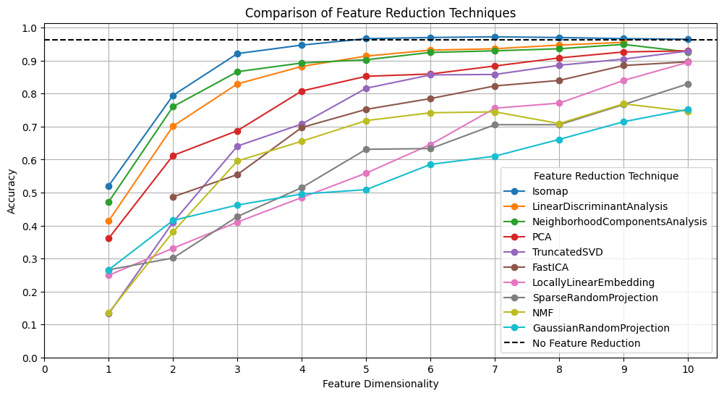
Feature Reduction
Decision: Isomap seems to deliver the highest accuracy and starts converging at five dimensions.

Slide 9
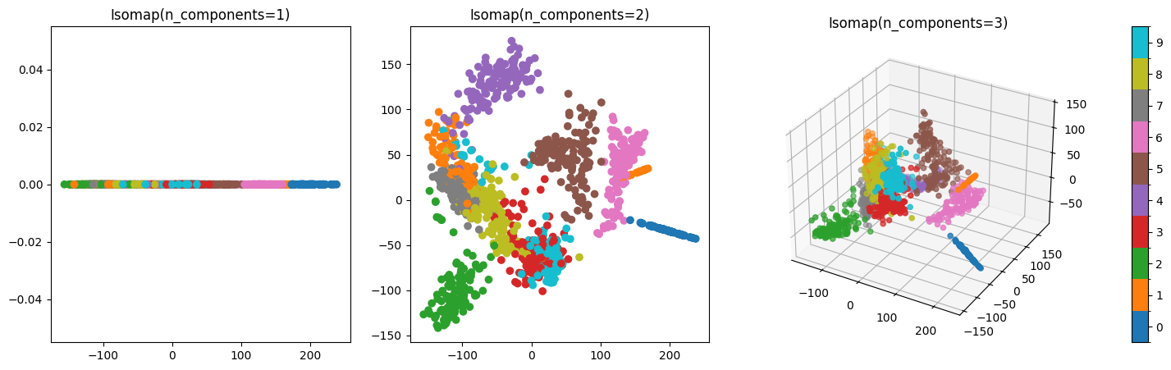
Feature Reduction

Slide 10
Encoding Circuit Selection

Slide 11
Encoding Circuit Selection
Optimization Problem
Maximize accuracy: Achieve the highest possible predictive performance
Minimize gate count: Reduce circuit depth to mitigate noise on real hardware
Types of Encoding Circuits
Predefined, parametrized circuits (e.g., ChebyshevPQC, ParamZFeatureMap, …)
Randomly generated, non-parametrized circuits (e.g., RandomLayeredEncodingCircuit)
Hyperparameter Search
Each encoding circuit was tested with 1-5 qubits and 1-5 layers (25 combinations)
Random circuits were initialized using quantum physicists' birthdays as seeds

Slide 12
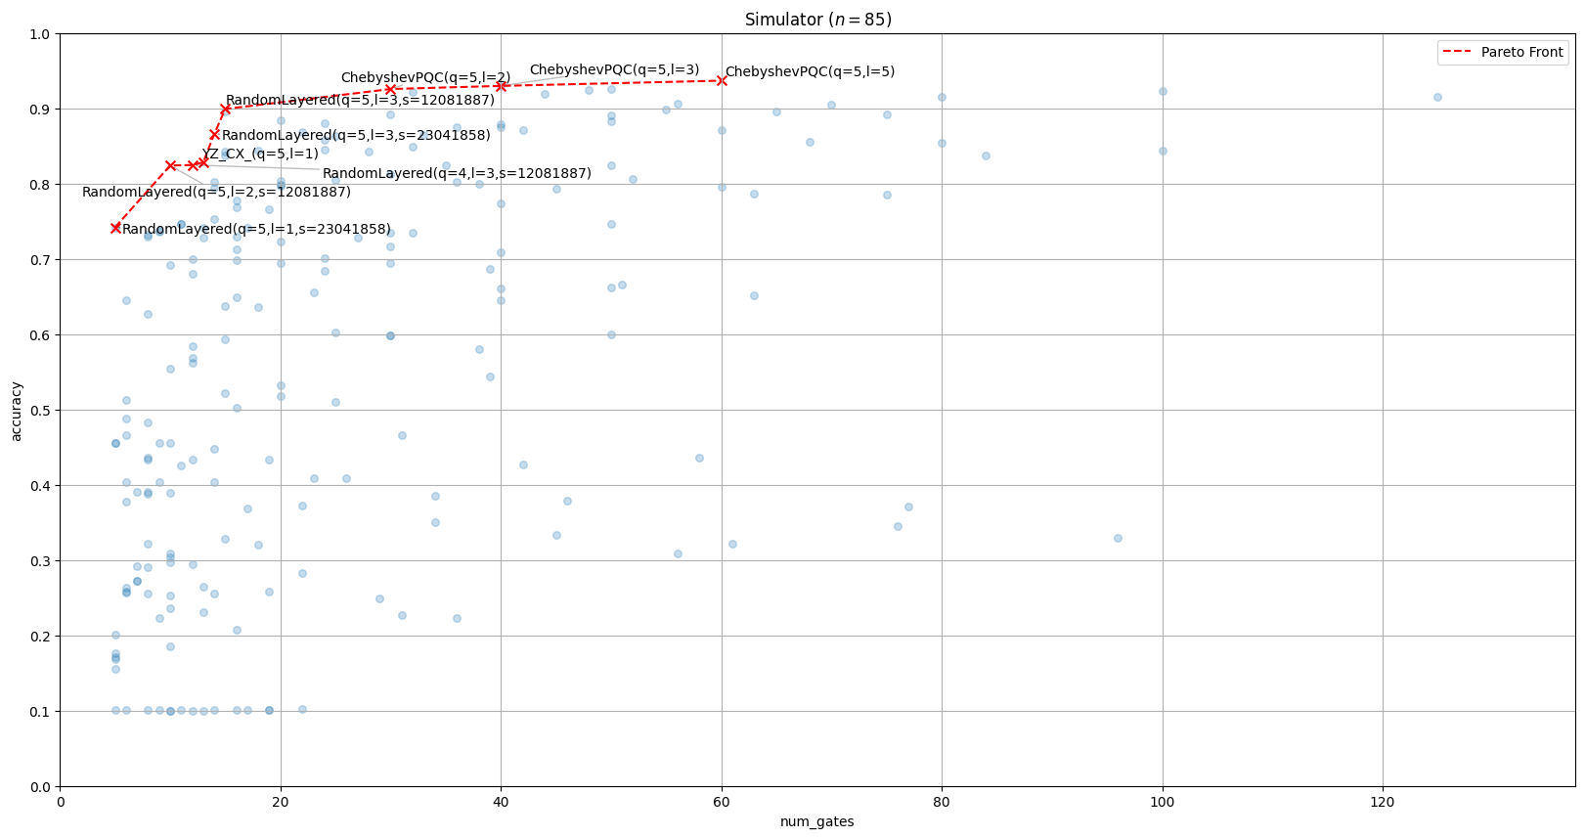
Encoding Circuit Selection

Slide 13
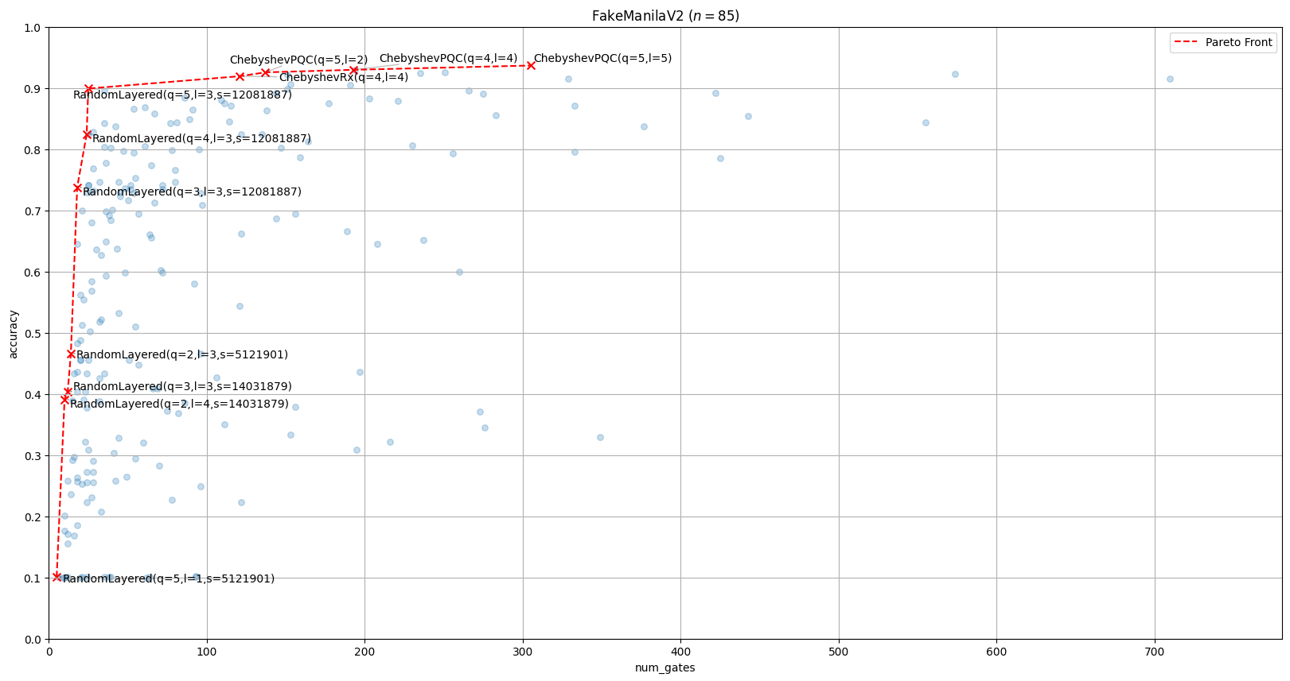
Encoding Circuit Selection

Slide 14
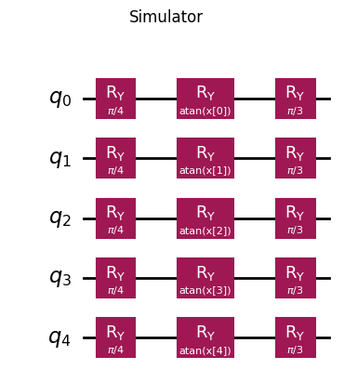
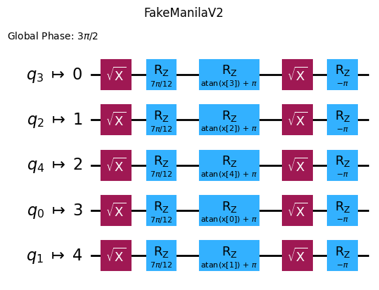
Encoding Circuit Selection
Decision: The random encoding circuit with 5 qubits, 3 layers, and seed 12081887 at the elbow of the Pareto front represents the optimal trade-off between accuracy and gate count.

Slide 15
OBSERVABLE Selection

Slide 16
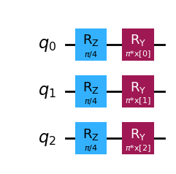
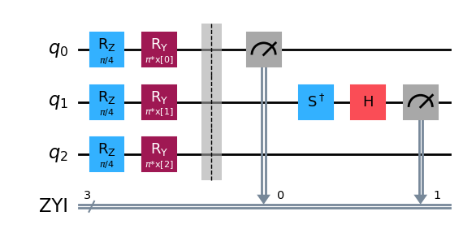
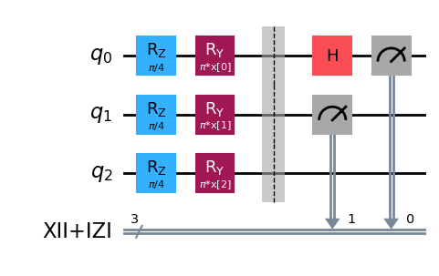

Observable Selection
Optimization Problem
Maximize accuracy: Achieve the highest possible predictive performance
Minimize gate count: Reduce the complexity of the observable
Example
$O=Z_{1}Y_{2}I_{3}+X_{1}I_{2}I_{3}+I_{1}Z_{2}I_{3}$

Slide 17
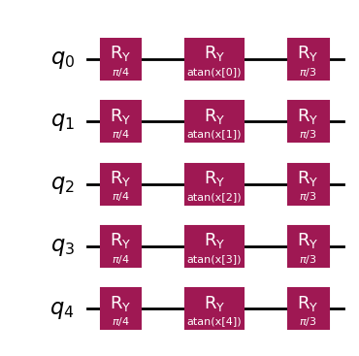
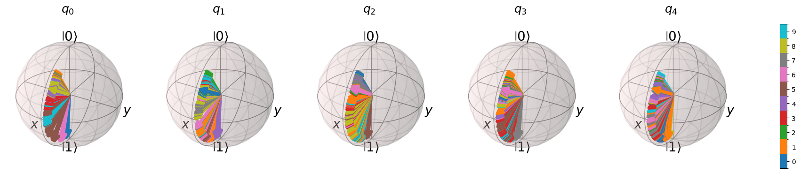

Observable Selection
Preselection: The chosen encoding circuit consists only of $R_{Y}$ gates, meaning the feature vector $\vec{x}$is encoded only within the $XZ$ plane of the Bloch sphere. Consequently, we can restrict the hyperparameter search to observables measuring in the $X$ and $Z$ bases.
State vectors of the first 100 handwritten digits:

Slide 18
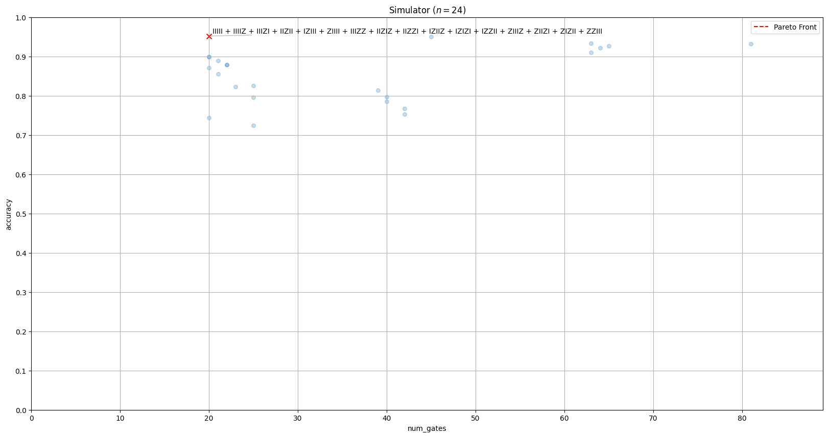
Observable Selection

Slide 19
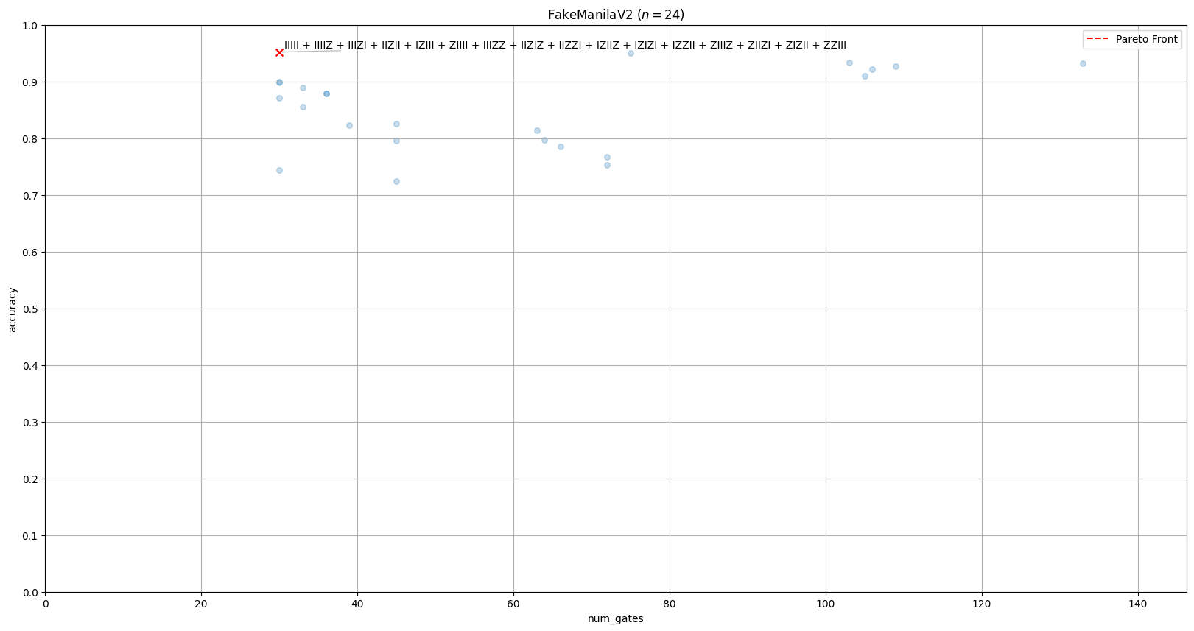
Observable Selection

Slide 20
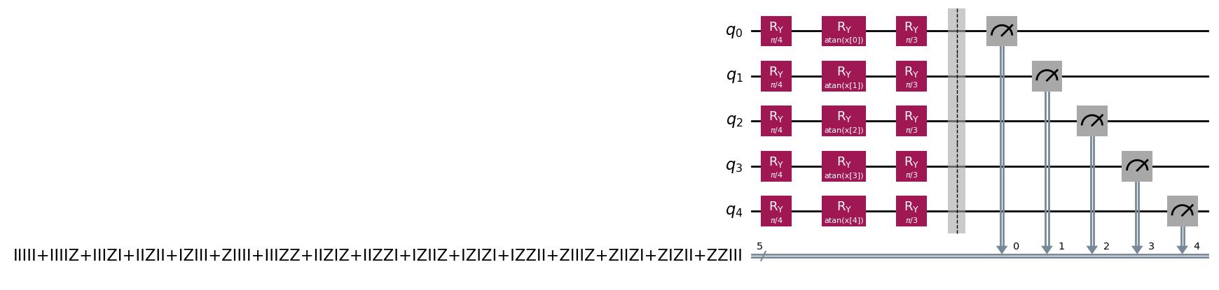

Observable Selection
Decision: The Ising Hamiltonian is the optimal observable that measures every single qubit and all qubit pairs in the $Z$ basis. Since all terms share the same basis, we can measure the entire observable using only a single circuit.

Slide 21
Final Pipeline & Evaluation

Slide 22
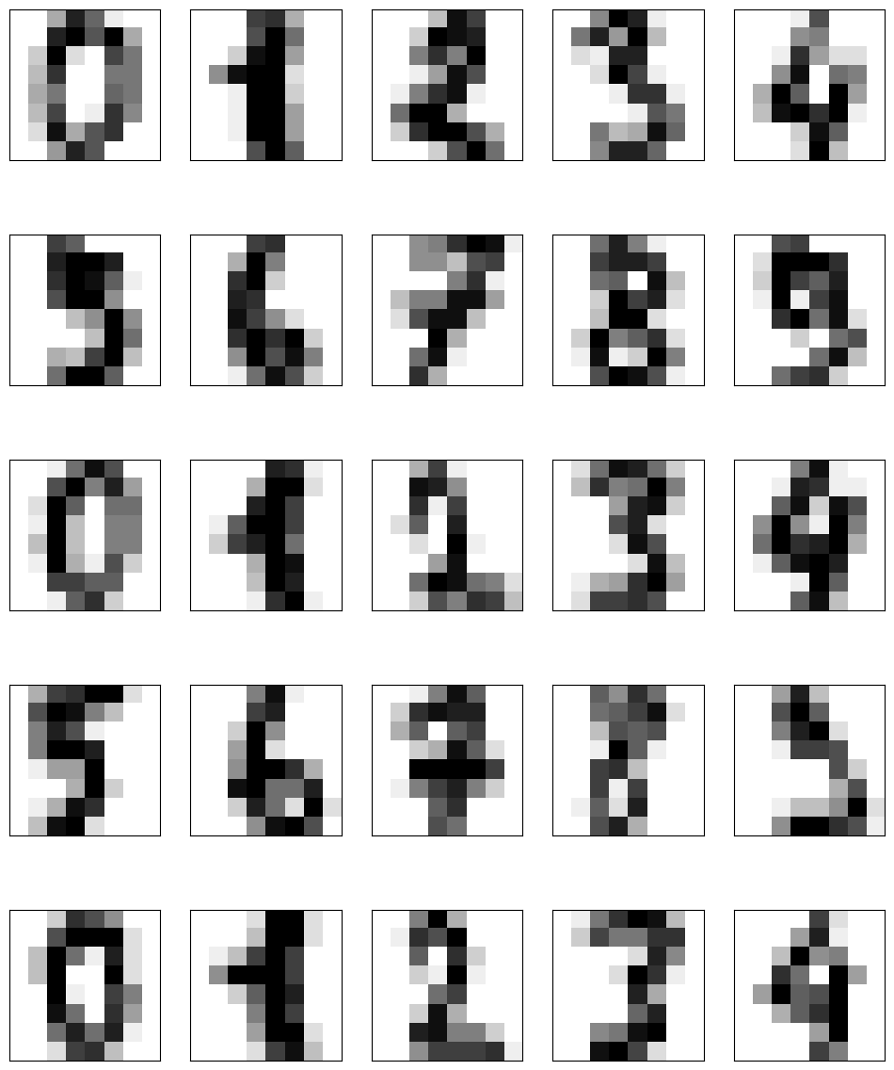

Final Pipeline & Evaluation
(no trainable parameters) (trainable coefficients)
Data Feature Reduction Encoding Circuit Observable
$$O\left(θ\right)=θ_{1}IIIII+θ_{2}IIIIZ \\ + θ_{3}IIIZI +θ_{4}IIZII \\ +{ θ}_{5}IZIII +θ_{6}ZIIII \\ +{ θ}_{7}IIIZZ +θ_{8}IIZIZ \\ +{ θ}_{9}IIZZI +θ_{10}IZIIZ \\ + θ_{11}IZIZI +θ_{12}IZZII \\ +{ θ}_{13}ZIIIZ +θ_{14}ZIIZI \\ +{ θ}_{15}ZIZII +θ_{16}ZZIII$$

Slide 23
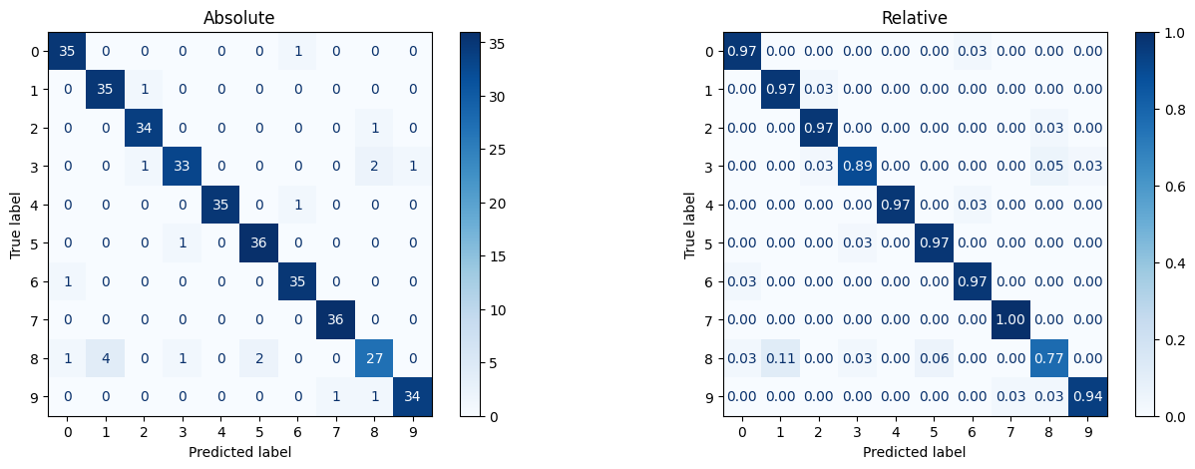
Final Pipeline & Evaluation
Accuracy
Train: 0.95
Test: 0.94
Parameters
Circuit: 0
Operator: 160

Slide 24

Final Pipeline & Evaluation
Criteria | Quantum Neural Network | Logistic Regression
Train Accuracy | 0.95 | 0.98
Test Accuracy | 0.94 | 0.97
Feature Dimensionality | 5 | 64
HPO Duration | 8 h + 4 h | 3.5 s
Training Duration | 10 m | 100 ms
Parameters | 160 | 650
Inference Latency | 20 ms | 20 ms
There is no quantum advantage for handwritten digits classification.

Slide 25
(Optional) Accelerated Hyperparameter Search

Slide 26
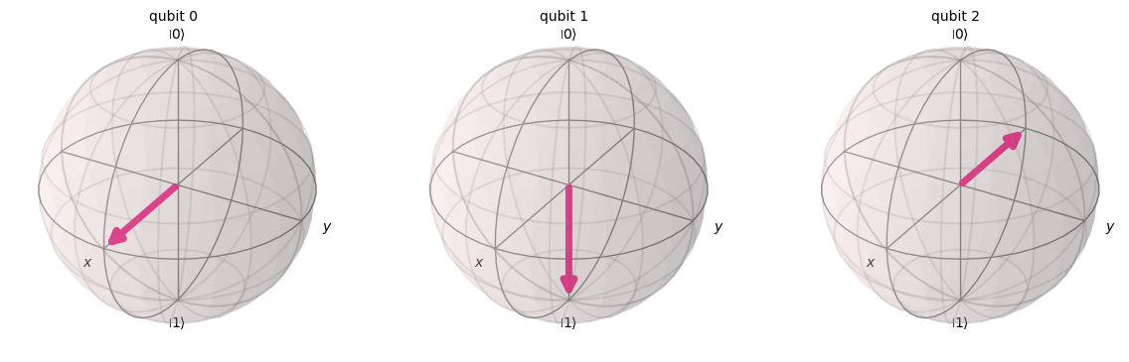
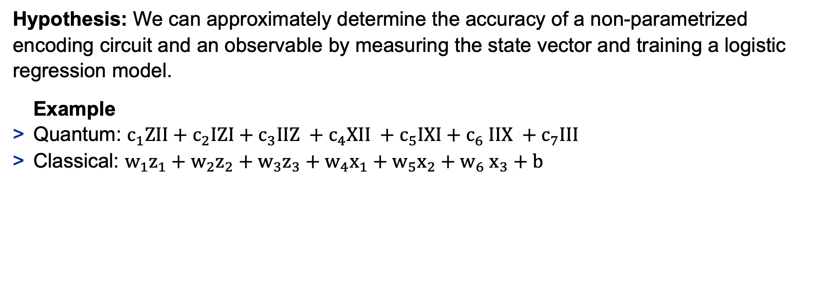
(Optional) Accelerated Hyperparameter Search
Hypothesis: We can approximately determine the accuracy of a non-parametrized encoding circuit and an observable by measuring the state vector and training a logistic regression model.
Example
Quantum: $c_{1}ZII+c_{2}IZI+c_{3}IIZ +c_{4}XII +c_{5}IXI{+ c}_{6}IIX +c_{7}III$
Classical: $w_{1}z_{1}+w_{2}z_{2}+w_{3}z_{3}+w_{4}x_{1}+w_{5}x_{2}{+ w}_{6}x_{3}+b$

Slide 27
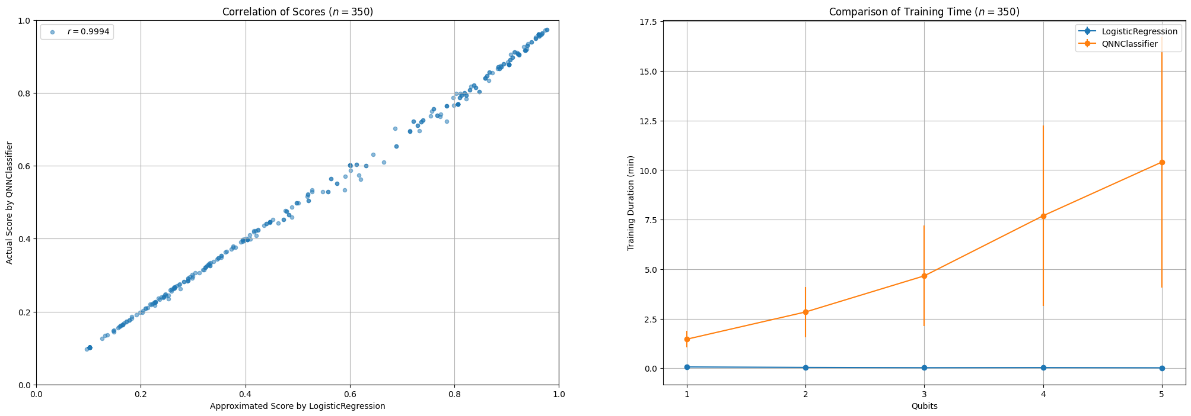
(Optional) Accelerated Hyperparameter Search

Slide 28
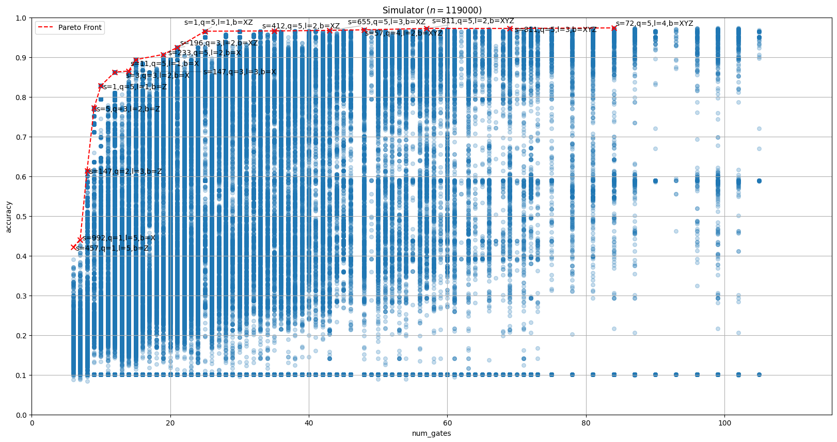
(Optional) Accelerated Hyperparameter Search

Slide 29
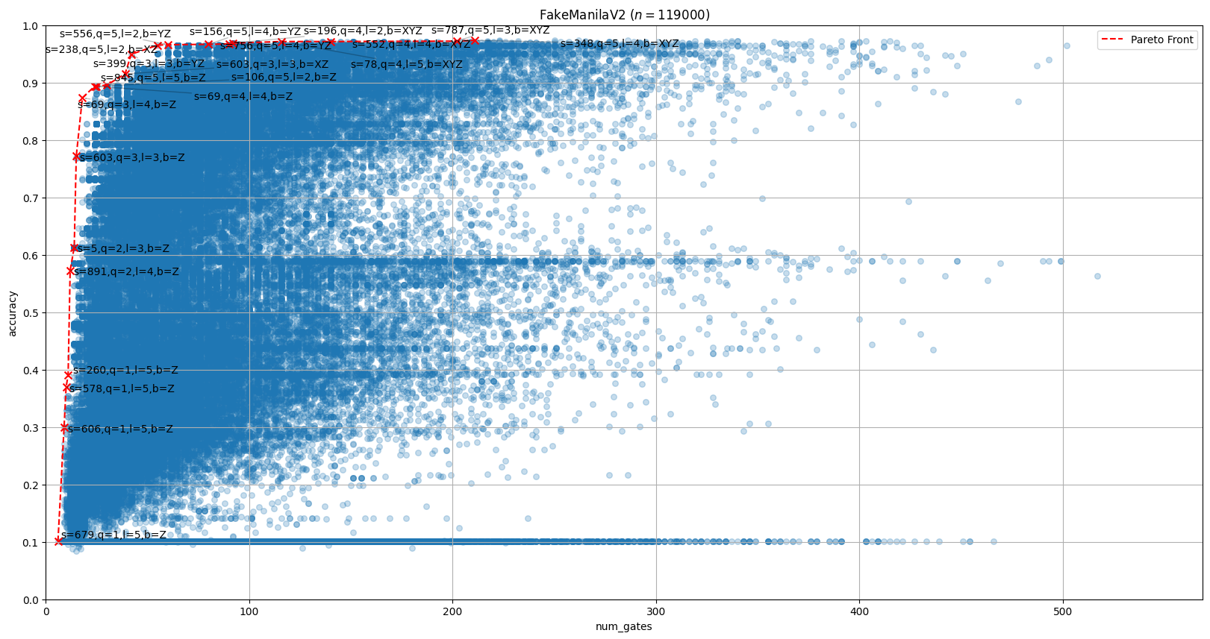
(Optional) Accelerated Hyperparameter Search

Slide 30
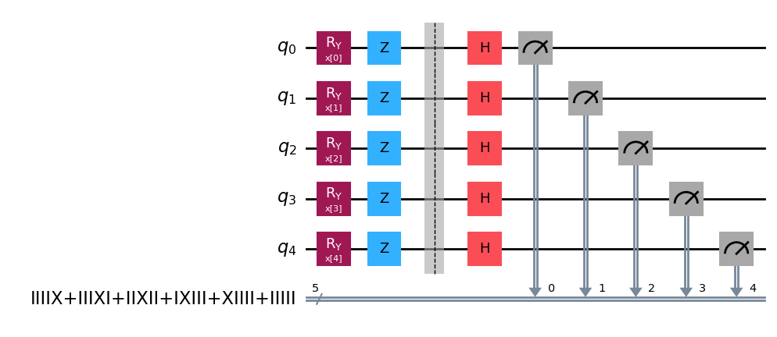
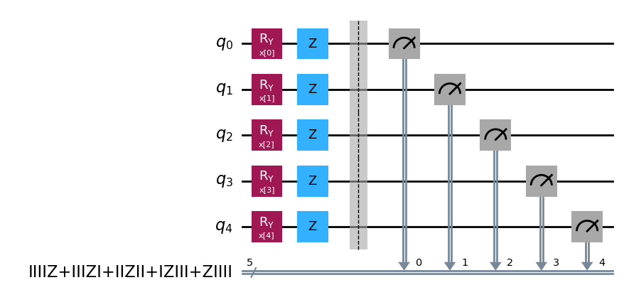
(Optional) Accelerated Hyperparameter Search
Outcome: The accelerated hyperparameter search enabled more combinations of encoding circuits and observables to be tested, resulting in an even more accurate model.
Accuracy
Train: 0.97 (+0.02)
Test: 0.97 (+0.03)

Slide 31


Thank you!
Please refer any questions to:
Nico Hofmann
M.Sc. Software Engineering
nhofmann1@stud.hs-heilbronn.de

