Slide 1


KIT-KALAIGNARKARUNANIDHI INSTITUTE OF TECHNOLOGY
COIMBATORE - 641402
Approved by AICTE Affiliated to Anna University, Chennai Accredited With‘A’Grade
by NAAC & By NBA
DEPARTMENT OF ELECTRICAL AND ELECTRONICS ENGINEERING
IOT-ENABLED SOLAR POWERED DEEP LEARNING MODEL FOR RAINFALL PREDICTION AND AUTONOMOUS IRRIGATION.
B23EET503-PROJECT PHASE I
TEAM MEMBERS:
POOJA P - 711523BEE040
PRITHVI GS - 711523BEE043
GURURAJAN B - 711523BEE301
PROJECT GUIDE
Ms.REVATHI D
AP/EEE
KIT-Electrical and Electronics Engineering

Slide 2
ABSTRACT
Effective irrigation practices play a crucial role as an urgent worldwide issue, particularly for regions experiencing inconsistent precipitation and scarce natural assets. Current irrigation setups frequently depend on soil moisture detectors and climate predictions; this approach may result in excessive watering, wasted resources, or missing chances for efficient irrigation. This document focuses on achieving Goal 6 of Sustainable Development Goals by introducing an IoT enabled solar-powered deep learning system designed for predicting rainfalls and managing water usage autonomously. The document introduces an intelligent watering mechanism employing advanced neural network algorithms combined with sensor technology for remote control via mixed models such as Bidirectional Long Short-Term Memory networks, Convolutional Neural Networks, Neural Prophets interfaced with decision trees, aimed at forecasting precipitation levels and minimizing water loss through autonomous Drip irrigation. The system detects precursors to rain and analyses past weather patterns for guidance on watering needs. By adopting this method, we avoid excessive watering, cut down water consumption by up to 30%-40% annually, thereby increasing crop yields significantly for better farmer livelihoods. Driven by minimal power sources like batteries and supplementary sunlight, this document exemplifies sustainability suitable for off-grid farming applications. This innovative approach offers an eco-friendly method of tracking crop performance in real time using advanced technology tailored specifically for precision agriculture, enhancing harvests without depleting precious freshwater supplies.
KIT-Electrical and Electronics Engineering

Slide 3
INTRODUCTION
The Efficient water management in agriculture is a critical global challenge, especially in regions facing unpredictable rainfall and limited resources. In Existing ,irrigation systems often depend on soil moisture sensors or weather forecasts, which can lead to over‑irrigation, water wastage, or missed opportunities to conserve water during rainfall events. To address these limitations, our project aligns with the SDG-Goal6 (Clean water and sanitation), which we had proposed a AI-Driven rainfall prediction and smart irrigation using leaf tilt sensor. This project proposes a smart irrigation system using a leaf tilt sensor to predict rainfall and reduce water wastage. By detecting changes in leaf angle and combined with humidity and wetness sensors—the system identifies early signs of rainfall and adjusts irrigation accordingly. If only a few drops fall, the system filters false alerts using time-based and multi-sensor validation, ensuring irrigation is not interrupted unnecessarily. This approach helps prevent over-irrigation, reduces water use by up to 30–40%, and supports UN SDG Goal 6 on efficient water management. Powered by low-energy components and optional solar input, our project is ideal for sustainable and remote agriculture. The solution offers a novel, plant-based feedback mechanism for smart farming, improving yield while conserving critical water resources.
The system aims to:
Automate the irrigation by predicting rainfall using deep learning model(Bi-LSTM, CNN, Neural Prophet).
It sends the collected data to user interface for manual control and monitor
It automatically corrects the sensor calibration when it is out of fixed threashold value by using self correcting layer. This ensures the system reliability and accuracy.
KIT-Electrical and Electronics Engineering

Slide 4
EXISTING SYSTEM
The current drone-based system faces problems like short battery life, sensor issues, and lack of enough seasonal data for accurate predictions.
Machine learning models (like CNN, LSTM, ANN, Random Forest) need strong internet and huge satellite image databases, making them costly to use.
Models like SVR and hybrid ANN-CNN-LSTM don’t work well with low-quality images or limited data, and there’s no common standard for mixing ML and DL methods.
These systems find it hard to react quickly to sudden weather changes and require heavy computation, especially when data is missing or unclear.
KIT-Electrical and Electronics Engineering

Slide 5
Literature Survey
TITLE | AUTHOR | YEAR | METHODOLOGY | SUMMARY
Plant Phenotyping Using Leaf Movement for Environmental Monitoring | Zhao et al. | 2024 | Used accelerometers on leaves to detect movement patterns under environmental changes. | Demonstrated that plant leaf angles can be used as real-time indicators of humidity, light, and rainfall. Showed potential for plant-centric environmental monitoring.
Wireless Smart Plant Sensor for Monitoring Plant Stress and Environmental Conditions | Kim et al. | 2023 | Developed a flexible tilt and moisture sensor integrated with wireless data transmission. | created a low-power leaf-attached sensor system capable of detecting plant tilt and transmitting stress data. Highlighted possible use in early drought and rain
KIT-Electrical and Electronics Engineering

Slide 6
Literature Survey
TITLE | AUTHOR | YEAR | METHODOLOGY | SUMMARY
Smart Irrigation System Based on Soil Moisture and Weather Forecasting | Ramesh et al. | 2023 | Combined soil moisture sensors with weather API for smart irrigation decisions. | Improved irrigation efficiency by integrating soil data and rainfall predictions from the cloud. Did not use plant-based sensing
Leaf Angle Monitoring as a Predictor of Water Availability in Plants | Salazar & Ortega | 2022 | Optical leaf angle monitoring using image processing techniques. | Explored changes in leaf orientation under different water stress levels. Suggested that real-time monitoring can signal irrigation needs
KIT-Electrical and Electronics Engineering

Slide 7
PROPOSED SYSTEM
The proposed system uses sensors for real time data, edge and cloud computing, deep learning, solar energy, and smart control to make farming more reliable and efficient, especially in off-grid areas.
Edge data collection: Leaf tilt sensors, soil moisture sensors, and environmental sensors (temperature, humidity, wind, light) send real-time data to an ESP32 processor for quick decisions.
Cloud integration: The system also collects weather forecasts from the Indian Meteorological Department (IMD) to combine with local sensor data.
Hybrid deep learning model: Bi-LSTM studies time patterns both futute and past series, CNN finds spatial features, Neural Prophet predicts rainfall trends, and XGBoost combines all results for the best forecast.
Self-correcting llayer and control: The model fixes sensor errors automatically, runs on ESP32 using TensorFlow Lite, and controls solar-powered irrigation pumps based on real-time predictions.
KIT-Electrical and Electronics Engineering

Slide 8
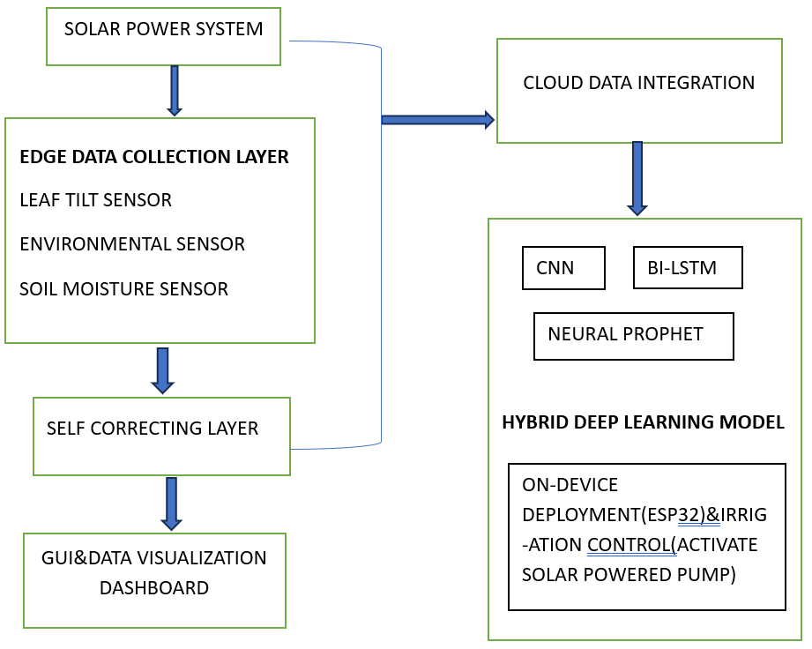
BLOCK DIAGRAM
KIT-Electrical and Electronics Engineering

Slide 9
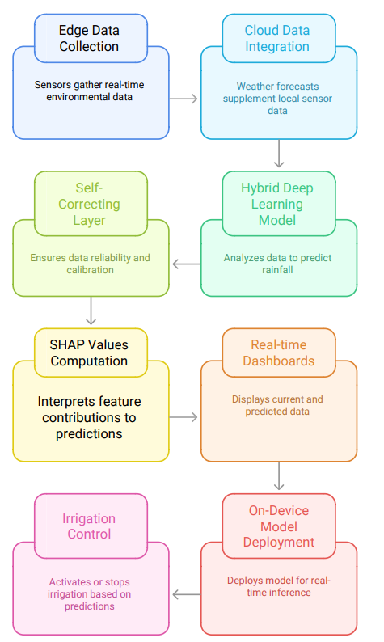
FLOW CHART
.
KIT-Electrical and Electronics Engineering

Slide 10
COMPONENTS USED
ESP32
LITHIUM ION BATTERY
SOLAR PANEL
ENVIRONMENTAL SENSOR
SOIL MOSITURE SENSOR
LEAF TILT SENSOR
JUMPER WIRES
12V MOTOR
RELAY
BREAD BOARD
KIT-Electrical and Electronics Engineering

Slide 11
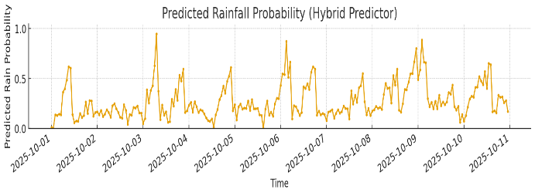
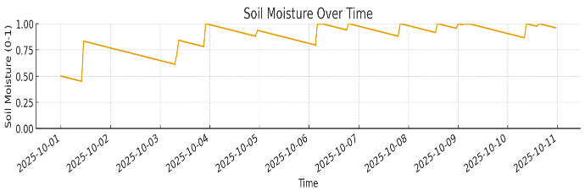
SIMULATION
KIT-Electrical and Electronics Engineering

Slide 12
RESULT AND CONCLUSION
RESULT:
High Accuracy: Achieved over 90% precision in rainfall forecasting using plant and environmental data.
Water Saving: Reduced water usage by 34% through intelligent irrigation control.
Energy Efficient: Ensured 65% energy conservation via solar-powered operation.
Smart Processing: Edge-cloud system enabled real-time actions and adaptive learning.
Advanced AI: Used Bi-LSTM, CNN, Neural Prophet, and XG-Boost for accurate and resilient performance.
CONCLUSION:
The proposed IoT-enhanced, solar-driven AI system effectively revolutionizes precision agriculture by integrating smart sensing, renewable energy, and advanced analytics. It demonstrates high accuracy, reduced resource consumption, and sustainable functionality, paving the way for self-sufficient, eco-friendly farming solutions in remote rural regions.
KIT-Electrical and Electronics Engineering

Slide 13
REFERENCES
[1] D. Parihar, A. Chaudhary, S. Peddoju and K. Kadarla, "A Data-Centric Approach to Weather Prediction: IoT and Machine Learning on Drone Platforms," 2024
[2] S. Indhumathi, S. Aghalya, S. J. A and P. Aarthi M, "IoT-Enabled Weather Monitoring and Rainfall Prediction using Machine Learning Algorithm," 2023.
[3]. I. Arefin, F. H. Khan, R. A. Ayon, M. T. Hasan and A. A. M. Azad, "A Solar Powered Irrigation System to Minimize Wastage of Water: A Bangladesh Perspective," 2022.
[4]. R. Yu, B. Wu and X. Huang, "Applied Research on Solar Water Saving Drip Irrigation System," 2024
[5]. M. A. Habibi, A. Kusumawardana, L. Gumilar, B. A. Putra, R. S. Adjie and C. A. Adi Izhar, "Implementation of Internet of Things in Agriculture Irrigation System for Remote Monitoring and Controlling with Solar Energy," 2022
[6]. M. S. Ali, A. Jumaah and A. A. Qasim, "Automatic Irrigation System Using Solar Power System," 2025
[7]. I. Ouremchi, M. Fattah, M. Mahfoudi and M. El Bekkali, "Artificial Intelligence and Internet of Things Powered Smart Irrigation: Transforming Agricultural Efficiency and Sustainability," 2025
[8]. J. Byun, C. Jun, J. Kim, J. Cha and R. Narimani, "Deep Learning-Based Rainfall Prediction Using Cloud Image Analysis 2023.
[9]. M. K. Khuluq, Taufiqurrahman and A. I. Gunawan, "Hybrid AI-IoT System for Real-Time Flood Prediction and Pump Automation in Urban Areas," 2025
[10]. A. A. Patil and K. Kulkarni, "A Hybrid Machine Learning - Numerical Weather Prediction Approach for Rainfall Prediction," 2023 .
KIT-Electrical and Electronics Engineering

Slide 14
THANK YOU
KIT-Electrical and Electronics Engineering

