Slide 1
Containerization in DevOps
Containerization is a method of packaging an application with all its dependencies (libraries, configuration files, runtime) into a single, portable unit called a Container. These containers run consistently across environments, whether on a developer’s laptop, a test server, or in production, without compatibility issues.

Slide 2
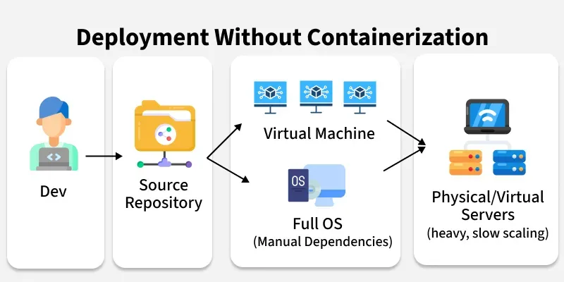

Slide 3
Before Containerization
Virtual Machines setup: Each application ran inside its own VM, with a full operating system on top of a hypervisor.
Resource wastage: Running multiple full OS instances consumed a lot of CPU, memory, and storage. Even small apps needed heavy resources.
Environment mismatch: “It works on my machine” was a common problem, because apps behaved differently across development, testing, and production environments.
Scaling issues: Scaling a monolithic app meant starting a new VM, which could take minutes and wasted resources since the entire OS had to boot.
Slow delivery: Updating even a small feature meant redeploying the entire application or spinning up more VMs, making releases slow and risky.

Slide 4
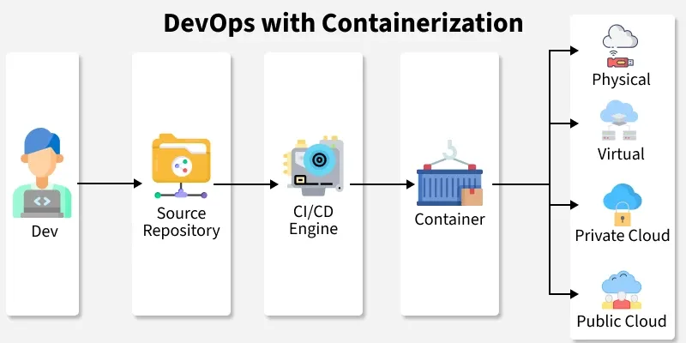

Slide 5
With containerization, applications no longer needed heavy Virtual Machines for isolation. Instead, they could run inside lightweight containers that package the application and all its dependencies together:
Write Once, Run Anywhere: Containers package an application with its dependencies into a single, portable unit, ensuring it runs consistently across any environment.
Consistency: Since the app and dependencies are bundled together, the same container image runs everywhere without conflicts.
Microservices-friendly: Instead of one large monolithic app, systems can be split into smaller services, each in its own container, making scaling and updates easier.
Faster scaling & deployment: Tools like Docker and orchestrators like Kubernetes allow containers to be deployed, replicated, and rolled back quickly.
Modern CI/CD pipelines: Containers integrate seamlessly with automated pipelines, ensuring smoother collaboration between developers, testers, and operations teams.

Slide 6
Containerization Workflow
Write the Application
Package the Application into an Image
Store the Image in a Registry
Run Containers from the Image
Scale and Update
Manage and Orchestrate

Slide 7
Common Containerization Tools
Docker
Linux Containers (LXC)
Kubernetes
Amazon ECS
Google GKE

Slide 8
What is Docker?
Docker is a containerization platform used to:
Create containers
Run containers
Manage container images
In simple words:
Docker is a tool used to build and run containers

Slide 9
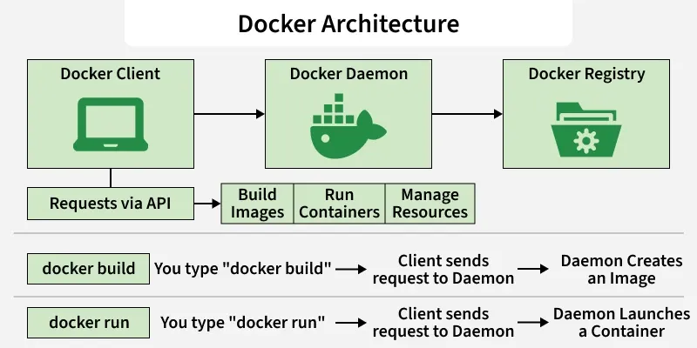

Slide 10
Docker Architecture
Docker uses a Client-Server architecture. It is not just a single program, but a system of three parts talking to each other.
Docker Client: The command line tool (docker) that you type commands into.
Docker Daemon (dockerd): The background process running on the host that does the heavy lifting (building, running, and distributing containers).
Docker Registry: A storage location for Docker Images (like Docker Hub).

Slide 11
Components of Docker
The main components of Docker include -
Docker clients and servers,
Docker images,
Dockerfile,
Docker Registries, and Docker containers.

Slide 12
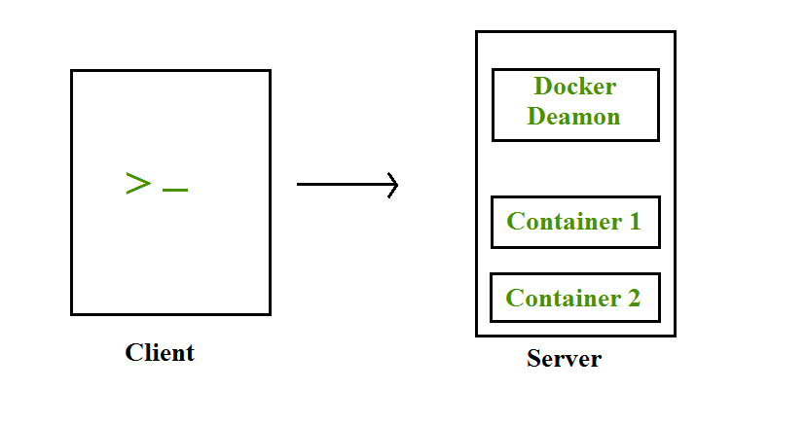
Docker Clients and Servers

Slide 13
Docker Images- A Docker Image is a read-only, inert template that contains the application code, libraries, dependencies, tools, and other files needed for an application to run.
Key Concept: Layered Architecture Images are not monolithic blobs; they are built in Layers.
If you pull an image like nginx, you aren't downloading one big file. You are downloading multiple small layers (e.g., a layer for the OS, a layer for the Nginx software, a layer for config files).
Immutability: Once an image is built, it cannot be changed. If you need to fix a bug, you don't "patch" the image; you modify the Dockerfile and build a new image

Slide 14
Docker File -A Dockerfile is a plain text file containing a sequential list of instructions (commands) that the Docker Daemon reads to automatically build an image. It is the "source code" of your infrastructure. Every line in a Dockerfile creates a new "layer" in the image. Docker reads the file from top to bottom.
FROM: The starting point (e.g., FROM ubuntu:20.04). This is the foundation.
RUN: Executes commands during the build process (e.g., RUN apt-get install python3). This "bakes" software into the image.
COPY: Moves your actual code from your computer into the image.
CMD: The default command that runs when the container starts (e.g., CMD ["python", "app.py"]).

Slide 15
Docker Containers- A Container is a runnable instance of an image. It is the actual "living" process. When you start a container, Docker takes the read-only Image and adds a thin Read-Write (R/W) layer on top of it.

Slide 16
What is Kubernetes?
Kubernetes is an open-source container orchestration platform.
Kubernetes manages containers automatically.
It was developed by Google and is now maintained by CNCF.

Slide 17
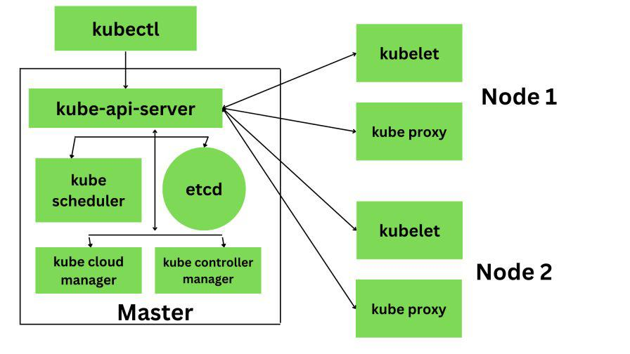

Slide 18
Kubernetes comes with a client-server architecture. It consists of master and worker nodes, with the master being installed on a single Linux system and the nodes on many Linux workstations. The master node, contains the components such as API Server, controller manager, scheduler, and etcd database for stage storage.

Slide 19
Kubernetes is composed of a number of components, each of which plays a specific role in the overall system. These components can be divided into two categories:
Nodes: Each Kubernetes cluster requires at least one worker node, which is a collection of worker machines that make up the nodes where our container will be deployed.
Control plane: The worker nodes and any pods contained within them will be under the control plane

