Slide 1
CHAPTER 06
Network Models and
Transportation Problems
Decision Making / Game Theory / Systems Analysis
TEXTBOOK
CHAPTER
WEEK
Modern Management Science, 9th ed.
Ch. 6
Week 10
Management Science · Kitae Kim, 2026 Spring, Korea Aerospace University
Made by Kitae Kim, formatted by Codex.

Slide 2
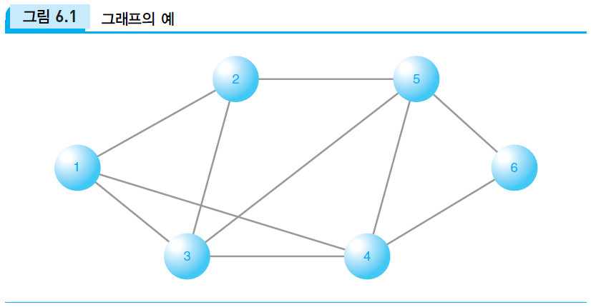
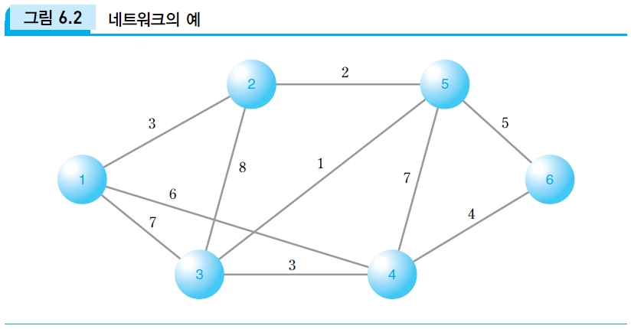
Graphs and Networks
Graph
GRAPH = (NODES, EDGES)
A graph represents the pattern of connections
between nodes.
NETWORK = (NODES, EDGES, ATTRIBUTES)
A network adds information about nodes or edges.
It helps us study flows and identify important nodes.
Categorical: gender, occupation, region, date, type
Numerical: strength, cost, distance, time, capacity
Weighted network
Chapter 6 · Network Models and Transportation
3

Slide 3
Types of Network Problems
Facility layout / design
Arrange or connect facilities, such as machines or base stations.
Routing
Find the best route between an origin and a destination.
Flow optimization
Determine how much traffic or material to send through a network.
Transportation
Ship directly from supply locations to demand locations.
Transshipment
Ship through intermediate locations or distribution hubs.
Assignment
Assign N workers or machines to N tasks, one to one.
Chapter 6 · Network Models and Transportation
4

Slide 4
Example 6-1: Connecting Six Offices
Company A has offices in Seoul, Busan, Gwangju, Daejeon, Gangneung, and Pohang.
It plans to build a private data network connecting all six offices. Data may pass through intermediate offices using a store-and-forward system.
Find a set of links that connects every office at minimum total cost.
Seoul
30
Gangneung
50
40
20
35
50
Daejeon
25
60
Pohang
20
25
15
Gwangju
Busan
30
Link costs are in units of KRW 100 million
Chapter 6 · Network Models and Transportation
5

Slide 5
Example 6-1: Minimum Spanning Tree
Minimal Spanning Tree
1. Start with any node.
2. Add the lowest-cost edge connecting a node in the current tree to a node outside it.
3. Repeat until all nodes are connected.
Do not add an edge that creates a cycle.
30
Seoul
Gangneung
50
40
20
35
50
Daejeon
25
60
Pohang
20
25
15
Gwangju
Busan
30
Illustration: start with Seoul → Daejeon (20).
Chapter 6 · Network Models and Transportation
6

Slide 6
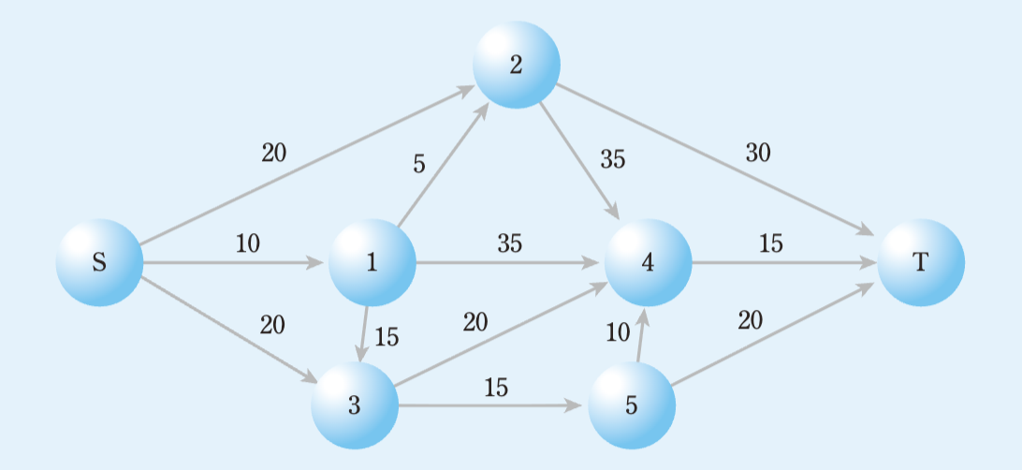
Example 6-2: Shortest Path Problem
A commuter travels from home (S) to work (T). The number on each directed arc is the travel time in minutes.
Possible routes include S → 1 → 4 → T and S → 3 → 5 → T.
Formulate an integer programming model to find the shortest route.
Chapter 6 · Network Models and Transportation
7

Slide 7
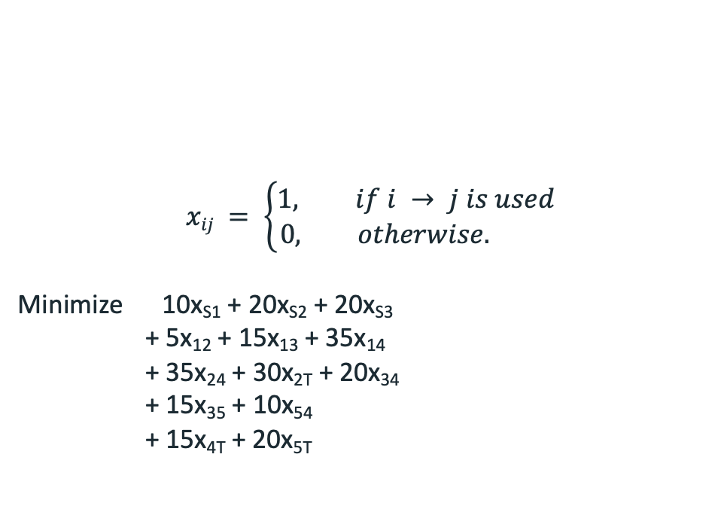
Example 6-2: Shortest-Path Model
VARIABLES AND OBJECTIVE
$$xij = \left\{\begin{aligned}1, if i → j is used \\ 0, otherwise. \end{aligned}\right.$$
Minimize 10x_{S1} + 20x_{S2} + 20x_{S3}
+ 5x₁₂ + 15x₁₃ + 35x₁₄
+ 35x₂₄ + 30x_{2T} + 20x₃₄
+ 15x₃₅ + 10x₅₄
+ 15x_{4T} + 20x_{5T}
Chapter 6 · Network Models and Transportation
9

Slide 8
Example 6-2: Shortest-Path Model
FLOW-BALANCE CONSTRAINTS
x_{S1} = x₁₂ + x₁₃ + x₁₄
x_{S2} + x₁₂ = x₂₄ + x_{2T}
x_{S3} + x₁₃ = x₃₄ + x₃₅
x₁₄ + x₂₄ + x₃₄ + x₅₄ = x_{4T}
x₃₅ = x₅₄ + x_{5T}
x_{S1} + x_{S2} + x_{S3} = 1
x_{2T} + x_{4T} + x_{5T} = 1
x_{ij} ∈ {0,1}
An algorithmic alternative: Dijkstra’s algorithm.
Chapter 6 · Network Models and Transportation
9

Slide 9
Example 6-2: Shortest-Path Model
VARIABLES AND OBJECTIVE
FLOW-BALANCE CONSTRAINTS
$$xij = \left\{\begin{aligned}1, if i → j is used \\ 0, otherwise. \end{aligned}\right.$$
Minimize 10x_{S1} + 20x_{S2} + 20x_{S3}
+ 5x₁₂ + 15x₁₃ + 35x₁₄
+ 35x₂₄ + 30x_{2T} + 20x₃₄
+ 15x₃₅ + 10x₅₄
+ 15x_{4T} + 20x_{5T}
x_{S1} = x₁₂ + x₁₃ + x₁₄
x_{S2} + x₁₂ = x₂₄ + x_{2T}
x_{S3} + x₁₃ = x₃₄ + x₃₅
x₁₄ + x₂₄ + x₃₄ + x₅₄ = x_{4T}
x₃₅ = x₅₄ + x_{5T}
x_{S1} + x_{S2} + x_{S3} = 1
x_{2T} + x_{4T} + x_{5T} = 1
x_{ij} ∈ {0,1} for every available arc.
An algorithmic alternative: Dijkstra’s algorithm.
Chapter 6 · Network Models and Transportation
9

Slide 10
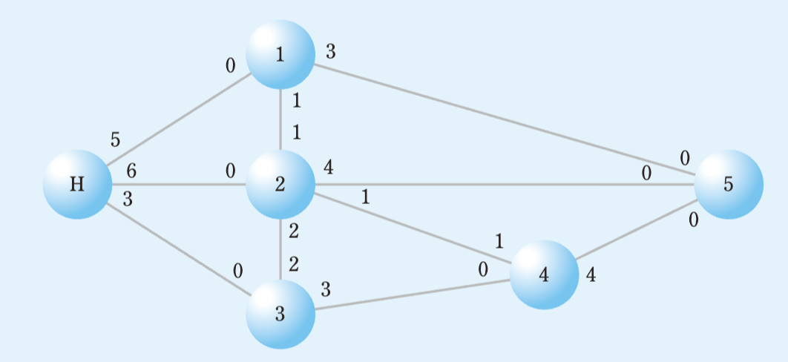
Example 6-3: Maximum Flow Problem
A dam (H) supplies water to cities 1–5 through a pipeline network. An earthquake has destroyed the water-storage facility in city 5.
Determine the maximum amount of water that can be sent from the dam to city 5.
The numbers indicate capacities per unit of time; a capacity of 0 means that flow is not allowed in that direction.
Chapter 6 · Network Models and Transportation
10

Slide 11
Example 6-3: Maximum-Flow Model
VARIABLES AND OBJECTIVE
x_{ij} = water sent from node i to node j per unit of time.
Maximize x₁₅ + x₂₅ + x₄₅
Chapter 6 · Network Models and Transportation
12

Slide 12
Example 6-3: Maximum-Flow Model
FLOW BALANCE AT INTERMEDIATE CITIES
x_{H1} + x₂₁ = x₁₂ + x₁₅
x_{H2} + x₁₂ + x₃₂ + x₄₂ = x₂₁ + x₂₃ + x₂₄ + x₂₅
x_{H3} + x₂₃ = x₃₂ + x₃₄
x₂₄ + x₃₄ = x₄₂ + x₄₅
CAPACITY CONSTRAINTS
x_{H1} ≤ 5; x_{H2} ≤ 6; x_{H3} ≤ 3
x₁₂ ≤ 1; x₂₁ ≤ 1
x₂₃ ≤ 2; x₃₂ ≤ 2
x₁₅ ≤ 3; x₂₅ ≤ 4
x₂₄ ≤ 1; x₄₂ ≤ 1
x₃₄ ≤ 3; x₄₅ ≤ 4
x_{ij} ≥ 0 for all allowed arcs. All zero-capacity directions carry no flow.
Chapter 6 · Network Models and Transportation
12

Slide 13
Example 6-3: Maximum-Flow Model
FLOW BALANCE AT INTERMEDIATE CITIES
VARIABLES AND OBJECTIVE
x_{H1} + x₂₁ = x₁₂ + x₁₅
x_{H2} + x₁₂ + x₃₂ + x₄₂ = x₂₁ + x₂₃ + x₂₄ + x₂₅
x_{H3} + x₂₃ = x₃₂ + x₃₄
x₂₄ + x₃₄ = x₄₂ + x₄₅
x_{ij} = water sent from node i to node j per unit of time.
Maximize x₁₅ + x₂₅ + x₄₅
CAPACITY CONSTRAINTS
x_{H1} ≤ 5; x_{H2} ≤ 6; x_{H3} ≤ 3
x₁₂ ≤ 1; x₂₁ ≤ 1
x₂₃ ≤ 2; x₃₂ ≤ 2
x₁₅ ≤ 3; x₂₅ ≤ 4
x₂₄ ≤ 1; x₄₂ ≤ 1
x₃₄ ≤ 3; x₄₅ ≤ 4
x_{ij} ≥ 0 for all allowed arcs. All zero-capacity directions carry no flow.
Chapter 6 · Network Models and Transportation
12

Slide 14
Example 6-4: Transportation Problem
Samsung Cider operates plants in Masan, Daejeon, and Gunsan and warehouses in Busan, Daegu, Gwangju, and Seoul.
Find the shipping plan that meets demand at minimum transportation cost.
Assume that supply must exactly meet demand.
Plant | Busan | Daegu | Gwangju | Seoul | Supply
Masan | 8 | 9 | 11 | 16 | 50
Daejeon | 12 | 7 | 5 | 8 | 80
Gunsan | 14 | 10 | 6 | 7 | 120
Demand | 90 | 70 | 40 | 50 | 250
Unit shipping costs are shown in KRW millions. Supply and demand are in units.
Chapter 6 · Network Models and Transportation
13

Slide 15
Example 6-4: Formulate the Model
Plant | Busan | Daegu | Gwangju | Seoul | Supply
Masan | 8 | 9 | 11 | 16 | 50
Daejeon | 12 | 7 | 5 | 8 | 80
Gunsan | 14 | 10 | 6 | 7 | 120
Demand | 90 | 70 | 40 | 50 | 250
Decision variables
x_{ij} = units shipped from plant i to warehouse j.
i = 1: Masan, 2: Daejeon, 3: Gunsan;
j = 1: Busan, 2: Daegu, 3: Gwangju, 4: Seoul.
Objective function
Balanced transportation model:
Total supply = total demand = 250 units.
Minimize 8x₁₁ + 9x₁₂ + 11x₁₃ + 16x₁₄
+ 12x₂₁ + 7x₂₂ + 5x₂₃ + 8x₂₄
+ 14x₃₁ + 10x₃₂ + 6x₃₃ + 7x₃₄
Chapter 6 · Network Models and Transportation
14

Slide 16
Example 6-4: Formulate the Model
Constraints
Plant | Busan | Daegu | Gwangju | Seoul | Supply
Masan | 8 | 9 | 11 | 16 | 50
Daejeon | 12 | 7 | 5 | 8 | 80
Gunsan | 14 | 10 | 6 | 7 | 120
Demand | 90 | 70 | 40 | 50 | 250
SUPPLY
Σⱼ x_{1j} = 50
Σⱼ x_{2j} = 80
Σⱼ x_{3j} = 120
DEMAND
Σᵢ x_{i1} = 90; Σᵢ x_{i2} = 70
Σᵢ x_{i3} = 40; Σᵢ x_{i4} = 50
x_{ij} ≥ 0 for all i and j.
Balanced transportation model:
Total supply = total demand = 250 units.
Chapter 6 · Network Models and Transportation
14

Slide 17
Example 6-4: Transportation Model
DECISION VARIABLES
Constraints
x_{ij} = units shipped from plant i to warehouse j.
i = 1: Masan, 2: Daejeon, 3: Gunsan;
j = 1: Busan, 2: Daegu, 3: Gwangju, 4: Seoul.
SUPPLY
Σⱼ x_{1j} = 50
Σⱼ x_{2j} = 80
Σⱼ x_{3j} = 120
DEMAND
MINIMIZE TOTAL TRANSPORTATION COST
Σᵢ x_{i1} = 90; Σᵢ x_{i2} = 70
Σᵢ x_{i3} = 40; Σᵢ x_{i4} = 50
x_{ij} ≥ 0 for all i and j.
Minimize 8x₁₁ + 9x₁₂ + 11x₁₃ + 16x₁₄
+ 12x₂₁ + 7x₂₂ + 5x₂₃ + 8x₂₄
+ 14x₃₁ + 10x₃₂ + 6x₃₃ + 7x₃₄
Chapter 6 · Network Models and Transportation
15

Slide 18
Example 6-5: Transshipment Problem
R Electronics ships from plants in Denver and Atlanta through hubs in Kansas City and Louisville to four destinations. Find the least-cost shipping plan.
PLANT → HUB ($ PER UNIT)
Plant | Kansas City | Louisville | Supply
Denver | 200 | 300 | 6000
Atlanta | 300 | 100 | 4000
HUB → DESTINATION ($ PER UNIT)
Hub | Detroit | Miami | Dallas | New Orleans
Kansas City | 200 | 600 | 300 | 600
Louisville | 400 | 400 | 600 | 500
Demand | 2000 | 1500 | 3500 | 3000
Chapter 6 · Network Models and Transportation
18

Slide 19
Example 6-5: Formulate the Model
PLANT → HUB ($ PER UNIT)
Decision variables
X_{ik}: units from plant i to hub k.
Y_{kj}: units from hub k to destination j.
Plant | Kansas City | Louisville | Supply
Denver | 200 | 300 | 6000
Atlanta | 300 | 100 | 4000
Objective function
HUB → DESTINATION ($ PER UNIT)
Hub | Detroit | Miami | Dallas | New Orleans
Kansas City | 200 | 600 | 300 | 600
Louisville | 400 | 400 | 600 | 500
Demand | 2000 | 1500 | 3500 | 3000
Minimize Z
  = 200X₁₁ + 300X₁₂ + 300X₂₁ + 100X₂₂
  + 200Y₁₁ + 600Y₁₂ + 300Y₁₃ + 600Y₁₄
  + 400Y₂₁ + 400Y₂₂ + 600Y₂₃ + 500Y₂₄
Chapter 6 · Network Models and Transportation
19

Slide 20
Example 6-5: Formulate the Model
PLANT → HUB ($ PER UNIT)
Constraints
Plant | Kansas City | Louisville | Supply
Denver | 200 | 300 | 6000
Atlanta | 300 | 100 | 4000
SUPPLY AND HUB FLOW BALANCE
X₁₁ + X₁₂ = 6,000
X₂₁ + X₂₂ = 4,000
X₁₁ + X₂₁ = Σⱼ Y_{1j}
X₁₂ + X₂₂ = Σⱼ Y_{2j}
HUB → DESTINATION ($ PER UNIT)
Hub | Detroit | Miami | Dallas | New Orleans
Kansas City | 200 | 600 | 300 | 600
Louisville | 400 | 400 | 600 | 500
Demand | 2000 | 1500 | 3500 | 3000
DEMAND
Y₁₁ + Y₂₁ = 2,000
Y₁₂ + Y₂₂ = 1,500
Y₁₃ + Y₂₃ = 3,500
Y₁₄ + Y₂₄ = 3,000
All X_{ik}, Y_{kj} ≥ 0.
Chapter 6 · Network Models and Transportation
19

Slide 21
Example 6-5: Formulate the Model
Decision variables
Constraints
X_{ik}: units from plant i to hub k.
Y_{kj}: units from hub k to destination j.
SUPPLY AND HUB FLOW BALANCE
X₁₁ + X₁₂ = 6,000
X₂₁ + X₂₂ = 4,000
X₁₁ + X₂₁ = Σⱼ Y_{1j}
X₁₂ + X₂₂ = Σⱼ Y_{2j}
Objective function
Minimize Z
  = 200X₁₁ + 300X₁₂ + 300X₂₁ + 100X₂₂
  + 200Y₁₁ + 600Y₁₂ + 300Y₁₃ + 600Y₁₄
  + 400Y₂₁ + 400Y₂₂ + 600Y₂₃ + 500Y₂₄
DEMAND
Y₁₁ + Y₂₁ = 2,000
Y₁₂ + Y₂₂ = 1,500
Y₁₃ + Y₂₃ = 3,500
Y₁₄ + Y₂₄ = 3,000
All X_{ik}, Y_{kj} ≥ 0.
Chapter 6 · Network Models and Transportation
19

Slide 22
Summary
Network vs. Graph
Graphs describe connections.
Networks add node and edge attributes.
SELECT A NETWORK MODEL
Minimum spanning tree
Shortest path
Maximum flow
Transportation
Transshipment
Assignment
Chapter 6 · Network Models and Transportation
24

