Slide 1
CHAPTER 03
Analysis of Linear Programming Models
Solving a two-variable model by drawing it
TEXTBOOK
CHAPTER
WEEK
Modern Management Science, 9th ed.
Ch. 3, Example 3-1
Week 3
Management Science · Fall 2026 · Kitae Kim, School of Business, Korea Aerospace University
Content prepared by the instructor; slide layout and formatting assisted by Claude (Anthropic).
Notes:
Last week we built models and solved none. This week we solve one — the two-variable case, by drawing it. Every idea here (feasible region, corner points, binding constraints) carries over to the simplex method in Chapter 4.

Slide 2
LAST WEEK
From a problem to a LP model
Samyoung Industrial, a manufacturer of table knives and forks, is determining the production volume for each product to maximize profits using its current production facilities. This product is of excellent quality, so they wish to keep it as a manufactured item. Regarding the green process and the next week in which this product is handled, the available workforce for each process is 700 hours for the press process and 1,000 hours for the scroll process. Producing one bag of handles and knives requires 12 minutes (0.2 hours) of press process manpower and 30 minutes (0.5 hours) of scroll process manpower, while producing one case of forks requires 24 minutes (0.4 hours) of press process manpower and 15 minutes (0.25 hours) of scroll process manpower. Samyoung Industrial intends to select the weapons for handles and forks to maximize total profit over the next week.
X₁, X₂ = cases of knives, forks produced next week
Maximize
8,000X₁ + 6,000X₂
subject to
0.2X₁ + 0.4X₂ ≤ 700
0.5X₁ + 0.25X₂ ≤ 1,000
X₁ ≥ 0, X₂ ≥ 0
Chapter 2 · Linear Programming Models
13 / 32
Notes:
Photograph this slide. Every case that follows is an application of these five steps.

Slide 3
LAST WEEK
Step-by-step
1
Read carefully
mark every number, unit and keyword
2
Set the decision variables
what is proportional to what?
3
Write the objective function
one expression, maximize or minimize
4
Write the constraints
one line per limit, plus X ≥ 0
5
Assemble the model
objective, subject to, constraints
Chapter 2 · Linear Programming Models
13 / 32
Notes:
Photograph this slide. Every case that follows is an application of these five steps.

Slide 4
THIS HOUR
What we will cover: Solving a LP with a graph
Constraints on a graph
The objective function on a graph
Finding the optimal solution
Slack variables and binding constraints
Chapter 3 · Analysis of Linear Programming Models
3 / 21
Notes:
One worked example carries the whole hour. Each constraint is drawn one at a time, then the objective, then the optimum, then what the optimum tells management.

Slide 5
EXAMPLE 3-1 · PRODUCT MIX
Example 3-1
F Electronics makes a standard and a high-performance amplifier
Each unit passes through assembly and then inspection
Set today's output of each so that profit is as large as possible
Standard
High-performance
Limits
Assembly (h / unit)
1.2
4
240 h
Inspection (h / unit)
0.5
1
81 h
Special chip (per unit)
—
1
40 chips
Profit (10,000 won / unit)
20
50
—
Chapter 3 · Analysis of Linear Programming Models
4 / 21
Notes:
Read the problem aloud. Profit is 200,000 won and 500,000 won per unit; the table keeps it in units of 10,000 won so the numbers stay small. Everything made is sold.

Slide 6
Read carefully
Example 3-1 — what the words tell us
“profit as large as possible” → maximize; the objective
“how many of each” → two decision variables
“240 hours … 81 hours” → two labor constraints, ≤
“only 40 chips a day” → a supply constraint, ≤
Units: hours per unit, chips per unit, 10,000 won per unit
Chapter 3 · Analysis of Linear Programming Models
5 / 21
Notes:
Have students call out the keywords before revealing each line. 'Only 40' is the one they miss — it applies to the high-performance amplifier alone.

Slide 7
THE MODEL
Example 3-1
Variables
X₁ = standard amplifiers, X₂ = high-performance amplifiers, per day
Objective
Maximize Z = 20X₁ + 50X₂ (10,000 won)
Constraints
1.2X₁ + 4X₂ ≤ 240 (assembly, hours)
0.5X₁ + X₂ ≤ 81 (inspection, hours)
X₂ ≤ 40 (chips)
X₁ ≥ 0, X₂ ≥ 0
Chapter 3 · Analysis of Linear Programming Models
6 / 21
Notes:
Same layout as last week's homework: variables, objective, constraints, non-negativity. Two variables is what makes this one drawable — X₁ on the horizontal axis, X₂ on the vertical.

Slide 8
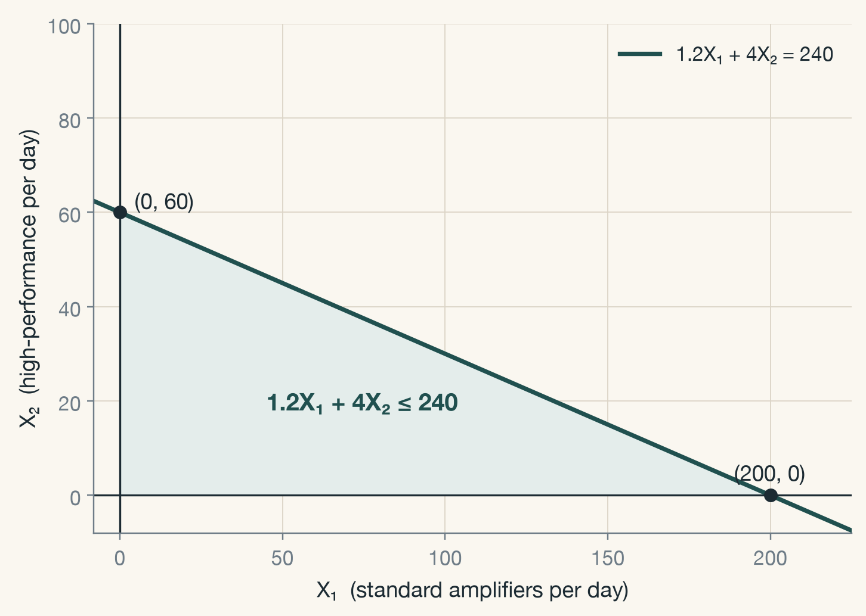
CONSTRAINT 1 · ASSEMBLY
1.2X₁ + 4X₂ ≤ 240
Draw the line 1.2X₁ + 4X₂ = 240: intercepts (0, 60) and (200, 0)
The “≤” side is the side that contains the origin
Every shaded point uses at most 240 assembly hours
Chapter 3 · Analysis of Linear Programming Models
7 / 21
Notes:
Find the intercepts by setting one variable to zero. Test the origin: 0 ≤ 240 is true, so the origin's side is the feasible side. Ask Gen AI to draw the graph and compare — this is the instruction on the Korean deck too.

Slide 9
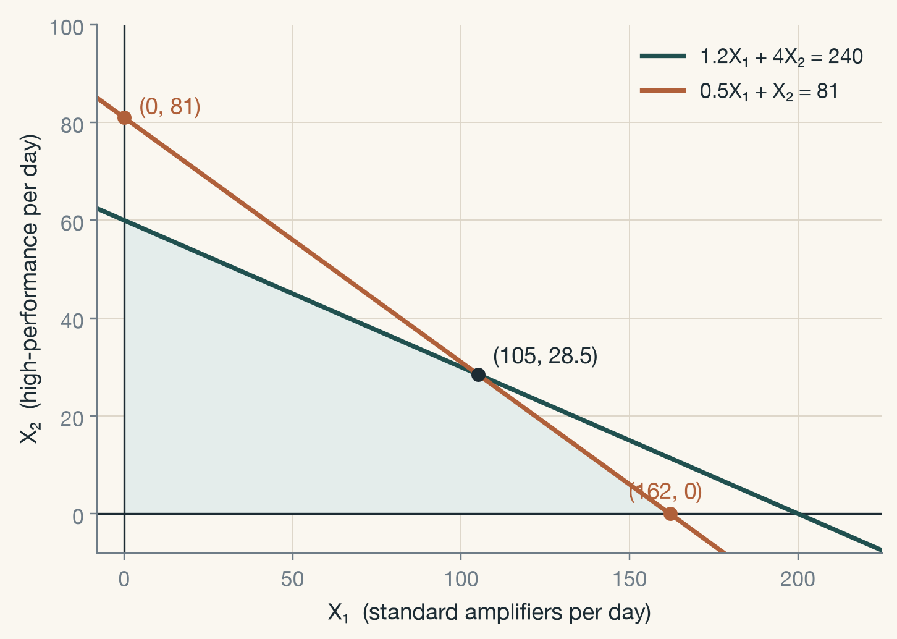
CONSTRAINT 2 · INSPECTION
0.5X₁ + X₂ ≤ 81
Line 0.5X₁ + X₂ = 81: intercepts (0, 81) and (162, 0)
Keep only the points that satisfy both constraints
The two lines cross at (105, 28.5) — remember this point
Chapter 3 · Analysis of Linear Programming Models
8 / 21
Notes:
Inspection is tighter on the right (it cuts the X₁ axis at 162, not 200); assembly is tighter on the left. The crossing point will turn out to be the optimum.

Slide 10
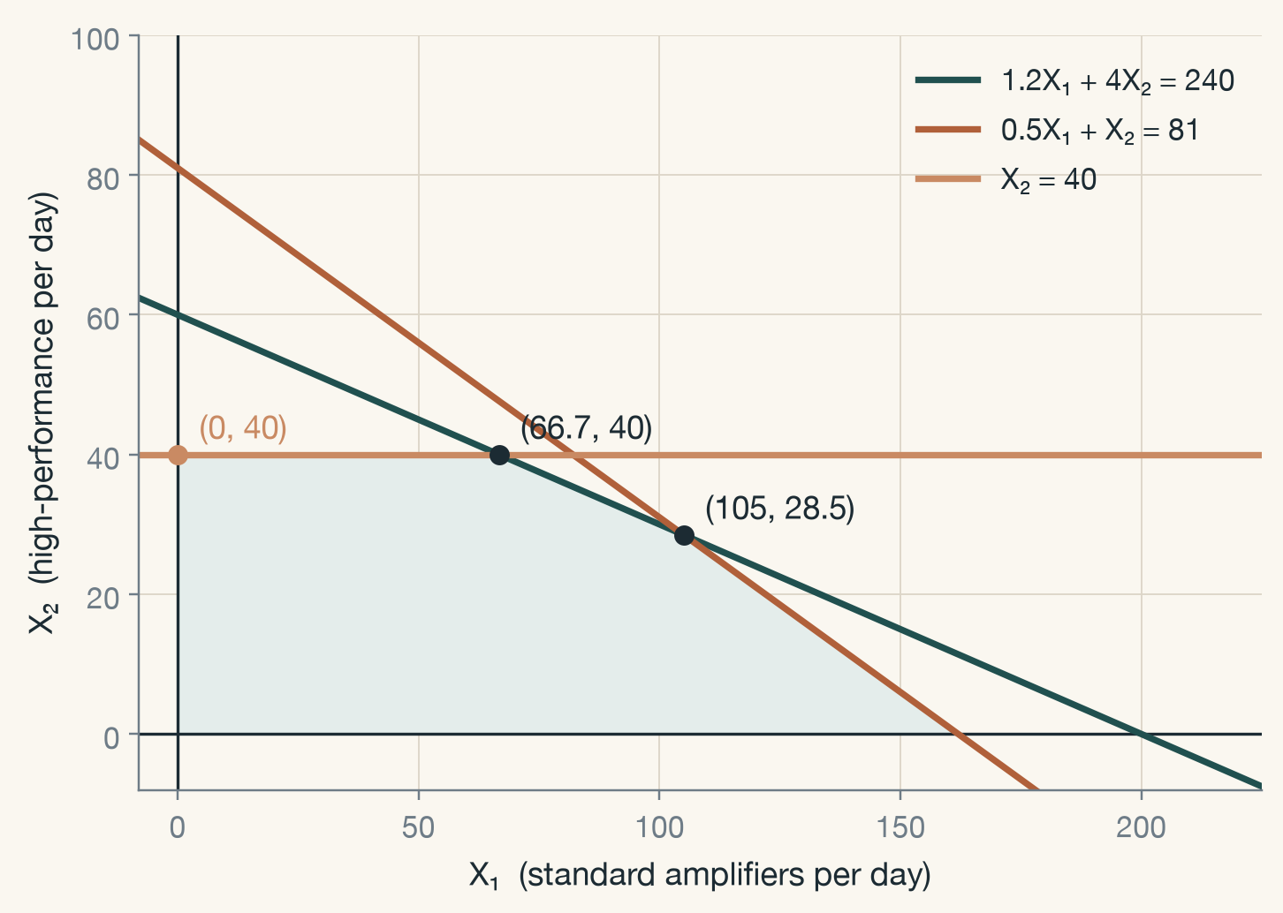
CONSTRAINT 3 · CHIP SUPPLY
X₂ ≤ 40
A constraint with one variable is a horizontal (or vertical) line
It caps high-performance output at 40 units a day
A new corner appears at (66.7, 40)
Chapter 3 · Analysis of Linear Programming Models
9 / 21
Notes:
X₂ ≤ 40 has no X₁ in it, so it is a horizontal line. It shaves the top off the region and creates the corner at (66.7, 40), where it meets the assembly line.

Slide 11
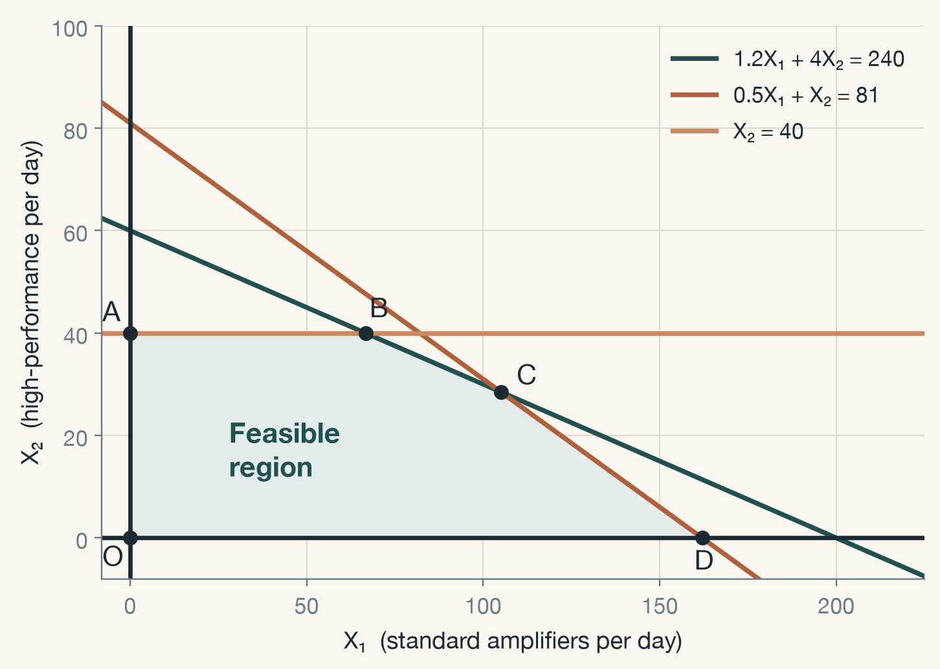
NON-NEGATIVITY
X₁ ≥ 0, X₂ ≥ 0 — the feasible region
Only the first quadrant is allowed
Feasible region: every point that satisfies all the constraints at once
Here, a pentagon with corners O, A, B, C, D
Chapter 3 · Analysis of Linear Programming Models
10 / 21
Notes:
Textbook Figure 3.2. The feasible region is the set of all feasible solutions. The corners are O = (0, 0), A = (0, 40), B = (66.7, 40), C = (105, 28.5), D = (162, 0).

Slide 12
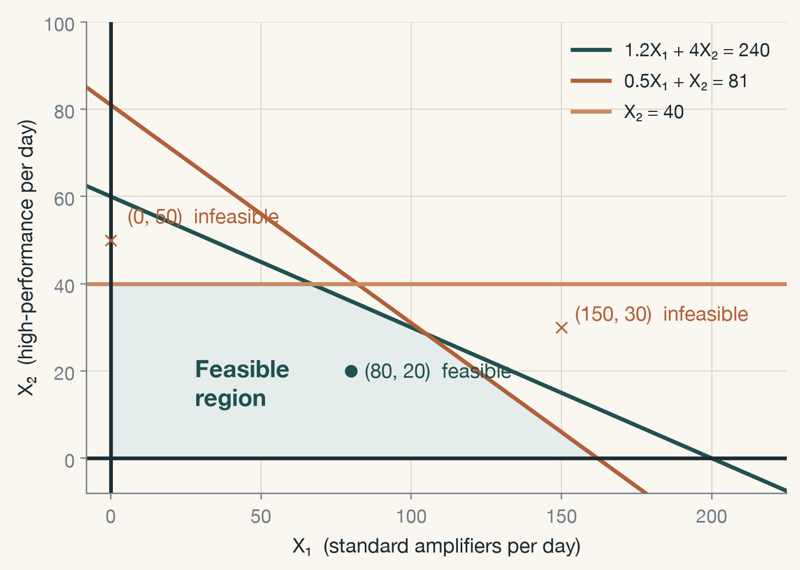
FEASIBLE OR NOT
Feasible and infeasible solutions
Feasible solution: satisfies every constraint — e.g. (80, 20)
Infeasible solution: breaks at least one — (0, 50) needs 50 chips
(150, 30) breaks both labor constraints at once
Chapter 3 · Analysis of Linear Programming Models
11 / 21
Notes:
Check (80, 20): assembly 96 + 80 = 176 ≤ 240, inspection 40 + 20 = 60 ≤ 81, chips 20 ≤ 40. Check (0, 50): only the chip constraint fails, but one failure is enough.

Slide 13
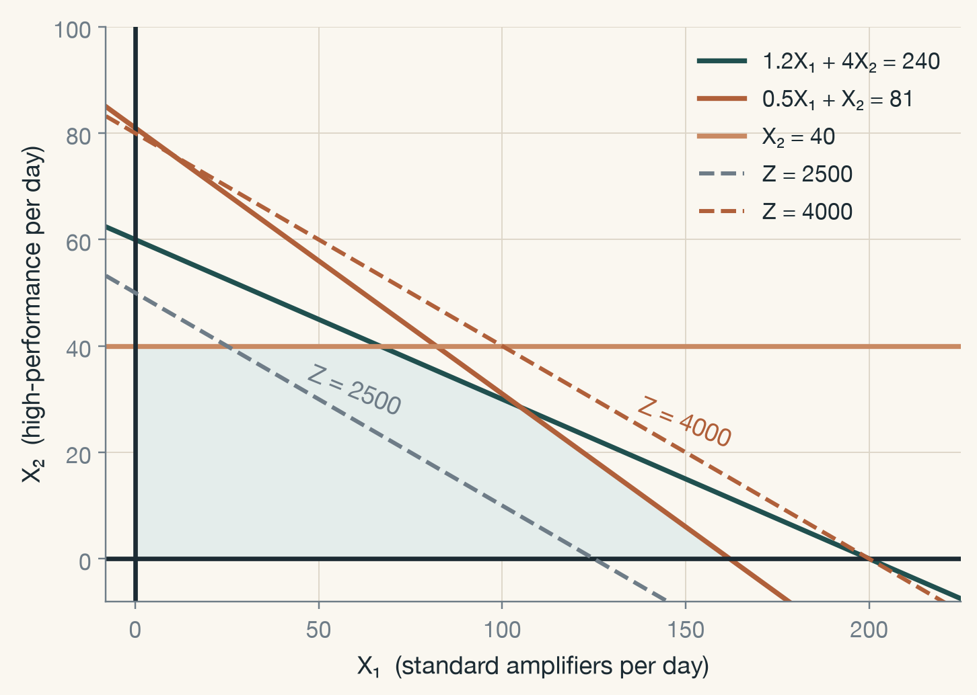
THE OBJECTIVE
Iso-profit lines
Z = 20X₁ + 50X₂: every point on one line earns the same profit
Z = 2500 passes through the region — many plans earn 2500
Z = 4000 misses the region — no feasible plan earns 4000
Larger Z moves the line outward, parallel to itself
Chapter 3 · Analysis of Linear Programming Models
12 / 21
Notes:
Pick a convenient Z and draw the line; then a second one. All iso-profit lines have the same slope, −20/50, so the family is parallel. Profit grows in the direction perpendicular to the lines.

Slide 14
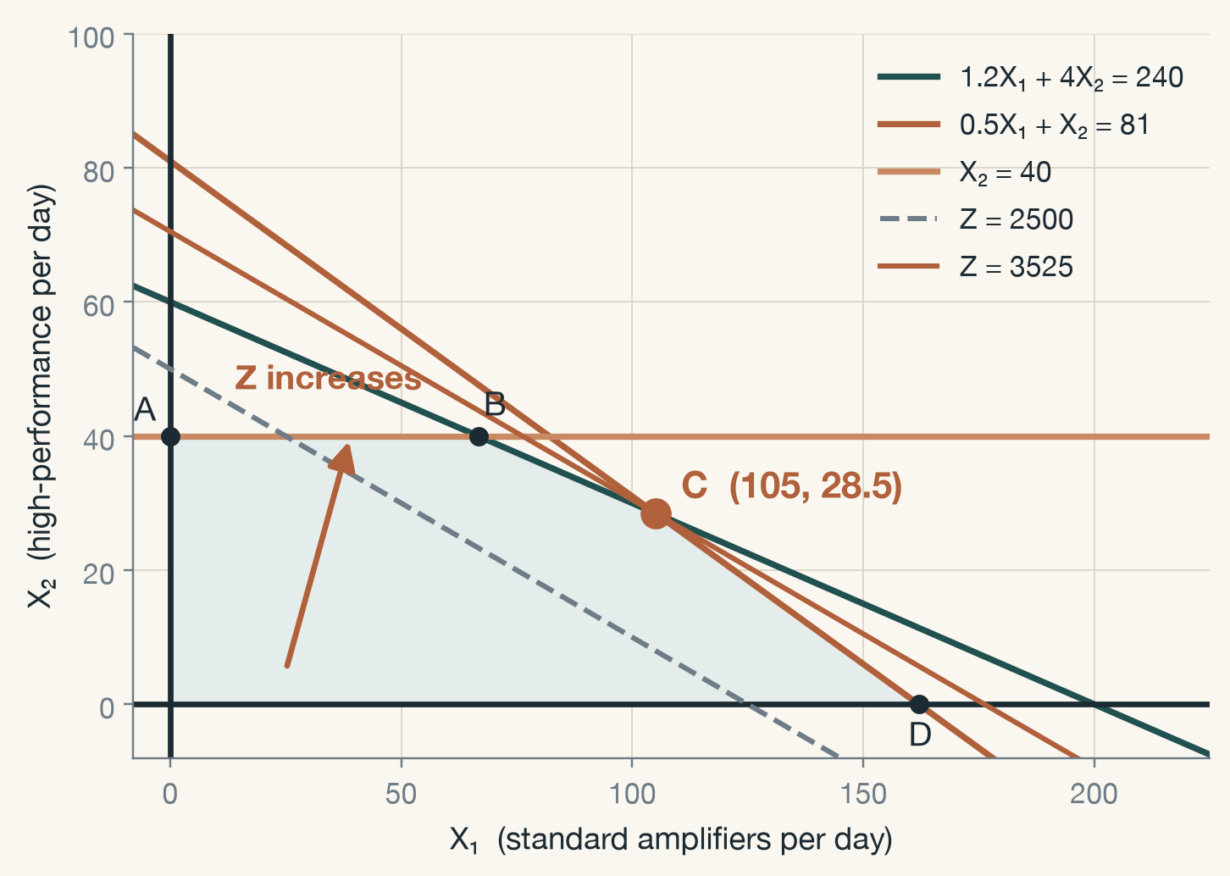
THE OPTIMUM
Push the line as far as it will go
Slide the iso-profit line outward while it still touches the region
The last point it touches is corner C
C is where the assembly and inspection lines cross
Chapter 3 · Analysis of Linear Programming Models
13 / 21
Notes:
The optimal solution is the feasible point with the largest Z. Because the region has straight edges and Z is linear, the last contact is always at a corner — the fact the simplex method is built on.

Slide 15
FINDING C
Two lines, two equations
1.2X₁ + 4X₂ = 240 and 0.5X₁ + X₂ = 81
From the second: X₂ = 81 − 0.5X₁
Substitute: 1.2X₁ + 4(81 − 0.5X₁) = 240
−0.8X₁ + 324 = 240 → X₁ = 105
X₂ = 81 − 0.5(105) = 28.5
Z = 20(105) + 50(28.5) = 3525
Chapter 3 · Analysis of Linear Programming Models
14 / 21
Notes:
Reading the corner off the graph gives roughly (105, 28); solving the two binding equations gives it exactly. Do this on the board slowly — it is the same algebra students will see inside the simplex tableau.

Slide 16
THE ANSWER
Example 3-1 — optimal solution
(X₁, X₂) = (105, 28.5)
Maximum daily profit 3525 × 10,000 won = 35,250,000 won
Assembly: 1.2(105) + 4(28.5) = 240 hours — all of it
Inspection: 0.5(105) + 28.5 = 81 hours — all of it
Chips: 28.5 of 40 — 11.5 to spare
Chapter 3 · Analysis of Linear Programming Models
15 / 21
Notes:
Plug the answer back into every constraint. Two are used to the hour; the third has room. That observation is the whole of the next section.

Slide 17
THE OPTIMUM
Push the line as far as it will go
Slide the iso-profit line outward while it still touches the region
The last point it touches is corner C
C is where the assembly and inspection lines cross
Chapter 3 · Analysis of Linear Programming Models
13 / 21
Notes:
The optimal solution is the feasible point with the largest Z. Because the region has straight edges and Z is linear, the last contact is always at a corner — the fact the simplex method is built on.

Slide 18
THE HALF UNIT
What does 28.5 amplifiers mean?
Half a unit: start it today, finish it tomorrow
If output must be whole numbers, round — then re-check feasibility
X₂ = 28 → X₁ = 106, Z = 3520
X₂ = 29 → X₁ = 103, Z = 3510
Rounding never beats the LP optimum — whole-number models are integer programming, Chapter 7
Chapter 3 · Analysis of Linear Programming Models
16 / 21
Notes:
Divisibility assumption from last week. With X₂ = 28 the inspection line allows X₁ ≤ 106; with X₂ = 29 the assembly line allows X₁ ≤ 103. Both are feasible, both earn less than 3525.

Slide 19
SLACK
Slack variables
A “≤” constraint need not use all of its capacity
Slack = capacity − amount used
S₁ = 240 − (1.2X₁ + 4X₂) (assembly hours unused)
S₂ = 81 − (0.5X₁ + X₂) (inspection hours unused)
S₃ = 40 − X₂ (chips unused)
Chapter 3 · Analysis of Linear Programming Models
17 / 21
Notes:
'Slack' means loose. A slack variable turns an inequality into an equation: 1.2X₁ + 4X₂ + S₁ = 240 with S₁ ≥ 0. The simplex method works on that form.

Slide 20
BINDING
Binding constraints — slack is zero
S₁ = 240 − (1.2 × 105 + 4 × 28.5) = 0
S₂ = 81 − (0.5 × 105 + 28.5) = 0
Assembly and inspection are used 100% — both are binding
The optimum sits exactly where these two lines cross
Chapter 3 · Analysis of Linear Programming Models
18 / 21
Notes:
A binding constraint is one that passes through the optimal point. Binding constraints are the ones that would change the answer if their right-hand side changed.

Slide 21
NON-BINDING
Non-binding constraints — slack is positive
S₃ = 40 − 28.5 = 11.5
11.5 chips a day are left over
The chip constraint is non-binding — its line does not touch C
Chapter 3 · Analysis of Linear Programming Models
19 / 21
Notes:
On the graph, the line X₂ = 40 is above C. Moving it a little — 38 chips, 45 chips — would not move the optimum at all.

Slide 22
THE INSIGHT
What is holding production back?
Not the chips — 11.5 a day go unused
Assembly and inspection hours are the bottleneck
More hours there would raise profit; more chips would not
Binding constraints are where management should look first
Chapter 3 · Analysis of Linear Programming Models
20 / 21
Notes:
This is the managerial payoff of the whole exercise. The natural next question — how much is one more assembly hour worth? — is sensitivity analysis, coming later in the course.

Slide 23
IN SUMMARY
Chapter 3
Each constraint is a half-plane; together they form the feasible region
Iso-profit lines: equal profit along a line, higher profit further out
The optimum is a corner point — here C = (105, 28.5), Z = 3525
Slack shows which constraints bind: assembly and inspection, not chips
Practice · draw Example 3-1 by hand, then ask Gen AI to draw it and compare
Next week · the same model in Python: Colab + CVXPY — bring your laptop
Notes:
Terms to know: feasible solution, feasible region, optimal solution, iso-profit line, slack variable, binding and non-binding constraint. Next week is hands-on: Colab setup, the CVXPY library, and Example 3-1 solved in code.

