Slide 1
CHAPTER 03
Analysis of Linear Programming Models - Part 2
Solving LP with Python and CVXPY
TEXTBOOK
CHAPTER
WEEK
Modern Management Science, 9th ed.
Ch. 3
Week 4
Management Science · Fall 2026 · Kitae Kim, School of Business, Korea Aerospace University
Content prepared by the instructor; slide layout and formatting assisted by Claude (Anthropic).
Notes:
Last week we built models and solved none. This week we solve one — the two-variable case, by drawing it. Every idea here (feasible region, corner points, binding constraints) carries over to the simplex method in Chapter 4.

Slide 2
Last Week
Solving a LP with a graph
Constraints on a graph
The objective function on a graph
Finding the optimal solution
Slack variables and binding constraints
Chapter 3 · Analysis of Linear Programming Models
Notes:
One worked example carries the whole hour. Each constraint is drawn one at a time, then the objective, then the optimum, then what the optimum tells management.

Slide 3
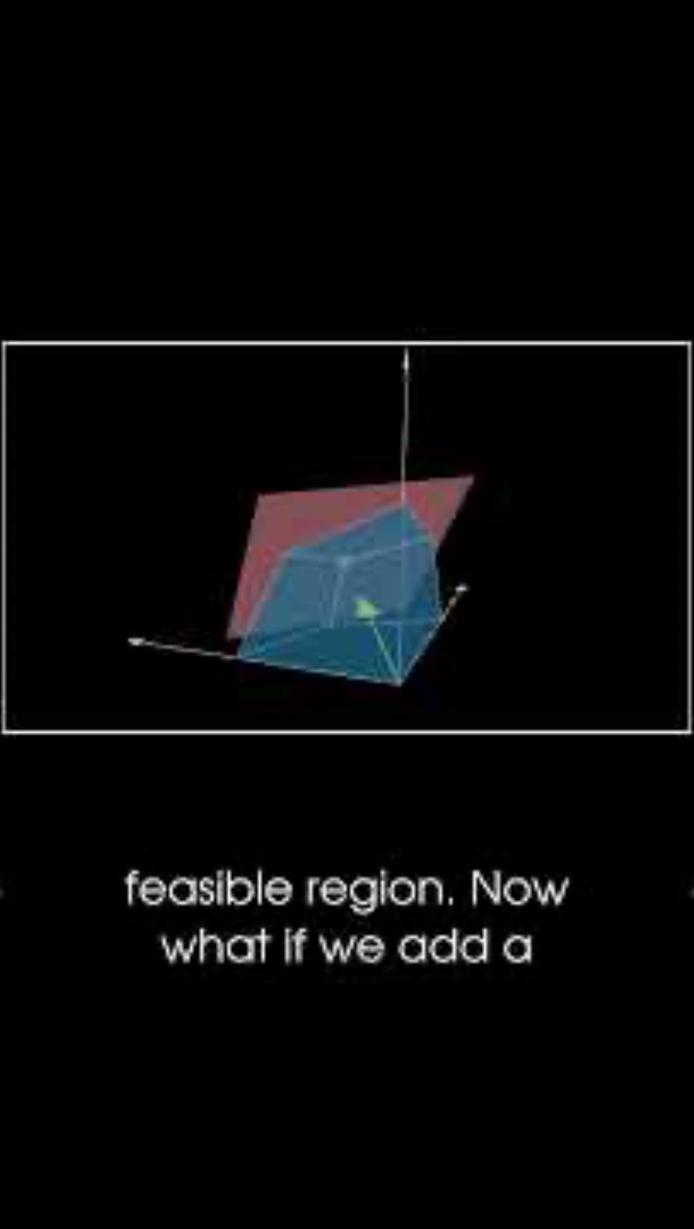
Last Week
The simplex method
The standard algorithm: the Simplex Method
Mathematically, the optimum is always at a corner point of the feasible region
Move from one corner to a better adjacent corner, iteratively, until no neighbouring corner is better
We let a computer solve a large problem instead
If there are 3 decision variables, can you solve the problem by hand?
If there are hundreds of decision variables?
Chapter 3 · Analysis of Linear Programming Models
https://www.youtube.com/shorts/ZT3b2awWE1I

Slide 4
PART 2
Analysis with Software
From drawing the region to letting a solver find the corner
Setting up the Colab environment
Introduction to the CVXPY library
Analyzing LP models with CVXPY (live demo): Examples 3-1 and 3-2
Management Science · Fall 2026 · Kitae Kim, School of Business, Korea Aerospace University
7 / 17

Slide 5

COLAB
Setting up Google Colab
Colab (Colaboratory): a free, cloud-based Python environment provided by Google
Notebooks are created and run directly from Google Drive
Quick start (see Colab_Basics.pdf)
1. Open Google Drive
2. Install the Colab app (New → More → Connect more apps)
3. Create a Jupyter notebook (.ipynb) file
All of today's code runs in Colab: no local Python installation needed
Chapter 3 · Analysis of Linear Programming Models

Slide 6

CVXPY
What is CVXPY?
An open-source, Python-embedded modeling language for convex optimization problems
You write the problem the way the math reads, not in the restrictive standard form a solver requires
Linear programs are a special case of convex problems, so CVXPY handles everything in this chapter
Model in CVXPY, then hand the model to a solver of your choice
Source: https://www.cvxpy.org/
Chapter 3 · Analysis of Linear Programming Models

Slide 7
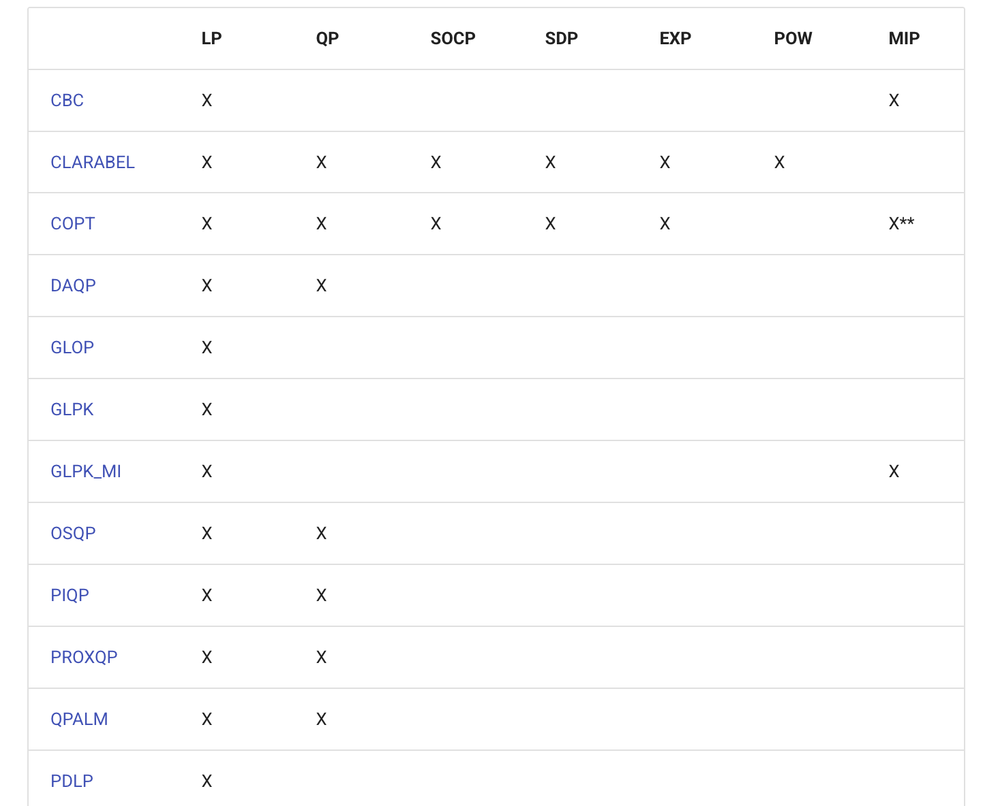
CVXPY
Many solvers, one interface
CVXPY supports a wide range of solvers
cvxpy.org/tutorial/solvers
Which problems a solver can handle, and how well, differ by solver
Problem class: LP, QP, SOCP, MIP, …
Performance: problem size, solution time, cost
Widely used in industry (commercial)
GUROBI, MOSEK, CPLEX
Widely used in research (free)
SCIPY, GLPK_MI (used in today's demo)
Problem classes supported by each solver (cvxpy.org)
Chapter 3 · Analysis of Linear Programming Models

Slide 8
CVXPY · EXAMPLE 3-1
CVXPY: Input (Example 3-1)
EXAMPLE 3-1 · FULL CODE
KEY CVXPY CALLS
import cvxpy as cp
# (1) Decision variables
X1 = cp.Variable()
X2 = cp.Variable()
# (2) Objective function: maximize total profit
z = cp.Maximize(20 * X1 + 50 * X2)
# (3) Constraints
constraints = [
1.2 * X1 + 4 * X2 <= 240, # assembly hours
0.5 * X1 + X2 <= 81, # inspection hours
X2 <= 40, # chip supply
X1 >= 0, X2 >= 0 # non-negativity
]
# (4) Formulate the problem
prob = cp.Problem(z, constraints)
# (5) Solve it (verbose=True prints the solver log)
prob.solve(solver='GLPK_MI', verbose=True)
# (6) Print the results
print("Optimal X1:", X1.value)
print("Optimal X2:", X2.value)
print("Max profit Z = 20X1 + 50X2:", prob.value)
print("Status:", prob.status)
Decision variables
cp.Variable()
Objective
cp.Maximize(expr) or cp.Minimize(expr)
Constraints
a Python list: [c1, c2, c3, …]
Problem
prob = cp.Problem(objective, constraints)
Solve
prob.solve()
choose a solver
prob.solve(solver='NAME')
show the solver log
prob.solve(verbose=True)
Results
X1.value, prob.value, prob.status
Chapter 3 · Analysis of Linear Programming Models

Slide 9
EXAMPLE 3-2
Example 3-2: a minimization problem
PROBLEM
FORMULATION
The dietitian at the cafeteria of University A knows that, to stay healthy, each student must consume 66 g of protein and 9 mg of iron per day. These nutrients come from meat and vegetables: 1 kg of meat contains 300 g of protein and 30 mg of iron, and 1 kg of vegetables contains 20 g of protein and 10 mg of iron. The cafeteria buys meat at ₩6,000 per kg and vegetables at ₩1,000 per kg. The dietitian wants a purchasing plan that keeps students healthy at the lowest possible food cost.
Decision variables
Objective function
Constraints
Set up the model first: variables, objective, constraints
Chapter 3 · Analysis of Linear Programming Models

Slide 10
EXAMPLE 3-2
Example 3-2: a minimization problem
PROBLEM
FORMULATION
The dietitian at the cafeteria of University A knows that, to stay healthy, each student must consume 66 g of protein and 9 mg of iron per day. These nutrients come from meat and vegetables: 1 kg of meat contains 300 g of protein and 30 mg of iron, and 1 kg of vegetables contains 20 g of protein and 10 mg of iron. The cafeteria buys meat at ₩6,000 per kg and vegetables at ₩1,000 per kg. The dietitian wants a purchasing plan that keeps students healthy at the lowest possible food cost.
Decision variables
X₁ = kg of meat bought per person per day
X₂ = kg of vegetables bought per person per day
Objective function
Minimize Z = 6000X₁ + 1000X₂ (₩)
Constraints
Protein: 300X₁ + 20X₂ ≥ 66 (g)
Iron: 30X₁ + 10X₂ ≥ 9 (mg)
Non-negativity: X₁, X₂ ≥ 0
Chapter 3 · Analysis of Linear Programming Models

Slide 11
EXAMPLE 3-2
Example 3-2: from model to code
FORMULATION
INPUT
Decision variables
import cvxpy as cp
# 1. Decision variables
x1 = cp.Variable()
x2 = cp.Variable()
# 2. Objective: minimize total food cost
z = 6000 * x1 + 1000 * x2
objective = cp.Minimize(z)
# 3. Constraints: minimum nutrient requirements
constraints = [
300 * x1 + 20 * x2 >= 66, # protein >= 66 g
30 * x1 + 10 * x2 >= 9, # iron >= 9 mg
x1 >= 0, # non-negativity
x2 >= 0
]
# 4. Formulate and solve the problem
problem = cp.Problem(objective, constraints)
problem.solve()
# 5. Print the results
print("Status:", problem.status)
print("Minimum food cost:", problem.value, "won")
print("Meat (X1):", x1.value, "kg")
print("Vegetables (X2):", x2.value, "kg")
X₁ = kg of meat per person per day
X₂ = kg of vegetables per person per day
Objective function
Minimize Z = 6000X₁ + 1000X₂
Constraints
300X₁ + 20X₂ ≥ 66 (protein, g)
30X₁ + 10X₂ ≥ 9 (iron, mg)
X₁, X₂ ≥ 0
Chapter 3 · Analysis of Linear Programming Models

Slide 12
EXAMPLE 3-2
Example 3-2: input and output
INPUT
OUTPUT
import cvxpy as cp
# 1. Decision variables
x1 = cp.Variable()
x2 = cp.Variable()
# 2. Objective: minimize total food cost
z = 6000 * x1 + 1000 * x2
objective = cp.Minimize(z)
# 3. Constraints: minimum nutrient requirements
constraints = [
300 * x1 + 20 * x2 >= 66, # protein >= 66 g
30 * x1 + 10 * x2 >= 9, # iron >= 9 mg
x1 >= 0, # non-negativity
x2 >= 0
]
# 4. Formulate and solve the problem
problem = cp.Problem(objective, constraints)
problem.solve()
# 5. Print the results
print("Status:", problem.status)
print("Minimum food cost:", problem.value, "won")
print("Meat (X1):", x1.value, "kg")
print("Vegetables (X2):", x2.value, "kg")
Status: optimal
Minimum food cost: 1499.999996424232 won
Meat (X1): 0.19999999972075516 kg
Vegetables (X2): 0.29999999809970107 kg
Status is optimal: the solver found the true minimum
Buy 0.2 kg of meat and 0.3 kg of vegetables per person per day
The long decimals (0.1999…) are floating-point noise
Minimum daily food cost: ₩1,500 per student
Chapter 3 · Analysis of Linear Programming Models

Slide 13
SUMMARY
Summary
Analyzing optimization problems with software
CVXPY IN SIX STEPS
The basic algorithm: the simplex method
1 Decision variables
x1 = cp.Variable()
A Python-based modeling package: CVXPY
2 Objective
z = cp.Maximize(...) or cp.Minimize(...)
Many solvers exist, so choose one that suits your problem
3 Constraints
constraints = [c1, ..., cn]
Solvers differ in the problem classes and sizes they can handle
4 Problem
prob = cp.Problem(z, constraints)
Solvers also search for the optimum differently, so their performance differs
5 Solve
prob.solve()
Model once in CVXPY; switch solvers with a single argument
6 Results
x1.value, prob.value, prob.status
Chapter 3 · Analysis of Linear Programming Models

