Slide 1
CHAPTER 03
Analysis of Linear Programming Models - Part 3
Equality constraints and special cases: infeasible, unbounded, and multiple optima
TEXTBOOK
CHAPTER
WEEK
Modern Management Science, 9th ed.
Ch. 3
Week 4
Management Science · Fall 2026 · Kitae Kim, School of Business, Korea Aerospace University
Content prepared by the instructor; slide layout and formatting assisted by Claude (Anthropic).

Slide 2
Last Week
Analysis with software
Google Colab: a free, cloud-based Python environment
CVXPY: write the model the way the math reads, then hand it to a solver
Many solvers, one interface: choose a solver that suits the problem class and size
LP problems solved in six steps:
    variables,
    objective,
    constraints,
    problem,
    solve,
    results
Chapter 3 · Analysis of Linear Programming Models

Slide 3
PART 3
Equality Constraints and Special Cases
What the solver tells you when a model has no ordinary optimum
Equality constraints (Example 3-3)
Infeasible models (Example 3-4)
Unbounded models (Example 3-5)
Multiple optimal solutions (Example 3-1)
Management Science · Fall 2026 · Kitae Kim, School of Business, Korea Aerospace University
3 / 15

Slide 4
EXAMPLE 3-3
Example 3-3: an equality constraint
PROBLEM
FORMULATION
K Electronics plans to hire skilled workers and apprentices as it expands into a new line of business. A skilled worker costs ₩10,000 per hour and an apprentice ₩5,000 per hour. The company has ₩150 million available for the new hiring plan, and under its agreement with the labor union this entire amount must be spent on hiring. Given its current situation, K Electronics plans to hire skilled workers for no more than 10,000 hours, while the union demands that apprentices be hired for at least 12,000 hours. Current cost analysis shows that a skilled worker earns the company ₩3,000 per hour and an apprentice ₩1,250 per hour. Management wants a hiring plan that maximizes total profit.
Decision variables
Objective function
Constraints
Chapter 3 · Analysis of Linear Programming Models

Slide 5
EXAMPLE 3-3
Example 3-3: from model to graph
FORMULATION
GRAPH
Decision variables
S = hours of skilled workers hired
P = hours of apprentices hired
Objective function
Maximize Z = 0.3S + 0.125P (profit, unit: ₩10,000)
Constraints
S + 0.5P = 15,000 (budget, unit: ₩10,000)
S ≤ 10,000 (skilled hours, unit: hours)
P ≥ 12,000 (apprentice hours, unit: hours)
S, P ≥ 0
Chapter 3 · Analysis of Linear Programming Models

Slide 6
EXAMPLE 3-3
Example 3-3: input and output
INPUT
OUTPUT
import cvxpy as cp
# 1. Decision variables
S = cp.Variable()
P = cp.Variable()
# 2. Objective: maximize total profit
objective = cp.Maximize(0.3 * S + 0.125 * P)
# 3. Constraints (note the == for equality)
constraints = [
S + 0.5 * P == 15000, # budget: spend all of it
S <= 10000, # skilled-worker hours
P >= 12000, # apprentice hours
S >= 0, # non-negativity
P >= 0
]
# 4. Formulate and solve the problem
problem = cp.Problem(objective, constraints)
problem.solve()
# 5. Print the results
print("Status:", problem.status)
print("Maximum profit (Z):", problem.value)
print("Optimal S:", S.value)
print("Optimal P:", P.value)
Status: optimal
Maximum profit (Z): 4199.999942204862
Optimal S: 8999.99884409724
Optimal P: 12000.002311805523
Status is optimal: the equality leaves only a line segment, but a best point still exists
Hire skilled workers for 9,000 hours and apprentices for 12,000 hours
The whole budget is spent: 9,000 + 0.5 × 12,000 = 15,000 (₩10,000s)
Maximum profit: ₩42 million (Z = 4,200 in ₩10,000s)
Chapter 3 · Analysis of Linear Programming Models

Slide 7
SPECIAL CASES
Not every LP model has an optimal solution
Infeasible
no feasible point at all
Unbounded
objective grows without limit
LP models
Unique optimum
exactly one optimal solution
Feasible
the feasible region is not empty
Has an optimal solution
a finite best value exists
Multiple optima
Multiple optimal solutions
Chapter 3 · Analysis of Linear Programming Models

Slide 8
EXAMPLE 3-4
Example 3-4: an infeasible model
PROBLEM
FORMULATION
Architect Park has been commissioned by the government to design an affordable solar-energy house. The house consists of a residential area and an energy-control area: the residential area must be at least 105 m², and the energy-control area at least 30 m². Construction costs ₩2 million per m² for the residential area and ₩4 million per m² for the energy-control area. The government requires a design that maximizes total floor area within a total construction budget of ₩240 million.
Decision variables
Objective function
Constraints
Chapter 3 · Analysis of Linear Programming Models

Slide 9
EXAMPLE 3-4
Example 3-4: from model to graph
FORMULATION
GRAPH
Decision variables
R = residential area (m²)
E = energy-control area (m²)
Objective function
Maximize Z = R + E (total area, m²)
Constraints
200R + 400E ≤ 24,000 (cost, ₩10,000s)
R ≥ 105 (residential area, m²)
E ≥ 30 (energy-control area, m²)
R, E ≥ 0
Chapter 3 · Analysis of Linear Programming Models

Slide 10
EXAMPLE 3-4
Example 3-4: output
INPUT
OUTPUT
import cvxpy as cp
# 1. Decision variables
R = cp.Variable()
E = cp.Variable()
# 2. Objective: maximize total floor area
objective = cp.Maximize(R + E)
# 3. Constraints
constraints = [
200 * R + 400 * E <= 24000, # construction cost
R >= 105, # residential area
E >= 30, # energy-control area
R >= 0, # non-negativity
E >= 0
]
# 4. Formulate and solve the problem
problem = cp.Problem(objective, constraints)
problem.solve()
# 5. Print the results
print("Status:", problem.status)
print("Maximum total area:", problem.value)
print("Optimal R:", R.value)
print("Optimal E:", E.value)
Status: infeasible
Maximum total area: -inf
Optimal R: None
Optimal E: None
Status is infeasible: no point satisfies all the constraints at once
The minimum areas alone cost 200 × 105 + 400 × 30 = 33,000, above the 24,000 budget
There is no solution to report: the variables are None and the objective is −inf
Infeasible: relax a requirement or raise the budget
Chapter 3 · Analysis of Linear Programming Models

Slide 11
EXAMPLE 3-5
Example 3-5: an unbounded model
PROBLEM
FORMULATION
S Industries produces two special-purpose motors, type A and type B. To meet next month's supply contracts, at least 1,000 units of each type must be produced. As a matter of company policy, the production volume of Type B motors should not exceed that of Type A motors by more than 500 units. The profit per unit is ₩200,000 for type A and ₩100,000 for type B. S Industries wants a production plan that maximizes total profit.
Decision variables
Objective function
Constraints
Chapter 3 · Analysis of Linear Programming Models

Slide 12
EXAMPLE 3-5
Example 3-5: from model to graph
FORMULATION
GRAPH
Decision variables
X₁ = units of type A motors produced
X₂ = units of type B motors produced
Objective function
Maximize Z = 20X₁ + 10X₂ (profit, ₩10,000s)
Constraints
X₁ ≥ 1,000 (type A contract)
X₂ ≥ 1,000 (type B contract)
X₂ −X₁ ≤ 500 (company policy)
X₁, X₂ ≥ 0
Chapter 3 · Analysis of Linear Programming Models

Slide 13
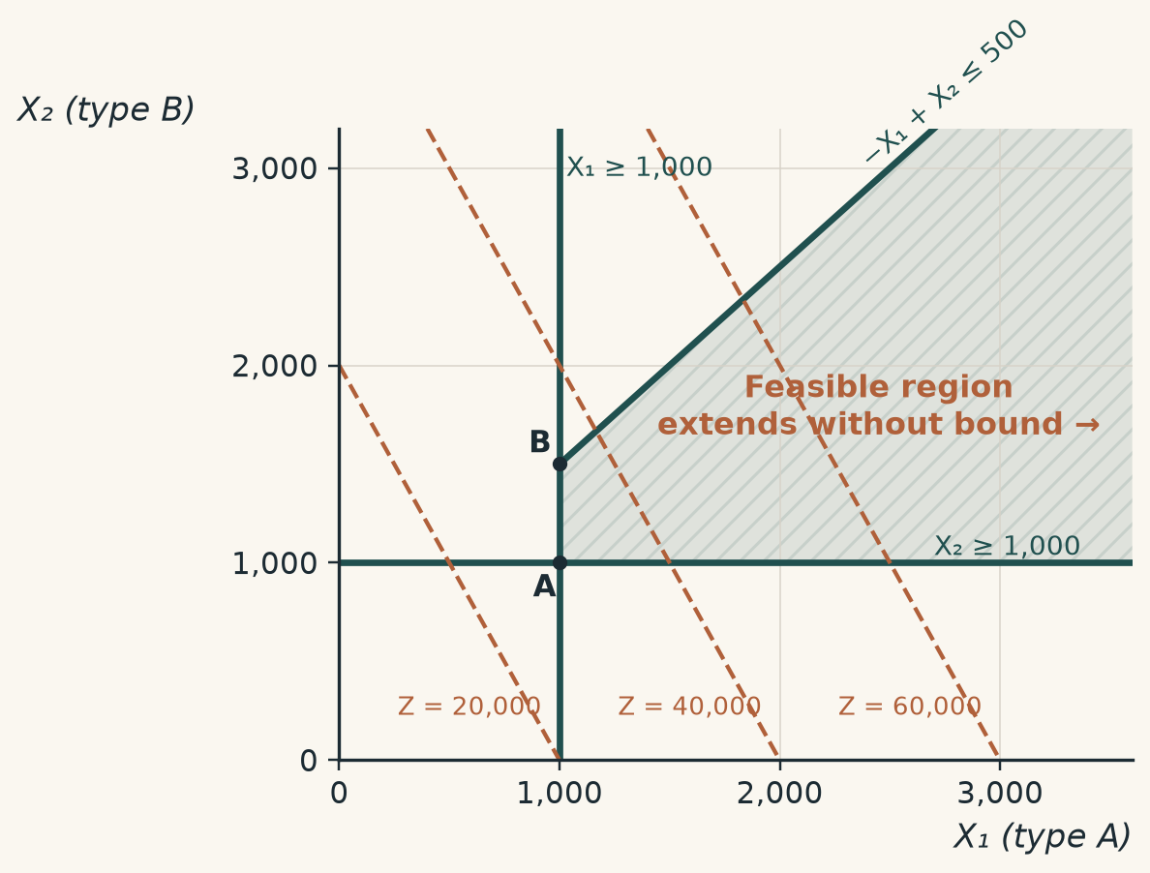
EXAMPLE 3-5
Example 3-5: from model to graph
FORMULATION
GRAPH
Decision variables
X₁ = units of type A motors produced
X₂ = units of type B motors produced
Objective function
Maximize Z = 20X₁ + 10X₂ (profit, ₩10,000s)
Constraints
X₁ ≥ 1,000 (type A contract)
X₂ ≥ 1,000 (type B contract)
X₂ −X₁ ≤ 500 (company policy)
X₁, X₂ ≥ 0
Chapter 3 · Analysis of Linear Programming Models

Slide 14
EXAMPLE 3-5
Example 3-5: input to output
INPUT
OUTPUT
import cvxpy as cp
# 1. Decision variables
X1 = cp.Variable()
X2 = cp.Variable()
# 2. Objective: maximize total profit
objective = cp.Maximize(20 * X1 + 10 * X2)
# 3. Constraints
constraints = [
X1 >= 1000, # type A supply contract
X2 >= 1000, # type B supply contract
X2 – X1 <= 500, # company policy
X1 >= 0, # non-negativity
X2 >= 0
]
# 4. Formulate and solve the problem
problem = cp.Problem(objective, constraints)
problem.solve()
# 5. Print the results
print("Status:", problem.status)
print("Maximum total profit:", problem.value)
print("Optimal X1:", X1.value)
print("Optimal X2:", X2.value)
Status: unbounded
Maximum total profit: inf
Optimal X1: None
Optimal X2: None
Status is unbounded: the feasible region has no upper limit, so profit grows without bound
No finite optimum exists, so the variables have no value (None)
In practice this signals a missing constraint, such as a capacity or demand limit
Unbounded: a constraint is missing from the model
Chapter 3 · Analysis of Linear Programming Models

Slide 15
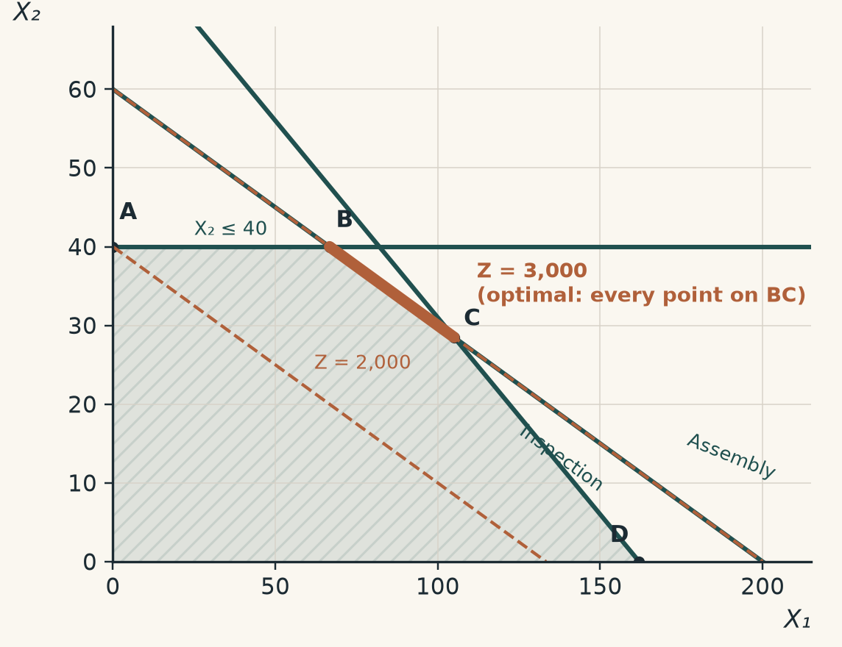
MULTIPLE OPTIMAL SOLUTIONS
Multiple optimal solutions
Some LP models have more than one optimal solution
Example 3-1 with a modified objective function
Maximize Z = 15X₁ + 50X₂ (was 20X₁ + 50X₂)
1.2X₁ + 4X₂ ≤ 240 (assembly, hours)
0.5X₁ + X₂ ≤ 81 (inspection, hours)
X₂ ≤ 40 (chip supply, units)
X₁, X₂ ≥ 0
The objective line is now parallel to the assembly constraint, so every point on segment BC is optimal (Z = 3,000)
Try it yourself: interactive LP simulator (click to open)
Chapter 3 · Analysis of Linear Programming Models

Slide 16
SUMMARY
Summary
What the solver's status tells you
STATUS CHEAT SHEET
optimal: a finite best solution exists (Ex. 3-3)
optimal
value is finite; X.value is set
infeasible: the constraints contradict one another (Ex. 3-4)
infeasible
value = -inf (max) or inf (min); X.value = None
unbounded: the objective grows without limit (Ex. 3-5)
Equality constraints are written with == in CVXPY
unbounded
value = inf (max) or -inf (min); X.value = None
Multiple optima arise when the objective is parallel to a binding constraint
equality constraint
S + 0.5 * P == 15000
next class
post-optimality and sensitivity analysis
Chapter 3 · Analysis of Linear Programming Models

