Slide 1
CHAPTER 04
Post-Optimal and Sensitivity Analysis
Shadow prices, reduced costs, and sensitivity analysis
TEXTBOOK
CHAPTER
WEEK
Modern Management Science, 9th ed.
Ch. 4
Week 5
Management Science · Fall 2026 · Kitae Kim, School of Business, Korea Aerospace University

Slide 2
CHAPTER 04
Post-Optimal and Sensitivity Analysis
Post-optimal analysis: What-if analysis performed after optimization
Evaluating resource values using shadow prices
Evaluating new-product profitability using reduced costs
Sensitivity analysis of changes in objective coefficients and resource availability (constraints)
Chapter 4 · Post-Optimal and Sensitivity Analysis

Slide 3
CHAPTER 04
Post-Optimal and Sensitivity Analysis
Shadow price
Dual variable
the increase in the objective function when the supply capacity of a resource increases by 1
mathematically, the shadow price is called the dual variable; it is called the shadow price when it has an economic interpretation
Chapter 4 · Post-Optimal and Sensitivity Analysis

Slide 4
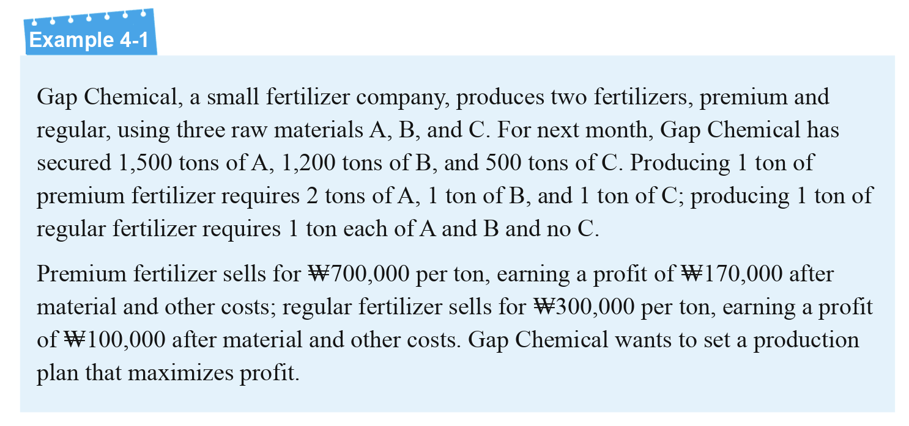
SHADOW PRICE
Shadow Price
Chapter 4 · Post-Optimal and Sensitivity Analysis

Slide 5
SHADOW PRICE
Shadow Price
Variables
Model
X₁: premium fertilizer production
X₂: regular fertilizer production
Maximize Z = 17X₁ + 10X₂ (profit, ₩10,000)
Subject to 2X₁ + X₂ <= 1500 (Material A, tons)
X₁ + X₂ <= 1200 (Material B, tons)
X₁ <= 500 (Material C, tons)
X₁, X₂ >= 0
Chapter 4 · Post-Optimal and Sensitivity Analysis

Slide 6
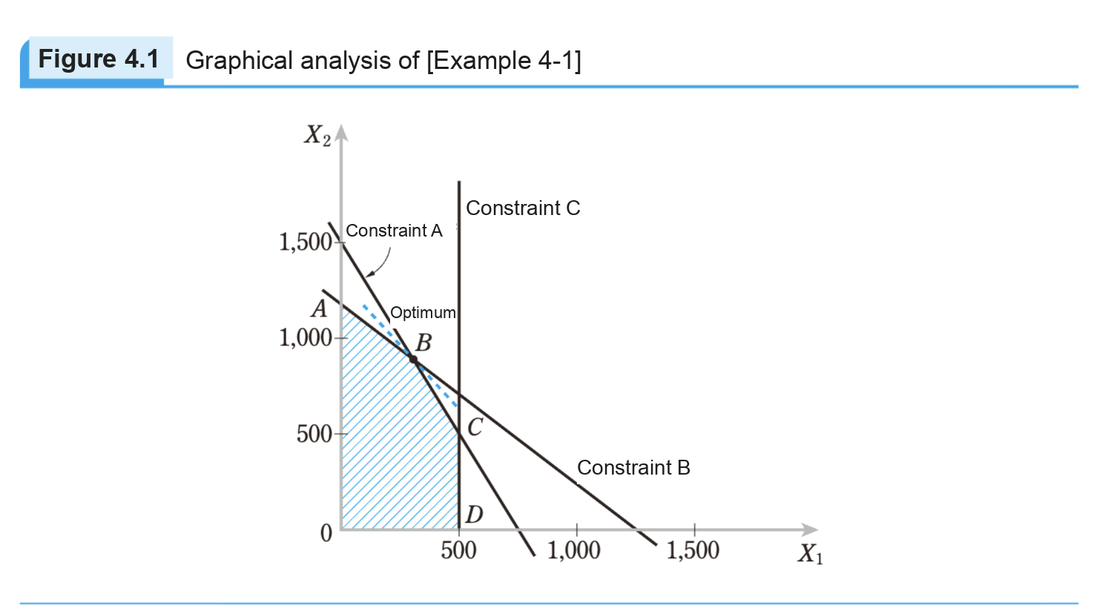
SHADOW PRICE
Shadow Price
Figure 4.1 Graphical analysis of Example 4-1
Optimal solution? Obtained by solving the following
2X₁ + X₂ = 1500
X₁ + X₂ = 1200
Optimal solution: X₁=300, X₂=900
Optimal value: Z = ₩141 million
2X₁ + X₂ = 1500
X₁ + X₂ = 1200
X1 = 1200 - X2
2*(1200-X2) + X2 = 1500
X2 = 900
X1= 300
Z = 17X₁ + 10X₂ = 17 * 300 + 10 * 900 = 141000
Chapter 4 · Post-Optimal and Sensitivity Analysis

Slide 7
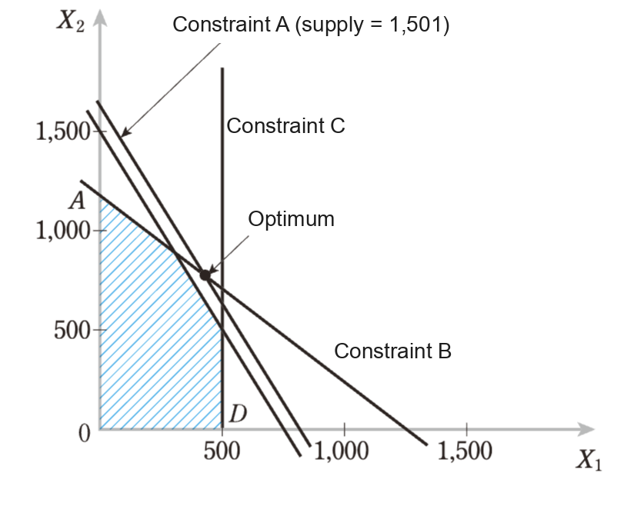
SHADOW PRICE
Shadow Price
Figure 4.2 Material A supply increases by 1 ton
Optimal solution? Obtained by solving the following
2X₁ + X₂ = 1501
X₁ + X₂ = 1200
Optimal solution: X₁= 301, X₂= 899
Optimal value: Z = ₩141.07 million
Chapter 4 · Post-Optimal and Sensitivity Analysis

Slide 8
SHADOW PRICE
Shadow Price
X1 = 1200 – X2 2(1200-X2) + X2 = 1501 X2 = 899 X1 = 301
Original
Material A supply +1 unit (1 ton)
From the constraints
2X₁ + X₂ = 1500
X₁ + X₂ = 1200
From the constraints
2X₁ + X₂ = 1501
X₁ + X₂ = 1200
Opt. solution: X₁= 300, X₂= 900
Opt. value: Z = ₩141 million
Opt. solution: X₁= 301, X₂= 899
Opt. value: Z = ₩141.07 million
Material A supply +1 unit (1 ton) → optimal value (i.e., objective function) increases by ₩70,000
Shadow price of Material A = ₩70,000/ton
This also represents the marginal profit of Material A’s supply capacity
Chapter 4 · Post-Optimal and Sensitivity Analysis

Slide 9
SHADOW PRICE
Shadow Price
Find the shadow prices of Materials B and C in the same way
To find the shadow price of Material B, modify the constraints as follows
< Original >
< Material B capacity +1 unit >
Maximize Z = 17X₁ + 10X₂
Subject to 2X₁ + X₂ <= 1500 (Material A)
X₁ + X₂ <= 1200 (Material B)
X₁ <= 500 (Material C)
X₁, X₂ >= 0
Maximize Z = 17X₁ + 10X₂
Subject to 2X₁ + X₂ <= 1500 (Material A)
X₁ + X₂ <= 1201 (Material B)
X₁ <= 500 (Material C)
X₁, X₂ >= 0
Chapter 4 · Post-Optimal and Sensitivity Analysis

Slide 10
SHADOW PRICE
Shadow Price
X1 = 1201 – X2 2(1201-X2) + X2 = 1500 X1, X2 = (299, 902) Z = 17*(299) + 10*(902)
Original
Material B supply +1 unit (1 ton)
From the constraints
2X₁ + X₂ = 1500
X₁ + X₂ = 1200
From the constraints
2X₁ + X₂ = 1500
X₁ + X₂ = 1201
Opt. solution: X₁= 300, X₂= 900
Opt. value: Z = ₩141 million
Opt. solution: X₁= 299, X₂= 902
Opt. value: Z = ₩141.03 million
Material B supply +1 unit (1 ton) → optimal value (i.e., objective function) increases by ₩30,000
Shadow price of Material B = ₩30,000/ton
Chapter 4 · Post-Optimal and Sensitivity Analysis

Slide 11
SHADOW PRICE
Shadow Price
Find the shadow prices of Materials B and C in the same way
To find the shadow price of Material C, modify the constraints as follows
< Original >
< Material C capacity +1 unit >
Maximize Z = 17X₁ + 10X₂
Subject to 2X₁ + X₂ <= 1500 (Material A)
X₁ + X₂ <= 1200 (Material B)
X₁ <= 500 (Material C)
X₁, X₂ >= 0
Maximize Z = 17X₁ + 10X₂
Subject to 2X₁ + X₂ <= 1500 (Material A)
X₁ + X₂ <= 1200 (Material B)
X₁ <= 501 (Material C)
X₁, X₂ >= 0
Chapter 4 · Post-Optimal and Sensitivity Analysis

Slide 12
SHADOW PRICE
Shadow Price
Original
Material C supply +1 unit (1 ton)
Material C constraint: X₁<=500
Material C constraint: X₁<=501
Increasing the supply of Material C does not move the optimal solution (point B)
Material C supply +1 unit (1 ton) → optimal value (i.e., objective function) increases by ₩0
Shadow price of Material C = ₩0/ton
Chapter 4 · Post-Optimal and Sensitivity Analysis

Slide 13
SHADOW PRICE
Shadow Price
Summary
Shadow price of Material A = ₩70,000/ton
Shadow price of Material B = ₩30,000/ton
Shadow price of Material C = ₩0/ton
In general, if a constraint is non-binding, its shadow price = 0
Chapter 4 · Post-Optimal and Sensitivity Analysis

Slide 14
POST-OPTIMAL ANALYSIS
Post-Optimal Analysis using Shadow Price
Valuing additional materials
If the shadow prices of Materials A, B, and C are ₩70,000/ton, ₩30,000/ton, and ₩0/ton, respectively, which material is worth acquiring more of to maximize profit?
Between acquiring more Material A and more Material B, which is more profitable, and by how much?
Chapter 4 · Post-Optimal and Sensitivity Analysis

Slide 15
POST-OPTIMAL ANALYSIS
Post-Optimal Analysis using Shadow Price
Deciding whether to buy more material
Company L offers to sell Material A at a ₩40,000 premium over its price. Should we buy it?
Chapter 4 · Post-Optimal and Sensitivity Analysis

Slide 16
POST-OPTIMAL ANALYSIS
Post-Optimal Analysis using Shadow Price
Deciding whether to produce a new product
A new product requires 1.5 tons of A, 1.5 tons of B, and 1 ton of C. Selling it yields a profit of ₩130,000 after material costs. Is it profitable to produce this new product?
What is the value of the A, B, C capacity used to make the new product?
Chapter 4 · Post-Optimal and Sensitivity Analysis

Slide 17
REDUCED COST
Reduced Cost
Reduced cost: the change in the objective function value when a variable that equals 0 in the optimal solution is increased by 1 unit is called the reduced cost (or relative cost).
Chapter 4 · Post-Optimal and Sensitivity Analysis

Slide 18
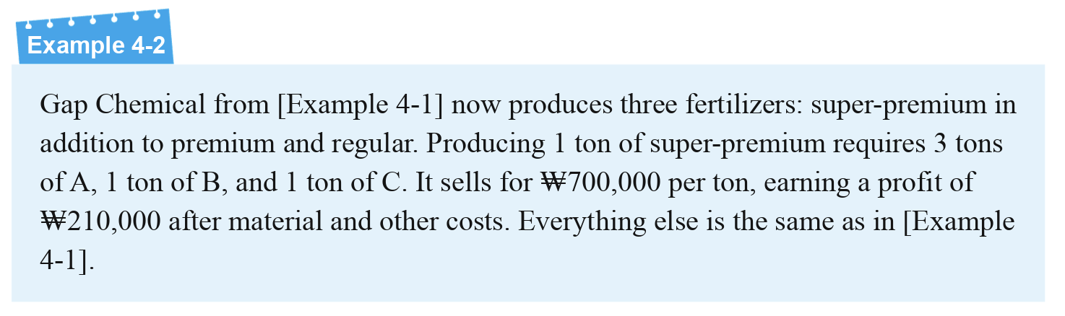
REDUCED COST
Reduced Cost
Chapter 4 · Post-Optimal and Sensitivity Analysis

Slide 19
REDUCED COST
Reduced Cost
Example 4-1 (two fertilizers)
Example 4-2 (+ super-premium)
Maximize Z = 17X₁ + 10X₂ (profit, ₩10,000)
Subject to 2X₁ + X₂ <= 1500 (Material A, tons)
X₁ + X₂ <= 1200 (Material B, tons)
X₁ <= 500 (Material C, tons)
X₁, X₂ >= 0
Maximize Z = 17X₁ + 10X₂ + 21X₃ (profit, ₩10,000)
Subject to 2X₁ + X₂ + 3X₃ <= 1500 (Material A, tons)
X₁ + X₂ + X₃<= 1200 (Material B, tons)
X₁ + X₃<= 500 (Material C, tons)
X₁, X₂, X₃ >= 0
Optimal solution (X₁, X₂, X₃)= (300, 900, 0)
Optimal value Z = ₩141 million
Chapter 4 · Post-Optimal and Sensitivity Analysis

Slide 20
REDUCED COST
Reduced Cost
Example 4-2 (+ super-premium)
Forcing 1 ton of super-premium
Maximize Z = 17X₁ + 10X₂ + 21X₃ (profit, ₩10,000)
Subject to 2X₁ + X₂ + 3X₃ <= 1500 (Material A, tons)
X₁ + X₂ + X₃<= 1200 (Material B, tons)
X₁ + X₃<= 500 (Material C, tons)
X₁, X₂, X₃ >= 0
Maximize Z = 17X₁ + 10X₂ + 21*1 (profit, ₩10,000)
Subject to 2X₁ + X₂ + 3 *1 <= 1500 (Material A, tons)
X₁ + X₂ + 1<= 1200 (Material B, tons)
X₁ + 1<= 500 (Material C, tons)
X₁, X₂>= 0
Optimal solution (X₁, X₂, X₃)= (300, 900, 0)
Optimal value Z = ₩141 million
Optimal solution (X₁, X₂, X₃)= (298, 901, 1)
Optimal value Z = ₩140.97 million → profit falls by ₩30,000!
Chapter 4 · Post-Optimal and Sensitivity Analysis

Slide 21
REDUCED COST
Reduced Cost
Reduced cost
Forcing 1 ton of super-premium
Reduced cost: the change in the objective function value when a variable that equals 0 in the optimal solution is increased by 1 unit
Maximize Z = 17X₁ + 10X₂ + 21*1 (profit, ₩10,000)
Subject to 2X₁ + X₂ + 3 *1 <= 1500 (Material A, tons)
X₁ + X₂ + 1<= 1200 (Material B, tons)
X₁ + 1<= 500 (Material C, tons)
X₁, X₂>= 0
In the example on the right, the reduced cost of X₃ is –₩30,000.
Optimal solution (X₁, X₂, X₃)= (298, 901, 1)
Optimal value Z = ₩140.97 million → profit falls by ₩30,000!
Chapter 4 · Post-Optimal and Sensitivity Analysis

Slide 22
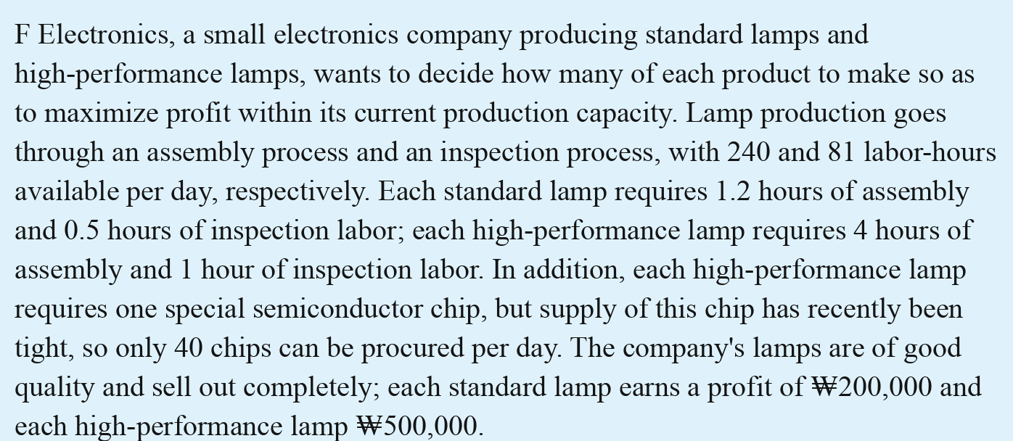
SENSITIVITY ANALYSIS
Sensitivity Analysis
Variables
X₁: daily production of standard lamps
X₂: daily production of high-performance lamps
Model
maximize Z = 20 X₁ + 50 X₂ (total profit, ₩10,000)
subject to 1.2 X₁ + 4 X₂ <= 240 (assembly, hours)
0.5 X₁ + X₂ <= 81 (inspection, hours)
X₂ <= 40 (chip supply, units)
X₁, X₂ >= 0
Chapter 4 · Post-Optimal and Sensitivity Analysis

Slide 23
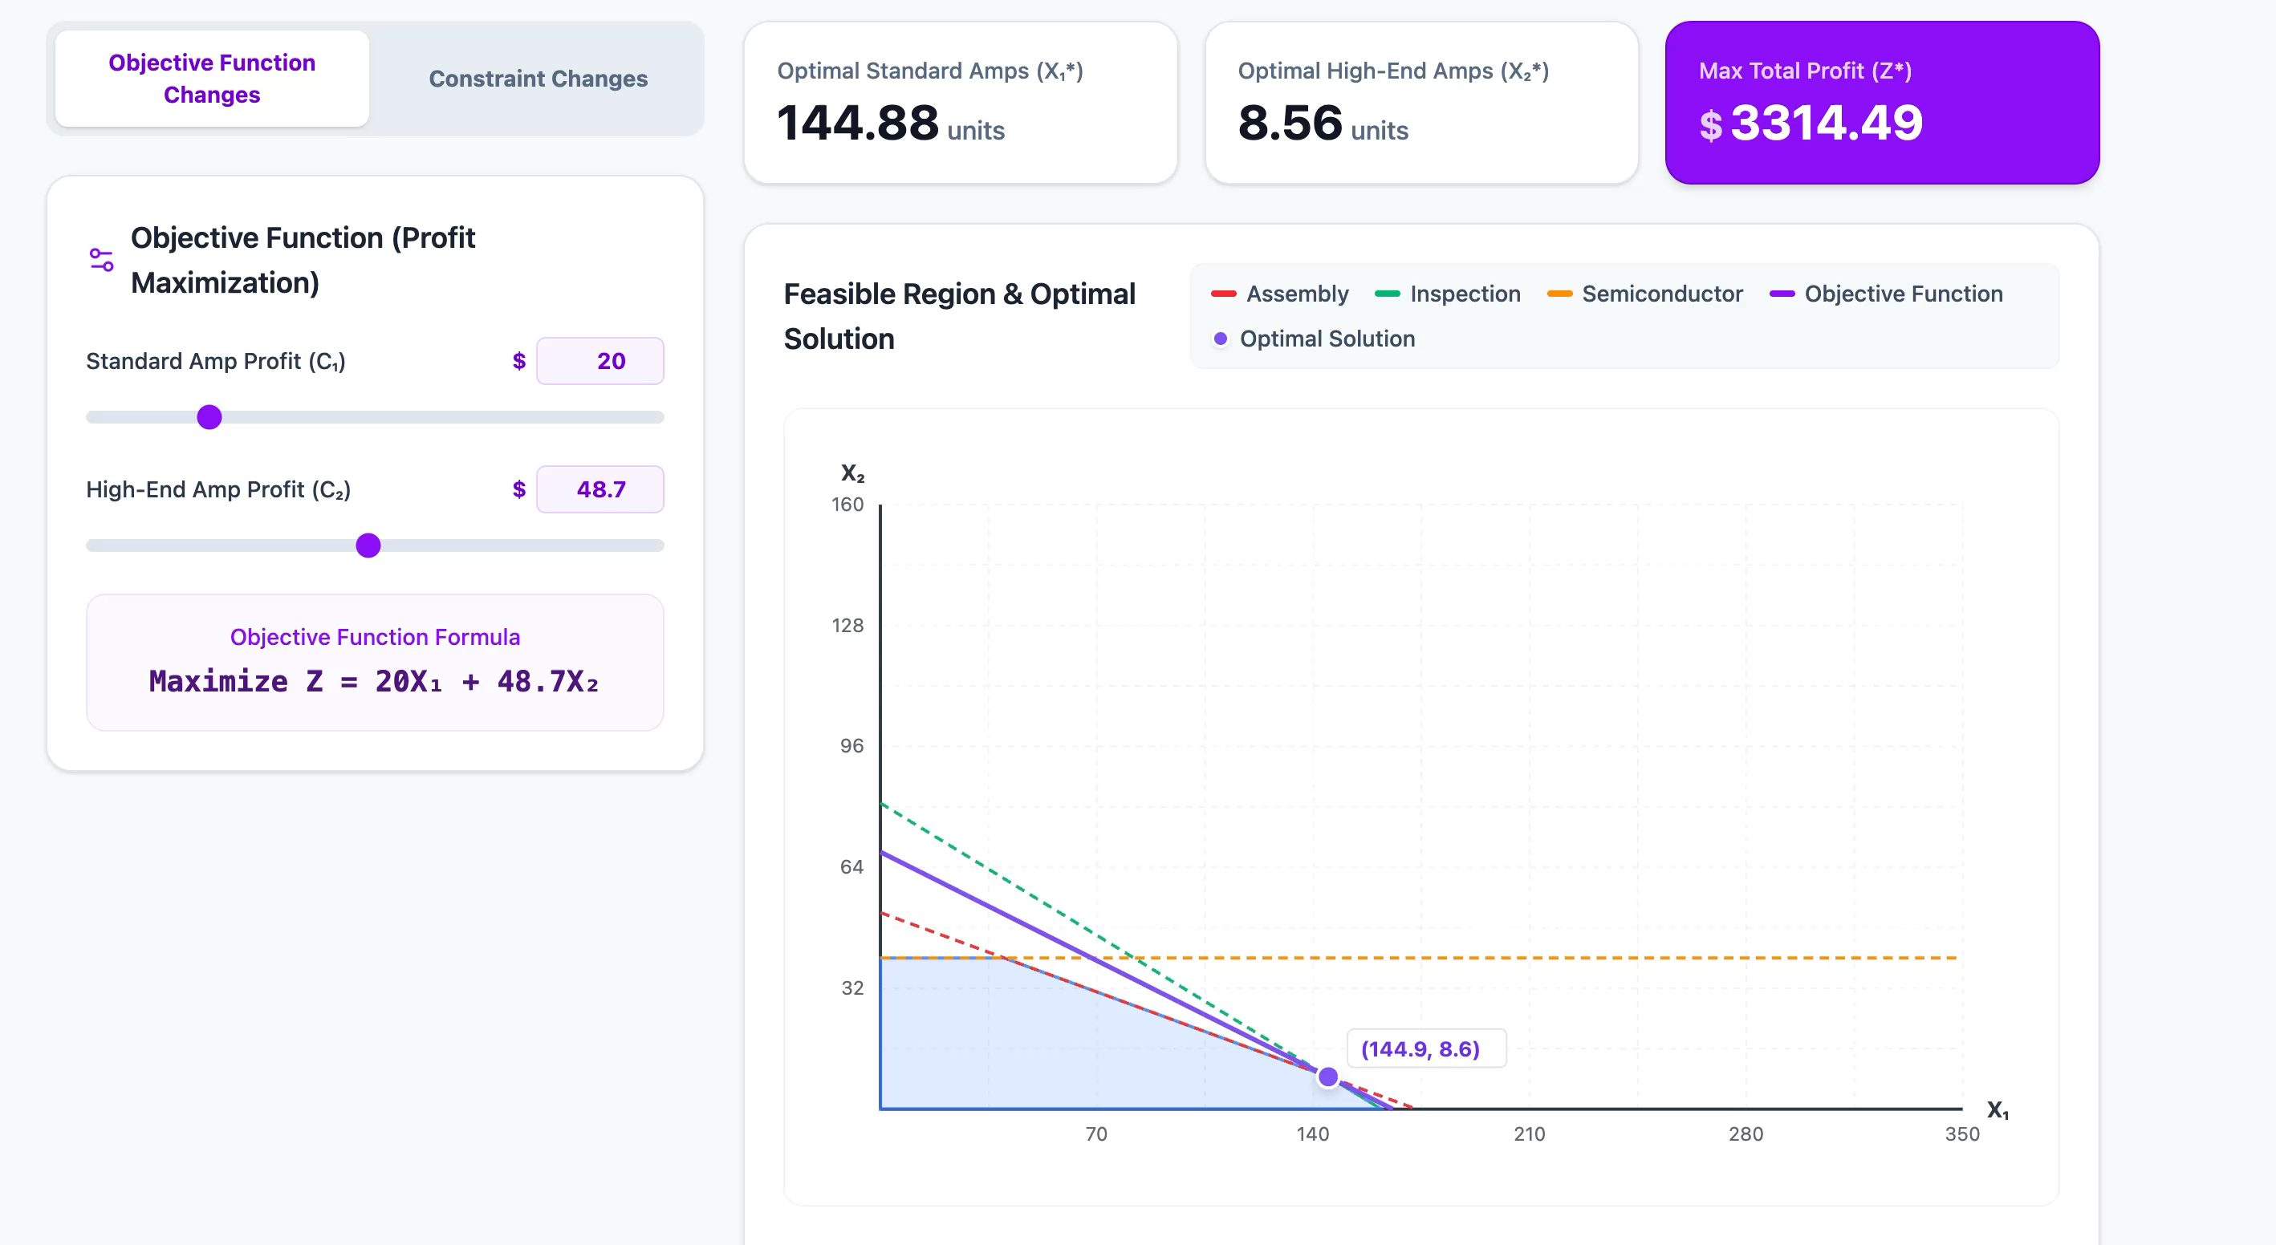
SENSITIVITY ANALYSIS
Sensitivity Analysis – Objective Coefficients
Mathematically, we can use the property that “the optimal solution is unchanged if the objective’s slope lies between the slopes of the two binding constraints” to find the range over which an objective coefficient can change without changing the optimal solution (the allowable range)
Chapter 4 · Post-Optimal and Sensitivity Analysis

Slide 24
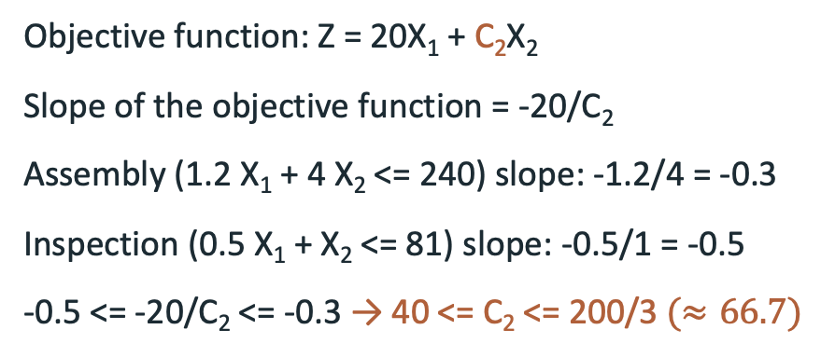
SENSITIVITY ANALYSIS
Sensitivity Analysis – Objective Coefficients
Change in objective coefficient C₂
Objective function: Z = 20X₁ + C₂X₂
Slope of the objective function = -20/C₂
Assembly (1.2 X₁ + 4 X₂ <= 240) slope: -1.2/4 = -0.3
Inspection (0.5 X₁ + X₂ <= 81) slope: -0.5/1 = -0.5
-0.5 <= -20/C₂ <= -0.3 → 40 <= C₂ <= 200/3 $(≈66.7)$
For 40 <= C₂ <= 200/3, the optimal solution (X₁=105, X₂=28.5) does not change
Here, the optimal value Z = 20 ⨉ 105 + C₂ ⨉ 28.5 = 28.5C₂ + 2,100 (₩10,000) is proportional to C₂
Chapter 4 · Post-Optimal and Sensitivity Analysis

Slide 25
SENSITIVITY ANALYSIS
Sensitivity Analysis – Changes in the RHS
When the right-hand side (RHS) changes
Changing the RHS shifts the constraint boundary, so the optimal solution itself changes
Small changes in the RHS are captured by the shadow price
However, when the change in the RHS is large, the shadow price itself changes
So, we need to check how far the RHS can change while the shadow price stays the same
Chapter 4 · Post-Optimal and Sensitivity Analysis

Slide 26
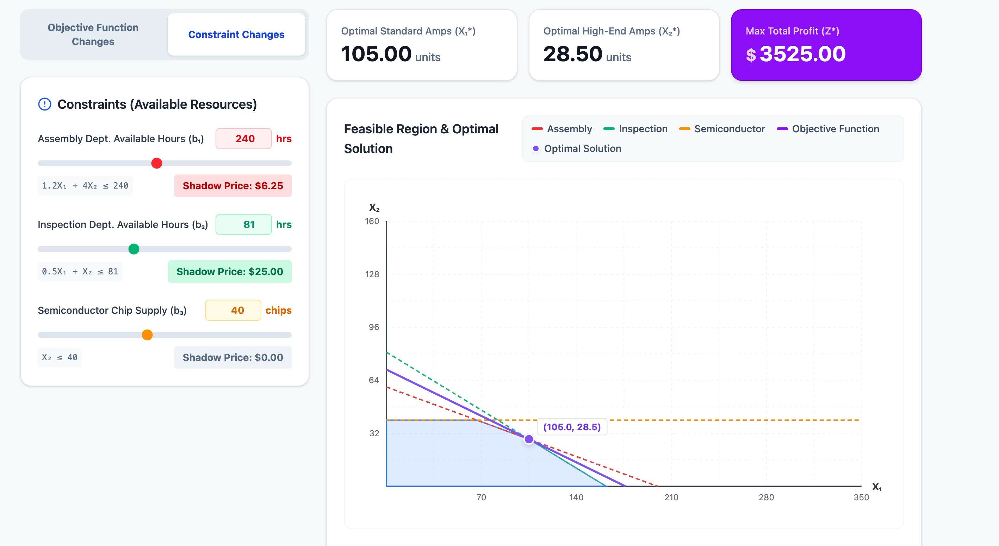
SENSITIVITY ANALYSIS
Sensitivity Analysis – Changes in the RHS
When the right-hand side (RHS) changes
Chapter 4 · Post-Optimal and Sensitivity Analysis

Slide 27
SENSITIVITY ANALYSIS
Post-Optimal Analysis Using Sensitivity Analysis
Deciding whether to change the production plan (objective coefficient change)
Q: For what profit per standard lamp should we keep the current optimal daily plan (105 standard lamps, 28.5 high-performance lamps)?
(Hint) For 15 <= C₁ <= 25, the optimal solution (X₁=105, X₂=28.5) does not change
Chapter 4 · Post-Optimal and Sensitivity Analysis

Slide 28
SENSITIVITY ANALYSIS
Post-Optimal Analysis Using Sensitivity Analysis
Deciding whether to change the production plan (objective coefficient change)
Q: For what profit per standard lamp should we keep the current optimal daily plan (105 standard lamps, 28.5 high-performance lamps)?
(Hint) For 15 <= C₁ <= 25, the optimal solution (X₁=105, X₂=28.5) does not change
A: If the profit per standard lamp is between ₩150,000 and ₩250,000, the current plan (105 standard lamps, 28.5 high-performance lamps) can be kept. If it falls below ₩150,000 or rises above ₩250,000, the production plan must be revised
Chapter 4 · Post-Optimal and Sensitivity Analysis

Slide 29
SENSITIVITY ANALYSIS
Post-Optimal Analysis Using Sensitivity Analysis
Deciding whether to add available hours (RHS change)
Adding 1 hour of daily labor in the assembly process costs ₩50,000.
Based on the current sensitivity analysis, should we add labor to the assembly process?
If so, how much labor should we add?
(Hint) For 194.5 ≤ b₁ ≤ 258.4, the assembly shadow price stays at ₩62,500/hour
Chapter 4 · Post-Optimal and Sensitivity Analysis

Slide 30
SENSITIVITY ANALYSIS
Post-Optimal Analysis Using Sensitivity Analysis
Deciding whether to add available hours (RHS change)
Adding 1 hour of daily labor in the assembly process costs ₩50,000.
Based on the current sensitivity analysis, should we add labor to the assembly process?
If so, how much labor should we add?
(Hint) For 194.5 ≤ b₁ ≤ 258.4, the assembly shadow price stays at ₩62,500/hour
Net profit per hour: ₩62,500 – ₩50,000 = ₩12,500
This shadow price is valid only for 194.5 ≤ b1 ≤ 258.4, so we can add at most 18.4 hours (258.4-240=18.4)
Total additional profit = ₩12,500/hour × 18.4 hours = ₩230,000
Chapter 4 · Post-Optimal and Sensitivity Analysis

Slide 31
SUMMARY
Summary
Post-optimal analysis: what-if analysis performed after optimization
Shadow price
The increase in the objective function when a resource’s supply capacity increases by 1
Reduced cost
The change in the objective function value when a variable that equals 0 in the optimal solution is increased by 1 unit
Sensitivity analysis
Analyzes how the optimal solution and optimal objective value change when model coefficients change
Allowable ranges of objective coefficients and of the RHS
Chapter 4 · Post-Optimal and Sensitivity Analysis

