Slide 1
CHAPTER 05
Business Applications of
Linear Programming
Five applications: LP formulation, CVXPY solutions, and interpretation
TEXTBOOK
CHAPTER
WEEK
Modern Management Science, 9th ed.
Ch. 5
Week 6
Management Science · Fall 2026 · Kitae Kim, School of Business, Korea Aerospace University
Content prepared by the instructor; slide layout and formatting assisted by Codex (OpenAI).
Notes:
Source: 5장.pptx, slide 1. Design reference: Chapter 4 Post-Optimal and Sensitivity Analysis (slides).pptx.

Slide 2
CHAPTER 05
LP Applications by Industry and Function
Industry | Problem examples | Selected example
Finance and investment | Cash-flow matching, portfolio selection, scenario-based investment planning | Portfolio selection
Marketing and sales | Advertising allocation, sales-channel planning, survey scheduling | Advertising allocation
Manufacturing | Resource transfers, make-or-buy decisions, production and inventory planning | Make-or-buy decisions
Services and workforce | Hourly staff scheduling, temporary staffing | Hourly staff scheduling
Airlines | Ticket allocation across routes and fare classes | Ticket allocation
Chapter 5 · Business Applications of Linear Programming
Notes:
Chapter overview based on the five retained applications.

Slide 3
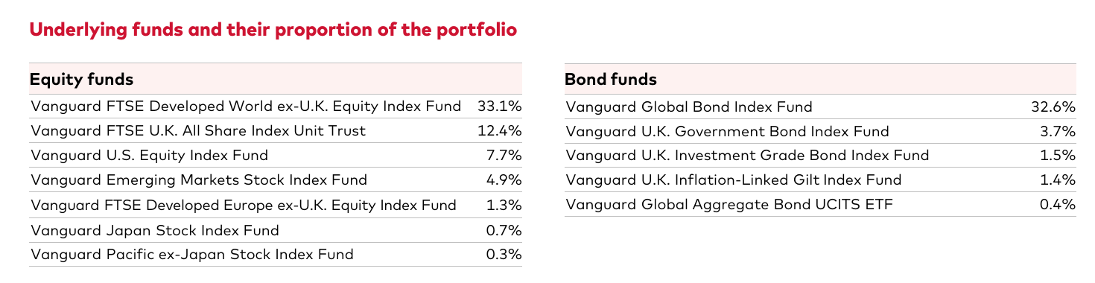
FINANCE AND INVESTMENT
A Real Investment Portfolio
Vanguard LifeStrategy 60% Equity Fund · Actual holdings · 31 August 2026
https://fund-docs.vanguard.com/LifeStrategy_60_Equity_Fund_9241_GBP_EN_UK.pdf
Investment weights turn a portfolio into an allocation decision.
Why does this fund spread its money across many investments?
Source: Vanguard, fund factsheet, 31 August 2026, p. 2.
Chapter 5 · Business Applications of Linear Programming
Notes:
Actual fund disclosure. Introductory context, not evidence that Vanguard uses the textbook LP. Original holdings table is shown as a cropped image with no numerical changes.
Source: https://fund-docs.vanguard.com/LifeStrategy_60_Equity_Fund_9241_GBP_EN_UK.pdf
Accessed: 2026-10-06.

Slide 4
FINANCE AND INVESTMENT
Portfolio Selection: Problem and Data
Allocate one unit of investment across four assets to maximize annual return.
Asset | Variable | Annual return | Risk index
Equity fund (Stocks) | S | 10% | 80
Bonds | B | 3% | 20
Income fund | I | 4% | 30
Money market fund | M | 1% | 0
Policy limits
Weighted risk ≤ 40. Equity ≤ 75%. Income fund ≥ bonds.
Money market fund: 10% to 30% of the portfolio.
Chapter 5 · Business Applications of Linear Programming
Notes:
Source: original 5장.pptx, slide(s) 5, 6.

Slide 5
FINANCE AND INVESTMENT
Portfolio Selection: LP Model
S, B, I, M are fractions of the total investment.
Maximize 0.1S + 0.03B + 0.04I + 0.01M
Subject to
S + B + I + M = 1
80S + 20B + 30I ≤ 40
S ≤ 0.75
I − B ≥ 0
M ≥ 0.1
M ≤ 0.3
S, B, I, M ≥ 0
Chapter 5 · Business Applications of Linear Programming
Notes:
Source: original 5장.pptx, slide(s) 6.

Slide 6
FINANCE AND INVESTMENT
Portfolio Selection: CVXPY Model
import cvxpy as cp
# 1. Decision variables
S = cp.Variable()
B = cp.Variable()
I = cp.Variable()
M = cp.Variable()
# 2. Objective function
objective = cp.Maximize(0.1*S + 0.03*B + 0.04*I + 0.01*M)
# 3. Constraints
constraints = [
S + B + I + M == 1,
80*S + 20*B + 30*I <= 40,
S <= 0.75,
I - B >= 0,
M >= 0.1,
M <= 0.3,
S >= 0, B >= 0, I >= 0, M >= 0,
]
Chapter 5 · Business Applications of Linear Programming
Notes:
Source: original 5장.pptx, slide(s) 5, 6.
Code structure and visual style follow Week 3/4 lecture slides. CVXPY selects the solver automatically. Tables show one optimal solution. Displayed values are rounded. https://www.cvxpy.org/examples/basic/linear_program.html

Slide 7
FINANCE AND INVESTMENT
Portfolio Selection: CVXPY Solution
INPUT
OUTPUT
# 4. Formulate and solve the problem
Status: optimal
problem = cp.Problem(objective, constraints)
problem.solve()
# 5. Print the results
Asset | Allocation
Equity fund | 40.9%
Bonds | 14.5%
Income fund | 14.5%
Money market fund | 30%
print("Status:", problem.status)
print("Objective:", round(100 * problem.value, 1), "% annual return")
print("S:", round(100 * float(S.value), 1), "%")
print("B:", round(100 * float(B.value), 1), "%")
print("I:", round(100 * float(I.value), 1), "%")
print("M:", round(100 * float(M.value), 1), "%")
Annual return ≈ 5.4%
Rounded shares may not total 100%.
The risk limit binds at 40. The money market allocation reaches its 30% cap.
Chapter 5 · Business Applications of Linear Programming
Notes:
Source: original 5장.pptx, slide(s) 5, 6, 7.
Code structure and visual style follow Week 3/4 lecture slides. CVXPY selects the solver automatically. Tables show one optimal solution. Displayed values are rounded. https://www.cvxpy.org/examples/basic/linear_program.html

Slide 8
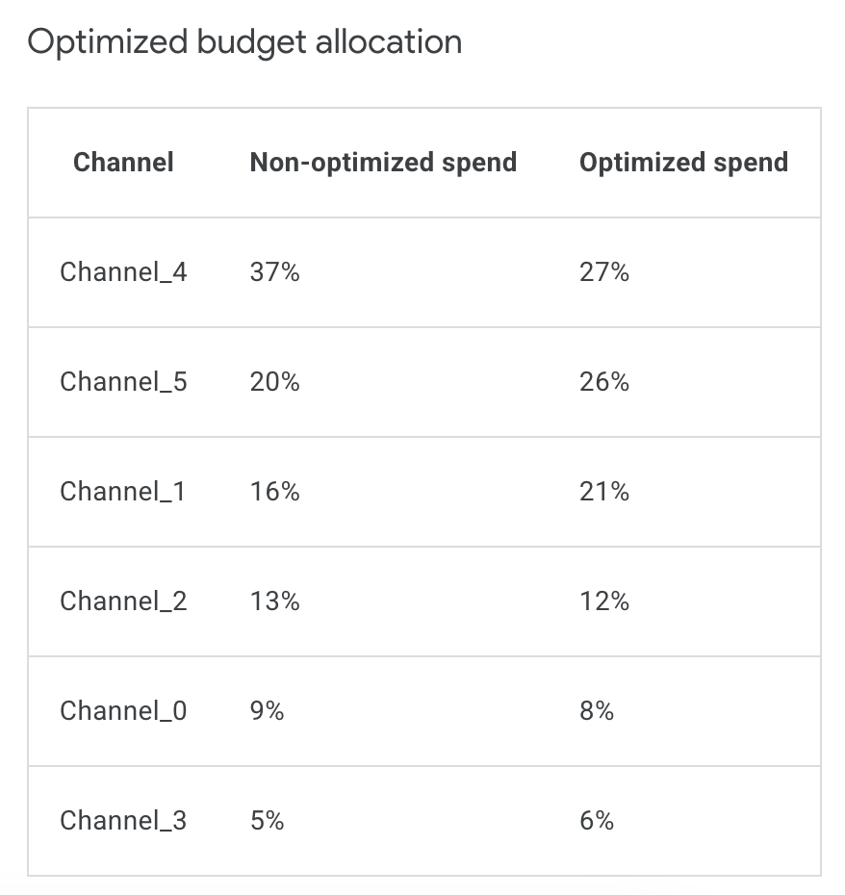
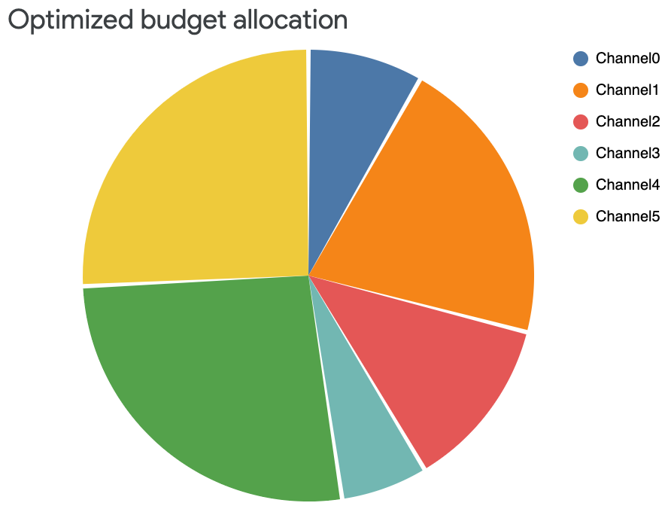
MARKETING AND SALES
Advertising Budget Allocation in Meridian
Google Meridian · Official solution example
https://developers.google.com/meridian/docs/post-modeling/interpret-optimizations
Budget shares before and after optimization
Which channels should receive more of the same total budget?
Source: Google Meridian documentation. CC BY 4.0, unless otherwise noted.
Chapter 5 · Business Applications of Linear Programming
Notes:
Official illustrative optimization report with anonymous channel names. Not an identified advertiser’s actual budget. Meridian uses MMM and nonlinear response curves, not the textbook LP.
Source: https://developers.google.com/meridian/docs/post-modeling/interpret-optimizations
Accessed: 2026-10-06.

Slide 9
MARKETING AND SALES
Advertising Allocation: Problem and Data
Allocate advertising across TV, radio, and newspapers to maximize exposure.
Later placements have lower exposure and customer acquisition effects.
Placement block | Exposure / ad | New customers / ad | Cost / ad (KRW 10,000)
TV: first 10 | 90 | 4,000 | 1,000
TV: additional | 55 | 1,500 | 1,000
Radio: first 15 | 25 | 2,000 | 300
Radio: additional | 20 | 1,200 | 300
Newspaper: first 20 | 10 | 1,000 | 100
Newspaper: additional | 5 | 800 | 100
Chapter 5 · Business Applications of Linear Programming
Notes:
Source: original 5장.pptx, slide(s) 13, 14.

Slide 10
MARKETING AND SALES
Advertising Allocation: Variables and Policies
Placement block | Exposure / ad | New customers / ad | Cost / ad (KRW 10,000)
TV: first 10 | 90 | 4,000 | 1,000
TV: additional | 55 | 1,500 | 1,000
Radio: first 15 | 25 | 2,000 | 300
Radio: additional | 20 | 1,200 | 300
Newspaper: first 20 | 10 | 1,000 | 100
Newspaper: additional | 5 | 800 | 100
Campaign requirements
Budget ≤ KRW 300 million. New customers ≥ 100,000.
TV: 14–20 placements. Radio: at most 33 and at least twice TV.
Newspaper: at least 30 placements.
Chapter 5 · Business Applications of Linear Programming
Notes:
Source: original 5장.pptx, slide(s) 13, 14.

Slide 11
MARKETING AND SALES
Advertising Allocation: LP Model
Maximize 90T₁ + 55T₂ + 25R₁ + 20R₂ + 10N₁ + 5N₂
Subject to
1,000T₁ + 1,000T₂ + 300R₁ + 300R₂ + 100N₁ + 100N₂ ≤ 30,000
4,000T₁ + 1,500T₂ + 2,000R₁ + 1,200R₂ + 1,000N₁ + 800N₂ ≥ 100,000
R₁ + R₂ ≥ 2T₁ + 2T₂
T₁ + T₂ ≥ 14
T₁ + T₂ ≤ 20
R₁ + R₂ ≤ 33
N₁ + N₂ ≥ 30
T₁ ≤ 10 R₁ ≤ 15 N₁ ≤ 20
All variables ≥ 0
Chapter 5 · Business Applications of Linear Programming
Notes:
Source: original 5장.pptx, slide(s) 14.

Slide 12
MARKETING AND SALES
Advertising Allocation: CVXPY Setup
import cvxpy as cp
# 1. Decision variables
T1 = cp.Variable()
T2 = cp.Variable()
R1 = cp.Variable()
R2 = cp.Variable()
N1 = cp.Variable()
N2 = cp.Variable()
# 2. Objective function
objective = cp.Maximize(
90*T1 + 55*T2 + 25*R1 + 20*R2 + 10*N1 + 5*N2
)
Each variable represents one placement block.
The upper bounds on T1, R1, and N1 preserve the first-block limits.
Chapter 5 · Business Applications of Linear Programming
Notes:
Source: original 5장.pptx, slide(s) 13, 14.
Code structure and visual style follow Week 3/4 lecture slides. CVXPY selects the solver automatically. Tables show one optimal solution. Displayed values are rounded. https://www.cvxpy.org/examples/basic/linear_program.html

Slide 13
MARKETING AND SALES
Advertising Allocation: CVXPY Constraints
# 3. Constraints
constraints = [
1000*T1 + 1000*T2 + 300*R1 + 300*R2 + 100*N1 + 100*N2 <= 30000,
4000*T1 + 1500*T2 + 2000*R1 + 1200*R2 + 1000*N1 + 800*N2 >= 100000,
R1 + R2 >= 2*T1 + 2*T2,
T1 + T2 >= 14,
T1 + T2 <= 20,
R1 + R2 <= 33,
N1 + N2 >= 30,
T1 <= 10,
R1 <= 15,
N1 <= 20,
T1 >= 0, T2 >= 0, R1 >= 0, R2 >= 0,
N1 >= 0, N2 >= 0,
]
Chapter 5 · Business Applications of Linear Programming
Notes:
Source: original 5장.pptx, slide(s) 14.
Code structure and visual style follow Week 3/4 lecture slides. CVXPY selects the solver automatically. Tables show one optimal solution. Displayed values are rounded. https://www.cvxpy.org/examples/basic/linear_program.html

Slide 14
MARKETING AND SALES
Advertising Allocation: CVXPY Solution
INPUT
OUTPUT
# 4. Formulate and solve the problem
Status: optimal
problem = cp.Problem(objective, constraints)
problem.solve()
# 5. Print the results
Medium | First block | Additional | Total
TV | 10 | 6 | 16
Radio | 15 | 18 | 33
Newspaper | 20 | 16 | 36
print("Status:", problem.status)
print("Exposure:", round(problem.value))
print("T1:", round(float(T1.value)))
print("T2:", round(float(T2.value)))
print("R1:", round(float(R1.value)))
print("R2:", round(float(R2.value)))
print("N1:", round(float(N1.value)))
print("N2:", round(float(N2.value)))
Maximum exposure = 2,272
The plan uses the full KRW 300 million budget and attracts 134,150 customers.
Chapter 5 · Business Applications of Linear Programming
Notes:
Source: original 5장.pptx, slide(s) 13, 14.
Code structure and visual style follow Week 3/4 lecture slides. CVXPY selects the solver automatically. Tables show one optimal solution. Displayed values are rounded. https://www.cvxpy.org/examples/basic/linear_program.html

Slide 15
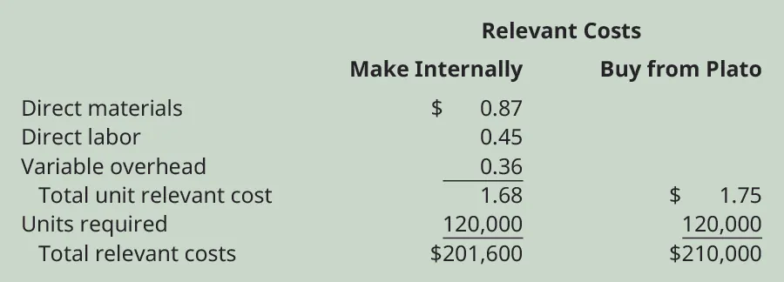
MANUFACTURING
Make or Buy? A Component Cost Comparison
Thermal Mugs · 120,000 lids · OpenStax teaching example
https://openstax.org/books/principles-managerial-accounting/pages/10-3-evaluate-and-determine-whether-to-make-or-buy-a-component
Make: $201,600 Buy: $210,000 Savings from making: $8,400
What changes when production capacity is limited?
OpenStax · Franklin, Graybeal & Cooper (2019) · CC BY-NC-SA · Unchanged source image
Notes:
Source: https://openstax.org/books/principles-managerial-accounting/pages/10-3-evaluate-and-determine-whether-to-make-or-buy-a-component
Access for free at https://openstax.org/books/principles-managerial-accounting/pages/1-why-it-matters
OpenStax, Principles of Accounting Volume 2: Managerial Accounting, section 10.3. Authors Mitchell Franklin, Patty Graybeal, Dixon Cooper (2019). Source image unchanged. This slide is licensed CC BY-NC-SA, matching the source. Educational example, not a real company disclosure. The $0.51 per-unit fixed overhead is assumed unavoidable and excluded from relevant costs in this scenario. Relevant make cost = $0.87 + $0.45 + $0.36 = $1.68 per lid; buy = $1.75. Costs for 120,000 units = $201,600 versus $210,000. The following textbook LP extends the choice to several products sharing limited capacity.

Slide 16
MANUFACTURING
Make-or-Buy Decisions: Problem and Data
Meet product demand using internal production and outside purchases at minimum cost.
Product | Demand | Make cost (KRW / unit) | Buy cost (KRW / unit)
A | 60,000 | 4,500 | 6,000
B | 40,000 | 5,000 | 7,000
C | 35,000 | 2,500 | 5,000
Process | A (min / unit) | B (min / unit) | C (min / unit) | Capacity (min)
Manufacturing | 2 | 3 | 4 | 216,000
Assembly | 1.5 | 2 | 3 | 150,000
Quality control | 2 | 1.5 | 4 | 180,000
Chapter 5 · Business Applications of Linear Programming
Notes:
Source: original 5장.pptx, slide(s) 38, 39.

Slide 17
MANUFACTURING
Make-or-Buy Decisions: LP Model
A, B, C: quantities made. BA, BB, BC: quantities bought.
Minimize 4,500A + 5,000B + 2,500C + 6,000BA + 7,000BB + 5,000BC
Subject to
2A + 3B + 4C ≤ 216,000
1.5A + 2B + 3C ≤ 150,000
2A + 1.5B + 4C ≤ 180,000
A + BA ≥ 60,000
B + BB ≥ 40,000
C + BC ≥ 35,000
A, B, C, BA, BB, BC ≥ 0
Chapter 5 · Business Applications of Linear Programming
Notes:
Source: original 5장.pptx, slide(s) 38, 39.

Slide 18
MANUFACTURING
Make-or-Buy Decisions: CVXPY Model
import cvxpy as cp
# 1. Decision variables
A = cp.Variable()
B = cp.Variable()
C = cp.Variable()
BA = cp.Variable()
BB = cp.Variable()
BC = cp.Variable()
# 2. Objective function
objective = cp.Minimize(
4500*A + 5000*B + 2500*C + 6000*BA + 7000*BB + 5000*BC
)
# 3. Constraints
constraints = [
2*A + 3*B + 4*C <= 216000,
1.5*A + 2*B + 3*C <= 150000,
2*A + 1.5*B + 4*C <= 180000,
A + BA >= 60000,
B + BB >= 40000,
C + BC >= 35000,
A >= 0, B >= 0, C >= 0, BA >= 0,
BB >= 0, BC >= 0,
]
Chapter 5 · Business Applications of Linear Programming
Notes:
Source: original 5장.pptx, slide(s) 38, 39.
Code structure and visual style follow Week 3/4 lecture slides. CVXPY selects the solver automatically. Tables show one optimal solution. Displayed values are rounded. https://www.cvxpy.org/examples/basic/linear_program.html

Slide 19
MANUFACTURING
Make-or-Buy Decisions: CVXPY Solution
INPUT
OUTPUT
# 4. Formulate and solve the problem
Status: optimal
problem = cp.Problem(objective, constraints)
problem.solve()
Product | Make | Buy
A | 54,646 | 5,354
B | 34,016 | 5,984
C | 0 | 35,000
# 5. Print the results
print("Status:", problem.status)
print("KRW million:", round(problem.value))
print("A:", (round(float(A.value))))
print("B:", (round(float(B.value))))
print("C:",(round(float(C.value))))
print("BA:", (round(float(BA.value))))
print("BB:", (round(float(BB.value))))
Minimum total cost = KRW 665 million
print("BC:", (round(float(BC.value))))
Rounded results from the notebook run.
Costs and capacity usage refer to the unrounded LP solution.
Chapter 5 · Business Applications of Linear Programming
Notes:
Rounded values from the saved default-solver run in Chapter 5 CVXPY Examples v3.ipynb. Multiple optimal solutions exist. Rounding is only for display and may change resource usage. Objective output uses KRW million.

Slide 20
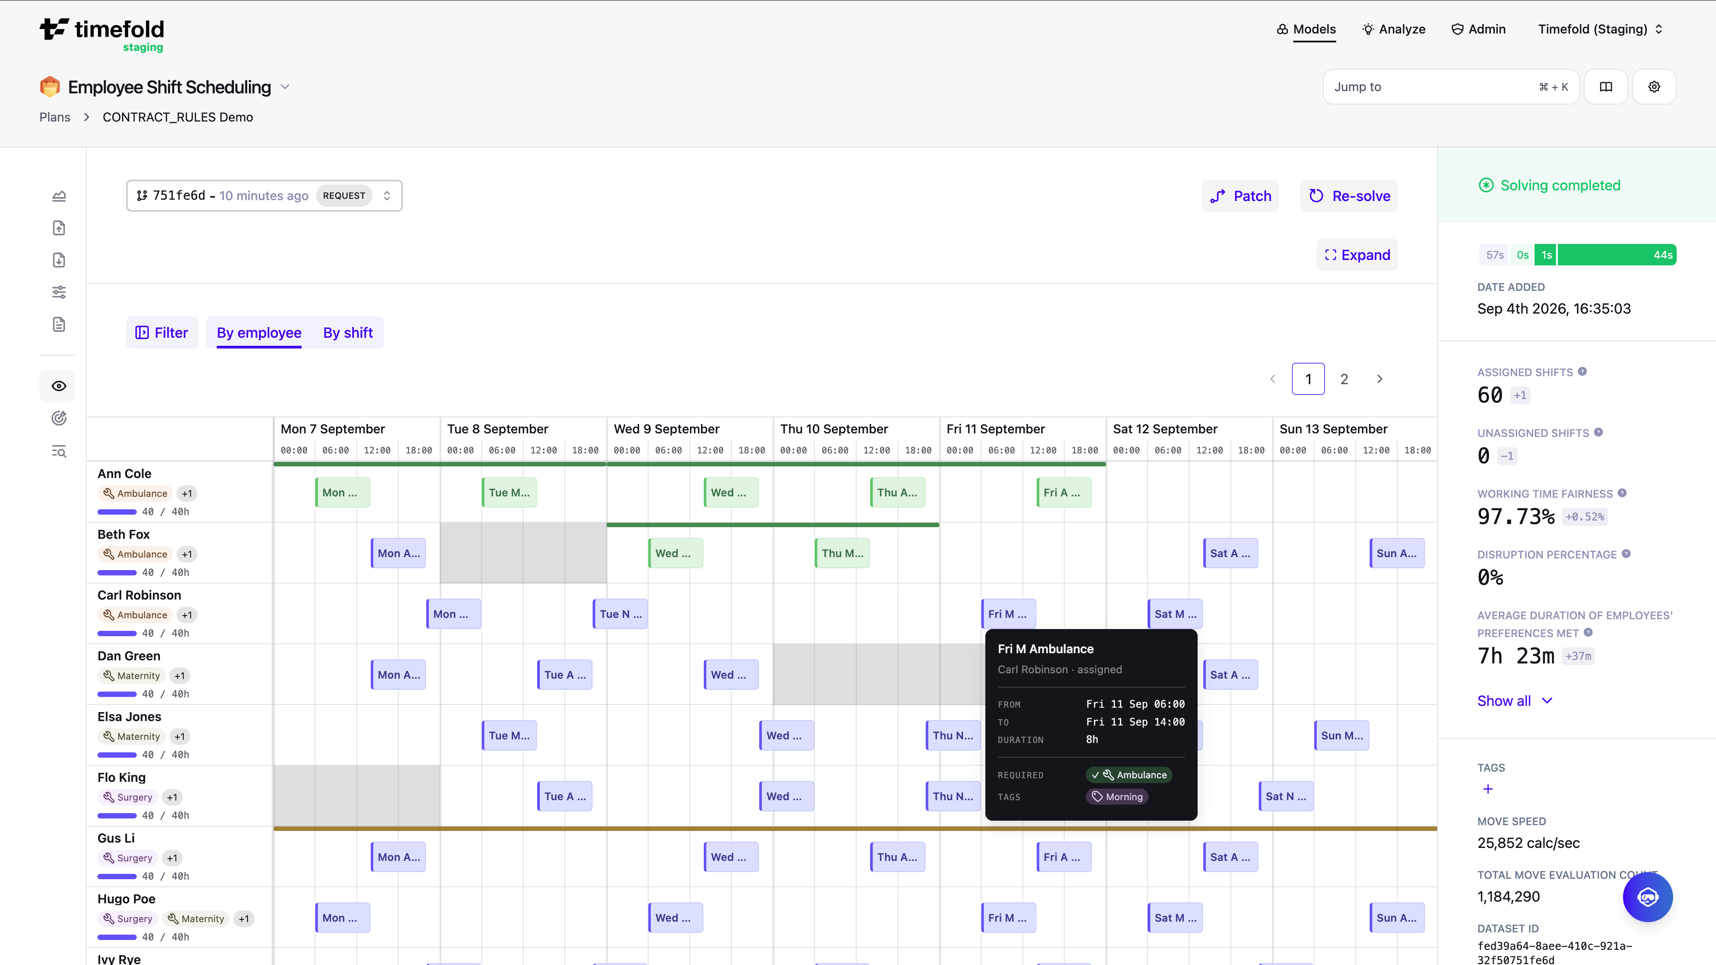
SERVICES AND WORKFORCE
An Employee Shift Schedule
Timefold · Official employee scheduling demo
https://docs.timefold.ai/employee-shift-scheduling/latest/user-guide/visualizations
Rows identify employees. Blocks show assigned shifts across the week.
Can we cover every shift with the people available?
Source: Timefold, Employee Shift Scheduling documentation, By employee view.
Chapter 5 · Business Applications of Linear Programming
Notes:
Official demo screenshot, not actual employee records. Individual shift assignment is discrete; the textbook coverage LP uses continuous variables.
Source: https://docs.timefold.ai/employee-shift-scheduling/latest/user-guide/visualizations
Accessed: 2026-10-06.

Slide 21
SERVICES AND WORKFORCE
Hourly Staff Scheduling: Variables and Coverage
Choose starting times and staff types to meet demand at minimum daily cost.
At least one X-type employee must cover every hour.
Hour | Required staff | Hour | Required staff
9–10 a.m. | 5 | 2–3 p.m. | 6
10–11 a.m. | 4 | 3–4 p.m. | 4
11 a.m.–noon | 9 | 4–5 p.m. | 7
Noon–1 p.m. | 10 | 5–6 p.m. | 4
1–2 p.m. | 9 | 6–7 p.m. | 4
X_{h} = X-type employees starting at hour h
Y_{h} = Y-type employees starting at hour h
Start-time labels: h = 9, 10, 11, 12, 1, 2, 3, 4, 5, 6.
Labels 1–6 denote afternoon starting times.
X-type shift: four work hours, a one-hour break, then three work hours.
Cost per employee: KRW 128,000.
Y-type shift: four consecutive work hours. Cost: KRW 40,000.
At 1–2 p.m., X9 is on break. At 2–3 p.m., X9 returns and X10 is on break.
The coverage equations account for these breaks.
Chapter 5 · Business Applications of Linear Programming
Notes:
Source: original 5장.pptx, slide(s) 24, 25.
Shift interpretation follows the coverage coefficients in source slides 24–25. Staffing costs and the modeled start-time set are retained.

Slide 22
SERVICES AND WORKFORCE
Hourly Staff Scheduling: LP Coverage Model
Hour | Required staff | Hour | Required staff
9–10 a.m. | 5 | 2–3 p.m. | 6
10–11 a.m. | 4 | 3–4 p.m. | 4
11 a.m.–noon | 9 | 4–5 p.m. | 7
Noon–1 p.m. | 10 | 5–6 p.m. | 4
1–2 p.m. | 9 | 6–7 p.m. | 4
Minimize daily cost in KRW 10,000.
Minimize 12.8(X₉ + X₁₀ + X₁₁ + X₁₂ + X₁ + X₂ + X₃ + X₄ + X₅ + X₆)
+ 4(Y₉ + Y₁₀ + Y₁₁ + Y₁₂ + Y₁ + Y₂ + Y₃ + Y₄ + Y₅ + Y₆)
Subject to
X₉ + Y₉ ≥ 5
X₉ + X₁₀ + Y₉ + Y₁₀ ≥ 4
X₉ + X₁₀ + X₁₁ + Y₉ + Y₁₀ + Y₁₁ ≥ 9
X₉ + X₁₀ + X₁₁ + X₁₂ + Y₉ + Y₁₀ + Y₁₁ + Y₁₂ ≥ 10
X₁₀ + X₁₁ + X₁₂ + X₁ + Y₁₀ + Y₁₁ + Y₁₂ + Y₁ ≥ 9
X₉ + X₁₁ + X₁₂ + X₁ + X₂ + Y₁₁ + Y₁₂ + Y₁ + Y₂ ≥ 6
X₉ + X₁₀ + X₁₂ + X₁ + X₂ + X₃ + Y₁₂ + Y₁ + Y₂ + Y₃ ≥ 4
X₉ + X₁₀ + X₁₁ + X₁ + X₂ + X₃ + X₄ + Y₁ + Y₂ + Y₃ + Y₄ ≥ 7
X₁₀ + X₁₁ + X₁₂ + X₂ + X₃ + X₄ + X₅ + Y₂ + Y₃ + Y₄ + Y₅ ≥ 4
X₁₁ + X₁₂ + X₁ + X₃ + X₄ + X₅ + X₆ + Y₃ + Y₄ + Y₅ + Y₆ ≥ 4
Chapter 5 · Business Applications of Linear Programming
Notes:
Source: original 5장.pptx, slide(s) 24.

Slide 23
SERVICES AND WORKFORCE
Hourly Staff Scheduling: Core Staff Coverage
Subject to (continuted)
Hour | Required staff | Hour | Required staff
9–10 a.m. | 5 | 2–3 p.m. | 6
10–11 a.m. | 4 | 3–4 p.m. | 4
11 a.m.–noon | 9 | 4–5 p.m. | 7
Noon–1 p.m. | 10 | 5–6 p.m. | 4
1–2 p.m. | 9 | 6–7 p.m. | 4
X₉ ≥ 1
X₉ + X₁₀ ≥ 1
X₉ + X₁₀ + X₁₁ ≥ 1
X₉ + X₁₀ + X₁₁ + X₁₂ ≥ 1
X₁₀ + X₁₁ + X₁₂ + X₁ ≥ 1
X₉ + X₁₁ + X₁₂ + X₁ + X₂ ≥ 1
X₉ + X₁₀ + X₁₂ + X₁ + X₂ + X₃ ≥ 1
X₉ + X₁₀ + X₁₁ + X₁ + X₂ + X₃ + X₄ ≥ 1
X₁₀ + X₁₁ + X₁₂ + X₂ + X₃ + X₄ + X₅ ≥ 1
X₁₁ + X₁₂ + X₁ + X₃ + X₄ + X₅ + X₆ ≥ 1
All variables ≥ 0
Chapter 5 · Business Applications of Linear Programming
Notes:
Source: original 5장.pptx, slide(s) 25.

Slide 24
SERVICES AND WORKFORCE
Hourly Staff Scheduling: CVXPY Setup
import cvxpy as cp
# 2. Objective function
objective = cp.Minimize(
# 1. Decision variables
12.8*(X9 + X10 + X11 + X12 + X1 + X2 + X3 + X4 + X5 + X6)
X9 = cp.Variable()
+ 4*(Y9 + Y10 + Y11 + Y12 + Y1 + Y2 + Y3 + Y4 + Y5 + Y6)
X10 = cp.Variable()
)
X11 = cp.Variable()
X12 = cp.Variable()
X1 = cp.Variable()
X2 = cp.Variable()
X3 = cp.Variable()
X4 = cp.Variable()
X5 = cp.Variable()
The variable names match the LP.
No integer=True option is used.
These are continuous LP variables.
X6 = cp.Variable()
Y9 = cp.Variable()
Y10 = cp.Variable()
Y11 = cp.Variable()
Y12 = cp.Variable()
Y1 = cp.Variable()
Y2 = cp.Variable()
Y3 = cp.Variable()
Y4 = cp.Variable()
Y5 = cp.Variable()
Y6 = cp.Variable()
Chapter 5 · Business Applications of Linear Programming
Notes:
Source: original 5장.pptx, slide(s) 24, 25.
Code structure and visual style follow Week 3/4 lecture slides. CVXPY selects the solver automatically. Tables show one optimal solution. Displayed values are rounded. https://www.cvxpy.org/examples/basic/linear_program.html

Slide 25
SERVICES AND WORKFORCE
Hourly Staff Scheduling: Demand Constraints
# 3. Constraints
constraints = [
X9 + Y9 >= 5,
X9 + X10 + Y9 + Y10 >= 4,
X9 + X10 + X11 + Y9 + Y10 + Y11 >= 9,
X9 + X10 + X11 + X12 + Y9 + Y10 + Y11 + Y12 >= 10,
X10 + X11 + X12 + X1 + Y10 + Y11 + Y12 + Y1 >= 9,
X9 + X11 + X12 + X1 + X2 + Y11 + Y12 + Y1 + Y2 >= 6,
X9 + X10 + X12 + X1 + X2 + X3 + Y12 + Y1 + Y2 + Y3 >= 4,
X9 + X10 + X11 + X1 + X2 + X3 + X4 + Y1 + Y2 + Y3 + Y4 >= 7,
X10 + X11 + X12 + X2 + X3 + X4 + X5 + Y2 + Y3 + Y4 + Y5 >= 4,
X11 + X12 + X1 + X3 + X4 + X5 + X6 + Y3 + Y4 + Y5 + Y6 >= 4,
]
Chapter 5 · Business Applications of Linear Programming
Notes:
Source: original 5장.pptx, slide(s) 24.
Code structure and visual style follow Week 3/4 lecture slides. CVXPY selects the solver automatically. Tables show one optimal solution. Displayed values are rounded. https://www.cvxpy.org/examples/basic/linear_program.html

Slide 26
SERVICES AND WORKFORCE
Hourly Staff Scheduling: Core Staff Constraints
constraints += [
X9 >= 1,
X9 + X10 >= 1,
X9 + X10 + X11 >= 1,
X9 + X10 + X11 + X12 >= 1,
X10 + X11 + X12 + X1 >= 1,
X9 + X11 + X12 + X1 + X2 >= 1,
X9 + X10 + X12 + X1 + X2 + X3 >= 1,
X9 + X10 + X11 + X1 + X2 + X3 + X4 >= 1,
X10 + X11 + X12 + X2 + X3 + X4 + X5 >= 1,
X11 + X12 + X1 + X3 + X4 + X5 + X6 >= 1,
X9 >= 0, X10 >= 0, X11 >= 0, X12 >= 0,
X1 >= 0, X2 >= 0, X3 >= 0, X4 >= 0,
X5 >= 0, X6 >= 0, Y9 >= 0, Y10 >= 0,
Y11 >= 0, Y12 >= 0, Y1 >= 0, Y2 >= 0,
Y3 >= 0, Y4 >= 0, Y5 >= 0, Y6 >= 0,
]
constraints += [...] adds these requirements to the demand constraints.
Chapter 5 · Business Applications of Linear Programming
Notes:
Source: original 5장.pptx, slide(s) 25.
Code structure and visual style follow Week 3/4 lecture slides. CVXPY selects the solver automatically. Tables show one optimal solution. Displayed values are rounded. https://www.cvxpy.org/examples/basic/linear_program.html

Slide 27
SERVICES AND WORKFORCE
Hourly Staff Scheduling: CVXPY Solution
INPUT
OUTPUT
# 4. Formulate and solve the problem
Status: optimal
problem = cp.Problem(objective, constraints)
problem.solve()
Start | X-type | Y-type
9 a.m. | 1 | 4
10 a.m. | 0 | 2
11 a.m. | 1 | 2
Noon | 0 | 1
1 p.m. | 0 | 3
2 p.m. | 0 | 0
3 p.m. | 0 | 1
4 p.m. | 0 | 2
5–6 p.m. | 0 | 0
# 5. Print the results
print("Status:", problem.status)
print("KRW:", round(10000 * problem.value))
print("X9:", round(float(X9.value)))
print("X10:", round(float(X10.value)))
print("X11:", round(float(X11.value)))
print("X12:", round(float(X12.value)))
print("X1:", round(float(X1.value)))
print("X2:", round(float(X2.value)))
print("X3:", round(float(X3.value)))
print("X4:", round(float(X4.value)))
print("X5:", round(float(X5.value)))
print("X6:", round(float(X6.value)))
print("Y9:", round(float(Y9.value)))
print("Y10:", round(float(Y10.value)))
print("Y11:", round(float(Y11.value)))
print("Y12:", round(float(Y12.value)))
print("Y1:", round(float(Y1.value)))
print("Y2:", round(float(Y2.value)))
print("Y3:", round(float(Y3.value)))
print("Y4:", round(float(Y4.value)))
print("Y5:", round(float(Y5.value)))
print("Y6:", round(float(Y6.value)))
Minimum daily cost = KRW 856,000
Rounded results from the notebook run.
Rounding may violate coverage constraints.
Chapter 5 · Business Applications of Linear Programming
Notes:
Rounded values from the saved default-solver run in Chapter 5 CVXPY Examples v3.ipynb. The objective is KRW 856,000 before rounding variables. Rounded staffing values can violate coverage and need not retain the optimal cost. The final row combines 5 and 6 p.m., which both have zero rounded values. Multiple optimal solutions exist.

Slide 28
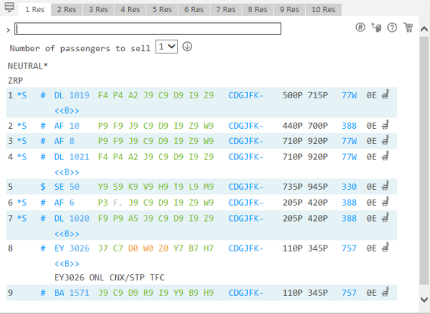
AIRLINES
Seats Available by Booking Class
Travelport Smartpoint · Official training example
F4 · P4 · A2 · J9
Booking codes and seats available to sell
Green: available
Grey: closed
Orange: waitlist
https://support.travelport.com/webhelp/Smartpoint1P/Content/Air/AirAvailability/DisplayingAvailability.htm
Availability counts are not additive across booking classes.
Why is one booking class available while another is closed?
Source: Travelport Smartpoint, Displaying Air Availability.
Chapter 5 · Business Applications of Linear Programming
Notes:
Historical training screenshot, not a live inventory lookup or optimization output. Booking-class availability cannot be summed to infer physical seats, and the display does not contain ticket prices.
Source: https://support.travelport.com/webhelp/Smartpoint1P/Content/Air/AirAvailability/DisplayingAvailability.htm
Accessed: 2026-10-06.

Slide 29
AIRLINES
Airline Ticket Allocation: Flight Network
Each flight leg has 132 seats. Connecting passengers use a seat on every leg of their route.
Beijing
Shanghai
Cheongju
Tokyo
Jeju
Chapter 5 · Business Applications of Linear Programming
Notes:
Source: original 5장.pptx, slide(s) 17, 18, 19, 20.

Slide 30
AIRLINES
Airline Ticket Allocation: Fares and Demand
F = full fare. D = discount fare. Each ticket code is a decision variable.
Fares are in KRW 10,000. Demand gives an upper bound on sales.
Route | Full fare | Discount fare | Full demand | Discount demand | Variables
Beijing–Cheongju | 20 | 13 | 16 | 33 | BCF / BCD
Beijing–Jeju | 30 | 19 | 6 | 44 | BJF / BJD
Beijing–Tokyo | 31 | 21 | 11 | 45 | BTF / BTD
Shanghai–Cheongju | 21 | 14 | 15 | 26 | SCF / SCD
Shanghai–Tokyo | 31 | 23 | 9 | 39 | STF / STD
Shanghai–Jeju | 29 | 19 | 7 | 56 | SJF / SJD
Cheongju–Jeju | 9 | 7 | 8 | 64 | CJF / CJD
Cheongju–Tokyo | 25 | 18 | 10 | 46 | CTF / CTD
Chapter 5 · Business Applications of Linear Programming
Notes:
Source: original 5장.pptx, slide(s) 18.

Slide 31
AIRLINES
Airline Ticket Allocation: LP Model
Route | Full fare | Discount fare | Full demand | Discount demand | Variables
Beijing–Cheongju | 20 | 13 | 16 | 33 | BCF / BCD
Beijing–Jeju | 30 | 19 | 6 | 44 | BJF / BJD
Beijing–Tokyo | 31 | 21 | 11 | 45 | BTF / BTD
Shanghai–Cheongju | 21 | 14 | 15 | 26 | SCF / SCD
Shanghai–Tokyo | 31 | 23 | 9 | 39 | STF / STD
Shanghai–Jeju | 29 | 19 | 7 | 56 | SJF / SJD
Cheongju–Jeju | 9 | 7 | 8 | 64 | CJF / CJD
Cheongju–Tokyo | 25 | 18 | 10 | 46 | CTF / CTD
Variables: the number of tickets sold in each route and fare class.
Maximize 20BCF + 13BCD + 30BJF + 19BJD + 31BTF + 21BTD
+ 21SCF + 14SCD + 31STF + 23STD + 29SJF + 19SJD
+ 9CJF + 7CJD + 25CTF + 18CTD
Subject to
BCF ≤ 16, BCD ≤ 33, BJF ≤ 6, BJD ≤ 44
BTF ≤ 11, BTD ≤ 45, SCF ≤ 15, SCD ≤ 26 …
BCF + BCD + BJF + BJD + BTF + BTD ≤ 132
SCF + SCD + STF + STD + SJF + SJD ≤ 132
BJF + BJD + SJF + SJD + CJF + CJD ≤ 132
BTF + BTD + STF + STD + CTF + CTD ≤ 132
Chapter 5 · Business Applications of Linear Programming
Notes:
Source: original 5장.pptx, slide(s) 18, 19, 20.

Slide 32
AIRLINES
Airline Ticket Allocation: CVXPY Setup
import cvxpy as cp
# 2. Objective function
objective = cp.Maximize(
# 1. Decision variables
20*BCF + 13*BCD + 30*BJF + 19*BJD + 31*BTF + 21*BTD
BCF = cp.Variable()
+ 21*SCF + 14*SCD + 31*STF + 23*STD + 29*SJF + 19*SJD
BCD = cp.Variable()
+ 9*CJF + 7*CJD + 25*CTF + 18*CTD
BJF = cp.Variable()
)
BJD = cp.Variable()
BTF = cp.Variable()
BTD = cp.Variable()
SCF = cp.Variable()
Each ticket has its own scalar variable.
The objective adds fare × tickets sold
across all 16 ticket types.
SCD = cp.Variable()
STF = cp.Variable()
STD = cp.Variable()
SJF = cp.Variable()
SJD = cp.Variable()
CJF = cp.Variable()
CJD = cp.Variable()
CTF = cp.Variable()
CTD = cp.Variable()
Chapter 5 · Business Applications of Linear Programming
Notes:
Source: original 5장.pptx, slide(s) 18, 19.
Code structure and visual style follow Week 3/4 lecture slides. CVXPY selects the solver automatically. Tables show one optimal solution. Displayed values are rounded. https://www.cvxpy.org/examples/basic/linear_program.html

Slide 33
AIRLINES
Airline Ticket Allocation: CVXPY Constraints
# 3. Constraints
constraints += [
constraints = [
BCF + BCD + BJF + BJD + BTF + BTD <= 132,
BCF <= 16,
SCF + SCD + STF + STD + SJF + SJD <= 132,
BCD <= 33,
BJF + BJD + SJF + SJD + CJF + CJD <= 132,
BJF <= 6,
BTF + BTD + STF + STD + CTF + CTD <= 132,
BJD <= 44,
BCF >= 0, BCD >= 0, BJF >= 0, BJD >= 0,
BTF <= 11,
BTF >= 0, BTD >= 0, SCF >= 0, SCD >= 0,
BTD <= 45,
STF >= 0, STD >= 0, SJF >= 0, SJD >= 0,
CJF >= 0, CJD >= 0, CTF >= 0, CTD >= 0,
SCF <= 15,
]
SCD <= 26,
STF <= 9,
STD <= 39,
SJF <= 7,
SJD <= 56,
CJF <= 8,
CJD <= 64,
CTF <= 10,
CTD <= 46,
]
Chapter 5 · Business Applications of Linear Programming
Notes:
Source: original 5장.pptx, slide(s) 18, 20.
Code structure and visual style follow Week 3/4 lecture slides. CVXPY selects the solver automatically. Tables show one optimal solution. Displayed values are rounded. https://www.cvxpy.org/examples/basic/linear_program.html

Slide 34
AIRLINES
Airline Ticket Allocation: CVXPY Solution
INPUT
OUTPUT
# 4. Formulate and solve the problem
Status: optimal
problem = cp.Problem(objective, constraints)
problem.solve()
Route | Full | Discount
B–C | 16 | 33
B–J | 6 | 44
B–T | 11 | 22
S–C | 15 | 26
S–T | 9 | 34
S–J | 7 | 41
C–J | 8 | 26
C–T | 10 | 46
# 5. Print the results
print("Status:", problem.status)
print("KRW 10000:", round(problem.value))
print("BCF:", round(float(BCF.value)))
print("BCD:", round(float(BCD.value)))
print("BJF:", round(float(BJF.value)))
print("BJD:", round(float(BJD.value)))
print("BTF:", round(float(BTF.value)))
print("BTD:", round(float(BTD.value)))
print("SCF:", round(float(SCF.value)))
print("SCD:", round(float(SCD.value)))
print("STF:", round(float(STF.value)))
print("STD:", round(float(STD.value)))
Maximum revenue ≈ KRW 66 million
print("SJF:", round(float(SJF.value)))
print("SJD:", round(float(SJD.value)))
All four flight legs use 132 seats.
print("CJF:", round(float(CJF.value)))
print("CJD:", round(float(CJD.value)))
Some discount demand remains unmet because connecting tickets share scarce seats.
print("CTF:", round(float(CTF.value)))
print("CTD:", round(float(CTD.value)))
Chapter 5 · Business Applications of Linear Programming
Notes:
Source: original 5장.pptx, slide(s) 18, 19, 20, 21.
Code structure and visual style follow Week 3/4 lecture slides. CVXPY selects the solver automatically. Tables show one optimal solution. Displayed values are rounded. https://www.cvxpy.org/examples/basic/linear_program.html

Slide 35
SUMMARY
Five Applications of Linear Programming
Application | Decision variables | Objective | Key constraints
Portfolio selection | Investment shares | Maximize return | Budget, risk, allocation limits
Advertising allocation | Placements by medium | Maximize exposure | Budget, reach, media limits
Make-or-buy | Make and buy quantities | Minimize total cost | Capacity, product demand
Staff scheduling | Staff by starting time | Minimize staffing cost | Hourly demand, shift coverage
Airline ticket allocation | Sales by route and fare | Maximize revenue | Demand, shared flight capacity
A common workflow
Define variables, write the objective and constraints, then solve with CVXPY.
Interpret the solution in context. Rounded LP values do not enforce integer decisions.
Notes:
Summary of the five textbook applications in this deck. The same workflow applies across domains: formulate an LP, solve with CVXPY, and interpret the objective and variable values against operational constraints. The portfolio example uses a linear risk index. Advertising and staffing variables are continuous in the presented LPs. Rounding a displayed result does not impose integer constraints.

