Slide 1
CHAPTER 07
Integer Programming
Decision Making / Game Theory / Systems Analysis
TEXTBOOK
CHAPTER
WEEK
Modern Management Science, 9th ed.
Ch. 7
Week 9
Management Science · Kitae Kim, 2026 Spring, Korea Aerospace University
Made by Kitae Kim, formatted by Codex.

Slide 2
Overview
Introduction to Integer Programming (IP)
How to solve IP
Applications of IP

Slide 3
RECAP
Recap: Linear Programming Assumptions
Certainty
Linearity
Proportionality
Additivity
Divisibility: Variables may take fractional values
Chapter 7 · Integer Programming
3

Slide 4
Integer Programming Models
Use Integer Programming when variables must take integer values rather than fractions or decimals (the divisibility assumption does not hold).
Variables represent the number of units produced
Model either-or decisions with binary variables (0 or 1)
Chapter 7 · Integer Programming
4

Slide 5
Example 7-1: Problem and Data
Hankook Supermarket has secured KRW 15.5 billion to expand by opening stores and storage facilities. Each new store costs KRW 1 billion and earns KRW 30 million per month. Each storage facility costs KRW 3 billion and earns KRW 72 million per month. Management plans to open at least one storage facility and no more than five stores.
Formulate an Integer Programming model to maximize profit within the available budget.
Chapter 7 · Integer Programming
5

Slide 6
Example 7-1: Integer Programming Model
X1: Number of new stores
X2: Number of new storage facilities
Maximize Z = 0.3 X1 + 0.72 X2 (Monthly profit, unit: KRW 100 million)
Subject to: 10X1 + 30X2 <= 155 (Budget, unit: KRW 100 million)
      X1 <= 5 (Store limit)
      X2 >= 1 (Minimum storage facilities)
      X1 , X2 >= 0
      X1, X2 are integers
Chapter 7 · Integer Programming
6

Slide 7
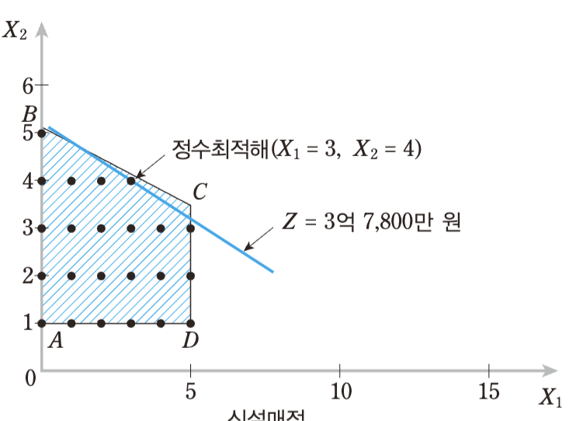
Example 7-1: Integer Solution
Solution to the Integer Programming model
Integer optimum (X₁ = 3, X₂ = 4)
Z = KRW 378 million
New stores
Chapter 7 · Integer Programming
7

Slide 8
Introduction to Integer Programming (IP)
How to solve IP
Applications of IP

Slide 9
How to solve IP models?
LP relaxation
Branch-and-bound method
Chapter 7 · Integer Programming
6

Slide 10
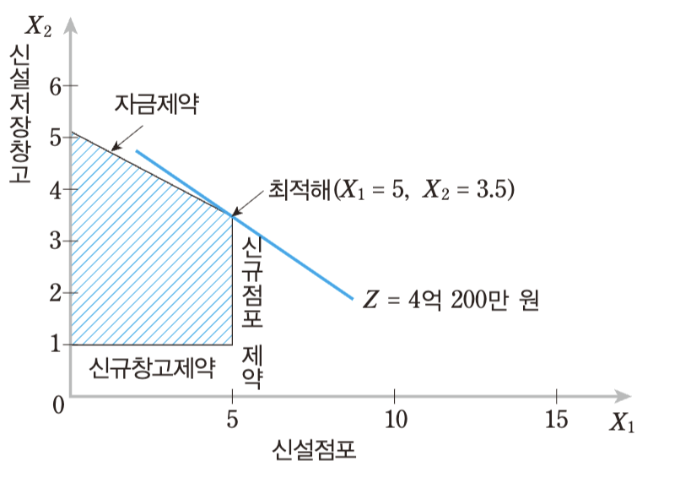
SOLUTION METHODS
Linear Programming Relaxation
LP relaxation: Ignore integrality constraints and find the optimal solution
Then adjust any fractional values to integers
LP relaxation optimum:
Is (5, 3) or (5, 4) optimal?
What about (3, 4)?
New storage facilities
Budget
Z = 0.3 X₁ +0.72 X₂
LP optimum (5, 3.5)
Z = KRW 402 million
Storage min.
Store limit
New stores
Chapter 7 · Integer Programming
9

Slide 11
SOLUTION METHODS
Branch-and-Bound Method
Branch-and-bound divides the feasible region into subproblems and analyzes each separately.
An efficient method for solving Integer Programming models
For Example 7-1, the LP relaxation optimum is (X1 = 5, X2 = 3.5).
Branch into X2 <= 3 and X2 >= 4, then solve each subproblem.
Chapter 7 · Integer Programming
10

Slide 12
SOLUTION METHODS
Branch-and-Bound: First Branch
Case: X₂ ≤ 3
New storage facilities
10 X₁ +30 X₂ <= 155
Budget
Z = 0.3 X₁ +0.72 X₂
LP optimum (5, 3.5)
Z = KRW 402 million
Storage min.
Store limit
New stores
Chapter 7 · Integer Programming
11

Slide 13
SOLUTION METHODS
Branch-and-Bound: Further Branching
Case: X₂ ≥ 4
X₁ ≥ 4
X₁ ≤ 3
New storage facilities
Budget
10 X₁ +30 X₂ <= 155
Z = 0.3 X₁ +0.72 X₂
LP optimum (5, 3.5)
Z = KRW 402 million
Storage min.
Store limit
New stores
Chapter 7 · Integer Programming
12

Slide 14
Introduction to Integer Programming (IP)
How to solve IP
Applications of IP

Slide 15
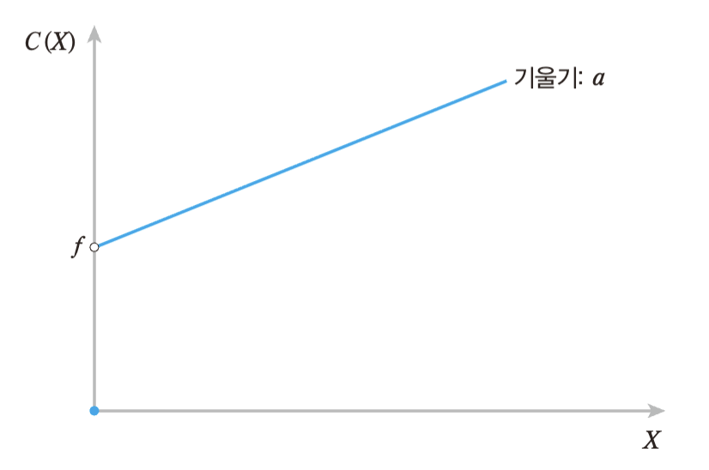
FIXED COSTS
Fixed-Cost Problems
Linear programming assumes variable costs only, with no fixed costs
In practice, firms also incur fixed costs
Use Integer Programming to model fixed costs
This brings us to mixed integer programming
b
Total cost C(X) = aX + b if X > 0
0 if X = 0
Chapter 7 · Integer Programming
13

Slide 16
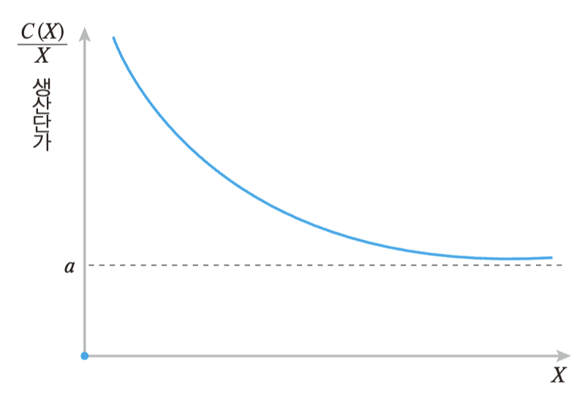
FIXED COSTS
Fixed Costs and Economies of Scale
Fixed costs are a common source of economies of scale.
Unit cost C(X)/X decreases as output increases.
Add a binary variable Y and link it to X:
  Y = 1 if X > 0 (producing)
  0 if X = 0 (not producing)
X ≤ cY, where c is production capacity
<Economies of Scale>
Chapter 7 · Integer Programming
14

Slide 17
FIXED COSTS
Example 7-3: Problem and Data
K Manufacturing must produce 20,000 units using three machines. Each machine incurs a fixed cost when activated. The table lists each machine’s fixed cost, variable cost, and production capacity.
Formulate an Integer Programming model to choose which machines to use and how much each should produce to minimize total production cost.
Machine | Fixed cost (KRW 10,000) | Variable cost (KRW 10,000/unit) | Capacity (units)
1 | 300 | 2 | 8,000
2 | 100 | 10 | 13,000
3 | 200 | 5 | 14,000
Chapter 7 · Integer Programming
15

Slide 18
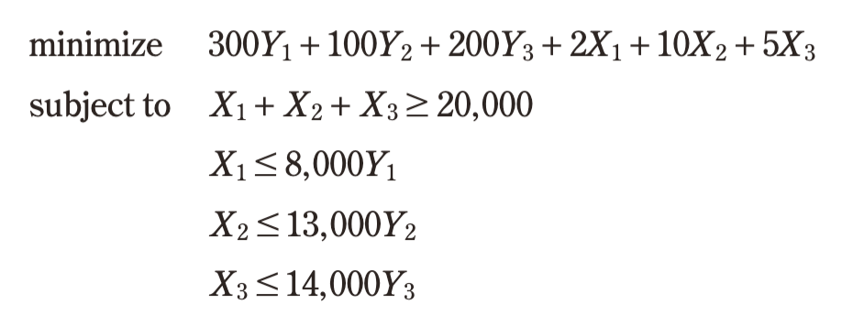
FIXED COSTS
Example 7-3: Model and Solution
Yⱼ = 1 if machine j operates
0 otherwise
Xⱼ = Output of machine j, j = 1, 2, 3
Optimal solution from CVXPY
Total cost: KRW 765 million
Y1 = 1
Y2 = 0
Y3 = 1
X1 = 8,000
X2 = 0
X3 = 12,000
X₁, X₂, X₃ ≥ 0
Y₁, Y₂, Y₃ ∈ {0, 1}
Chapter 7 · Integer Programming
16

Slide 19
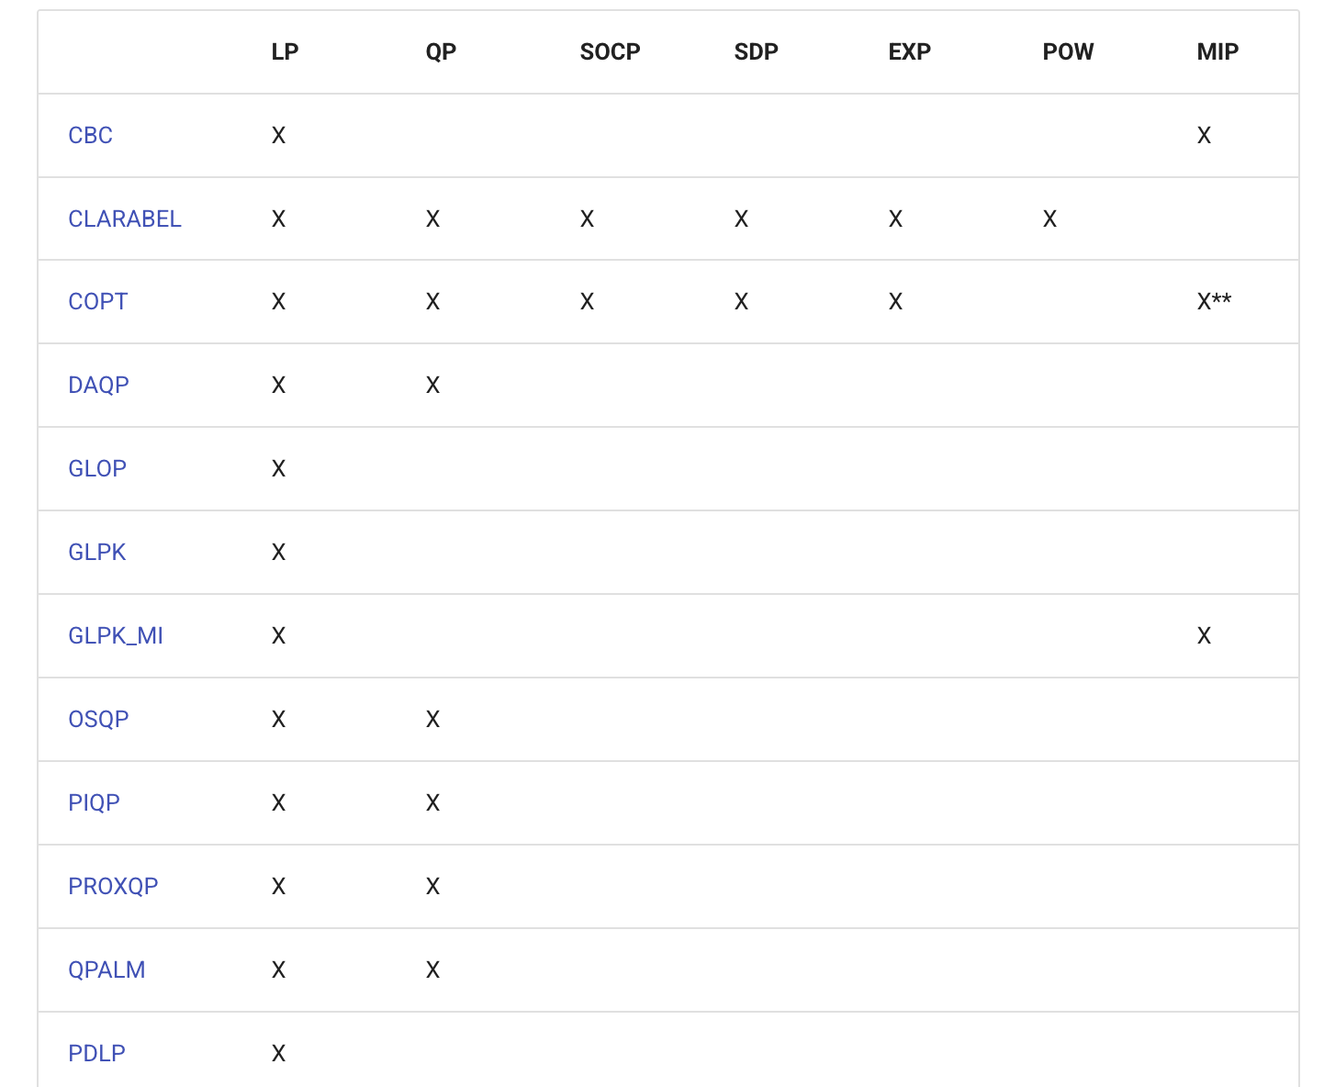
CVXPY
Integer Programming with CVXPY
Many real-world problems use mixed-Integer Programming models
These models optimize over both integer and continuous variables
CVXPY can solve integer and mixed-integer models using a solver that supports mixed-integer programming (MIP).
Problem type
Solver
Chapter 7 · Integer Programming
17

Slide 20
CVXPY
Integer Programming with CVXPY
If x must be integer:
  x = cp.Variable( )
If y must be 1 or 0:
  y = cp.Variable( )
Chapter 7 · Integer Programming
17

Slide 21
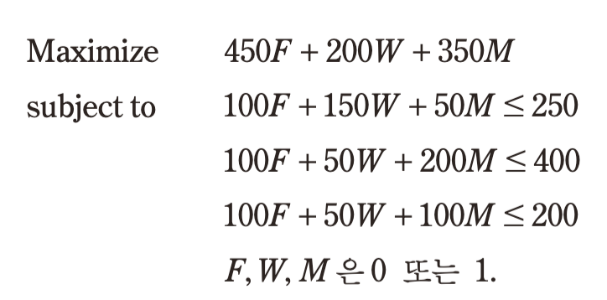
CAPITAL BUDGETING
Example 7-2: Investment Selection
H Group is considering three projects over the next three years. The table gives each project’s annual funding needs and present value of profit.
Table 7.1 Investment plan (KRW 100 million)
Project | Profit PV | Year 1 | Year 2 | Year 3
Factory expansion | 450 | 100 | 100 | 100
New warehouse | 200 | 150 | 50 | 50
Advanced machinery | 350 | 50 | 200 | 100
Available funds |  | 250 | 400 | 200
F, W, M ∈ {0, 1}
Present value discounts future investments and returns to today, then sums them. At a 10% annual rate, a project invests KRW 1 billion now and KRW 1 billion in year 1, then earns KRW 300 million annually from year 2 onward.
PV = −10 − 10/1.1 + 3/1.1² + 3/1.1³ + …
= −10 − 10/1.1 + (3/1.1²)[1/(1 − 1/1.1)]
≈ 8.2 (KRW 100 million)
Chapter 7 · Integer Programming
18

Slide 22
CAPITAL BUDGETING
Example 7-2: CVXPY Model and Solution
import cvxpy as cp
# 1. Binary project decisions
X1 = cp.Variable(boolean=True) # Factory
X2 = cp.Variable(boolean=True) # Warehouse
X3 = cp.Variable(boolean=True) # Machinery
# 2. Maximize present value of profit
objective = cp.Maximize(
450*X1 + 200*X2 + 350*X3)
# 3. Annual funding constraints
constraints = [
100*X1 + 150*X2 + 50*X3 <= 250,
100*X1 + 50*X2 + 200*X3 <= 400,
100*X1 + 50*X2 + 100*X3 <= 200
]
# 4. Define and solve the problem
problem = cp.Problem(objective, constraints)
problem.solve()
# 5. Results (profit in KRW 100 million)
print("Status:", problem.status)
print("Profit PV:", problem.value)
print("Factory:", round(float(X1.value)))
print("Warehouse:", round(float(X2.value)))
print("Machinery:", round(float(X3.value)))
F, W, M ∈ {0, 1}
Status: optimal · Profit PV: 800.0
Factory: 1 · Warehouse: 0 · Machinery: 1
Chapter 7 · Integer Programming
19

Slide 23
Summary
Introduction to Integer programming (IP)
  Use when decision variables must be integers
  LP divisibility assumption does not hold
  Binary variables (0/1)
How to solve IP
  LP relaxation
  Branch-and-bound:
Applications of IP
  Mixed-integer programming (MIP): Fixed costs
  Use a MIP-capable solver in CVXPY to solve integer and mixed-integer models

