Slide 2
AI for Medical Time Series - Spring 2022
Group Project – Classification of EEG time series of responses to neutral vs unpleasant images
Jiahui Yu / Shunyu Wu
1 June 2022

Slide 3
Table of Contents
Introduction
Classification 1 – Dynamic Time Warping + KNN
Dynamic Time Warping
K-NN algorithm
Data Preprocess
Result
Classification 2 – Neural Network
Data Preprocessing
Supervised Learning Method
Result
Open Questions

Slide 4
Introduction
Classification Task
This dataset consists of 21 subjects, 64 channels, 384 time points. There are 6 classes representing EEG responses to images with different familiarity and pleasantness (familiar and neutral (FN), familiar and pleasant (FP), familiar and unpleasant (FU), novel and neutral (NN), novel and pleasant (NP), novel and unpleasant (NP) pictures).
The goal of the project is to train a classifier that can classify Familiar (FN, FU and FP) and Novel (NN, NP and NU).

Slide 5
Classification 1
Dynamic Time Warping
Dynamic time warping finds the optimal non-linear alignment between two time series.
D(n, m) = min(D(n − 1,m − 1), D(n − 1,m), D(n, m − 1)) + c(x_{n} , y_{m})
DTW is quadratic in the length of the time series used, time complexity of O(nm)
Speed up
Enforce a locality constraint window size w, cause it is unlikely for X_{i} and Y_{j} to be matched if i and j are too far apart.
Use the LB Keogh lower bound of dynamic time warping. It is still the fastest known technique for indexing DTW.

Slide 6
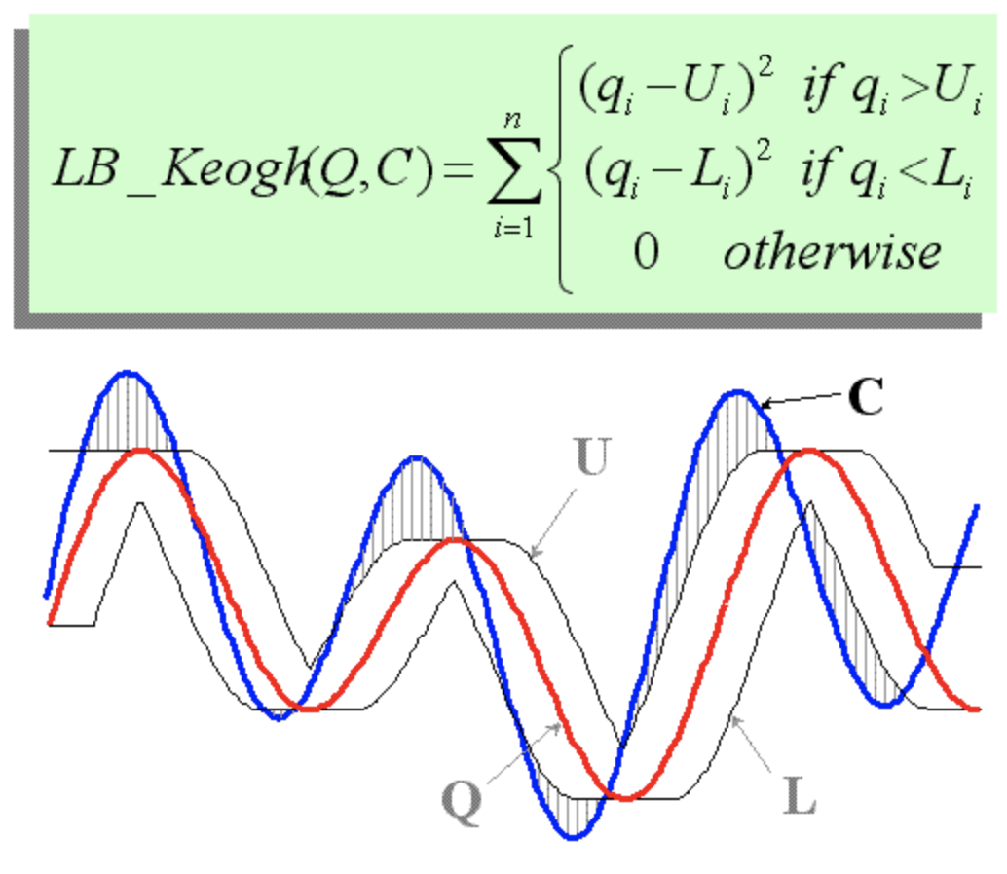
Classification 1
What is LB_Keogh?
To the left is a visual intuition of LB_Keogh, a protective envelope is built around the red time series, the Euclidean distance between the blue time series and the closest part of the protective envelope is a (tight) lower bound to the DTW. For indexing under uniform scaling or processing of streaming time series etc, the definition of the envelope differs, but the LB_Keogh definition is unchanged.

Slide 7
Classification 1
K-NN algorithm
1-NN algorithm with dynamic time warping Euclidean distance
LB_Keogh(X,Y) ≤ DTW(X,Y), and computing LB Keogh is much less expensive than performing DTW
In order to eliminate many unnecessary dynamic time warping computations, use LB Keogh to get rid of those cannot possibly be more similar that the current most similar time series.
Choose window size of 4.

Slide 8
Classification 1
Data Preprocess
Even though the code is sped up, it still take much longer than I expected. So I just average the channels of one subject, which is bad practice, to get an experimental result(over 1h running time for the first two subjects).
To classify familiar vs novel, new event label 1 to familiar and 0 to novel are reassigned manually.
Subject 1 has 983 trails and subject 2 has 268 trails, so the final data matrix size is (983+269)*(384+1). The last column is class label.
The data set is then split into train and test using train test split from sklearn, in which 33% will be test set and 67% will be train set.

Slide 9
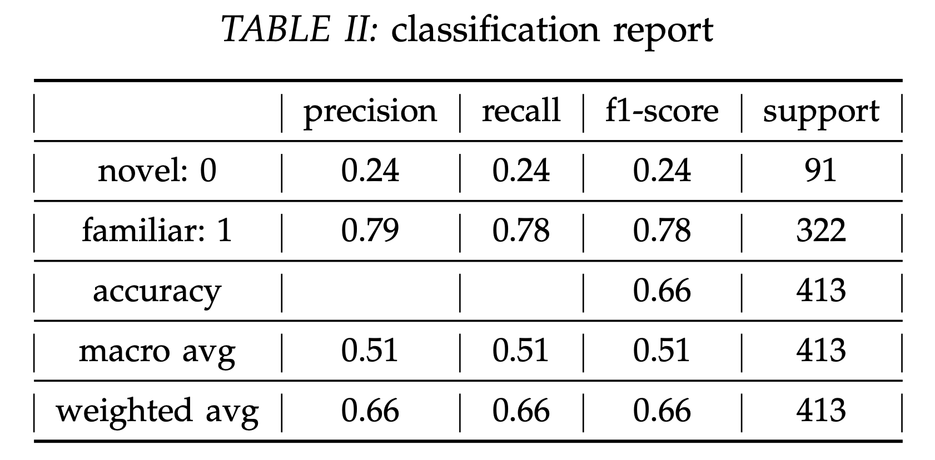
Classification 1
Result
As shown left using just 2 subjects data and average channels is clearly not enough for accuracy, twhich is only 66%.
But it is enough to present that DTW and KNN did their jobs, so the idea works. Just need better CPU or GPUs to compute the whole data set.

Slide 10
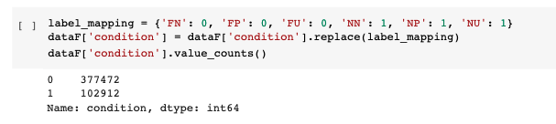
Classification 2
Data Preprocess
Dataset: 1-P-cleaned.fif, 2-P-cleaned.fif
Familiar (FN, FU, FP) VS Novel (NN, FP, NU)

Slide 11
Classification 2
Data Preprocess
Principle Component Analysis (PCA) : 20 main components
1) Normalize all the data points 2) Calculate the covariance matrix X of data points 3) Calculate eigenvectors and corresponding eigenvalues 4) Sort the eigenvectors according to their eigenvalues in decreasing order
5) choose the first k eigenvectors, and that will be the new k dimensions
6) Transform the original n-dimensional data points into k dimensions
Train – Test – Validation Split
60% Trainset
80% for train, 20% for validation
40% Test-set

Slide 12
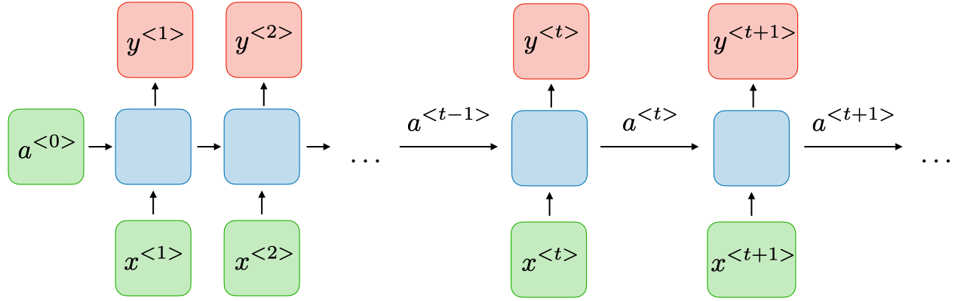


Classification 2
Method
Input:
Data points of 20 channels in objects 1 and 2
Output:
0 (Familiar)
1 (Novel)
update gate Γu to measure how mush past should maintain
relevance gate Γr to measure how much past should drop.

Slide 13
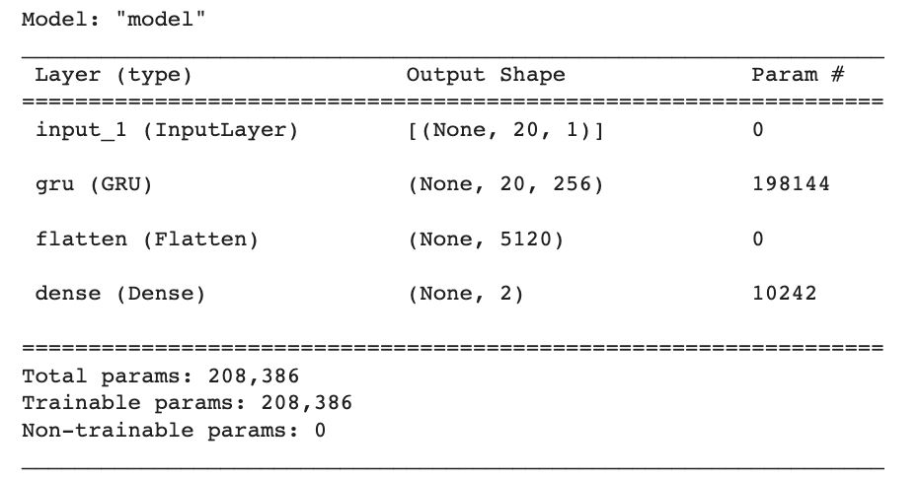
Classification 2
Method

Slide 14
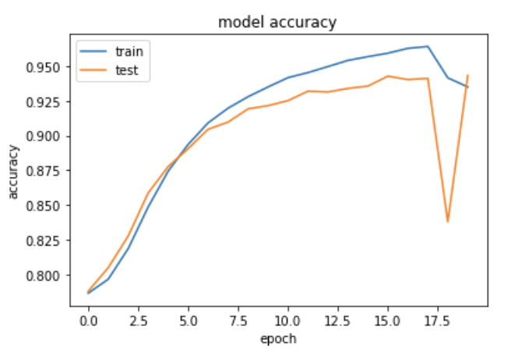
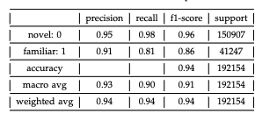
Classification 2
Result
Test Accuracy : 94.225%

Slide 15
Classification 2
Open Problems

Slide 16
Reference
1. https://www.cs.ucr.edu/~eamonn/LB_Keogh.htm
2. Course slide: AI for Medical Time Series Data Lecture 6: Unsupervised learning for time-series data

Slide 17

Thank you
For your attention
AI for Medical Time Series – Spring 2022
01.06.2022 Jiahui Yu / Shunyu Wu

