Slide 1
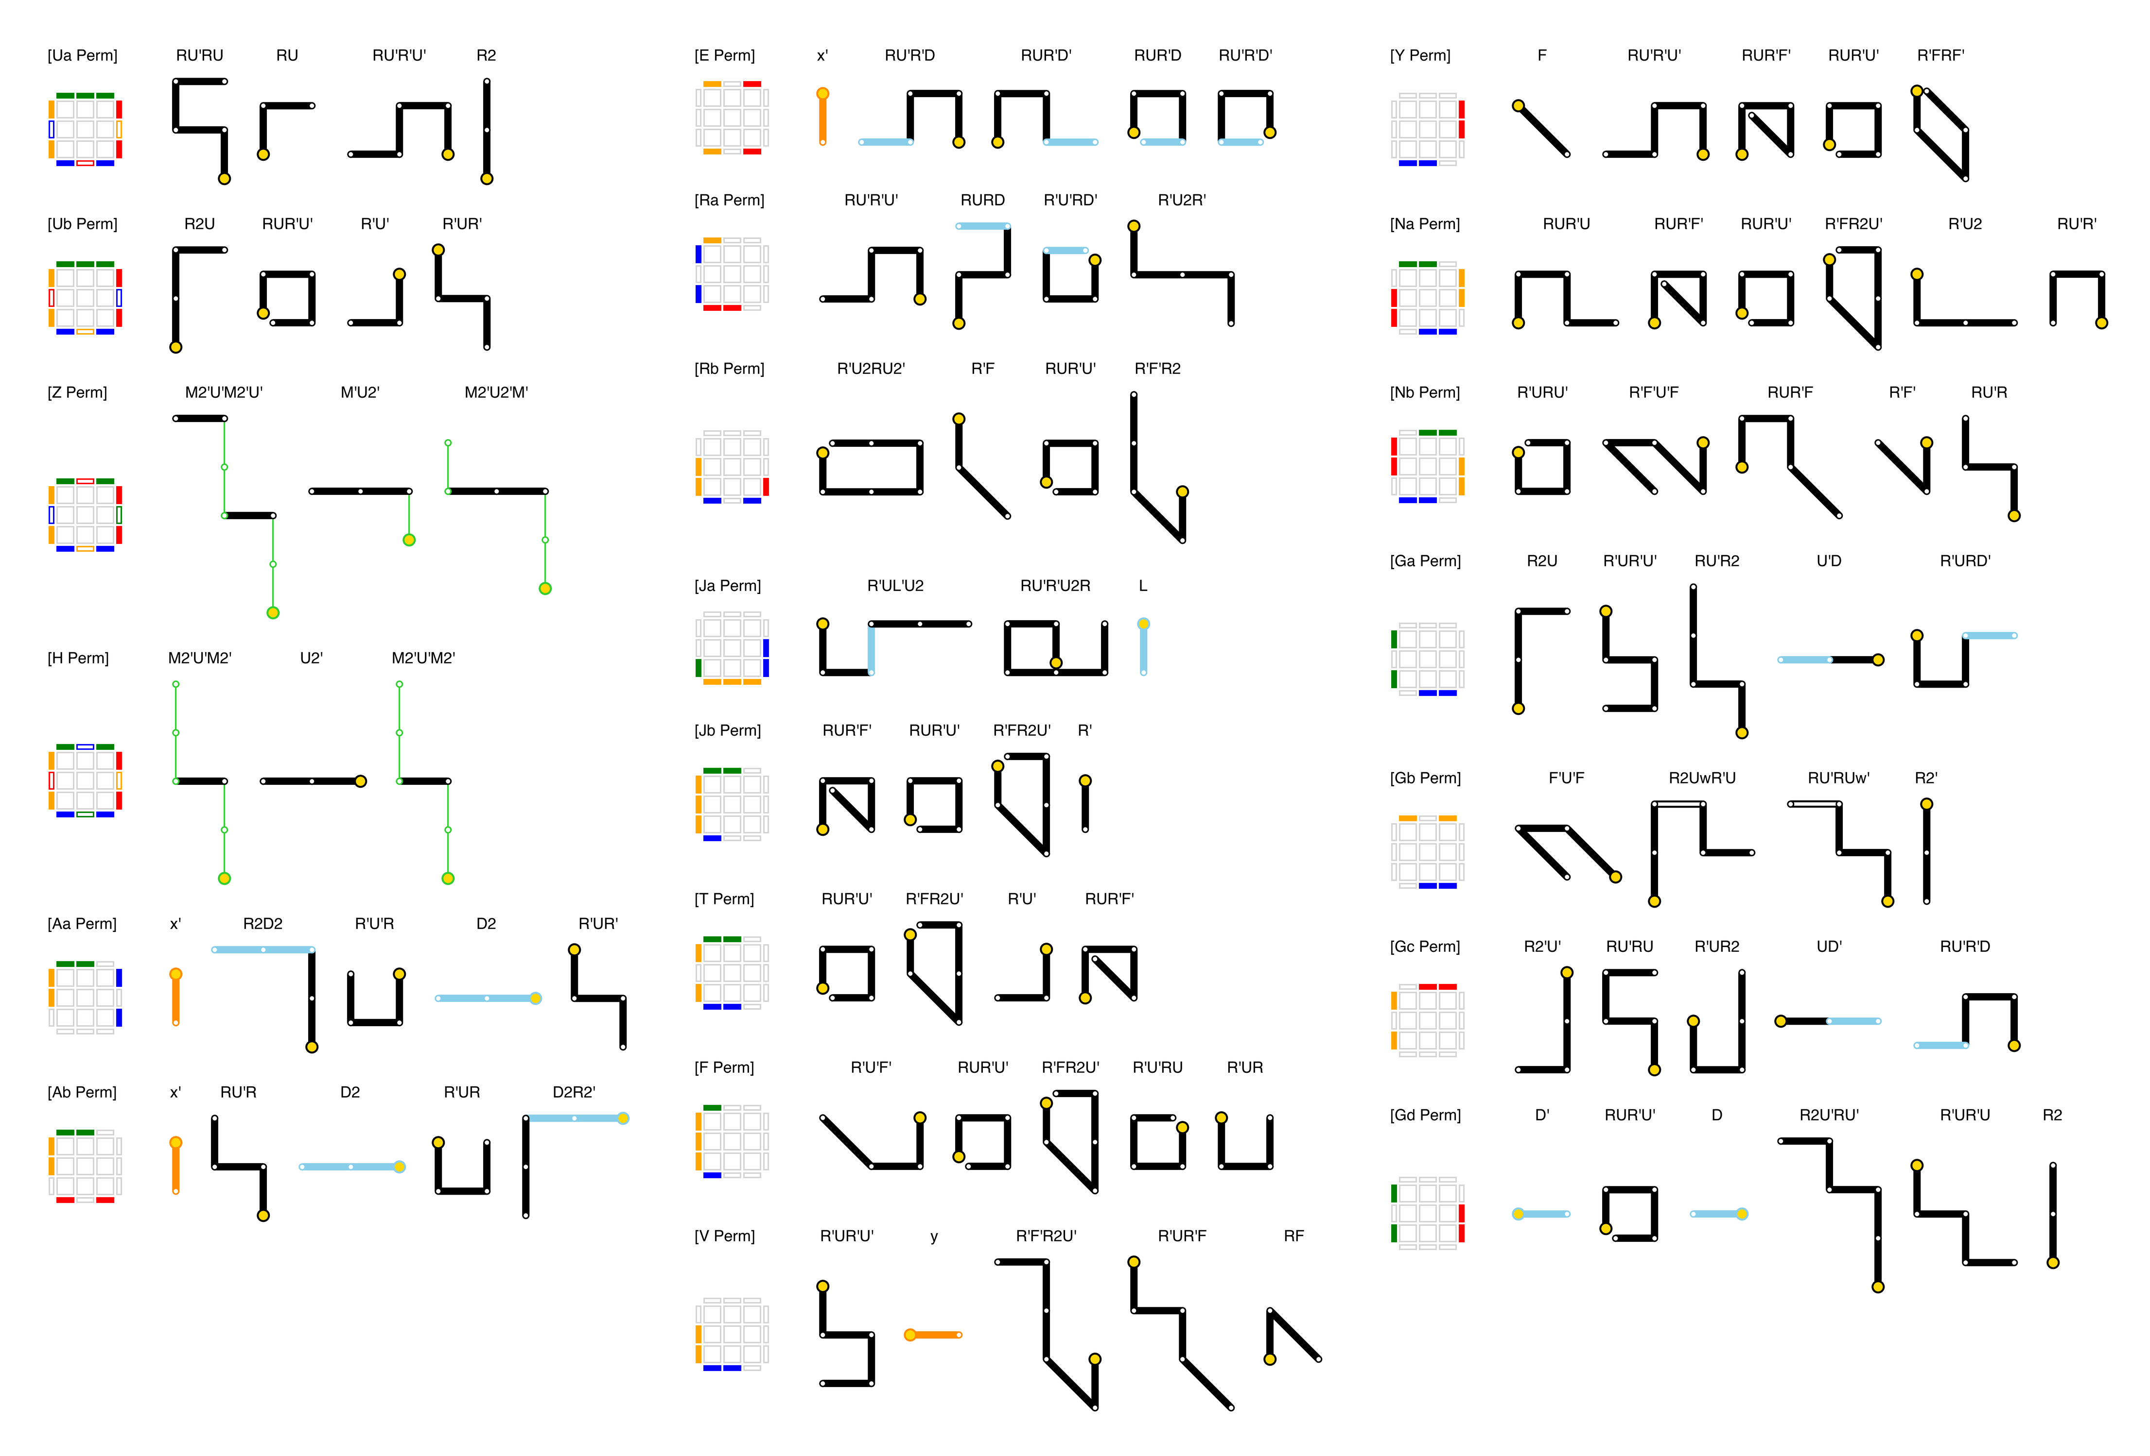
PLL Algorithms in Metro Notation

Slide 2
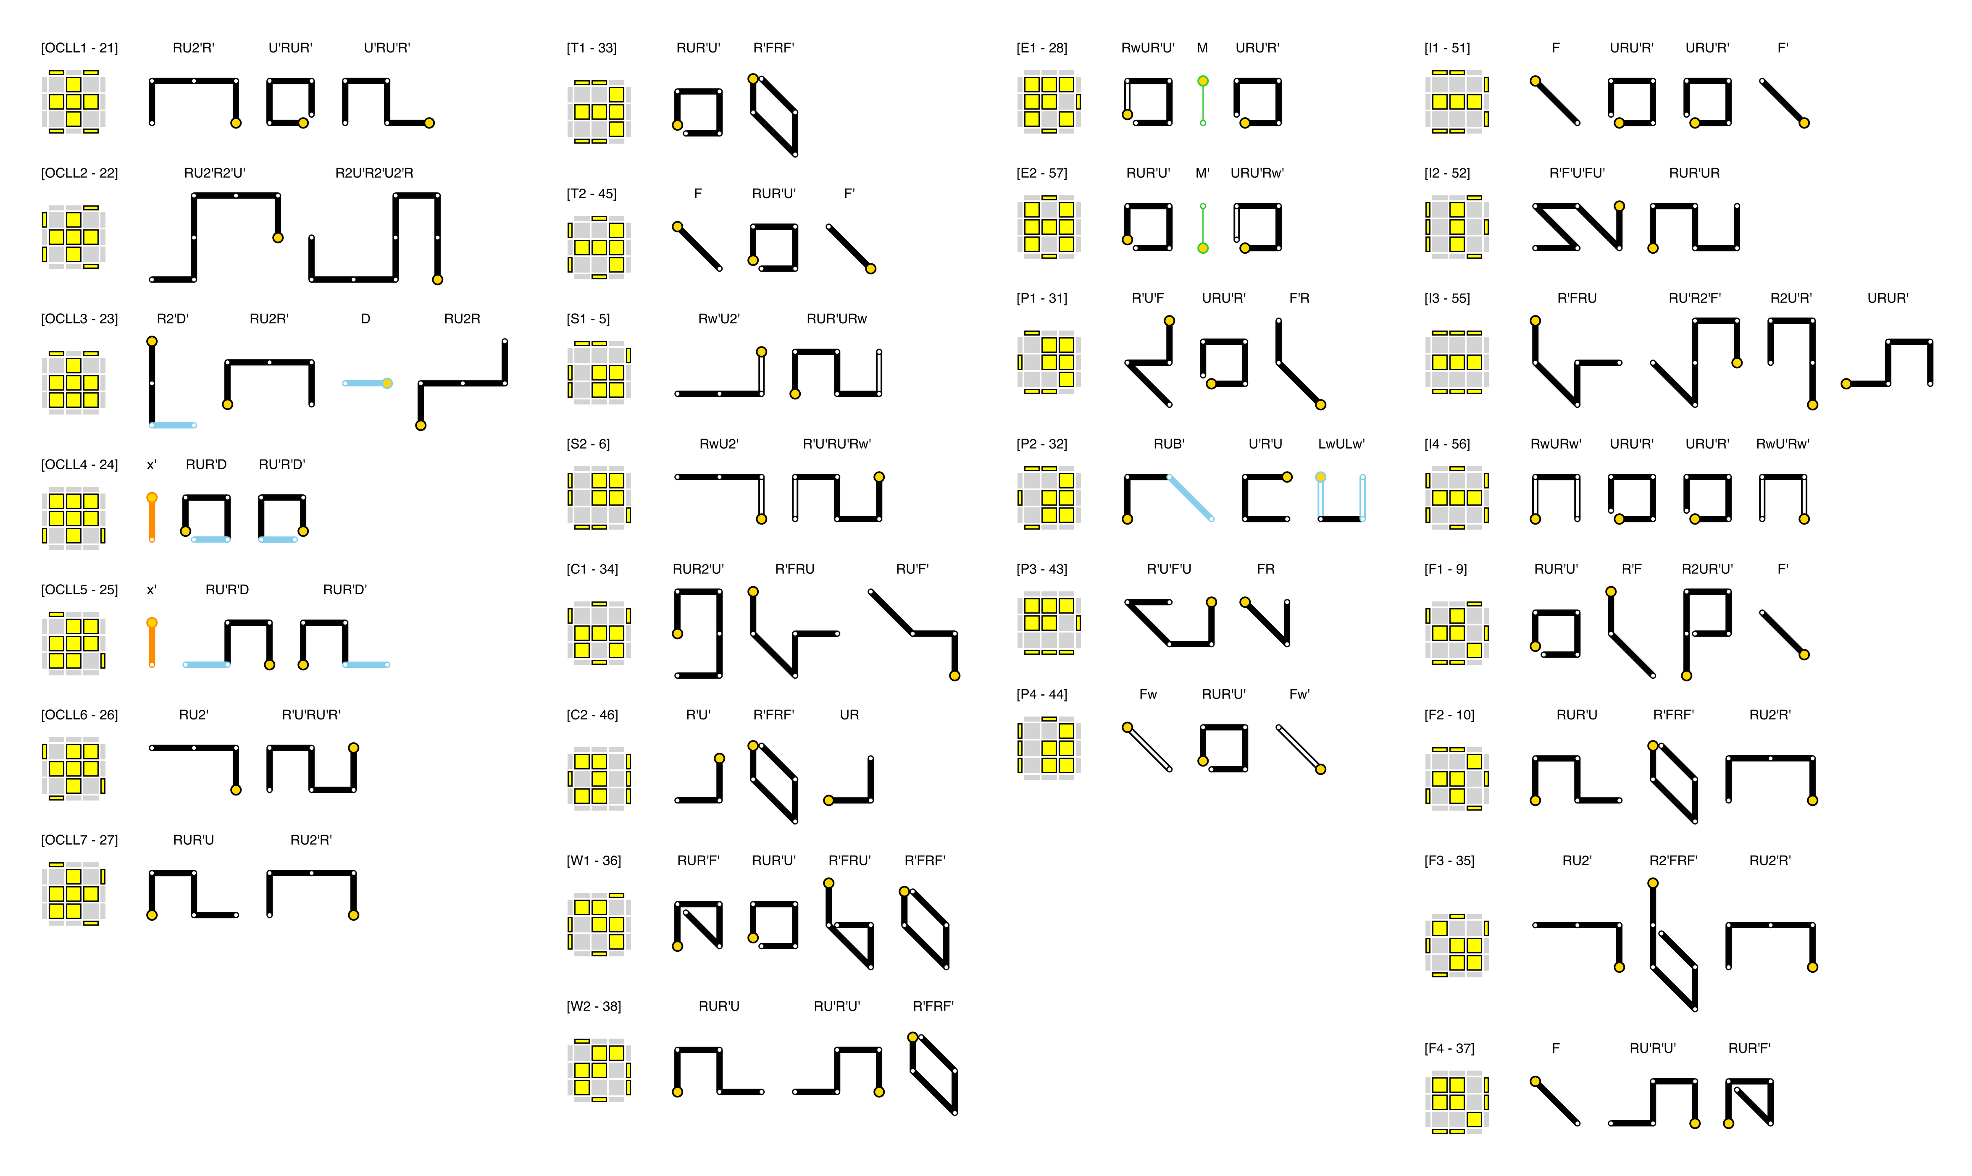
OLL Algorithms in Metro Notation (1/2)

Slide 3
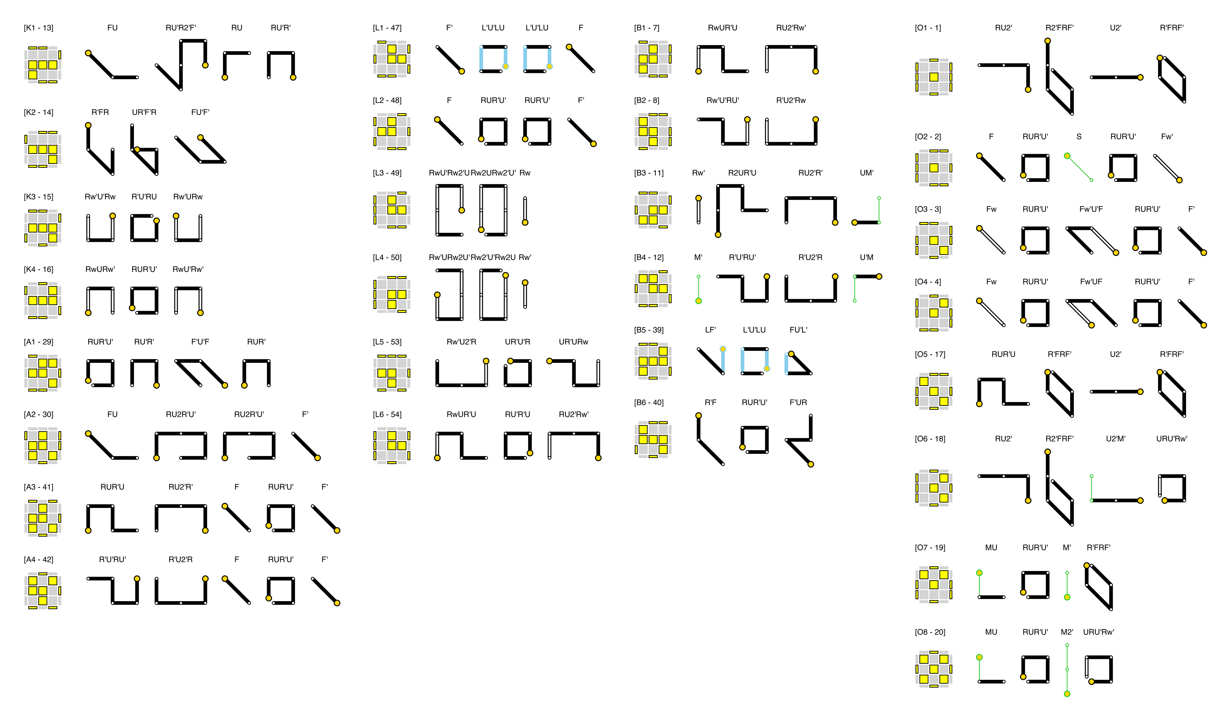
OLL Algorithms in Metro Notation (2/2)

