Slide 1
AeroCast AI
Predictive Airport Capacity & Delay-Risk Copilot
See capacity reductions coming — 3 to 12 hours before the weather does.
Challenge #5 · Autonomous SG 2026 · AI & Aerospace (Airbus) Track
Notes:
~10s. 'Our project is AeroCast AI - a human-in-the-loop copilot that predicts airport capacity reductions and flight delay risk hours before severe weather arrives.' Pause after the name.

Slide 2
THE PROBLEM · A REAL WORKFLOW, A REAL COST
Capacity is cut reactively — when it is already too late
When severe weather hits a hub, air-traffic controllers and airport duty managers must reduce the hourly arrival rate. Today that happens reactively, as the weather arrives — so aircraft burn fuel in airborne holding and on taxiways, and delays cascade into cancellations.
70%+
of air-traffic delays worldwide are driven by weather.
Reactive capacity cuts → holding, taxi-out fuel burn, downstream cancellations.
Who: an ATC / airport duty manager metering arrivals in real time.
AeroCast AI · Challenge #5 · Airbus Track
2
Notes:
~25s. Name the user and the status quo. Severe weather is 70%+ of delays. Because cuts are reactive, the cost is fuel, delay minutes and cancellations. Say 'reactive' clearly - that is the gap we close.

Slide 3
WHAT IT DOES · THE SOLUTION
Forecast capacity and delay risk 3–12 hours ahead
1 Hourly Arrival Acceptance Rate
(AAR)
How many arrivals per hour the airport can accept — with an 80% confidence band, so a reduction is visible before it bites.
2 Severe-delay risk
(> 45 min arrival delay)
A ranked, probability-scored list of which arriving flights to review — the 'who to watch' list.
Every prediction ships with its weather drivers, a confidence level, and a plain-English brief. The model advises; the controller decides.
AeroCast AI · Challenge #5 · Airbus Track
3
Notes:
~25s. Two outputs: a capacity forecast (AAR) and a per-flight delay-risk list, both 3-12h ahead. Each comes with drivers, confidence and a brief. Stress: human-in-the-loop - it advises, the controller decides.

Slide 4
HOW IT WORKS · THE RIGHT TOOL FOR EACH JOB
A leakage-safe pipeline — ML predicts, rules do the physics, the LLM only explains
Ingest
›
Enrich
›
Features
›
Models
›
Evaluate
›
Explain
›
Dashboard
Leakage-safe
Predicts hour h using only data known 3–12 h earlier. Enforced by a unit test.
Real public data
Live wind direction pulled & cached from Open-Meteo → a genuine crosswind feature.
Right-tool split
XGBoost + statistics + rules do the work; the LLM never computes a number or acts.
AeroCast AI · Challenge #5 · Airbus Track
4
Notes:
~30s. Walk the pipeline left to right. The key judging point: the right tool for each job - machine learning and statistics predict, trigonometry does crosswind, and the language model only explains verified numbers. Leakage is unit-tested; wind direction is real public data.

Slide 5
DOES IT WORK · TESTED HONESTLY, BASELINES AND ALL
Measured against baselines — and we show where it breaks
ROC 0.60
Delay-risk ranking
(PR-AUC 0.19 — ~1.6× base rate)
33%
of severe delays caught by
reviewing the top 20% (1.7× lift)
Calibrated
Brier 0.11; generalises across
airports (leave-one-airport-out)
Honest ceiling (we say this out loud). The capacity model ties the climatology baseline because this is a 0.5% flight sample of two low-severe-weather hubs where arrival delay is propagation-dominated. The same pipeline on the full feed at storm-prone hubs would show stronger weather skill — knowing and showing this is the point.
AeroCast AI · Challenge #5 · Airbus Track
5
Notes:
~30s. This is the honesty slide - 40% of the rubric. Real numbers with baselines: risk ROC 0.60, catches a third of severe delays reviewing only the top 20%, calibrated, generalises across airports. Then the honest ceiling: AAR ties climatology on a 0.5% sample of mild-weather hubs. We show where it fails and why.

Slide 6
HOW TO RUN IT · REPRODUCIBLE, ONE COMMAND
Install, train, launch — nothing manual
pip install -r requirements.txt
python -m aerocast.pipeline # trains + writes ./artifacts (~15 s)
streamlit run app.py # opens the dashboard on :8501
./run.sh # …or do all three at once
Automatic
Public weather is downloaded & cached — no manual data steps.
5 passing tests (leakage guard, crosswind, parsing).
Runs with only pandas / numpy / scikit-learn installed; xgboost, streamlit, plotly, meteostat, anthropic are optional upgrades — the pipeline falls back gracefully.
AeroCast AI · Challenge #5 · Airbus Track
6
Notes:
~15s. One command. The pipeline downloads and caches its own public weather data - no manual steps, which is a stated challenge requirement. Five tests pass, including the leakage guard. (Backup: happy to run it live.)

Slide 7
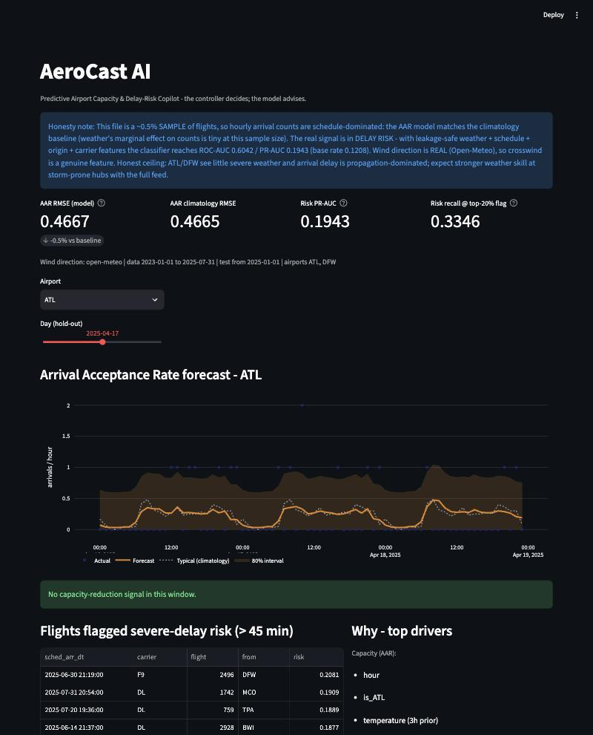
HOW TO USE IT · A CONTROL-ROOM COPILOT
Pick an airport, read the next 3–12 h, act early
1
Capacity-reduction alert lead time to meter arrivals before aircraft are holding.
2
Ranked risky flights review the top ~20% — re-sequence, plan gates, warn on connections.
3
Drivers + confidence + brief understand why, see uncertainty, in plain English.
4
Human approval the controller makes the final call — always.
Impact: from reactive cuts to 3–12 h of lead time — less holding, less fuel, fewer cascading cancellations.
AeroCast AI · Challenge #5 · Airbus Track
7
Notes:
~25s. Show the dashboard. Pick an airport and look ahead: a capacity-reduction alert gives lead time; the flagged-flights list says who to review; the drivers and brief say why, with confidence; and the human always decides. Impact: lead time instead of reacting. Close: 'Thank you - ready for questions.'

