Slide 1

WAAS
Kumoh National Institute of Tech.
Dept. of Applied Mathematics
prof./Ph.D Seung-Hyeok, SHIN
D509
054-478-7810
010-4156-0094
shinbaad@kumoh.ac.kr

Slide 2
Install Step
1. Download WAAS from http://github.com/kitdvl/waas
2. Install OpenJDK
3. Configure the waas.bat
4. Run the command "waas.bat config"
5. Run the command "waas.bat start"

Slide 3
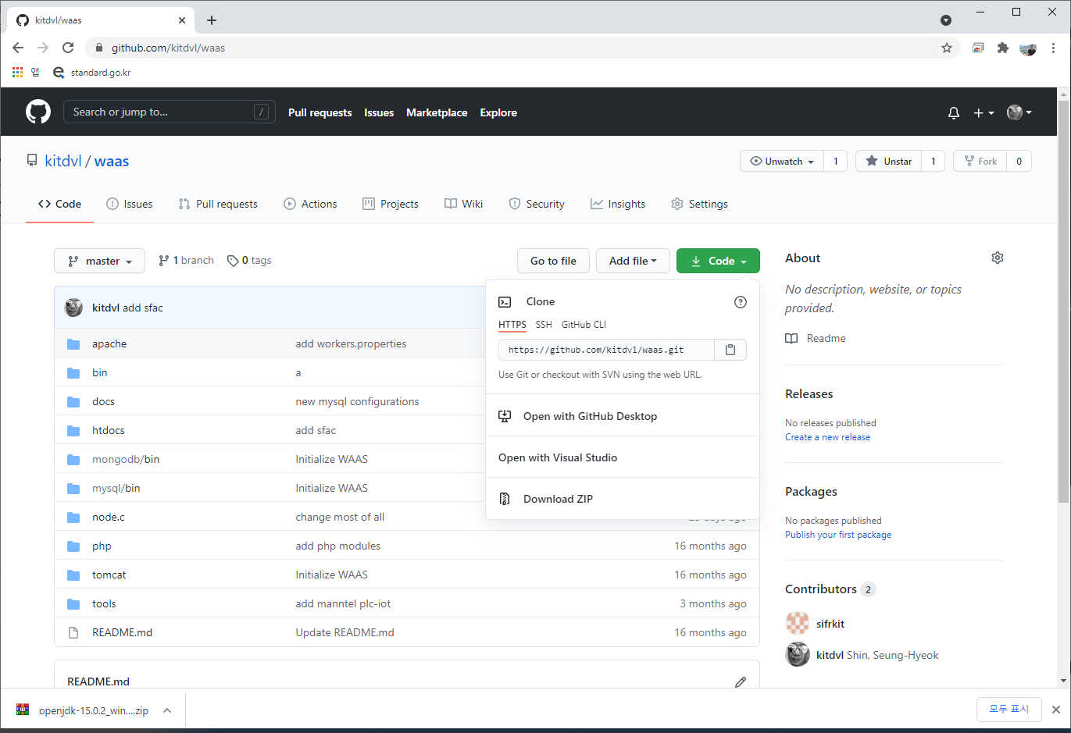
1. Download WAAS
from http://github.com/kitdvl/waas

Slide 4
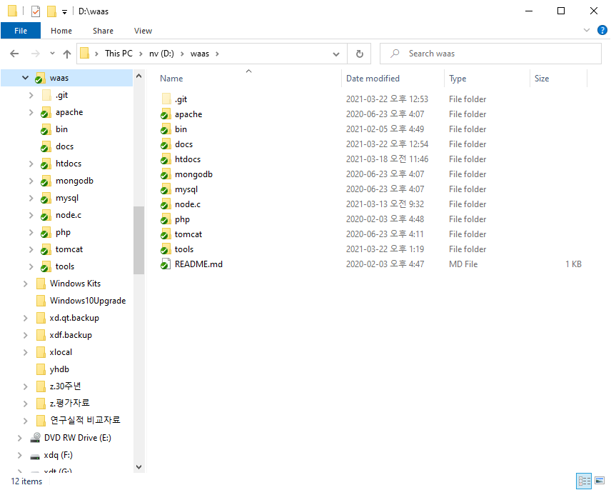
1. Download WAAS
extract to anywhere

Slide 5
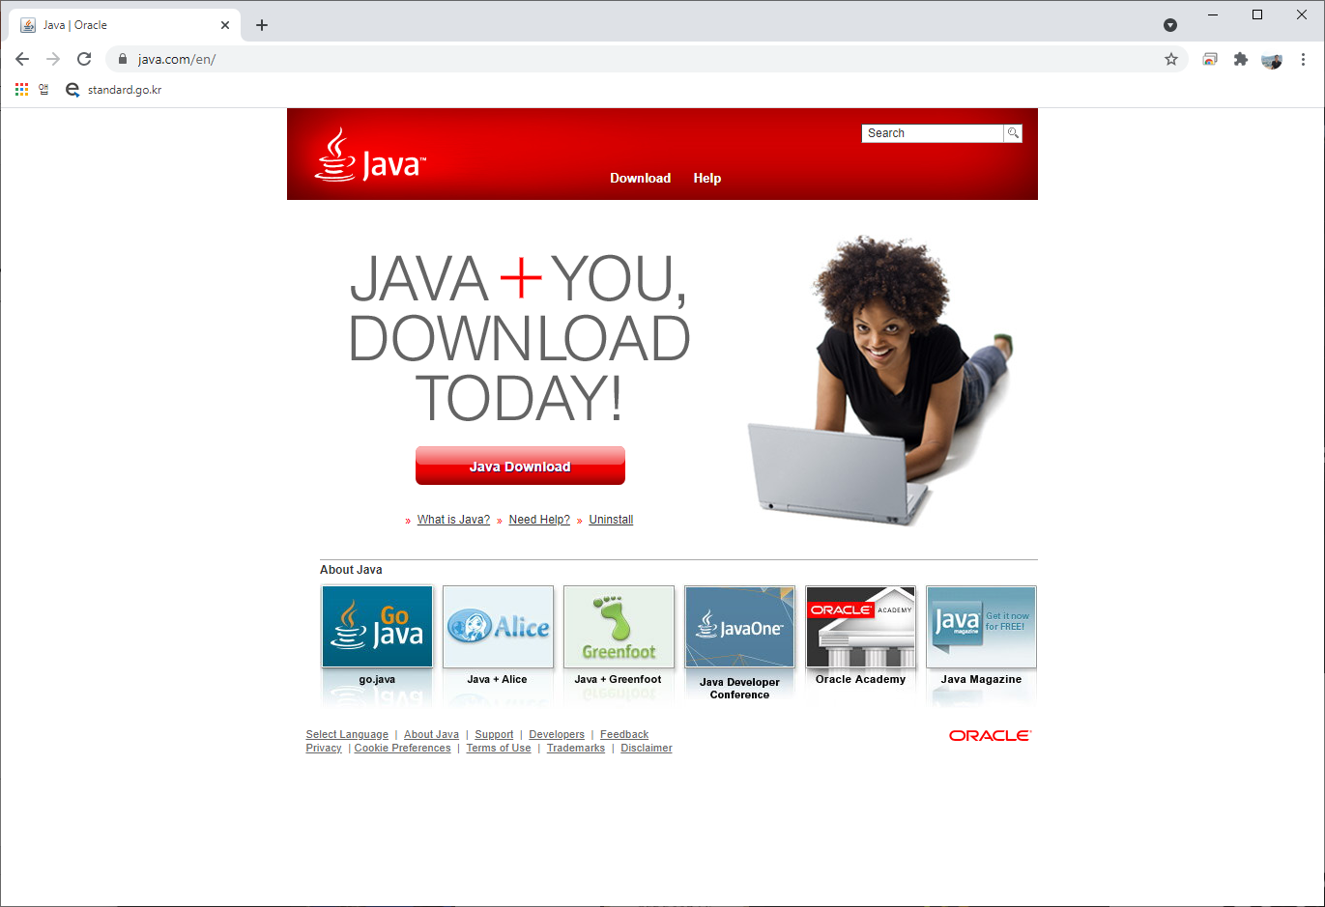
2. Install OpenJDK
download openjdk

Slide 6
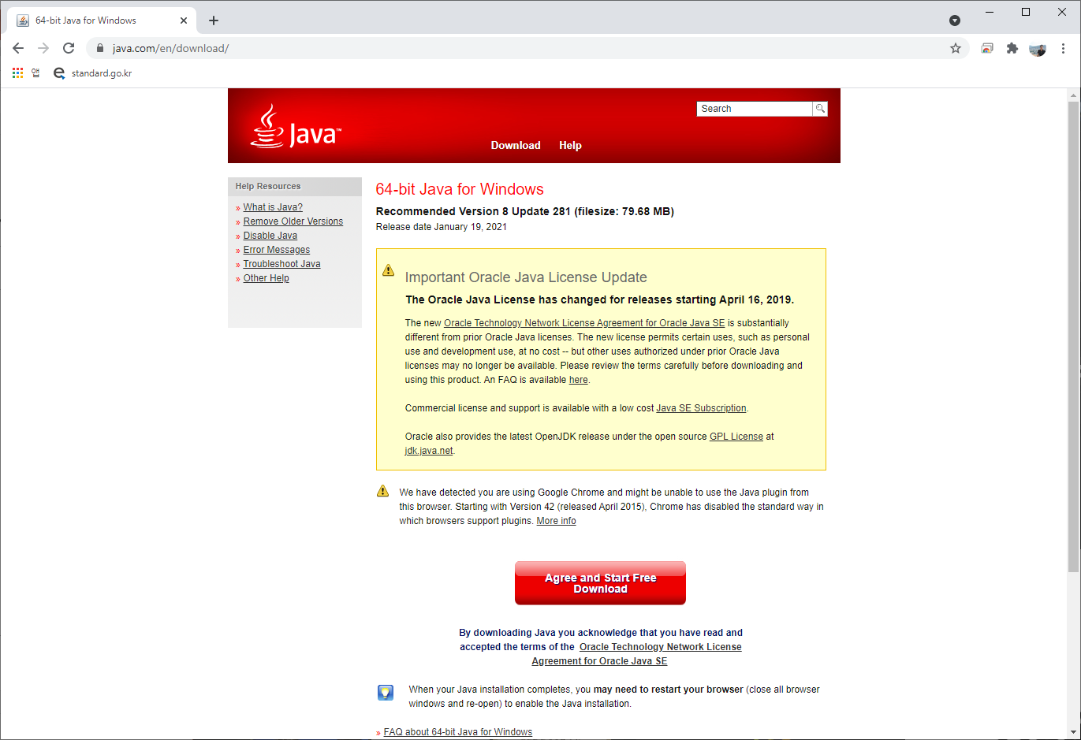
2. Install OpenJDK
download openjdk

Slide 7
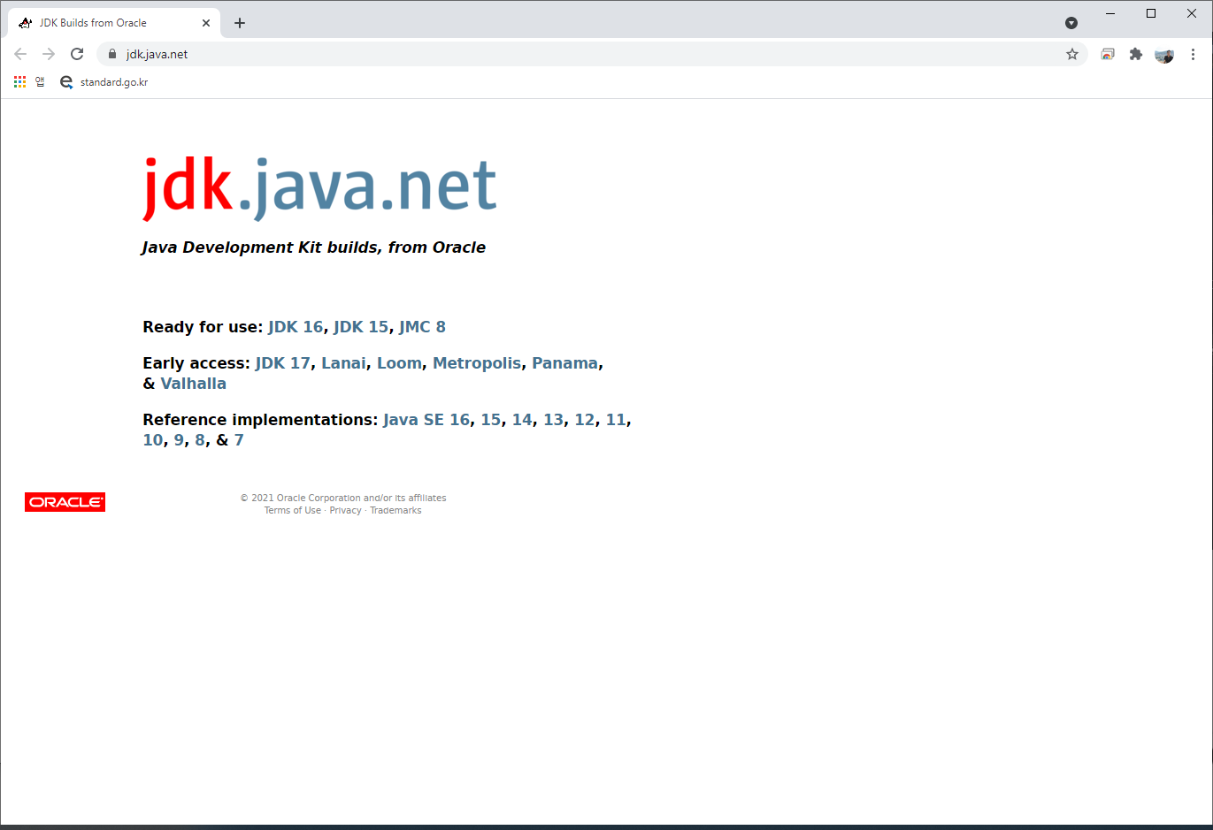
2. Install OpenJDK
download openjdk

Slide 8
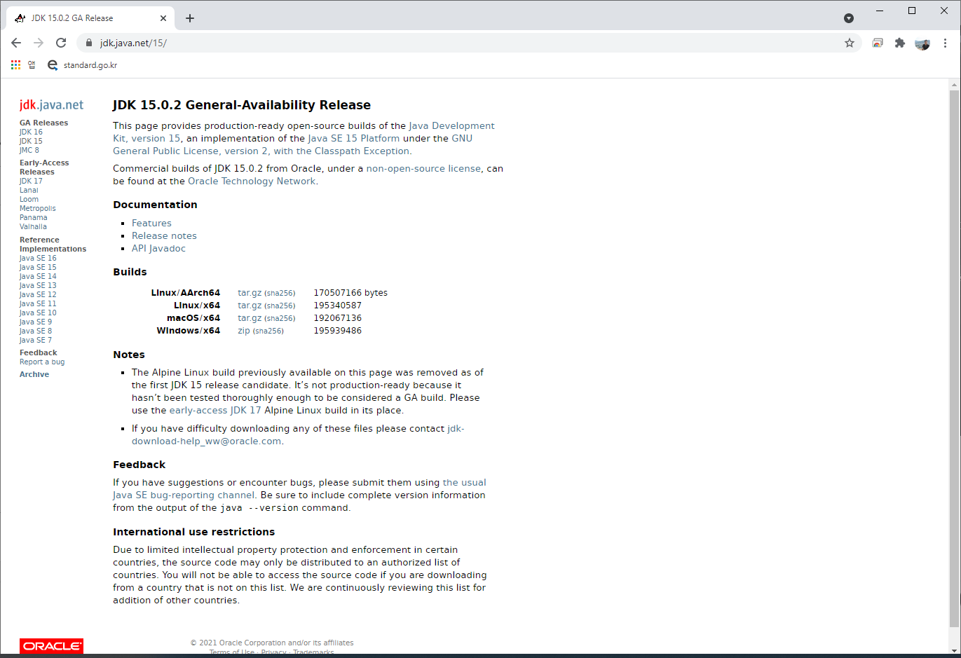
2. Install OpenJDK
download openjdk

Slide 9
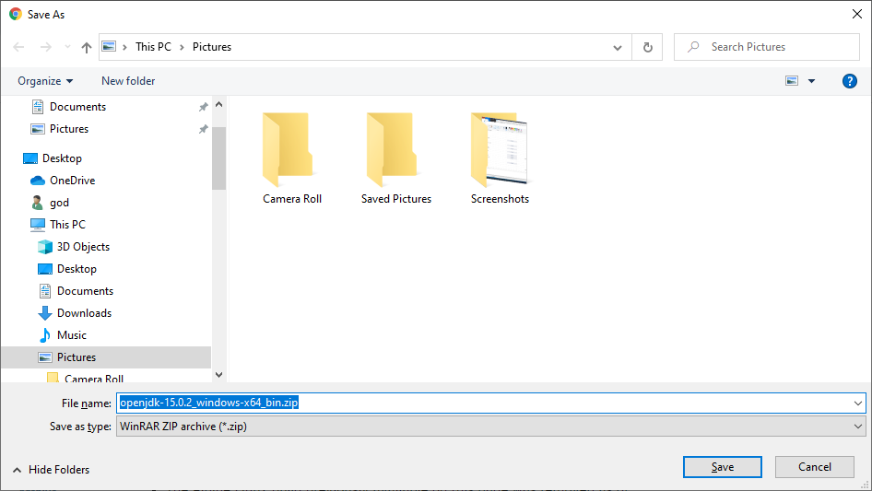
2. Install OpenJDK
download openjdk

Slide 10
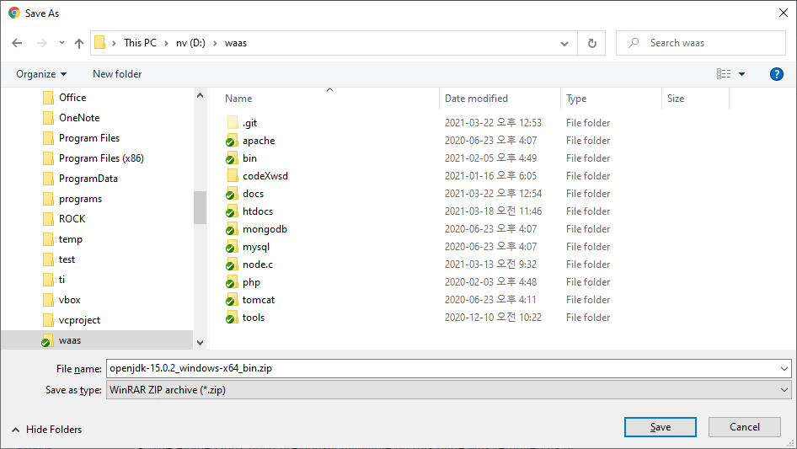
2. Install OpenJDK
download openjdk (save & extract to anywhere)

Slide 11
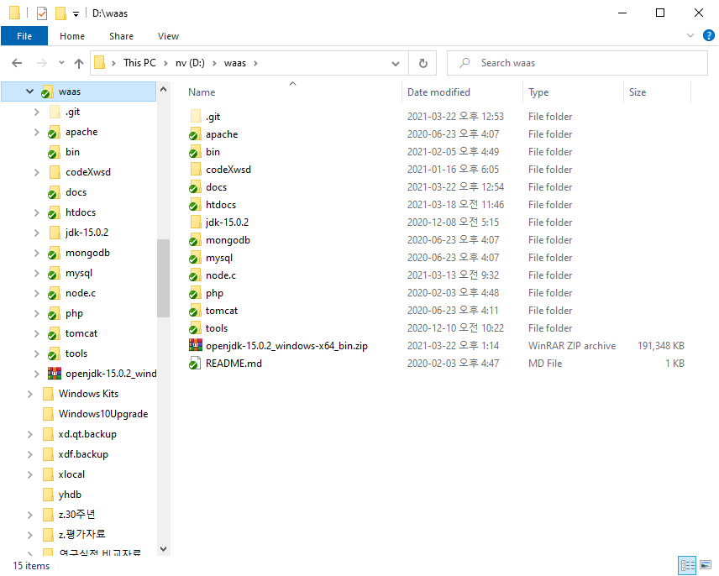
2. Install OpenJDK
download openjdk (for example)

Slide 12
2. Install OpenJDK
download openjdk (for example)

Slide 13
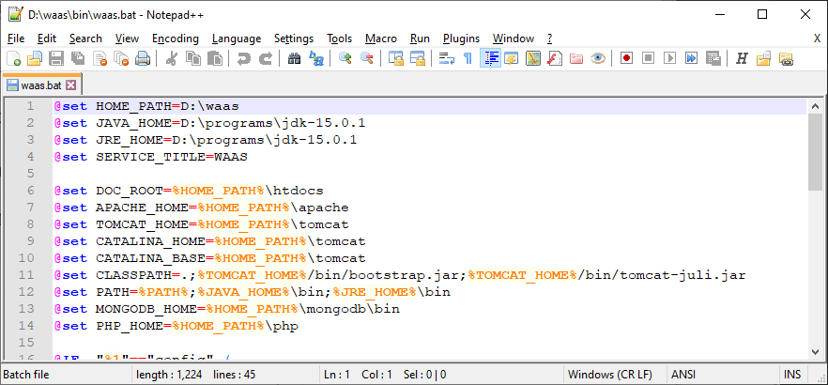
3. Configure the WAAS
edit path in the waas.bat

Slide 14
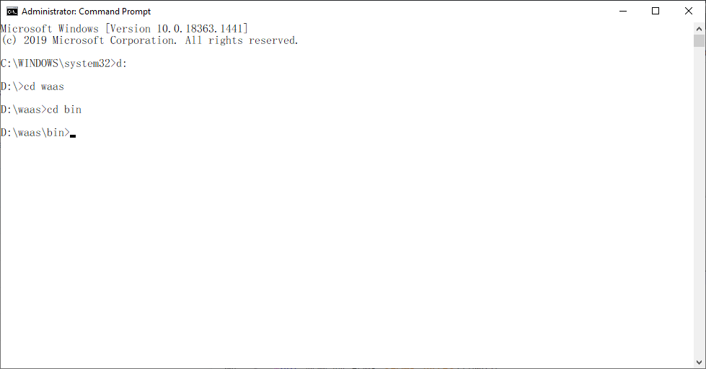
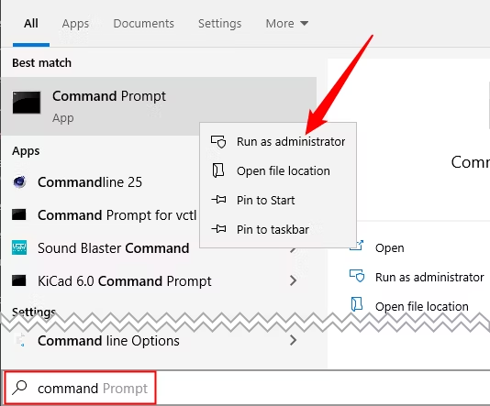
4. waas.bat config
Run as Administrator
Right Click

Slide 15

4. waas.bat config

Slide 16
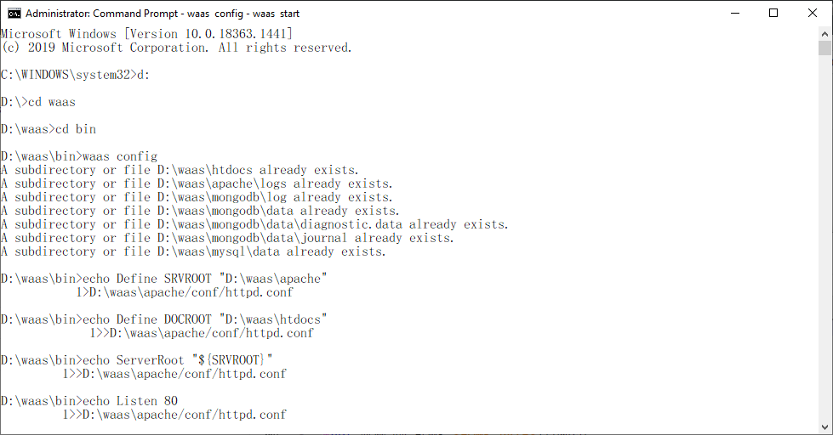
4. waas.bat config

Slide 17
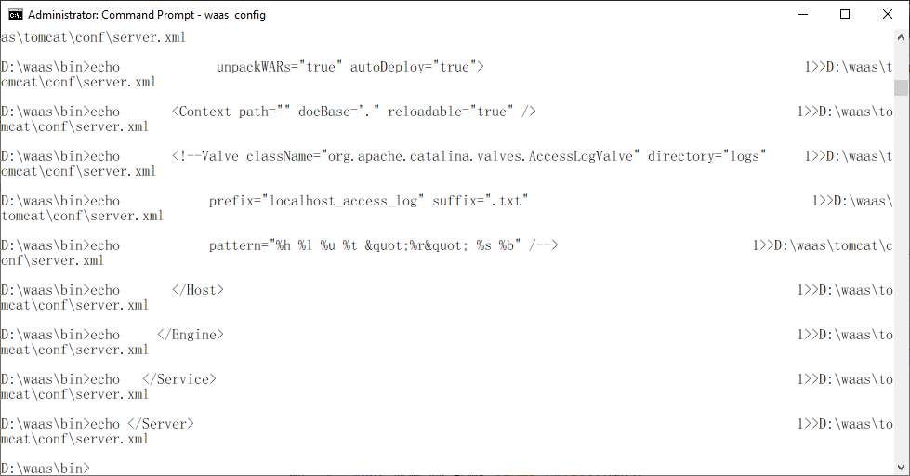
4. waas.bat config

Slide 18
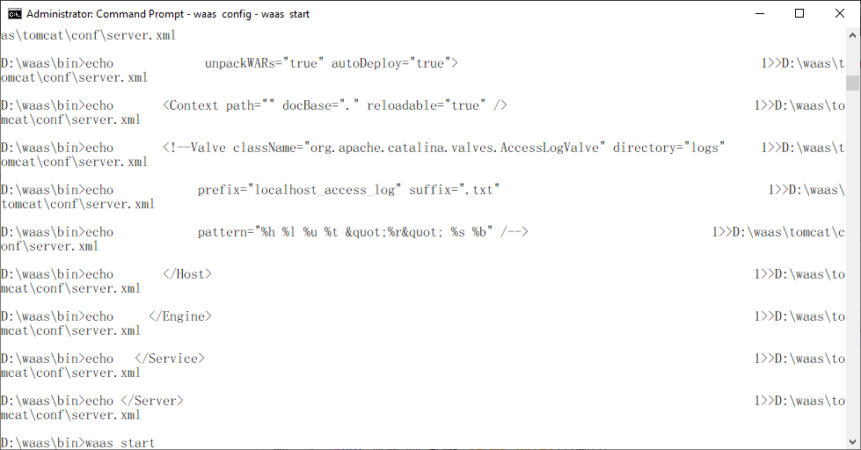
5. waas.bat start

Slide 19
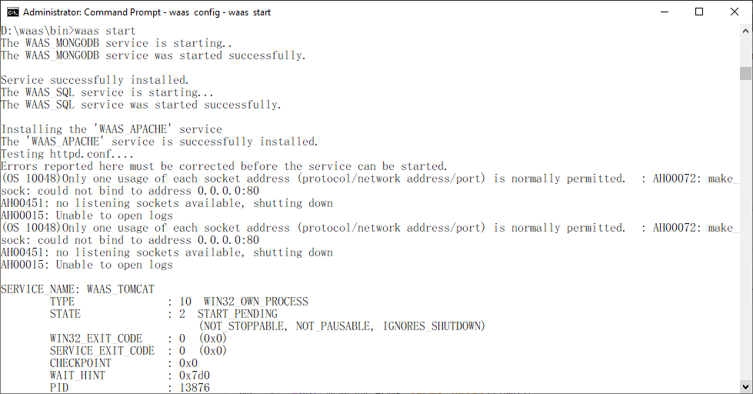
5. waas.bat start

Slide 20
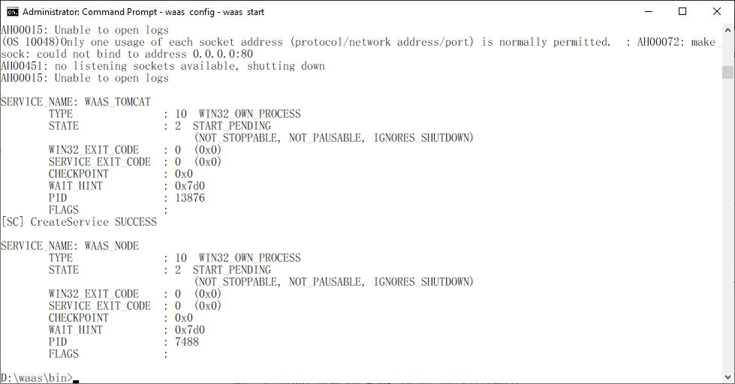
5. waas.bat start

Slide 21
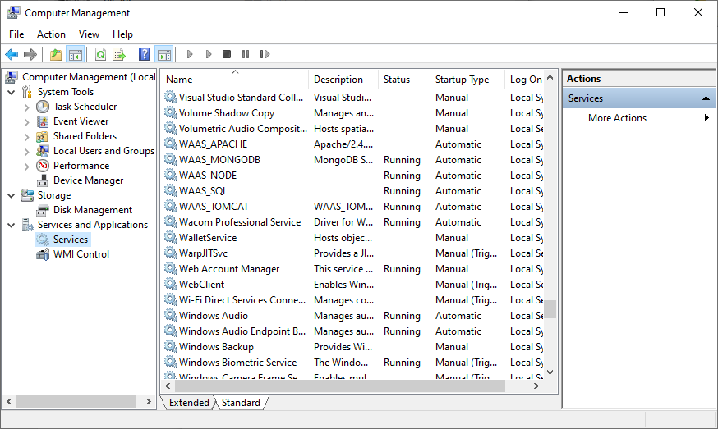
6. Complete

