Slide 1

Socket Programings
Kumoh National Institute of Tech.
Dept. of Applied Mathematics
prof./Ph.D Seung-Hyeok, SHIN
D509
054-478-7810
010-4156-0094
shinbaad@kumoh.ac.kr

Slide 2
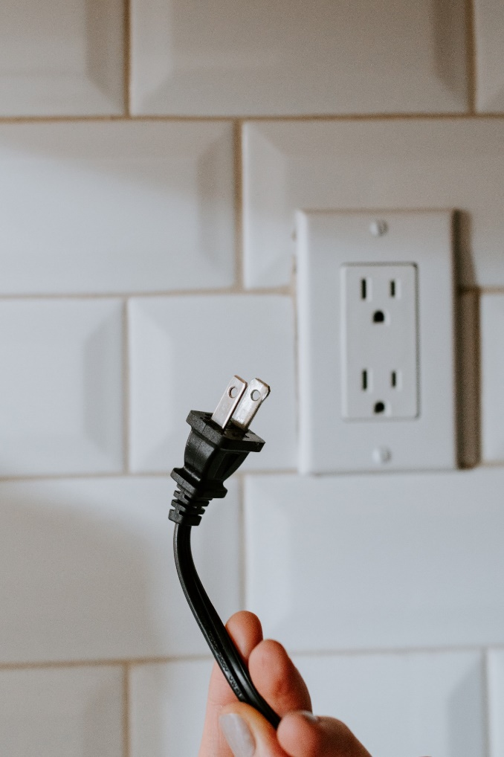
What is Socket ?

Slide 3
What is Port ?
Application
Application
Application
TCP
IP

Slide 4
What is Port & Socket ?
instance
instance
Application
Application
Application
TCP
IP

Slide 5
Network Model
Server
Client1
Client2
Client3

Slide 6
TCP Socket (Server & Client)
socket
socket
bind
socket, port, ip
listen
connect
accept
read/write
read/write
close
close

Slide 7
UDP Socket (Server & Client)
socket
socket
bind
socket, port, ip
read/write
read/write
close
close

Slide 8
Linked List

Slide 9
Double Linked List

Slide 10
Circular Queue

Slide 11
Graph

Slide 12
Realized Double Linked List

