Slide 1
Self-reports of Metacognitive Monitoring are Often False
Kit S. Double

Slide 2

What is Metacognition?
Metacognition: Knowledge and regulation of one's cognitive processes
Two key components:
Monitoring: Tracking and assessing one's own cognitive performance
Regulation: Adjusting cognitive strategies based on monitoring

Slide 3
Existing Methods of Measuring Metacognition
Two Dominant Approaches:
Online Measures
- Confidence ratings during task performance
- Assess actual monitoring accuracy
2. Self-Report Questionnaires
- Participants rate their perceived metacognitive abilities
- Widely used in educational research

Slide 4
Relationship Between Measures
A meta-analysis of 23 studies by Craig et al. (2020) found a small positive (r = .22) correlation between online and survey-based measures of metacognition
Many studies have shown no evidence of a correlation between survey-based measures and measures derived from metacognitive ratings (Craig et al., 2020; Dörrenbächer-Ulrich & Perels, 2023; Händel & Dresel, 2022; Saraç & Karakelle, 2012; Schraw & Dennison, 1994; Terneusen et al., 2024).
May depend on the subscales used and the components of metacognition assessed by the self-report questionnaire? (Händel & Dresel, 2022).

Slide 5
Survey Measures
Existing scales have a mixture of different metacognitive processes
-> may be distorting our understanding of the relationship between self-report and online measures of metacognition (Terneusen et al., 2024)
E.g. Metacognitive Awareness Inventory (Schraw & Dennison, 1994) asks respondents questions about their learning strategies and ability to organise information.

Slide 6
“Are on shaky ground, precisely because self-report questionnaires presuppose the metacognitive awareness of mental function that they seek to measure”
- Katyal and Fleming (2024, p. 224)
Katyal and Fleming (2024, p. 224) argue that survey-based measures of metacognitive capacities “are on shaky ground, precisely because self-report questionnaires presuppose the metacognitive awareness of mental function that they seek to measure”.
For example, items on the metacognitions questionnaire (MCQ; Wells & Cartwright-Hatton, 2004) ask participants to rate their agreement with items like “I am constantly aware of my thinking” and “I monitor my thoughts”. To be able to accurately rate one’s agreement with such items, one must possess the quality being assessed (metacognitive ability) which is inherently problematic.

Slide 7
“I am constantly aware of my thinking”
“I monitor my thoughts”
Notes:
MCQ; Wells & Cartwright-Hatton, 2004)
To be able to accurately rate one’s agreement with such items, one must possess the quality being assessed (metacognitive ability) which is inherently problematic.

Slide 8
Research Question
Do self-report questionnaires accurately reflect metacognitive monitoring abilities?

Slide 9
Study 1: Developing a New Metacognitive Monitoring Scale
N = 300; Prolific
64 items were included in the original item pool
Created an 8-item questionnaire
Two subscales:
1. Online Monitoring
2. Metacognitive Awareness

Slide 10
Item | Factor Loading (CFA)
Online Monitoring
I deliberately assess my performance on all tasks | .92
I evaluate how confident I am after each decision | .84
When I perform tasks, I keep close track of how well I am doing | .78
I always assess my performance | .86
Metacognitive Awareness
I'm realistic about my capabilities | .56
I know when I am performing well | .72
I am aware of my strengths and weaknesses | .58
I tend to be accurate in my self-assessments | .73

Slide 11
Scale Development
χ² = 891.04, CFI = .963, TLI = .946, RMSEA = .075, SRMR = .042. The factor loadings ranged from .58 to .92 and the factors were only moderately correlated covariance = .455.
The total scale (Cronbach's alpha = .82)
Both sub-scales showed good reliability:
Online monitoring: Cronbach's alpha = .83
Metacognitive awareness: Cronbach's alpha = .80.

Slide 12
Comparing Self-Reports with Performance
Participants completed:
Raven's Progressive Matrices (reasoning task)
Perceptual decision-making task
Confidence ratings
Newly developed self-report questionnaire

Slide 13
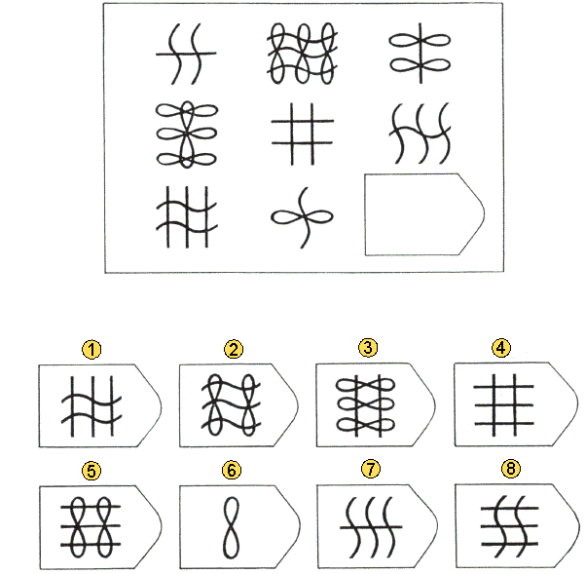
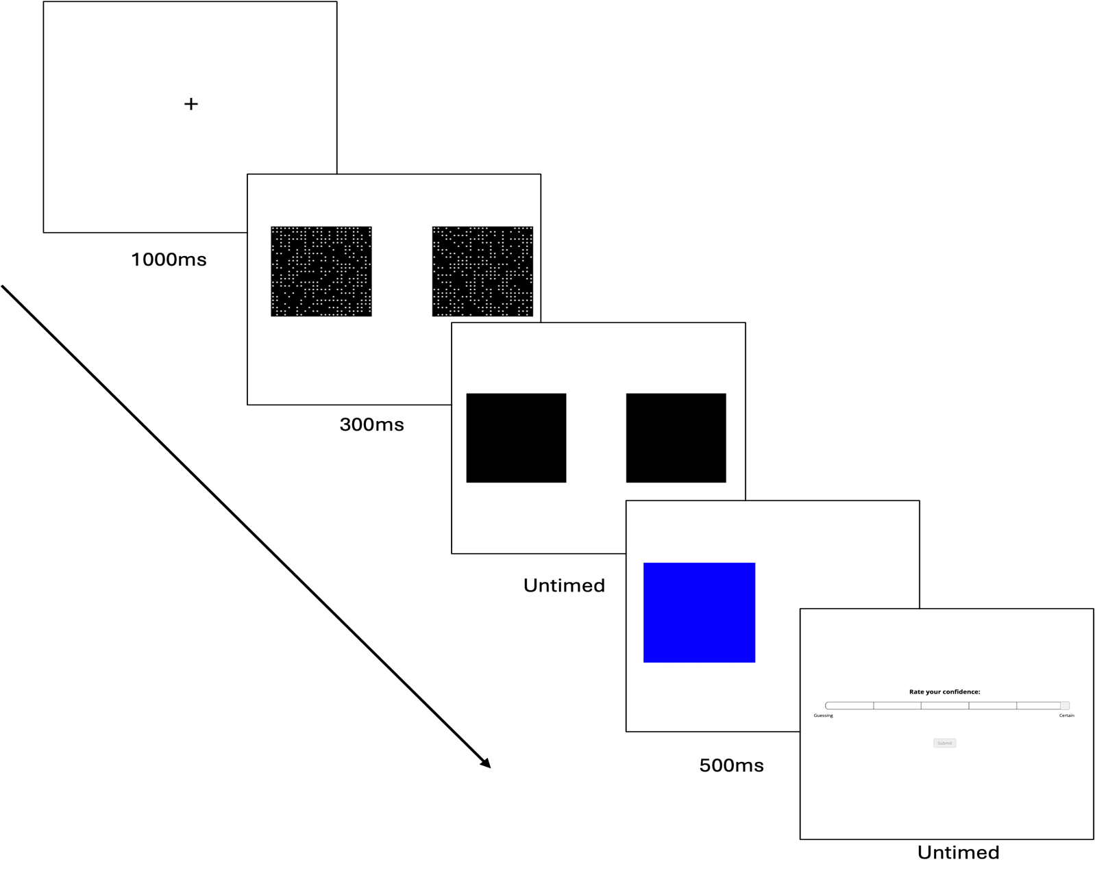

Slide 14
Online Measures of Metacognition
Resolution: Resolution is a measure of the relationship (correlation) between confidence and performance across the task (Maki et al., 2005).
Discrimination: Discrimination is a measure of the degree to which a person’s confidence differs between correct and incorrect responses (Schraw, 2009).
Metacognitive sensitivity: Measured by fitting a generative model of confidence using a signal detection model to two-alternative forced choice tasks. This approach parameterizes metacognitive sensitivity as the extent to which a person’s confidence distinguished between correct and incorrect items, known as meta-d’ (Maniscalco & Lau, 2012).
Metacognitive Efficiency: Metacognitive efficiency concerns how well confidence ratings discriminate correct from incorrect responses, relative to how informative we might expect those confidence ratings to be given the observer’s perceptual performance (Maniscalco & Lau, 2015).

Slide 15
Variable | 1 | 2 | 3 | 4 | 5 | 6 | 7 | 8 | 9 | 10 | 11 | 12
Self-report
1. Total | 1
2. Monit. | .924*** | 1
3. Awareness | .812*** | .528*** | 1
Perceptual task
4. Perf. | -.151* | -0.127 | -0.142 | 1
5. Resolution | -.154* | -.153* | -0.11 | 0.101 | 1
6. Disc. | -0.142 | -.148* | -0.089 | 0.084 | .726*** | 1
7. Sensitivity | -0.092 | -0.088 | -0.071 | .154* | .771*** | .831*** | 1
8. Efficiency | -0.111 | -0.109 | -0.08 | -0.08 | .688*** | .651*** | .767*** | 1
9. Confidence | .304*** | .295*** | .227** | 0.017 | -.216** | -0.12 | .208** | 0.022 | 1
Raven's Progressive Matrices
10. Perf. | -.227** | -.258*** | -0.111 | 0.078 | 0.048 | 0.035 | -0.033 | -0.02 | -.223** | 1
11. Resolution | -.231* | -.241* | -0.13 | -0.004 | 0.13 | 0.054 | 0.018 | 0.152 | -.237* | .339** | 1
12. Disc. | -.283** | -.319** | -0.124 | 0.081 | -0.045 | 0.151 | -0.004 | -0.003 | -.216* | .468*** | .773*** | 1
13. Confidence | 0.103 | 0.026 | 0.182 | -.231* | -.290** | -.265* | -0.19 | -.260* | .314** | .480*** | 0.08 | 0.054

Slide 16
Variable | Total | Monitor | Aware
Self-report
1. Total
2. Monit.
3. Awareness
Perceptual task
4. Perf.
5. Resolution
6. Disc.
7. Sensitivity
8. Efficiency
9. Confidence | .304*** | .295*** | .227**
Raven's Progressive Matrices
10. Perf.
11. Resolution
12. Disc.
13. Confidence

Slide 17
Variable | Total | Monitor | Aware
Self-report
1. Total
2. Monit.
3. Awareness
Perceptual task
4. Perf. | -.151*
5. Resolution | -.154* | -.153*
6. Disc. |  | -.148*
7. Sensitivity
8. Efficiency
9. Confidence | .304*** | .295*** | .227**
Raven's Progressive Matrices
10. Perf.
11. Resolution
12. Disc.
13. Confidence

Slide 18
Variable | Total | Monitor | Aware
Self-report
1. Total
2. Monit.
3. Awareness
Perceptual task
4. Perf.
5. Resolution
6. Disc.
7. Sensitivity
8. Efficiency
9. Confidence
Raven's Progressive Matrices
10. Perf. | -.227** | -.258***
11. Resolution | -.231* | -.241*
12. Disc. | -.283** | -.319**
13. Confidence

Slide 19
Results
Self-Report Measures Were:
Negatively correlated with online metacognitive measures
Associated with:
Higher confidence in the perceptual task
Lower actual performance in both tasks (at least the total scale score)
Poorer metacognitive accuracy (total and monitoring)

Slide 20
Discussion
Despite the theoretical similarities between metacognition surveys and monitoring judgments, research consistently shows that survey-based metacognition measures don't align with online measures.
This disconnect is concerning because both measurement types are widely used in metacognition research
Without agreement between our measurement tools, we cannot make firm conclusions about metacognition and risk confusing different concepts or using different terms for the same concept (jingle-jangle fallacies).

Slide 21
Discussion
Interestingly, we found a negative relationship between our performance measures on both the perceptual task and the reasoning task with survey-based measures of metacognitive monitoring
While I could offer speculation as to why self-reported metacognitive monitoring was negatively correlated with performance, this is obviously hampered by the fundamental point we are making – we do not know what it is we are measuring when we ask people to self-report their metacognition.
Notes:
If one assumes that participants are providing accurate responses to the questionnaire then it might point to a dual-task cost whereby more resources spent monitoring one’s cognition affords less resources for cognitive processes and reduces performance.
However, we do not believe it is a reasonable assumption to take responses to the metacognitive questionnaire at face-value; a high response might actually indicate a lack of metacognition due to overconfidence (see our next point) or an ignorance of one’s ignorance as one might expect to arise based on phenomena such as the Dunning-Kruger Effect (Dunning, 2011).

Slide 22
Limitations
While we were able to develop a more conceptually pure measure here to illustrate our point, it is important to generalize this to other measures of metacognition cautiously.
Furthermore, the broad scope of the survey-based metacognition measure may limit our findings' generalisability

Slide 23
Implications
Operationally and conceptually, metacognition is hard to pin down
But if our measures have no relationship with each other, we have little hope of an integrated approach to studying metacognition
We need better measurement methods that maintain scientific rigor without oversimplifying this complex concept.

Slide 24
Questions?
kit.double@sydney.edu.au

